Slide 1

Phase Locked Loop (PLL)

Slide 2
Contents
PD (Phase Detector)
PFD (Phase Frequency Detector)
LFP (Low Pass Filter) / Loop Filter
VCO (Voltage Controlled Oscillator)
PLL (Phase Locked Loop)
Applications of VCO and PLL
PLLTS12FFCFRACF Programmable Fractional PLL

Slide 3
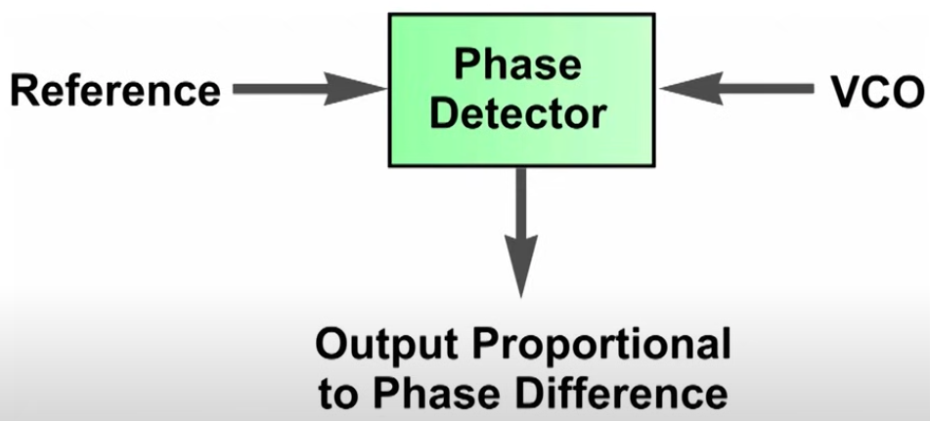
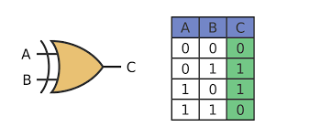
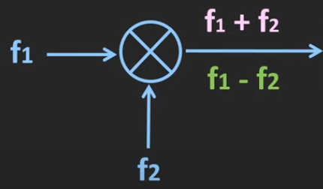
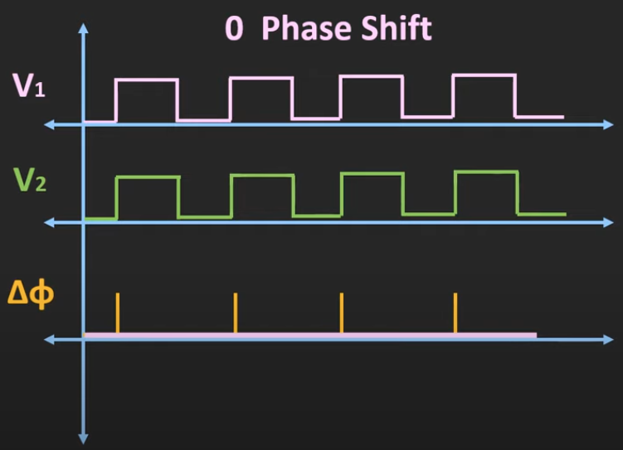
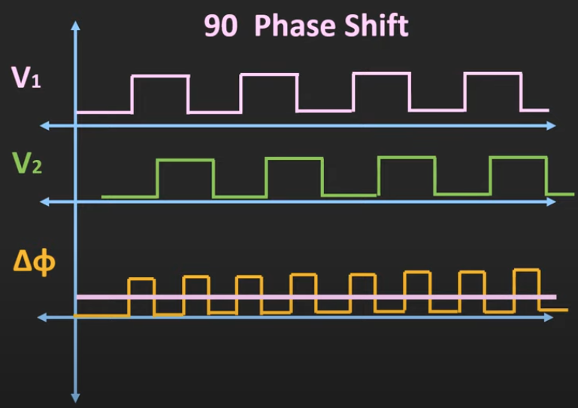
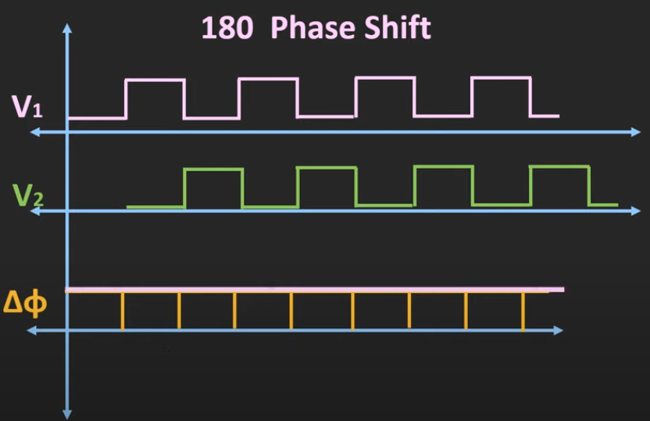
PD (Phase Detector)
Takes two inputs signals, produces a signal proportional to the phase difference
Let A, B the phases of two signals, then
phase difference (▵ϕ) = (A-B) ≅ sin(A-B) = sinAcosB - sinBcosA ≅ sinAcosB = sin(A-B) + sin(A+B)
2 2
A phase detector can be a XOR gate,

Slide 4
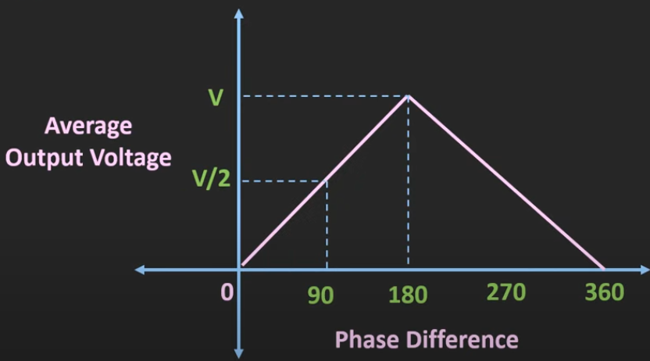
PD (Phase Detector)
Average Output Voltage v/s Phase Difference -
Drawbacks -
As the phase difference increases beyond the 180°, then the average output will start reducing.
Moreover, is is difficult to identify, which signal is leading or lagging.
Apart from that, for the XOR gate to work as a linear phase detector, both signals should have approximately 50% of duty cycle
And whenever the two signals are operating at the different frequencies then it is quite possible that the loop can get locked to the harmonic frequency.

Slide 5
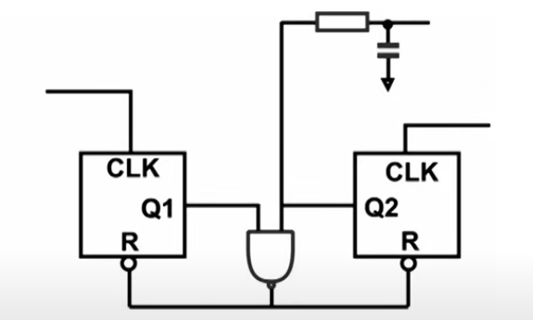
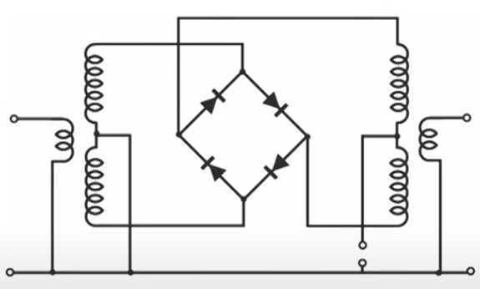
PD (Phase Detector)
Phase Frequency Sensitive
Phase only Sensitive

Slide 6
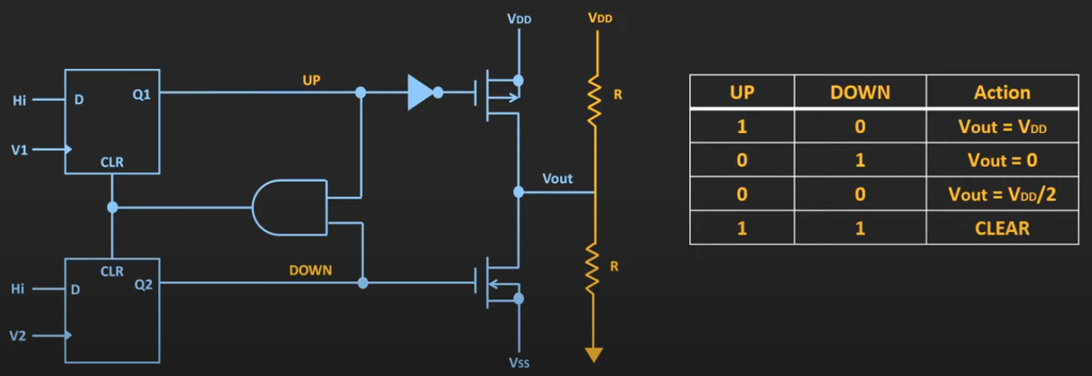
PFD (Phase Frequency Detector)
Considering Positive Edge Triggered D-Flip Flops

Slide 7
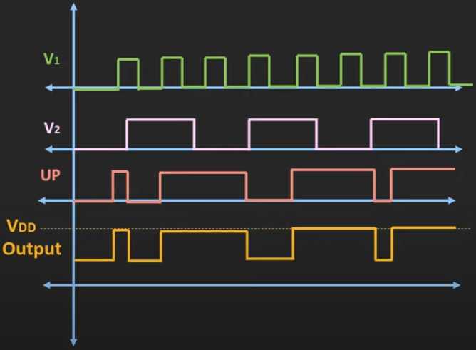
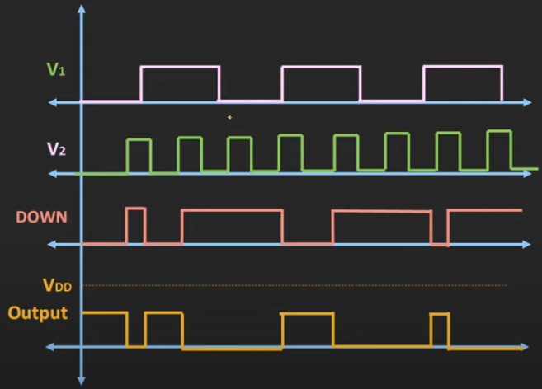
PFD (Phase Frequency Detector)
Case -1
V1 - Input of PLL and V2 - Output of VCO; f(v1) > f(v2); V1 is leading the V2; UP signal will be high
Case -1
V1 - Input of PLL and V2 - Output of VCO; f(v1) < f(v2); V1 is lagging the V2; DOWN signal will be high

Slide 8
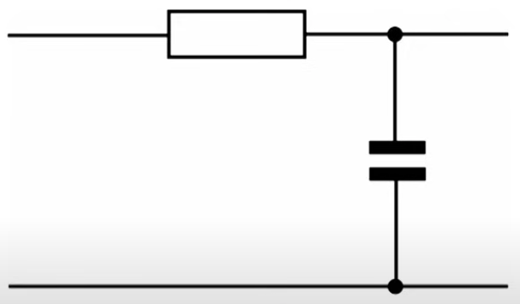
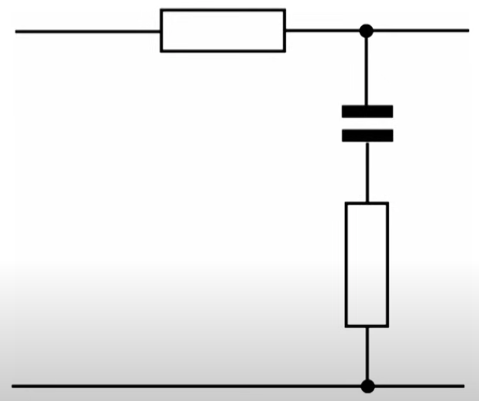
LPF (Low Pass Filter) / Loop Filter
Often Simple CR network
Shapes phase noise characteristic of output
Governs the frequency agility
Determines loop stability
Attenuates reference signal level on output

Slide 9
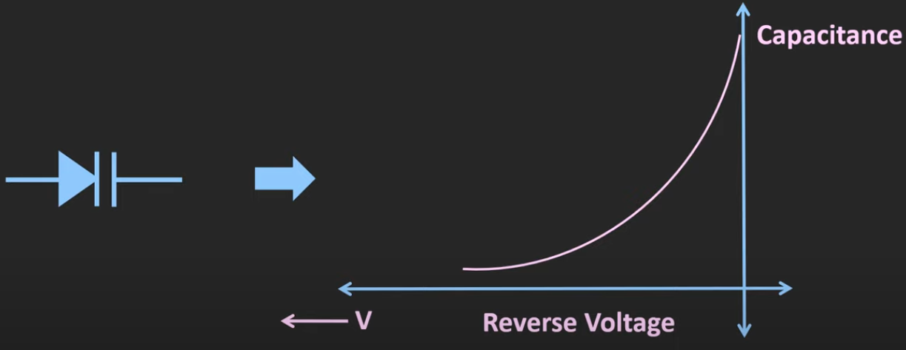
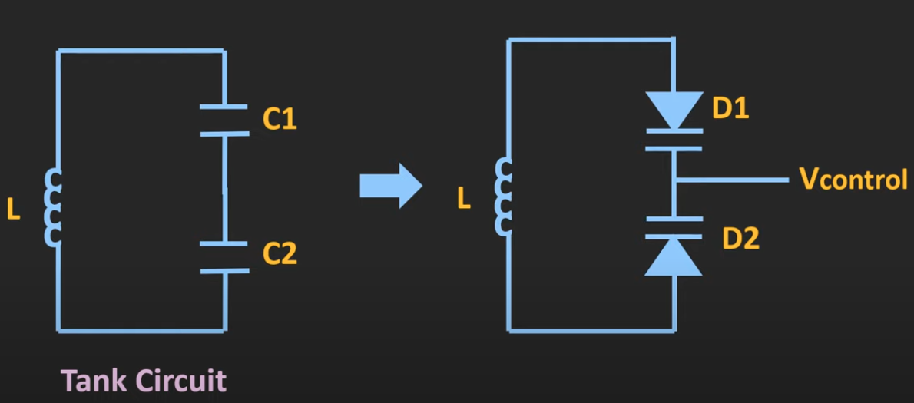
VCO (Voltage Controlled Oscillator)
Simple Oscillator, Normally uses varactor diodes
The VCO generates an output frequency that is directly proportional to its input voltage
Control terminal to which control voltage applied
Types - 1. Relaxation Oscillator
2. Harmonic Oscillator (i. RC Oscillator
ii. LC Oscillator
iii. Crystal Oscillator)
Varactor Diode (VarCap) - 6. Tank Circuit -
RC Oscillator -> f ∝ 1 / RC
LC Oscillator -> f ∝ 1 / √(LC)

Slide 10
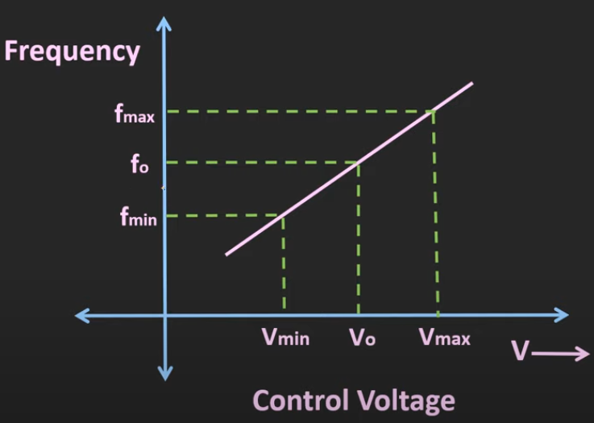
VCO (Voltage Controlled Oscillator)
Frequency v/s Control Voltage -
Specifications -
Tuning Range - 0.5V to 10V; 40 MHz to 80 MHz
Tuning Gain / Tuning Sensitivity - Unit - Hz / V
Supply Pushing - Changes in the output frequency with the changes in the supply voltage. Unit - Hz / V
Load Pulling - Change in the output frequency with the changes in the load. Maximum deviation from the nominal frequency
Spectral Purity - In time domain is called Jitter and in frequency domain is called phase noise. Unit - dBc / Hz
f(t) = fo + KVc(t)

Slide 11
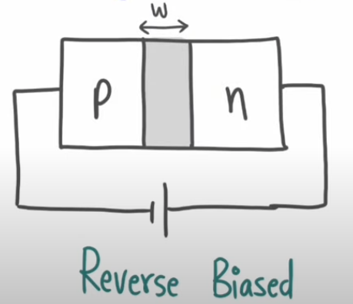
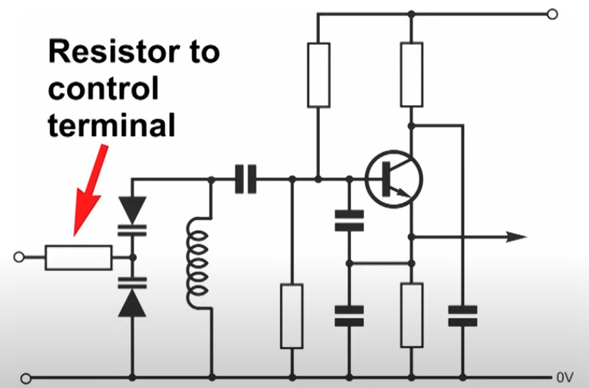
VCO (Voltage Controlled Oscillator)
Ranges -
Capture Range - The range of input frequencies around the VCO centre frequency in which loop can lock when starting from the unlocked condition
Lock Range - The range of input frequencies over which the loop remain in the lock condition once it has captures the input signal
R, L, C based VCO - Principle of VCO -
Vin | w | C = εA / d | f ∝ 1 / C
Increases | Increases | Decreases | Increases
Decreases | Decreases | Increases | Decreases

Slide 12
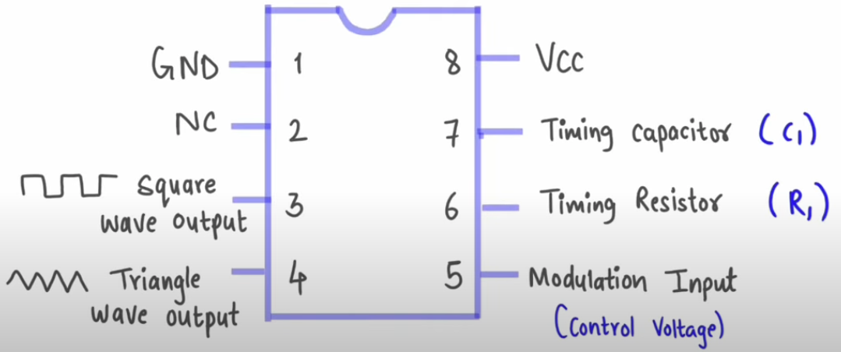
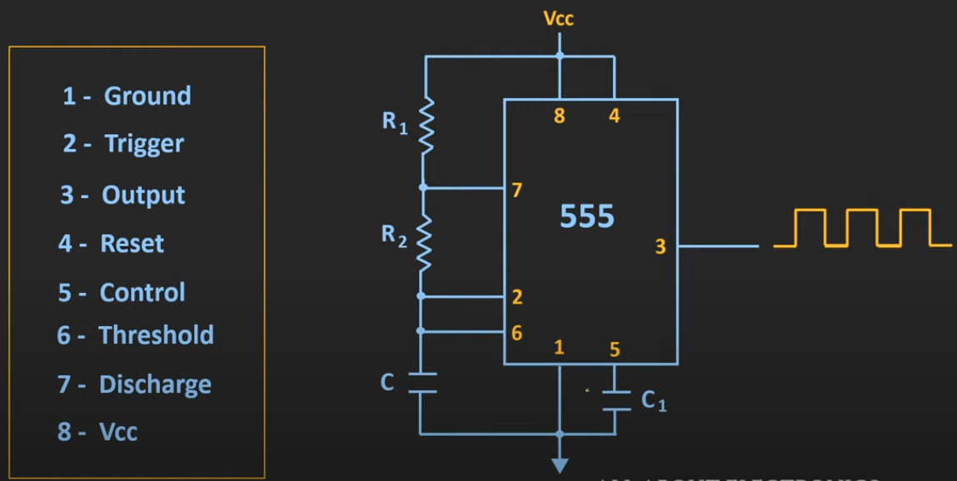
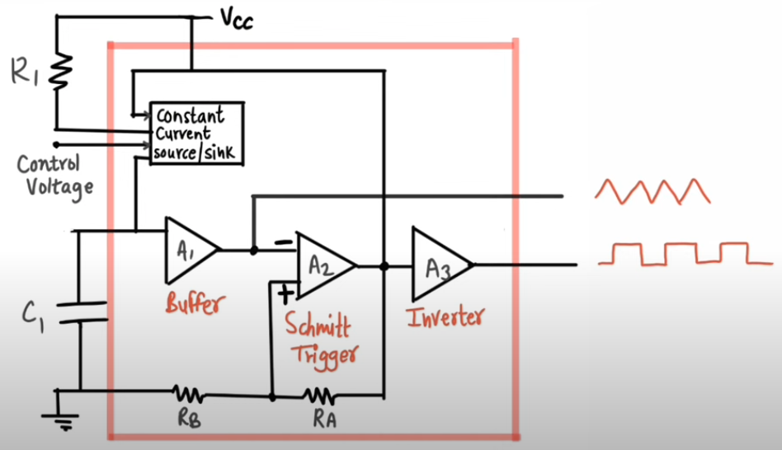
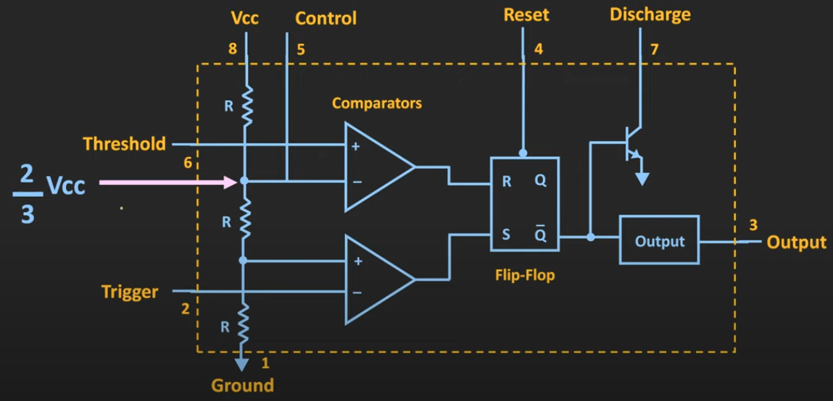
VCO (Voltage Controlled Oscillator)
IC LM566 - IC 555 Timer -
f = {2.4(Vcc - Vc)} / RCVcc
Where, Vcc - Power Supply, Vc - Control Supply

Slide 13
PLL (Phase Locked Loop)
Synchronize input and output signal in frequency as well as phase
PLL makes phase difference constant but not makes the phase equal
PLL detects the phase difference between signals
PLL can acquire lock state only when reference frequency is within capture range
Based on the phase of signals -
When the phase difference between signals changes this means they are on different frequencies
When phase difference remains constant frequencies are equal
Mode of operation of PLL -
Free Running State - Before the input is applied VCO runs at centre frequency (fo)
Capture mode - After the input frequency is applied, VCO frequency continues to changes until it equals the input frequency
Phase Locked Loop - When, fin = fout

Slide 14
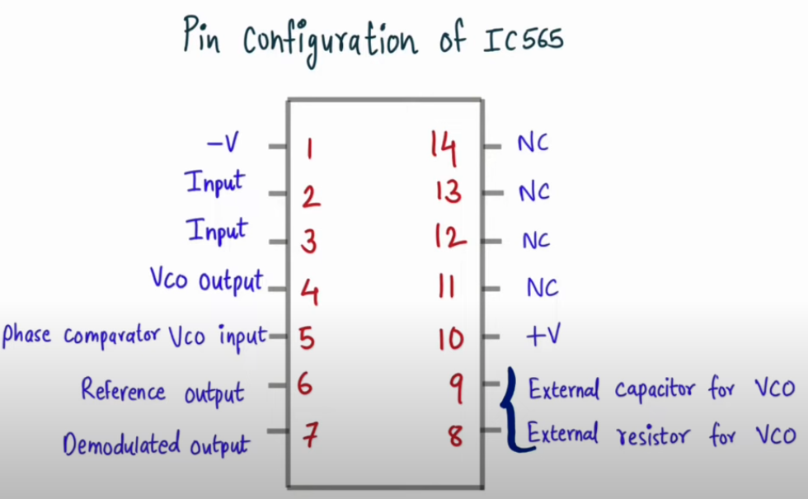
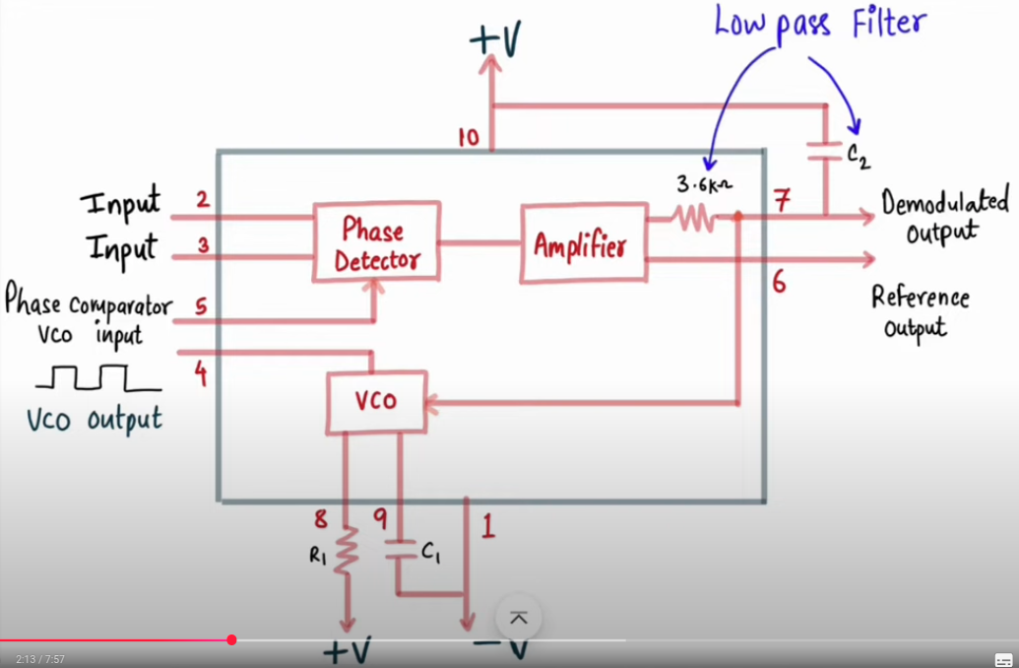
PLL (Phase Locked Loop)
IC 565 -
Center frequency, fout = 1.2 Hz
4RC
Where, R - connected to pin 8, C - connected to pin 9
Lock range, FL = ± (8)(fout) Hz
V
Where, fout - free running frequency / centre frequency of VCO
V = (+V) - (-V)
Capture range, FC = ± √ FL
√{(2Ⲡ)(3600)C}
Where, C - capacitance of a LPF
PLL is a multi-function, general purpose frequency synthesizer with ultra-wide
input and output ranges and best-in-class jitter performance. It offers excellent
supply noise immunity, making it suitable for noisy SoC environments and
provides ultra-low jitter output clocks

Slide 15
Applications of VCO and PLL
Applications of VCO -
Frequency Modulators
Pulse Modulators
Phase Locked Loop
Tone Generator
Clock Generator
Variable Frequency signal Generator
Function Generator
Applications of PLL -
Clock Recovery
Synchronization and Demodulation circuits
Noise and Jitter Reduction
Frequency Synthesizers
Microprocessors (Clock Multiplier and Clock Distribution)
Signal Reconstruction
Frequency Demodulators

Slide 16
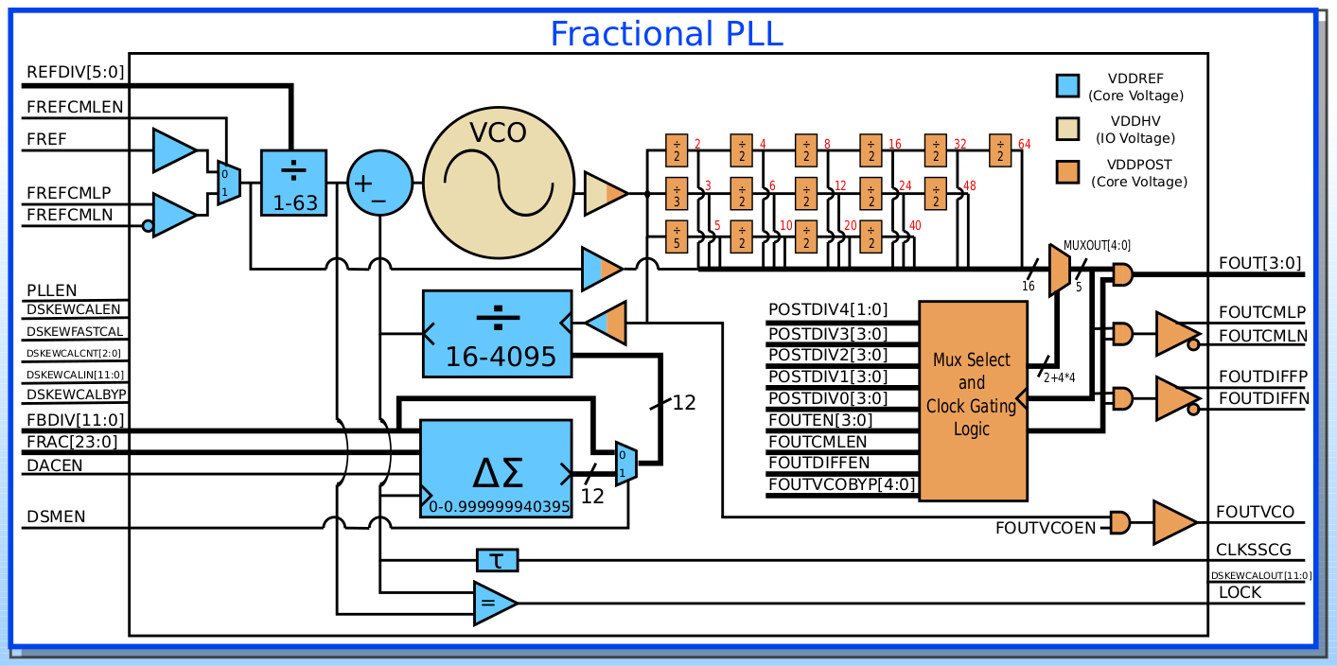
PLLTS12FFCFRACF
Programmable Fractional PLL

Slide 17
PLLTS12FFCFRACF
Programmable Fractional PLL
Pre-Divider (REFDIV) - Divides the input reference frequency (FREF) to produce the phase frequency detector (PFD) reference frequency (FPFD)
Phase Frequency Detector (PFD) - Compares the phase and frequency of its two input signals (FPFD - from the pre-divider and feedback signal from the feedback divider). It outputs an error signal proportional to the phase and frequency difference
Charge Pump - Converts the digital error signals from the PFD into analog current pulses
Loop Filter - Filters the output of the charge pump, converting the current pulses into a stable control voltage. This voltage controls the VCO. The loop filter determines the PLLs stability and response characteristics
VCO - Generate an output frequency (FVCO) that is proportional to the control voltage received from loop filter
Feedback Divider (FBDIV) - Divides the VCO output frequency (FVCO) before feeding it back to the PFD. In a locked state, the divided VCO frequency matches the PFD reference frequency
Deskew calibration - Includes DSKEWCALEN, DSKEWFASTCAL, and DSKEWCALBYP signals for dskew calibration indicated by DSKEW_PLL_LOCKED output

Slide 18
PLLTS12FFCFRACF
Programmable Fractional PLL
Post Dividers (POSTDIV*) - These divide the VCO output (or a pre-divided version of it) to generate the desired output clock frequencies (FOUT). For optimal performance, the value of the first post-divide should be maximized before calling subsequent ones
Fractional Mode (ΔΣ) - It is a delta sigma fractional PLL meaning it can generate output frequencies that are not integer multiples of the input reference clock by using a fractional portion (FRAC[3:0]) of the feedback divide value. This provides much finer frequency resolution compared to integer - N PLLs. The DACEN input enables a fractional noise-cancelling DAC
Multiple Independent Outputs - It features five independent outputs (FOUT[3:0] and MUXOUT[4:0]) with glitch-free post divide switching. This allows for dynamic frequency changes without disruptions
Spread Spectrum Modulation (SSMOD) - The PLL supports an optional Spread Spectrum Modulator (SSMOD) with a wave table, which is active when the PLL is in fractional -N mode. This is used for electromagnetic interference (EMI) reduction but may impact long-term jitter
CML I/O - Supports CML (Current Mode Logic) input and output clocks (FREFCML P/N, FOUTCML P/N, FOUTCMLEN) in addition to single ended CMOS logic

Slide 19
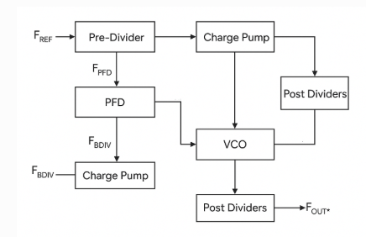
PLLTS12FFCFRACF
Programmable Fractional PLL
Features -
Input frequency range - 8 MHz to 650 MHz, 10 MHz to 650 MHz (fractional mode)
Output frequency range - 31 MHz to 8000 MHz
4:1 VCO frequency range allows PLL to be optimized for minimum jitter or minimum power
24 bit frequency accuracy - ΔΣ noise cancellation DAC allows fractional mode jitter performance to nearby match integer mode performance
Isolated analog supply (1.8V) allows for excellent supply rejection in noisy SoC applications
Lock detect signal indicates when frequency lock has been achieved
Five independent outputs with glitch-free post divide switching
Current Mode Logic (CML) input and output clocks
Low area (0.09 sq. mm)

Slide 20
THANK YOU

