Slide 1

Smart Safety Band
For Personal Safety and Communication
Power-Saving GPS • SOS Emergency • Audio Communication

Slide 2

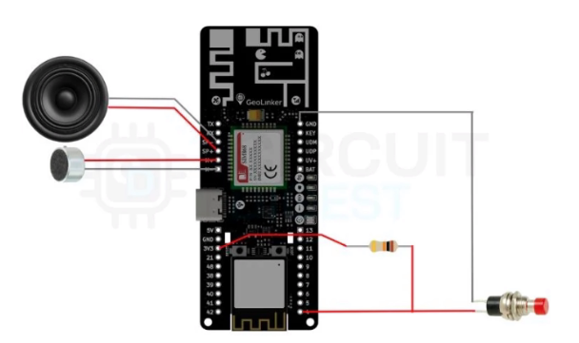
Circuit Diagram
An industrial-grade cellular telemetry and emergency call framework featuring dynamic 2D Kalman filtering and GPS/Cell-Tower hybrid location fallback.

Slide 3
Quick Overview
Parameters Used | Details
Main Board | GeoLinker GL868 (ESP32-S3 + SIM868)
GSM Module | SIM868 (2G GSM / GPRS + GPS)
Trigger | Push Button on GPIO 4
Audio Output | 4Ω Speaker on SP+ / SP- pins (max 1W at 8Ω)
Audio Input | Condenser microphone on M+ / M-
Power Supply | 3.7V Li-ion battery via JST connector
SIM Type | 2G GSM SIM with active voice plan
Auto-Answer | Yes – detects RUNG, sends ATA command

Slide 4
Components Used
S No | Parameters Used | Details
1. | GeoLinker GL868 dev board | The main controller for the project
2. | 4Ω Speaker | To get the audio output
3. | Condenser Mic | To give audio input to the device
4. | 3.7V Lithium Battery | To power the whole project
5. | Push Button | To trigger a SMS and Call on button press
6. | SIM Card | 2G GSM card for connectivity
7. | Connecting wires | To make the whole circuit

Slide 5
SIM868 AT Commands Used
S No | AT Command | Purpose
1. | AT | Basic modem communication / AT handshake. Used during SIM868 initialization and diagnostics
2. | ATI | Reads modem identification / firmware information. Used during full diagnostics
3. | AT+CGSN | Reads the modem IMEI number
4. | AT+CIMI | Reads the IMSI of the SIM
5. | AT+CCID | Reads the SIM ICCID
6. | AT+CNUM | Reads the phone number associated with the SIM / modem
7. | AT+CPIN? | Check whether the SIM is ready. The source looks for READY
8. | AT+CCID? | Queries SIM ICCID in the SIM-status diagnostic function

Slide 6
SIM868 AT Commands Used
S No | AT Command | Purpose
9. | AT+COPS? | Queries the currently selected network / operator. Used in diagnostics
10. | AT+CSQ | Reads GSM signal quality / RSSI. Used during registration timeout, diagnostics and call preflight
11. | AT+CREG? | Checks GSM circuit-switched network registration status. Registration is accepted when the response contains status 1 or 5
12. | AT+CGREG? | Checks GPRS / packet-domain registration status.
13. | AT+CMEE=2 | Enables verbose modem error reporting
14. | AT+CIURC=0 | Disables initial readiness URCs such as Call Ready / SMS Ready
15. | AT+CGDCONT? | Queries the currently configured PDP context / APN
16. | AT+CGDCONT=1,”IP”,”<APN>” | Configures PDP context 1 with IP type and the configured APN

Slide 7
SIM868 AT Commands Used
S No | AT Command | Purpose
17. | AT+CGNSPWR=1 | Powers ON the SIM868 GNSS Engine
18. | AT+CGNSPWR=0 | Powers OFF the GNSS engine for power saving
19. | AT+CGNSSEQ=“GGA”,”GSA”,”GSV”,”RMC” | Requests richer GNSS sentence / metadata output
20. | AT+CGNSSEQ=“RMC” | Configures RMC as the final GNSS sequence
21. | AT+CGNSINF | Retrieves current GNSS information including fix status, timestamp, latitude, longitude, HDOP and satellite information
22. | AT+CIPGSMLOC=1,1 | Requests GSM / network-based location
23. | AT+CLBS=1,1 | Requests location based on cell / network information
24. | AT+CLBS? | Queries the cell-based location service / status

Slide 8
SIM868 AT Commands Used
S No | AT Command | Purpose
25. | AT+CMGF=1 | Selects SMS text mode
26. | AT+CMGS=“<number>” | Starts sending an SMS to the specified recipient and waits for the prompt
27. | ATD<number>; | Initiates voice call. The semicolon specifies a voice call
28. | AT+CLCC? | Queries current call list / status and is used to determine whether an active call exists
29. | AT+CPAS | Queries phone activity status after dialling
30. | AT+CEER | Retrieves an extended report when the call cannot be confirmed
31. | AT+CHFA=1 | Selects audio channel 0 / external audio path
32. | AT+CLVL=90 | Sets the speaker / loudspeaker volume level to 90
33. | AT+CMIC=0,12 | Sets microphone gain for channel 0 to 12
34. | AT+SIDET=1 | Enables / configures sidetone with the specified channel / gain parameters

Slide 9
SIM868 HTTP AT Commands
S No | AT Command | Purpose
35. | AT+CGATT=1 | Attaches modem to GPRS packet-data service
36. | AT+SAPBR=3,1,“Contype”,“GPRS” | Sets SAPBR bearer 1 connection type to GPRS
37. | AT+SAPBR=3,1,“APN”,“<apn>” | Sets the APN for bearer profile 1
38. | AT+SAPBR=1,1 | Opens (activates) the GPRS bearer / PDP context
39. | AT+SAPBR=2,1 | Confirms bearer status and assigned IP address
40. | AT+HTTPINIT | Initializes the HTTP service session
41. | AT+HTTPSSL=1 | Enables SSL for HTTPS endpoints
42. | AT+HTTPPARA=“CID”,1 | Binds the HTTP session to bearer profile 1

Slide 10
SIM868 HTTP AT Commands (contd.)
S No | AT Command | Purpose
43. | AT+HTTPPARA=“URL”,“<url>” | Sets the destination URL for the POST
44. | AT+HTTPPARA=“CONTENT”,“application/json” | Sets Content-Type header for the JSON body
45. | AT+HTTPPARA=“TIMEOUT”,30 | Sets the HTTP request timeout in seconds
46. | AT+HTTPDATA=<size>,10000 | Announces payload size; module replies DOWNLOAD
47. | AT+HTTPACTION=1 | Executes the HTTP POST with the uploaded JSON
48. | AT+HTTPREAD=0,<len> | Reads back the server’s response body
49. | AT+HTTPTERM | Terminates the HTTP session

Slide 11
About SIM868 GSM / GPRS + GNSS Module
Quad-Band GSM (850 / 900 / 1800 / 1900MHz) – Supports global network compatibility
Integrated GNSS – Includes, GPS, GLONASS and BeiDou for accurate positioning
Versatile Communication – Supports voice calls, SMS, and GPRS data transfer
Multiple Interfaces – Includes UART, USB, and GPIO for flexible integration
Technical Parameters – Frequency Bands: GSM 850 / 900 / 1800 / 1900 MHz
- GPRS: Class 12
- GNSS: GPS, GLONASS, BDS
- Operating Voltage: GSM - 3.4V to 4.4V, GPS – 2.9V to 4.4V
- Operating temperature: -40℃ to +85℃

Slide 12
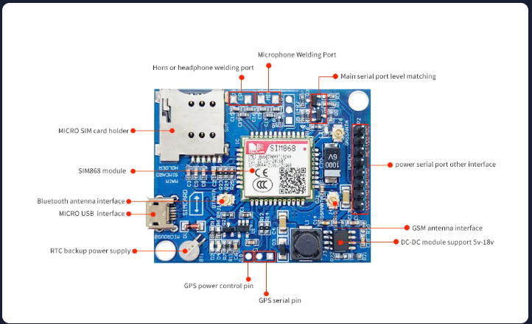
About SIM868 GSM / GPRS + GNSS Module

Slide 13
Features Implemented
SOS Button
Emergency Alert
Live GPS Location
Location Sharing
GSM / LTE
GNSS / GPS
Voice Communication
SMS Alerts
HTTP JSON Telemetry

Slide 14
1. SOS Button
The SOS GPIO is configured as an input with pull-up and any edge interrupt with active level 0.
A dedicated SOS button task polls the GPIO every 100 ms and debounces level changes before queuing a COMM_EVENT_EMERGENCY event.
The Communication Task picks up the event and calls gl868_modem_trigger_emergency() to start the alert sequence.

Slide 15
2. Emergency Alert
gl868_modem_trigger_emergency() first confirms the SIM is ready and waits up to 30 seconds for GSM network registration before proceeding.
A single GPS attempt (10 s timeout) is made; on failure the alert still proceeds and a deferred GPS retry is queued separately.
The alert SMS embeds the coordinates, a Google Maps link, and the current battery percentage, and is sent to every configured recipient (comma/semicolon-separated list).
After a 2 second delay, the modem places a call to the emergency number and logs whether the call was confirmed.

Slide 16
3. Live GPS Location
A dedicated task queues a COMM_EVENT_LIVE_TRACKING event every 3 minutes without competing for the modem UART used by SOS and diagnostics.
gl868_modem_send_live_location() resolves the current fix via gl868_modem_get_gps_coordinates() and builds a Google Maps link.
The link is sent as an SMS to the configured emergency contact, giving continuous live tracking outside of emergencies.

Slide 17
4. GSM / LTE
gl868_modem_init() brings up the SIM868 over UART at 115200 baud and performs an extended AT handshake, falling back to 3 retries with a power-cycle between attempts.
Once the modem responds, the code waits for the SIM to report ready (up to 30 s) and configures the APN before continuing.
GSM network registration is awaited for up to 45 seconds; initialization still proceeds if it doesn't complete, and later operations re-check registration as needed.

Slide 18
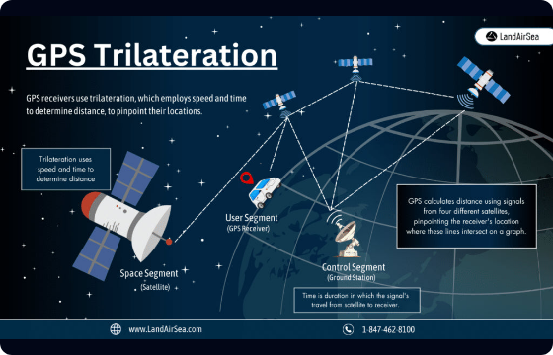
5. GNSS / GPS
GPS is enabled during initialization (AT+CGNSPWR=1) and configured for richer GGA / GSA / GSV / RMC metadata.
gl868_modem_get_gps_coordinates() checks HDOP and satellite count; a poor raw fix falls back to network-based location or a 6-sample weighted average.
Accepted fixes are smoothed through a 2D Kalman filter (gl868_modem_set_kalman_params(), movement profiles for stationary / walking / running) to reduce position jitter.

Slide 19
6. Voice Communication
make_call() configures the external speaker/microphone audio path before dialing and verifies the call connected via AT+CLCC before treating it as active.
If the dial command doesn't return an explicit OK, the code falls back to checking phone activity (AT+CPAS) and call-list state to confirm the call actually went through.
gl868_modem_hang_up_call() issues ATH to end an active call on demand, independent of the emergency-alert flow.

Slide 20
7. SMS Alerts
All SMS sending goes through a shared text-mode path (AT+CMGF=1) with a prompt wait and Ctrl-Z terminator, used by test, live-tracking, and emergency messages alike.
Emergency alerts support multiple recipients by splitting the configured number string on commas or semicolons and sending to each independently.
gl868_modem_send_test_sms() and gl868_modem_send_sms_to() expose the same mechanism for diagnostics and application-triggered messages outside the SOS flow.

Slide 21
8. HTTP JSON Event Upload
gl868_modem_upload_telemetry() builds the normalized Smart-City event JSON, used for SOS triggers, SOS updates, and periodic live-tracking heartbeats.
open_gprs_bearer() attaches GPRS and opens a SAPBR bearer; post_http_json_attempt() then starts the HTTP session (AT+HTTPINIT), sets URL/content-type via AT+HTTPPARA, and uploads the JSON with AT+HTTPDATA.
The POST runs via AT+HTTPACTION=1; the response is read with AT+HTTPREAD and the session closed with AT+HTTPTERM — an HTTP 2xx status confirms the upload.

Slide 22
Smart-City Event JSON Schema
Field | Type | Description
schema_version | string | Event schema identifier — currently "smart-city-event/1.0"
event_id | string | Unique ID generated fresh for every SOS activation / event
correlation_id | string | Groups every event belonging to one SOS episode
event_type | string | e.g. sos.triggered, sos.updated, device.live_location, device.heartbeat
severity | string | "critical" for SOS events, "info" for heartbeats
occurred_at | string (RFC 3339) | Actual event time in UTC, e.g. 2026-09-02T08:30:00Z
source | object | kind: "smart-band", source_id (same stable ID as payload.band_id)
location | object | kind: "geo", site_id, latitude, longitude, accuracy_m from the current GPS fix
evidence | array | Reserved for supporting media links; empty by default
payload | object | Event-specific fields, e.g. band_id, trigger, sos_status

