Slide 1






The City That
Responds in Seconds
ZMD Smart City Security System
Five systems, one response loop — aligned to India's ICCC mandate (IMAF 2.0).
ICCC · Edge Towers · Safety Bands · Cameras · Drones
Notes:
Five systems, strict hierarchy: the ICCC decides everything; edge towers process and report; tags broadcast direct; cameras feed the edge; drones fly only on ICCC command.

Slide 2

IMAF 2.0 Framework for Security & Surveillance
What 'security & surveillance' means under India's ICCC mandate — and the IMAF 2.0 pillar behind each
CAPABILITY
WHAT IT DELIVERS (Security & Surveillance)
IMAF 2.0 PILLAR
DETECT
Spot incidents automatically — intrusion, fire, crowds, anomalies, number plates
Use Cases (II, 15%) · Infrastructure (I)
DETER
Warn & prevent — camera talk-down, warning lights, visible response
Use Cases (II) · Stakeholder Engagement (IX)
RESPOND
Act in seconds — dispatch drones & responders, live public announcements
Interdepartmental Coordination (VIII, 15%)
RECORD
Capture & retain admissible evidence, auto-logged to CCTNS
Data Lifecycle (IV) · Governance (V)
PROTECT
Secure the system & citizen data end-to-end
Cybersecurity (III, 15%) · Data Lifecycle (IV)
ZMD delivers all five — designed against IMAF 2.0, MoHUA's five-star ICCC maturity framework.

Slide 3








Security & Surveillance Use Cases
IMAF requires 5+ SOP-documented use cases
Intrusion & perimeter
Crowd density
ANPR → CCTNS
Fire & smoke
Line-crossing, loitering, restricted zones
Overcrowding alerts for events & transit
Plates read at the edge, logged nationally
From video — no extra sensors needed
Abandoned object
Audio anomaly
Missing person
Citizen SOS
Unattended-object detection & escalation
Gunshot / scream detection zones
Tag geofence + camera correlation at ICCC
Tag alerts with GPS, direct to command
Impact of use cases carries 50% of the IMAF assessment score — each of these ships with a documented SOP.
Notes:
Eight SOP-ready use cases against IMAF's five-minimum. Missing person and SOS showcase cross-system correlation at the ICCC.

Slide 4
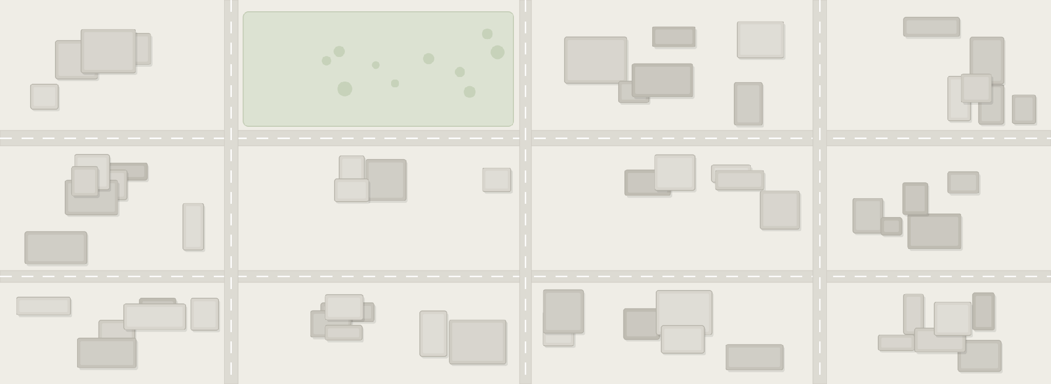






ZMD Ecosystem: Five Systems, One Response
The edge processes everything; the command centre decides on what matters
INTEGRATED COMMAND & CONTROL CENTRE
live aerial feed
PTZ Cameras
every decision · drones · announcements
announcements · via edge
SOS · direct
dispatch command
metadata + short clips
SAFETY BAND
direct alert to command centre
DRONE DOCK
EDGE TOWER
standalone · 24×7
ICCC-commanded only
processes video · reports to command whole zone · commands nothing
Notes:
The one-diagram pitch. Six numbered flows: cameras→tower (raw), tower→ICCC (metadata, −90%), tag→ICCC (direct GSM), ICCC→dock (command), drone→ICCC (feed), ICCC→speakers (PA). Note the dock is standalone — not wired to the tower.

Slide 5
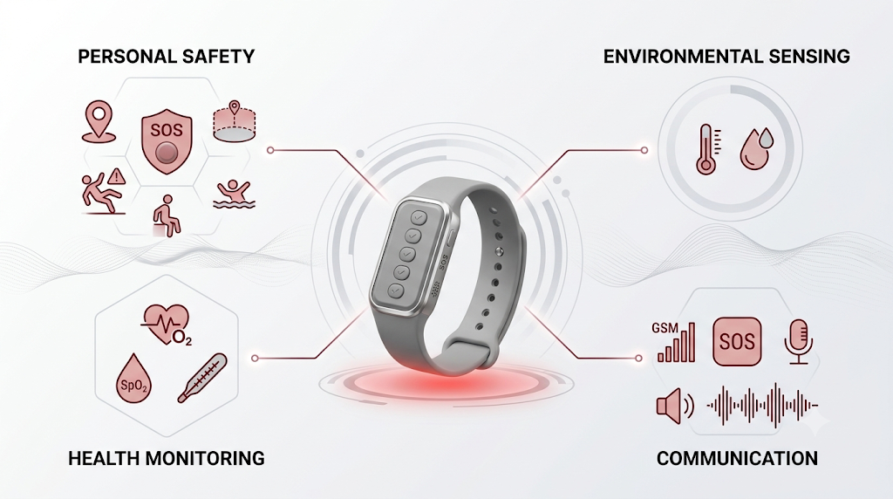
Safety Band
Multi-Sensor Safety Band for Instant Emergency Detection
KEY DIFFERENTIATOR | Instead of offering isolated safety function, the safety band integrates the functions that currently exist across multiple products into one band.
DIGITAL INFORMATION | Safety Band contains a unique identification number linked to a secure profile. Authorized emergency responders can instantly retrieve this information to provide informed and timely assistance.
DATA PRIVACY | Secure PIN based Authentication. Information is accessible only to the user, with emergency access granted to responders when required.

Slide 6
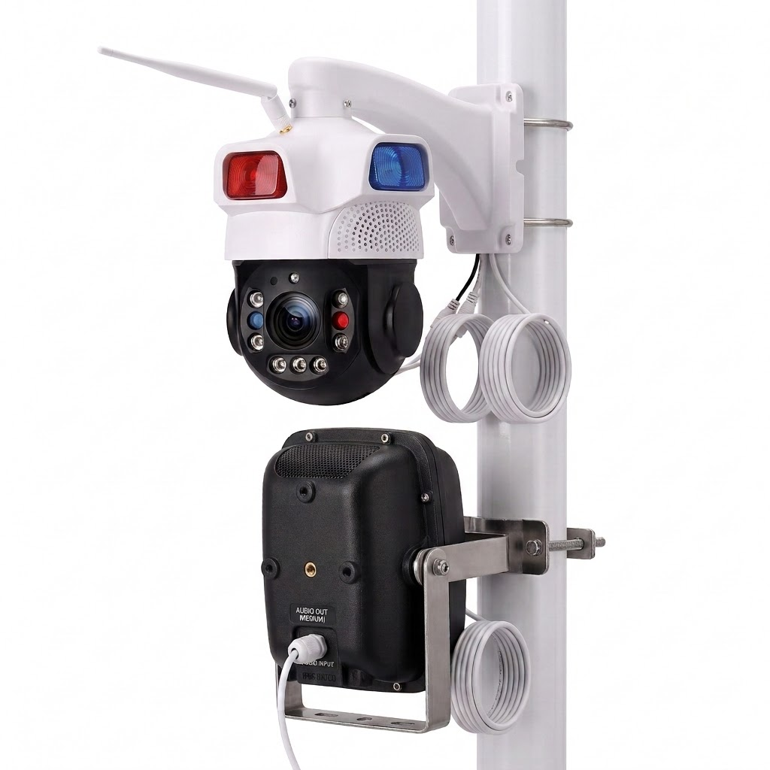
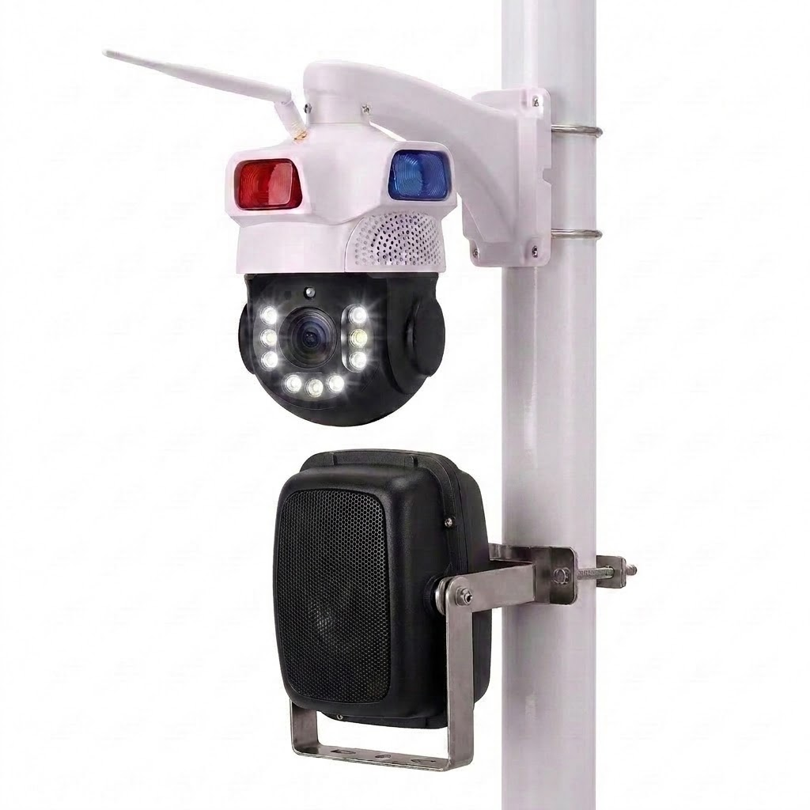
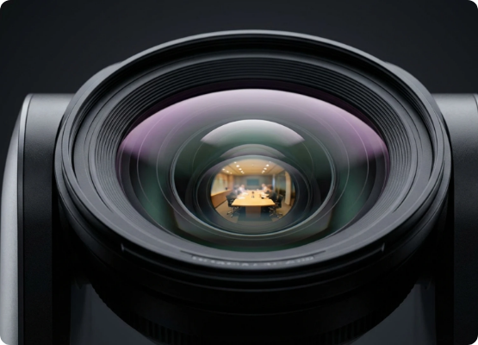
The PTZ Camera
A rugged, all-weather eye that sees in the dark, speaks back, and tracks on its own — every feed through the edge.
⌂
Rugged, vandal-proof housing
All-weather industrial chassis with a reinforced dome for high-risk zones.
↻
Full-motion PTZ + auto-track
Motorised pan-tilt-zoom sweeps the whole area — no blind spots.
Ultra-HD clarity
Sharp enough to read number plates and faces, even at long zoom.
◑
Colour night vision
Full-colour footage in complete darkness with an integrated spotlight.
⚠
Active deterrence
Two-way audio talk-down plus flashing red & blue warning lights.
Next-Generation PTZ Camera
Every feed is processed at the edge; PTZ, audio and alerts return through the edge — never straight from command.
Notes:
System 3 with the use-case mapping the CEO asked for. 80/15/5 mix from the PRD; bidirectionality (speakers) is the differentiator — the ICCC can talk through any pole.

Slide 7



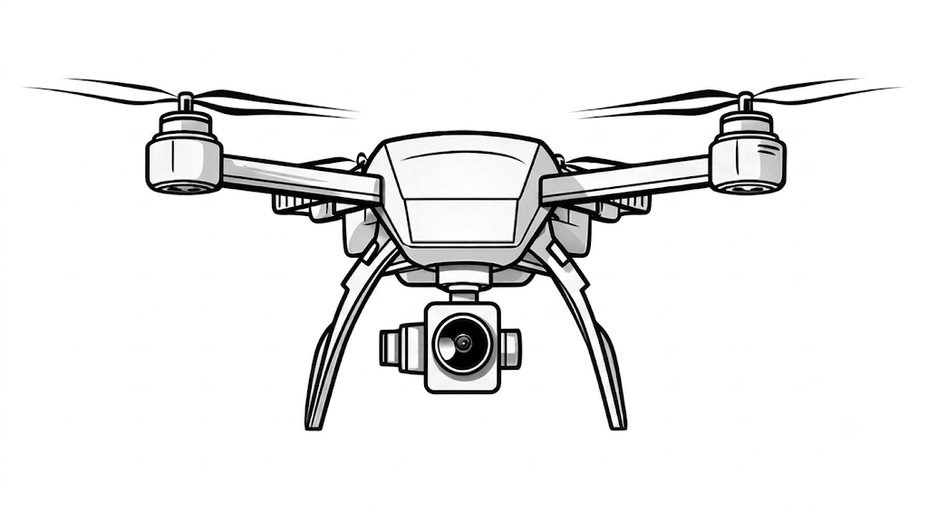

Drone Platform — Feature Set
Autonomous flight, full sensor suite, mission payloads, and rapid emergency response—reaching destinations up to
1 km in approximately 50–60 seconds with 24/7 deployment from autonomous docking stations.
Autonomous flight
Rapid Response
Integrated Payload Suite
RTK GPS Precision Navigation
AI Path Planning
Autonomous Waypoint Missions
Real-time Obstacle Avoidance
Pilot-less Standard Operations
Airborne in ~5 Seconds
1 km Response in ~50–60 Seconds
Cruise Speed: ~60–70 km/h
24×7 Mission Ready
4K Optical Camera
Thermal Camera
Loudspeaker & Microphone
LED Display
Spotlight
Mission payloads
First-Aid Kit
Fire Blanket
Life Jacket with GPS Beacon
Fleet & docking
Six mission profiles
Autonomous Docking
Automatic Charging
Health Self-Tests
Fleet Monitoring
Remote Mission Dispatch
Road Accidents
Fallen Person Detection
Cardiac Emergency (AED)
Fire Mapping
Flood Rescue
Event Surveillance
Notes:
Drone deck features with realistic timings baked in. Six mission profiles ready on day one.

Slide 8
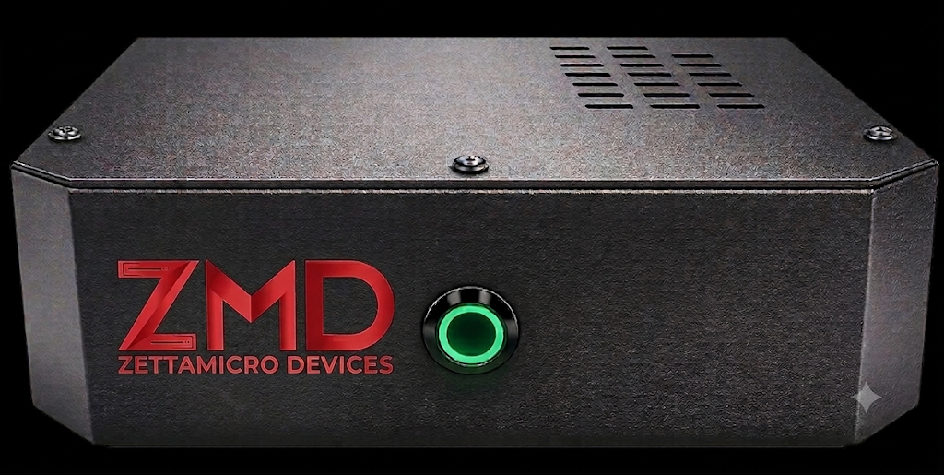
ZMD Edge Compute System
Processes every camera in its zone — sends only what matters to command
WHAT THE EDGE DELIVERS
›
Real-time AI on every camera feed — detection in the blink of an eye
›
Sends alerts and short clips to command — never raw video
›
Runs the whole zone locally; keeps working if the network drops
›
Scales up as the city grows — more cameras, more analytics
ZMD Edge Compute — rugged · zone-ready
›
Secure by design — encrypted, signed, tamper-resistant
One edge tower covers a full neighbourhood — every camera connects to it, and only it reports to command.
Notes:
System 2 on ZMD's own Arrow Lake hardware. Capacity: 16–24 AI streams base, 32–64 with the GPU slot populated. Role box repeats the governance rule.

Slide 9
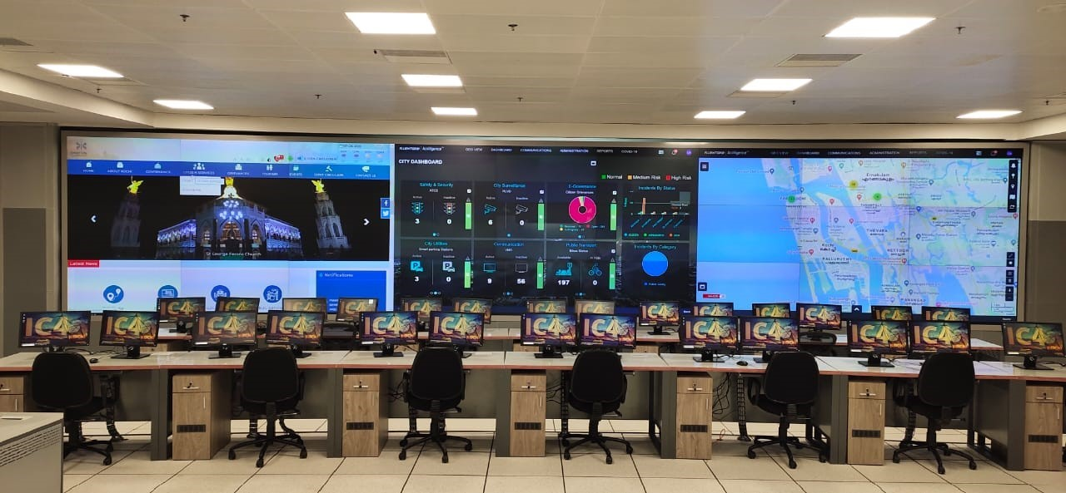
The Brain: Command & Control Centre
The operational and legal locus — every decision, dispatch, and announcement
WHAT IT DECIDES
›
Single-pane view of edge alerts, drone feeds & safety tags
›
Alert triage — from edge event to operator in seconds
›
Sole drone authority — operators initiate every mission
›
Two-way public address, relayed through the edge
›
SOP rule engine — auto-escalation & routing (IMAF Pillar II)
Designed to the ICCC Maturity Assessment Framework (IMAF 2.0, MoHUA) · CCTNS-logged · DPDP-compliant · N+1 uptime
Notes:
System 1. The ICCC is the only entity that commands — drones and announcements included. Everything else in the stack exists to inform it faster.

Slide 10




Use Case: ANPR → CCTNS
Number plates read at the edge and logged nationally — with instant watch-list response
HOW IT SOLVES
3
CCTNS
ICCC
1
Camera captures the plate and streams to the edge
command
4
national DB
2
Edge reads the plate (ANPR) and passes it to the ICCC
2
DRONE
1
responds
ICCC auto-logs the event to the CCTNS national database
CAMERA
EDGE
3
sees & speaks
processes
4
On a watch-list hit, ICCC dispatches a drone / patrol to intercept
— data (up) — command (down)
Plates are read at the edge; only the result and evidence reach the ICCC and CCTNS.

Slide 11
Use Case: Intrusion & Perimeter
Line-crossing and loitering in restricted zones — caught, verified, and answered in seconds
HOW IT SOLVES
ICCC
1
Camera spots line-crossing or loitering and streams to the edge
command
3
2
4
Edge AI confirms the intrusion and alerts the ICCC
DRONE
2
responds
1
3
ICCC dispatches the nearest drone for eyes-on
CAMERA
EDGE
sees & speaks
processes
4
ICCC triggers talk-down — via the edge to the camera speaker
— data (up) — command (down)
Cameras talk only to the edge; the ICCC commands through the edge — never straight to a camera.

Slide 12
Use Case: Fire & Smoke
Fire and smoke detected from video alone — no extra sensors, no waiting
HOW IT SOLVES
ICCC
1
Camera picks up a smoke or flame signature and streams to the edge
command
3
2
4
2
Edge AI classifies the fire and alerts the ICCC
DRONE
responds
1
ICCC dispatches a drone for aerial mapping + responders
CAMERA
EDGE
3
sees & speaks
processes
4
ICCC broadcasts an evacuation message via camera speakers
— data (up) — command (down)
Detection happens on-site at the edge; the ICCC coordinates the response.

Slide 13

Use Case: Citizen SOS
A safety-band SOS reaches command directly — then every system converges on the citizen
HOW IT SOLVES
ICCC
1
Citizen presses the safety band — SOS + GPS goes direct to the ICCC
command
3
2
ICCC pulls the nearest camera view — via the edge
DRONE
2
1
responds
4
3
ICCC dispatches a drone and responder to the GPS location
CAMERA
EDGE
sees & speaks
processes
4
ICCC opens talk-down / guidance through the camera speaker
SAFETY BAND
citizen SOS
— data (up) — command (down)
The safety band is the only device that talks to the ICCC directly; cameras stay behind the edge.

Slide 14




Designed to Meet, Measured by SLA
Standards alignment stated honestly — certification finalises with procured hardware
<5 s
edge alert to ICCC operator display
DESIGNED TO MEET
IMAF 2.0 (MoHUA) — ten-pillar ICCC framework · ISO 37122 indicators
<100 ms
camera frame to alert event at the edge
DPDP Act 2023 — auto-blur, 90-day lifecycle, role-based access
CCTNS integration (MHA) — auto-logged alert events
≤60 s
drone reaches target location after ICCC command (validated)
Trusted, security-vetted hardware throughout — procurement-compliant by design
DGCA Drone Rules 2021 · Digital Sky NPNT · BVLOS pathway
24×7
dock readiness · 90-day archival · N+1 uptime
Every SLA above is contractual language, not marketing — sourced from the PRD's response benchmarks.
Notes:
Compliance now phrased 'designed to meet' throughout, per the PRD's own framing. SLA tiles use the validated numbers.

