Slide 1
Alderaanians
Wilbur Dulce, Kaden Goski, and William Peers

Slide 2
Needs
Simplistic Navigation – What main points would you like for the dropdowns? Example: Membership, Events, Careers and Certification
Streamline – Links back to the Simplistic Navigation. To reduce the clutter we will have to cut pages out or “hide” them from the original views. Which ones can be hidden?
Log in and Register system – How is this currently handled? Log in and register is difficult to find at the moment.
Events and Payment Processing on Website – Security risks if all done on site – personal information may be stored. Will be important to keep site up to date. Is it worth moving off of Eventbrite? (admin hours and such required for in-website solutions)
Replacement for Adobe Catalyst – Easy to configure and update – WordPress Jetpack or alternative WordPress will be used.
Career Section – What do you envision this to be? How could the current one be modified?

Slide 3
Wants
Aesthetically Pleasing – How important is this? Is functionality more important than aesthetics?
Engagement Paths – Mentioned Vlogs/Blogs and Social Medias. Are these a “need”? Is one favored?
Two-Way Communication - such as a forum or comments on events?

Slide 4
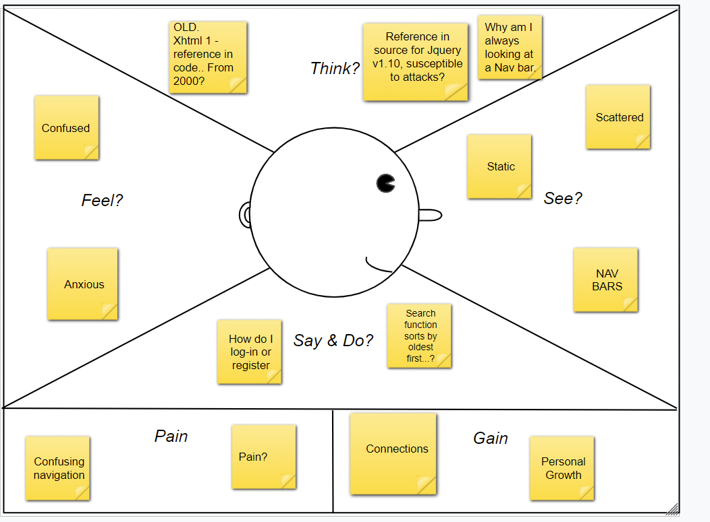
Empathy Map Diagram

Slide 5
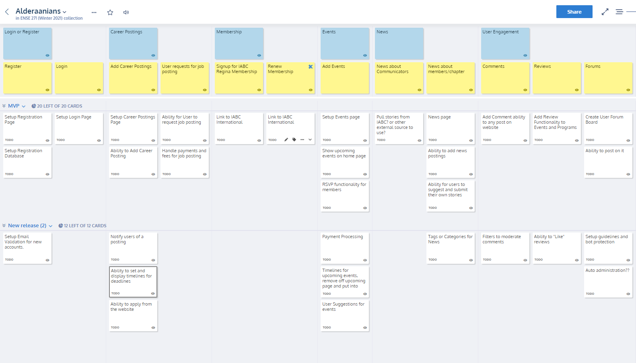
User Story Map

Slide 6
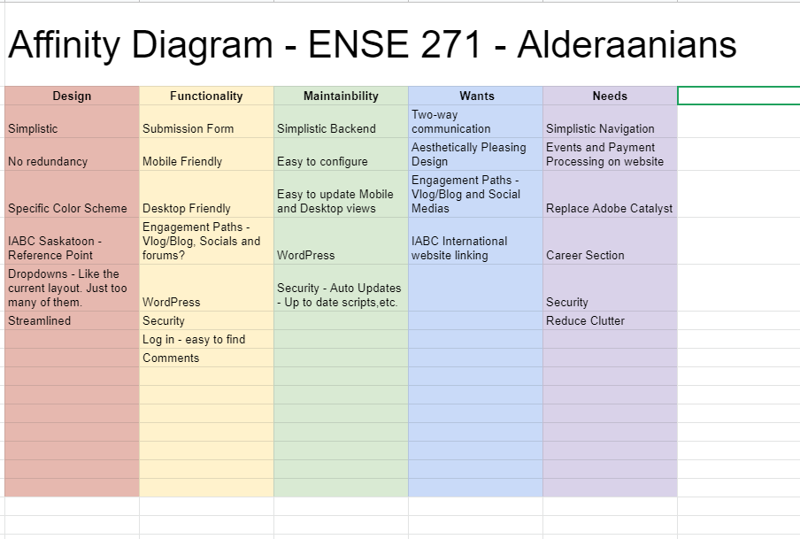
Affinity Diagrams

