Slide 1

RCE Saskatchewan Website Project
Presented By:
Matthew Amos & Tanvi Dave

Slide 2
Contents
1. Introduction
People Centred Design(PCD)
RCE Saskatchewan
Focussed Users
2. Project
Missing Requirements/ Empathy Mapping
3. Low Fidelity Mapping
4. High Fidelity Mapping
5. Conclusion

Slide 3
Introduction
PCD
What is PCD?
PCD is Human Focussed
“Human-centred design is a design philosophy”- Don Norman
“It means starting with a good understanding of people and the needs that the design is intended to meet.”- Don Norman
RCE Saskatchewan
Regional Centre of Expertise on Education for Sustainable Development

Slide 4

Introduction(cont’d)
RCE Saskatchewan website user requirements
Local Sustainability Leaders
RCE Saskatchewan Working Group/Flagships
Education and Research Community
RCE Partner Organizations
General Public & Politicians
Other RCEs
RCE Admin
Our Focussed Users
RCE Saskatchewan Working Group/Flagships
Education and Research Community

Slide 5
Issues we are mainly addressing…
RCE Saskatchewan Home Page:
Missing requirements
Data not well organized
Lot of data loaded on the home page
Some features not working (i.e. login page)
Profile
Contact information
Activities gallery
UN resources
Link to tools & pages

Slide 6

How our Focussed Users will be affected by above addressed issues?
Education & Research Community
RCE Saskatchewan Working Group
Publication
What are the missing requirements?
Publication completely missing e.g
Research paper publication
RCE SDG documentation
Details of documents
Events
What are the missing requirements?
Organize meeting
Post events

Slide 7
Course topics we are mainly focusing while designing the website…
Gulf of execution and gulf of evaluation.
Seven stages of action cycle.
Discoverability & understandability.
Design advice

Slide 8
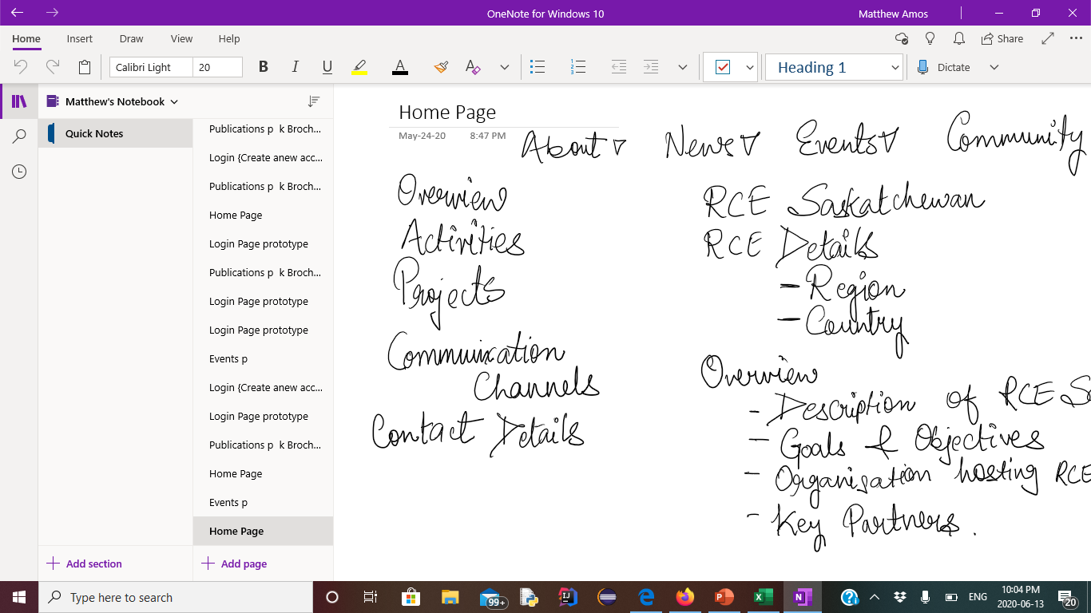

Low fidelity home page design

Slide 9
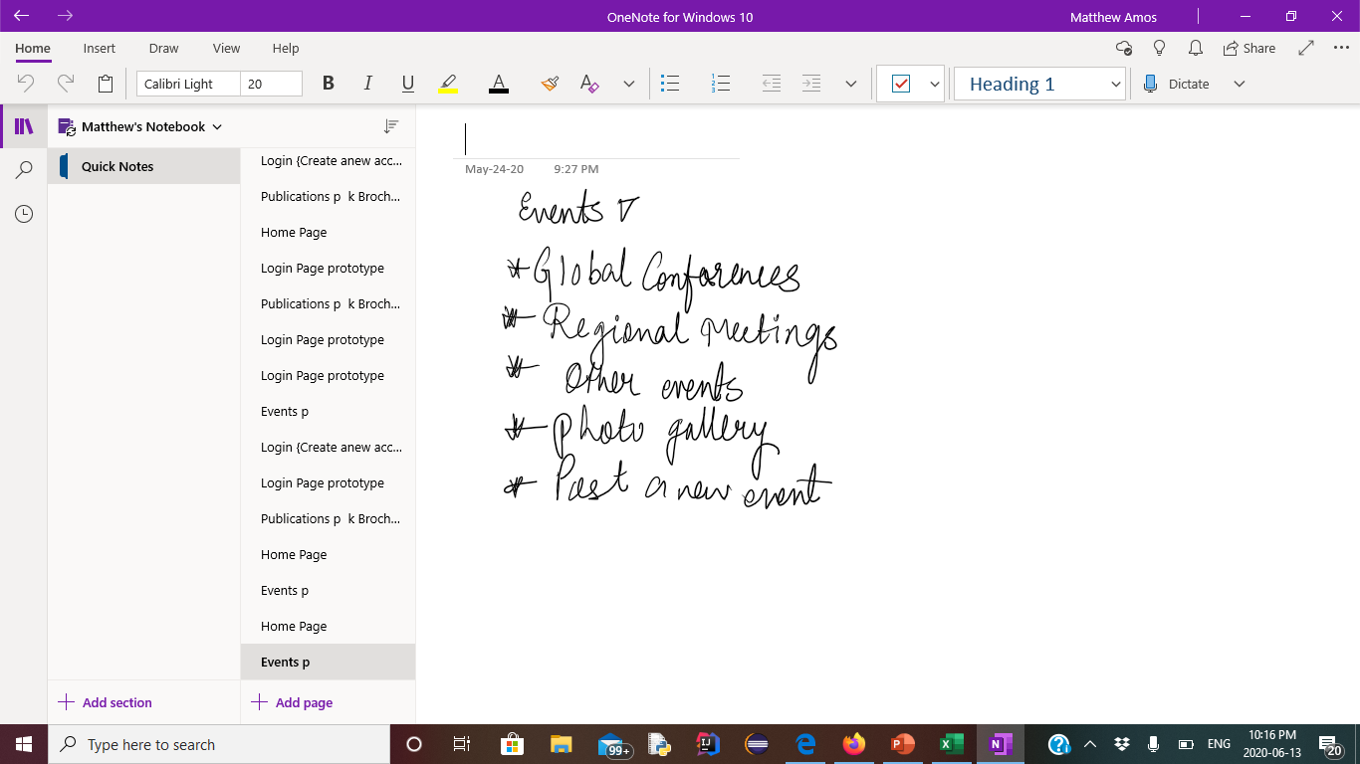
Event- Low Fidelity Mapping

Slide 10
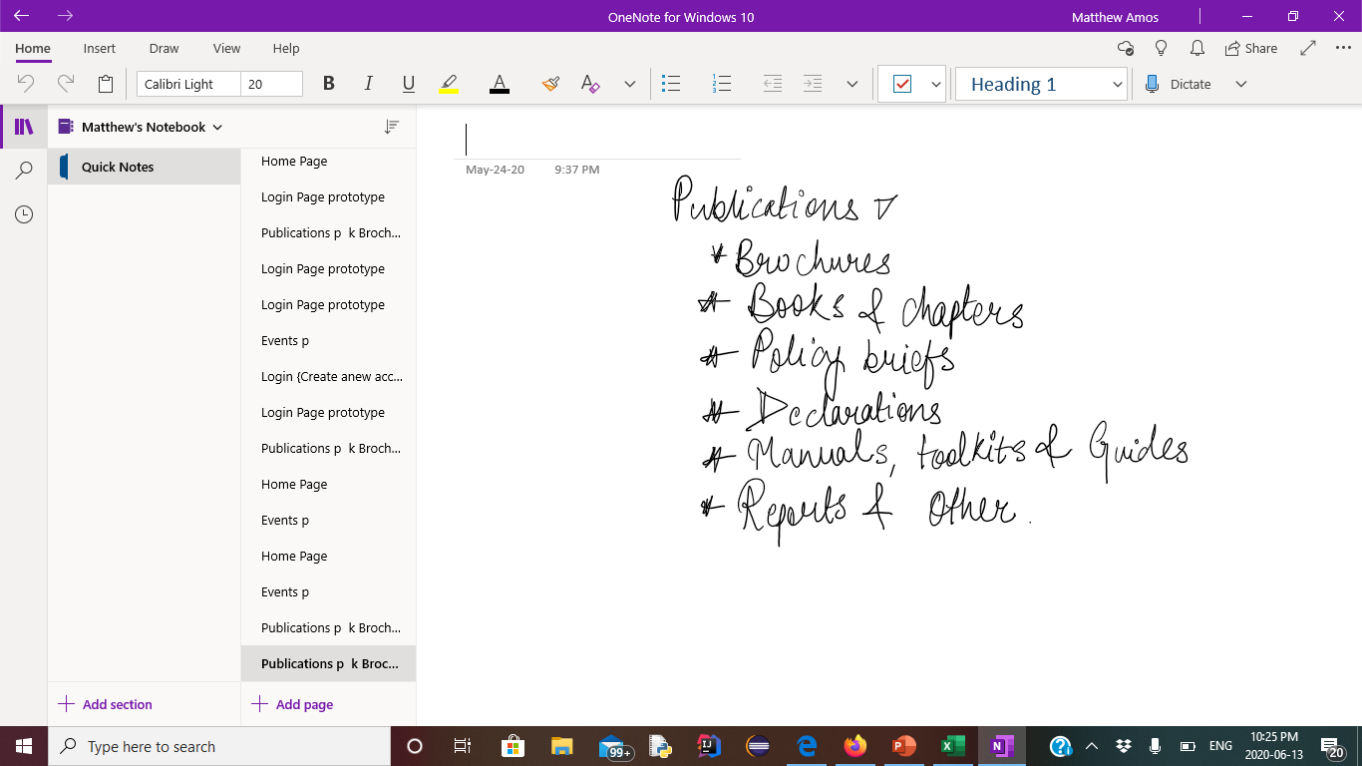
Publication- Low Fidelity Mapping

Slide 11
High Fidelity Mapping
Lets go to Adobe XD to see the high fidelity design…

Slide 12
Conclusion
RCE Saskatchewan website can match other world RCE websites when these changes are implemented
RCE Saskatchewan can link to other global RCEs very easily.
Events can be properly planned and communicated to every user
Research works and publications would be easily accessed on the RCE Saskatchewan website

