Slide 1
ENSE 271 FEEDBACKERS
Tolani Oke-Steve
Bilal Alissa
Omar Alabssi

Slide 2


Interactive Based website
To make sure that our north star customer understands the maps proposed appropriately and comprehend its purpose, the interactive approach was applied to the site map.
In order to apply the best mapping for our various site maps, the concept of interface design mappings was applied.
Each site map was made with the goal of showcasing the various features and functionalities of our suggested design.

Slide 3
SITE MAP Interactive Based website
Home page: includes content about the chosen topic as well as a link to the SSCF's "About Us".
Donate button: Provides link to where donations can be made to support the SSCF.
Filter button: Feature for filtering information based area of choice and topic of preference.
Contact us page: Contains company address and a contact form to reduce spam messages.
Services page: Covers the services the SSCF provides and how the SSCF works to accomplish the global goals.

Slide 4

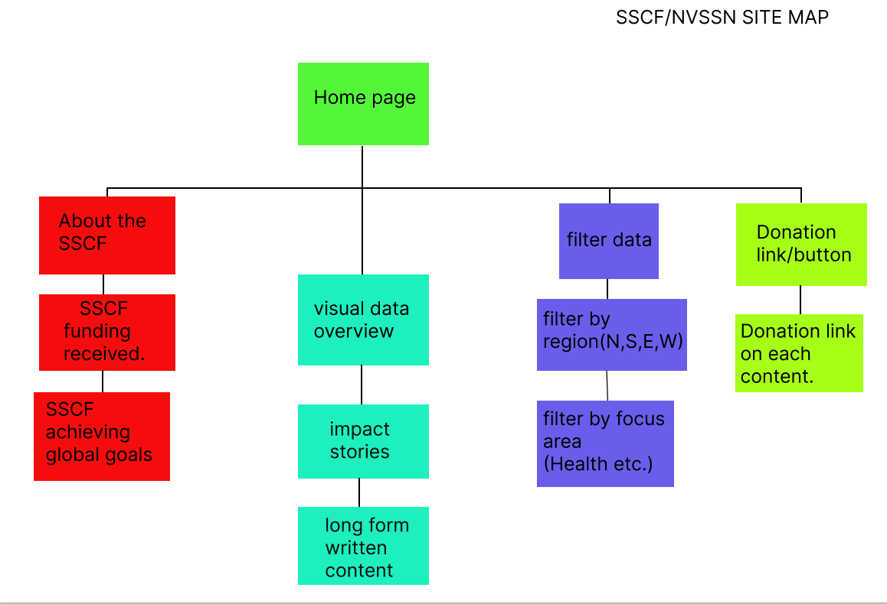


Interactive Based website

Slide 5
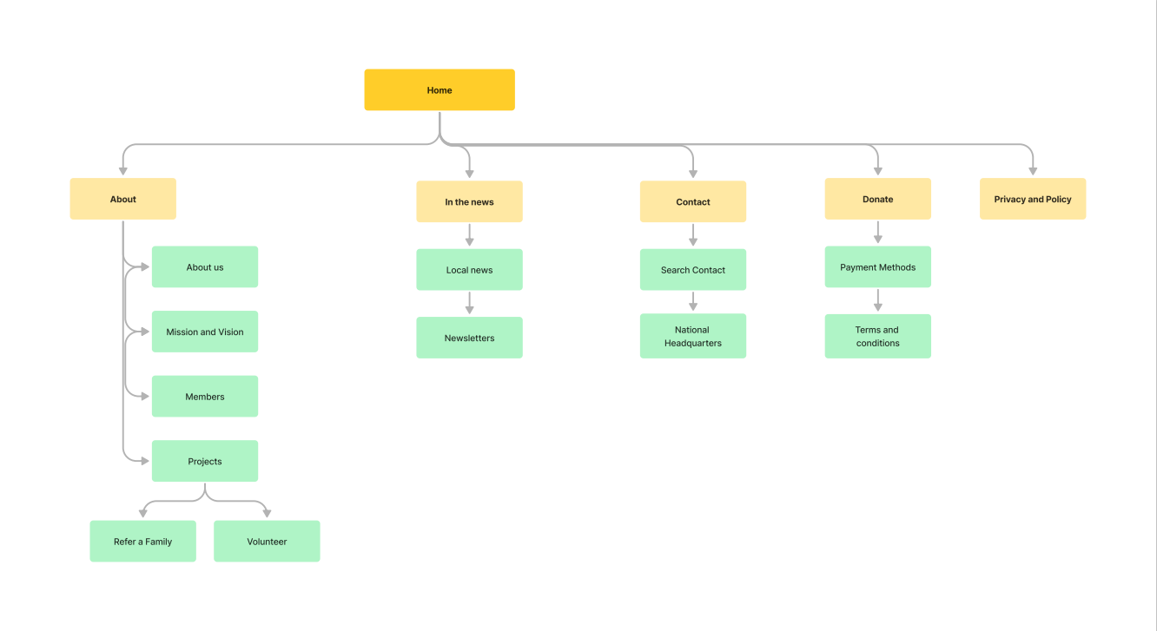
Interactive Based website

Slide 6
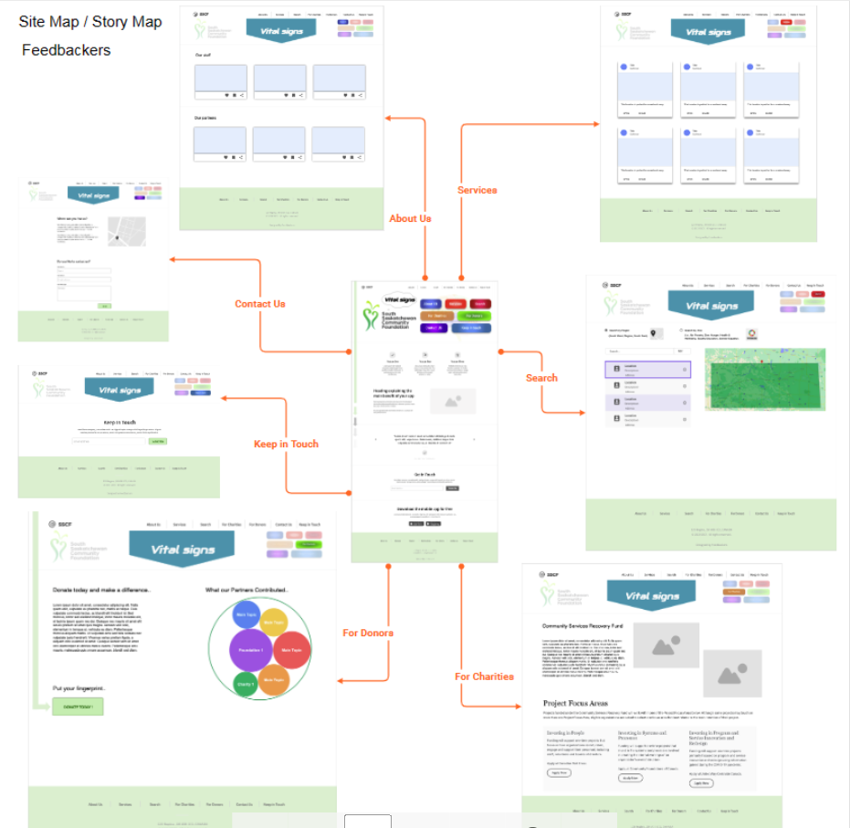
Interactive Based website

Slide 7
Low-fidelity prototypes
Each prototype provides an overview of each of our intended design.
In order to provide the optimal navigation of the design, signifiers are used in every design.
To give users the ideal interactive experience, every design was made with user engagement in mind.
The various prototypes put forth were designed to ensure that the user operations were completed appropriately and effectively.

Slide 8
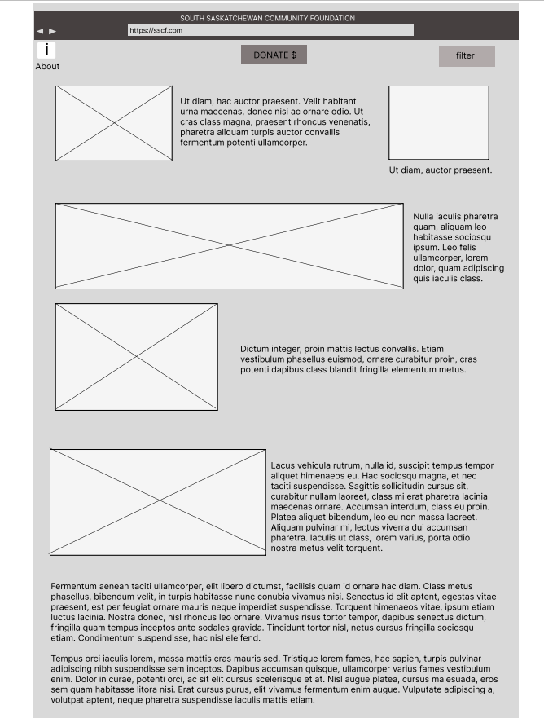
Low-fidelity prototypes

Slide 9
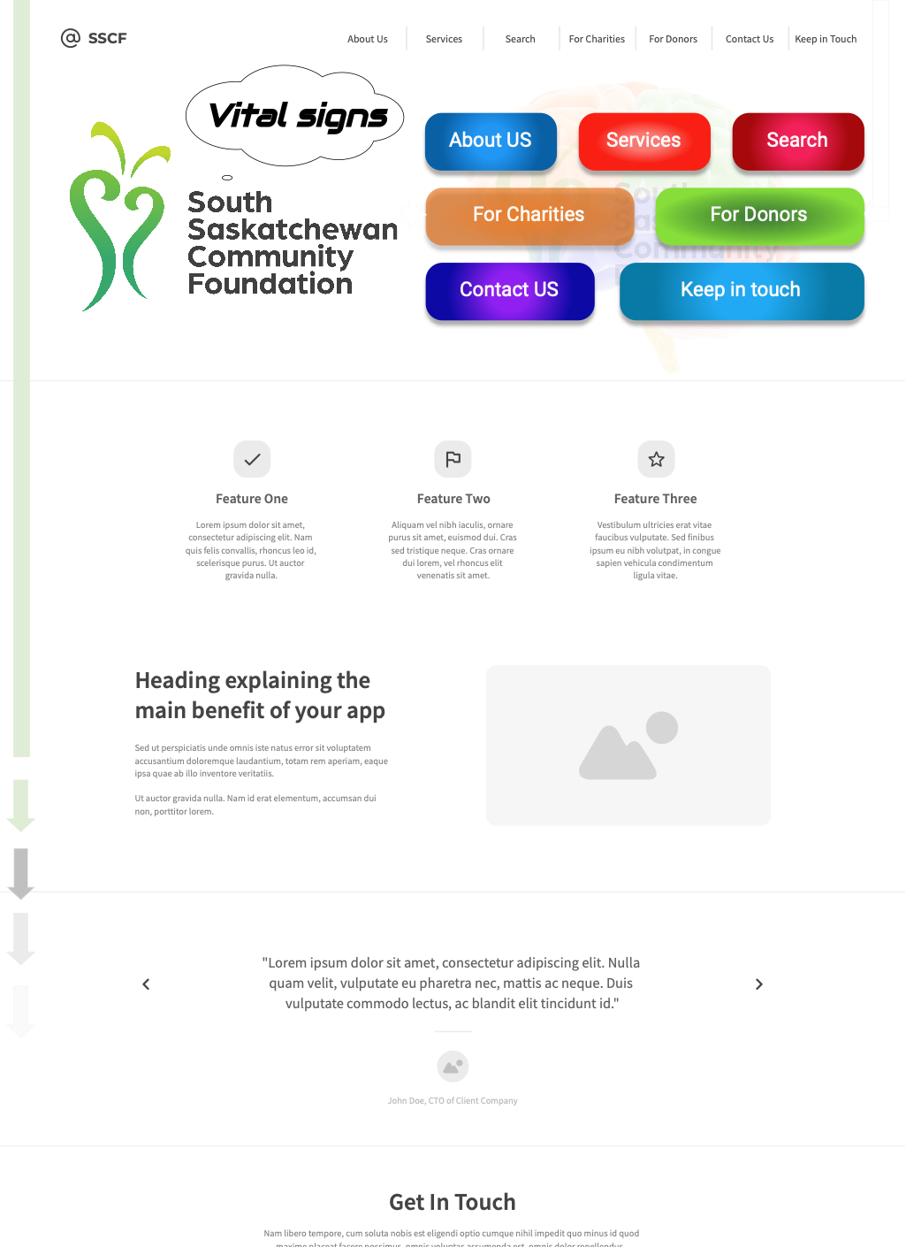
Low-fidelity prototypes

Slide 10
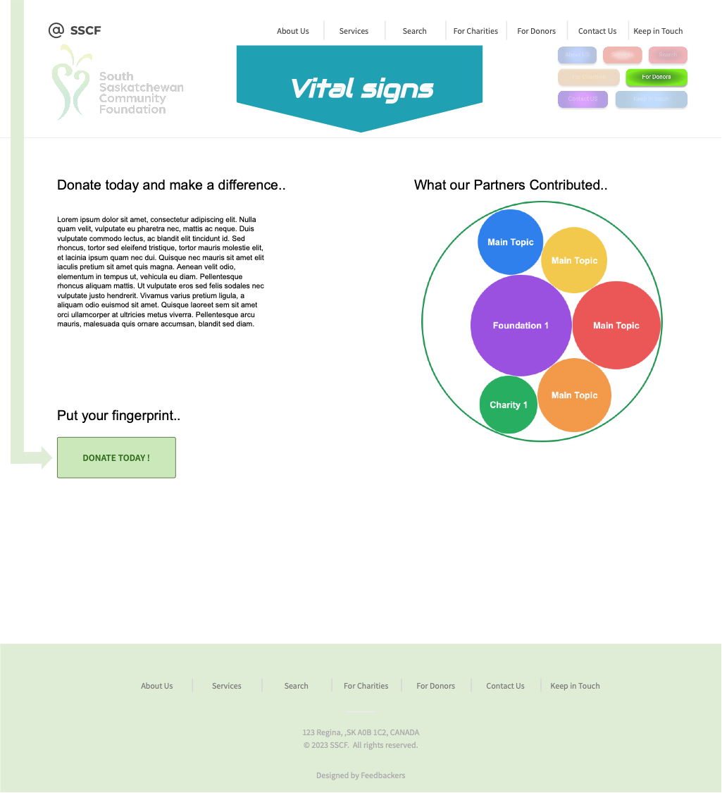
Low-fidelity prototypes

Slide 11
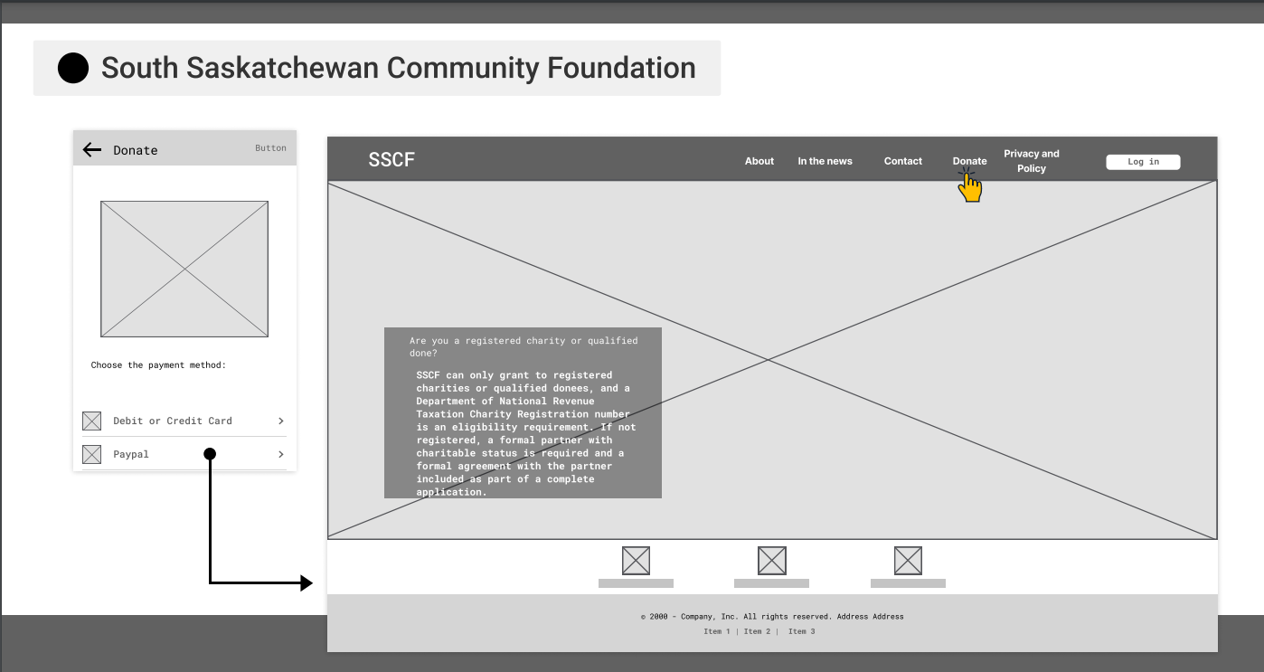
Low-fidelity prototypes

Slide 12
Questions?

Slide 13
Thank you.
FeedBAckers.

