Slide 1

Popularity Prediction of Instagram Posts
Team hodor
Ziad chemali
Josh Posyluzny
Patrick Pickard

Slide 2
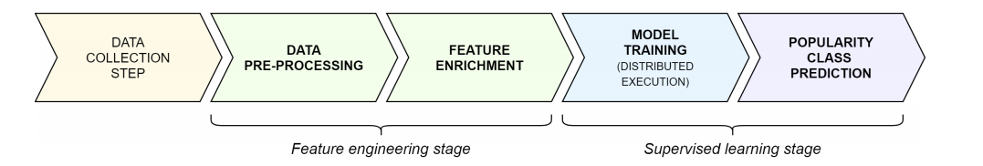
Project process
Notes:
Proposed method , to generate a model that predicts Instagram popularity
Step1: is to collect the data
Step2: Apply feature engineering
Step3: supervised Random forest or Gradient Boosting, Note: Our Target vector is generated based the num of likes compared to Likes moving average per account

Slide 3
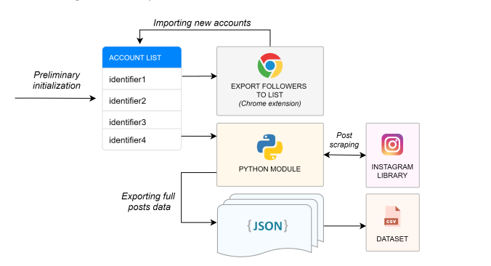
Phase One: Data Collection
Step 1: Collect a preliminary list of Instagram users ( min 100 post and normal accounts )
Step 2: use open-source crawler to extract the posts of the Instagram users without using an API
Step 3: extract result to json file
Notes:
We contacted the authors of the paper and they provided us with the original dataset prior to feature engineering
Extracting 1,000 more rows by following the same steps
First find 20 normal users that have at least 100 posts
Then use the open-source crawler to do post scraping and extract the data
Merge the new data with the original dataset

Slide 4

Phase Two: Feature Engineering
Sentimental score for caption (link)
Number of hashtags used
Number of people tagged in apost
Emoji used
Notes:
Apply feature engineering inorder to boost the performance of the classifiers and to improve the overall accuracy of the approach.
Such as sentimental score for caption, number of hashtags, emojis used, number of tagged people

Slide 5

Phase Three: Model Training
Supervised Learning
Ensemble: Gradient Boosting and Random Forest
Use GridSearch to find optimal hyperparameter
Notes:
Train either RandomForest or Gradient Boosting model
Find the optimal parameter so that we are close to the sweet spot of the validation curve (Note: since size of feature matrex is big then model parameters might not affect accuracy score)
Optional step: make the model available as a client interface or software API

