Slide 1

Popularity Prediction of Instagram Posts
Team hodor
Ziad chemali
Josh Posyluzny
Patrick Pickard

Slide 2
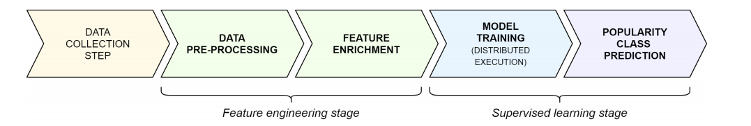
Project process
Notes:
Proposed method , to generate a model that predicts Instagram popularity
Step1: is to collect the data
Step2: Apply feature engineering
Step3: supervised Random forest or Gradient Boosting, Note: Our Target vector is generated based the num of likes compared to Likes moving average per account

Slide 3
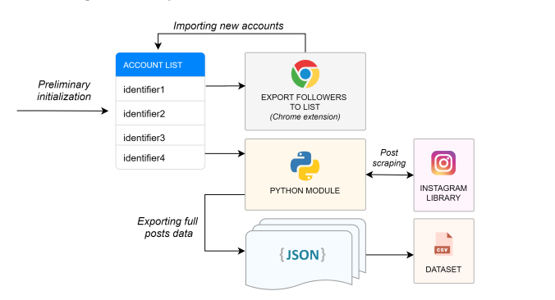
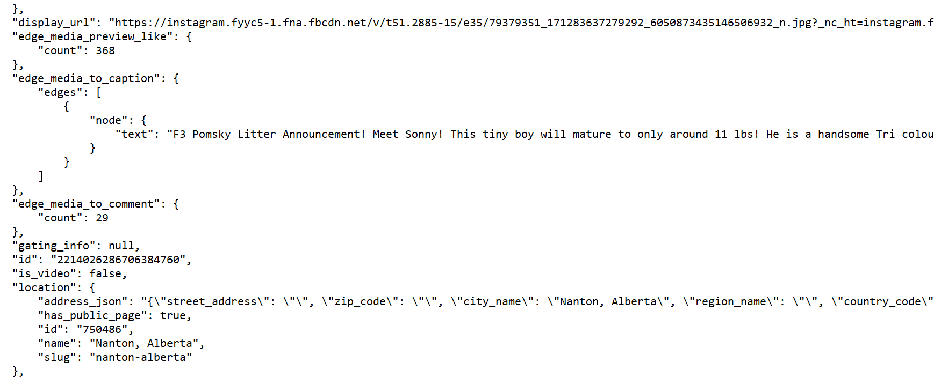
Data Collection
Instagram scraper was used to collect all fields required for dataset extension. (https://github.com/arc298/instagram-scraper)
1000 datapoints were extracted (100 posts per user)
Users had less than 25,000 followers, were public, and had > 100 posts.
JSON files for each post held metadata (only metadata was returned)
Files were parsed for required data

Slide 4
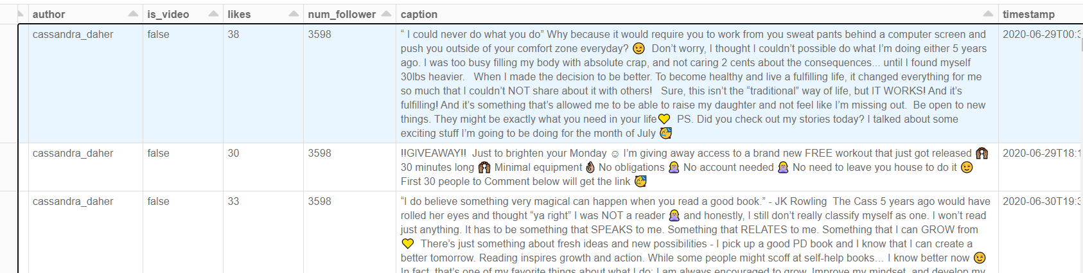





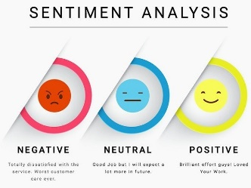

Phase Two: Feature Engineering
Step1: loading JSON to spark DataFrame
Step2: AverageLikes Features
Step3: TimeFeatures
Step4: Number of Likes of Prev Posts up to the 5th recent post from K
Step5: TextRelated Features number of words, number of users tagged, number of hashtags, sentiment score
Step 6: 10 categories of emoji , binary 1 or 0
Step 7: 5 features of most used hashtags 5 features of least used hashtags
Step 8: Target Vectors
Link to Data Frame
Notes:
First step was to load JSON Files into spark Datafram , explode and use SQL query to select fields of user,is_video,num_followe,timestamp
AverageLikes: We used Window to partition by author and rows between (-K,0)
Then create a column that calculates the avg of Like column over the window
TimeFeatures: Since TimeStamp column is of type timestamp we used sql function to extract time,month,day,year from timestamp
Prev Post likes num: Added 5 features that has number of likes of prev post upto the 5th recent one, again we used Window to partition by author
Counting Words: split by space, and remove any hashtags/tagged users/emojis/ stopwords
Hashtag: Use re to filter for # and return a list of the hastag words
Tagged People: Use re to filter for @ and return a list of the tagged users
Sentiment :In the paper they user SentiStrength, however inorder to implemt it in our project we needed the jar file and its not free, instead we chose to use nltk pretrained 'vader_lexicon’ model
Emoji Features: happiness, love, sadness, travel, food, pet, angry, music, party and sport
First :we created a list of all emojis that relate to each feature example smile emoji is included in happy list
Second: Find if each caption has any of the emojis in the lists
Hashtags features:
Step1:Use rdd to transform caption text to list of hastags
The use flatMap and reduceByKey to create a frequency for each hastag used
Sort and extract the most/least used hashtags
Step2: Check each caption again if it contains any of the 5most/least hashtags
Target Vectors are binary popular or nit based on the eqn in paper:
Also they used different combinations of K and delta to calculate the target vector
We have 12 possible target vectors which we have to create a machine leaning model for each
The extracted data had 7 columns after doing feature engineering the final datafram contained 58 columns

Slide 5
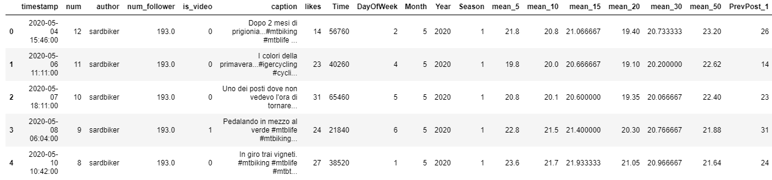
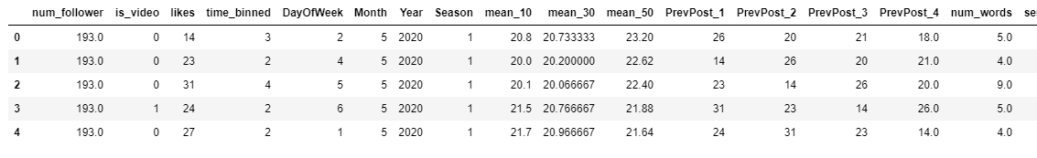
Phase Three: Model Training
Total Dataframe:
Data: bin the Time column, encode the is_video and Season columns, drop extraneous columns to form Feature Matrices
Feature Matrices:
Notes:
Todo: Josh

Slide 6
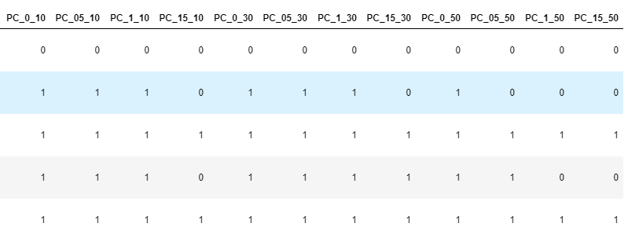
Phase Three: Model Training
Target Vectors
Vectors: Column titles are in the format of PC_X_Y, where X is the delta value, and Y is the amount of previous posts taken into account
Each feature matrix has 4 target vectors

Slide 7
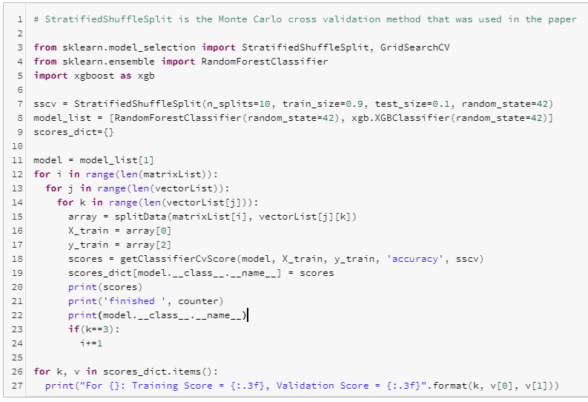
Phase Three: Model Training
Models: XGBoost and Random Forest Models
Run basic Monte Carlo cross-validation to find baseline scores
Use GridSearch to find optimal hyperparameters for each model and optimize

