Slide 1
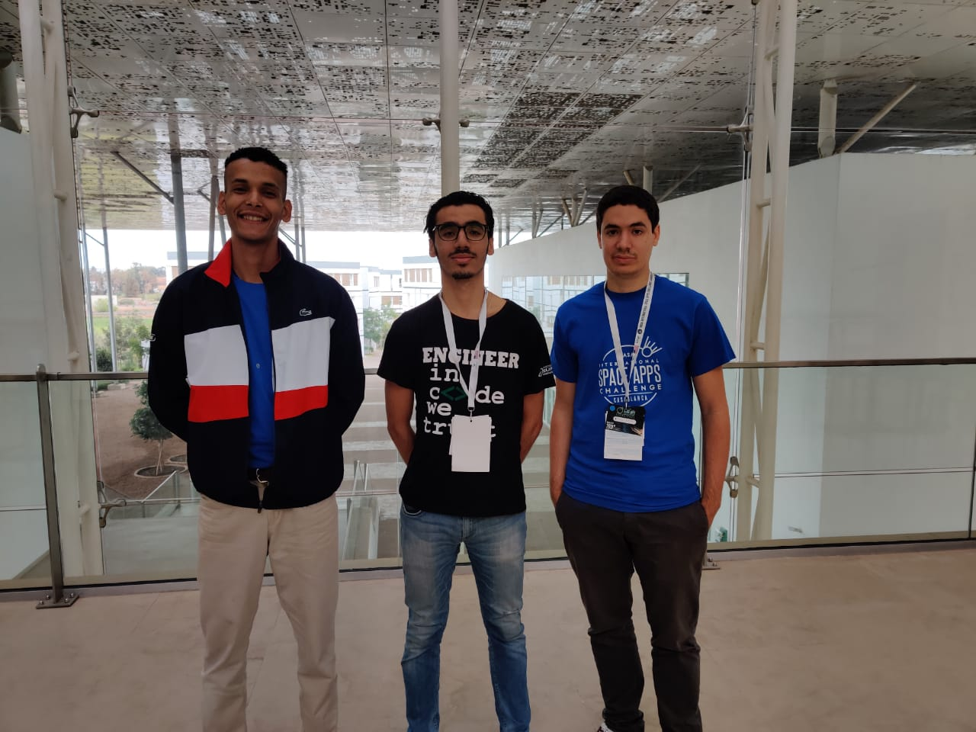



“When in doubt, hold your altitude; nobody ever collided with the sky.”

Slide 2

Challenge
Aircraft with no wires !!

Slide 3




Problems
Weight
Failures
Cost
Performance

Slide 4
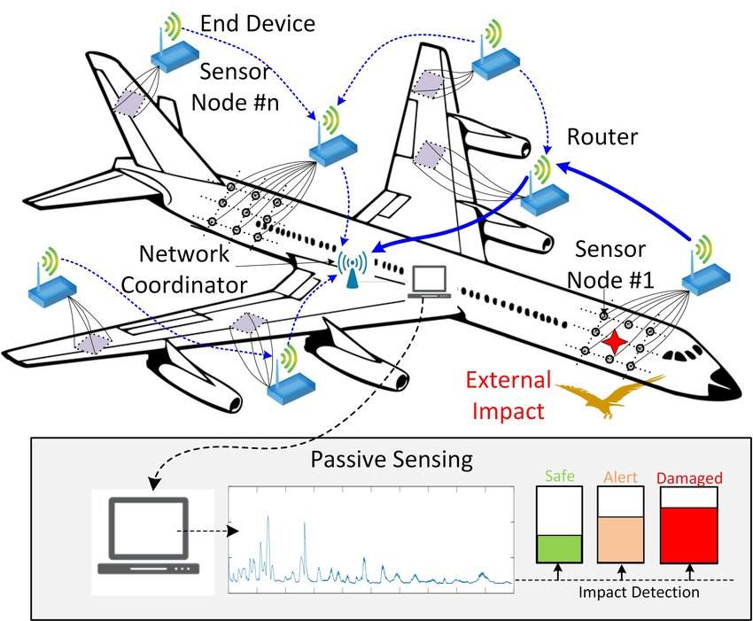
Solution
Concept of a wireless aircraft
Notes:
The connectivity between sensors it’s by PASSIVE WIRELESS (is a refinement of Wi-Fi technology that uses passive reflection to reduce energy consumption)

Slide 5
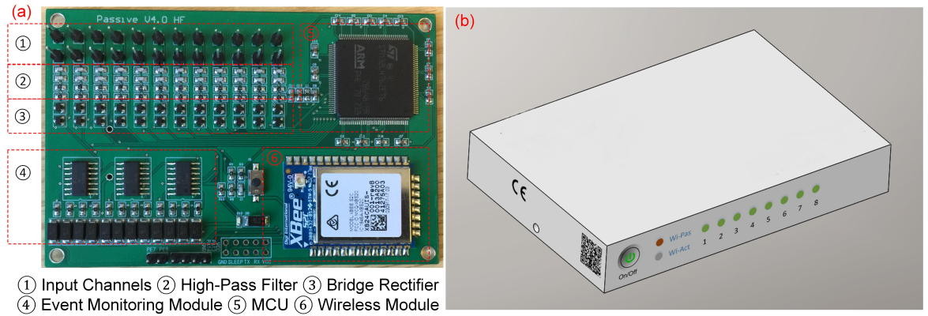
How To ?
Fig (a): Hardware implementation of the wireless sensing system on a printed circuit board .
Fig (b): illustration of the device for practical installation (b).
Notes:
The hardware design is implemented on a printed circuit board with the dimensions of 100 mm× 65 mm

Slide 6

Technological solution
Jeeva Wireless is revolutionizing the way devices communicate. This solution provide Wi-Fi, Bluetooth, and long range connectivity at 10,000x less power than the best solutions currently on the market.
Ressource: https://ntrs.nasa.gov/archive/nasa/casi.ntrs.nasa.gov/20180004760.pdf
Notes:
In searching we found a technological solution recommended by the NASA.

Slide 7
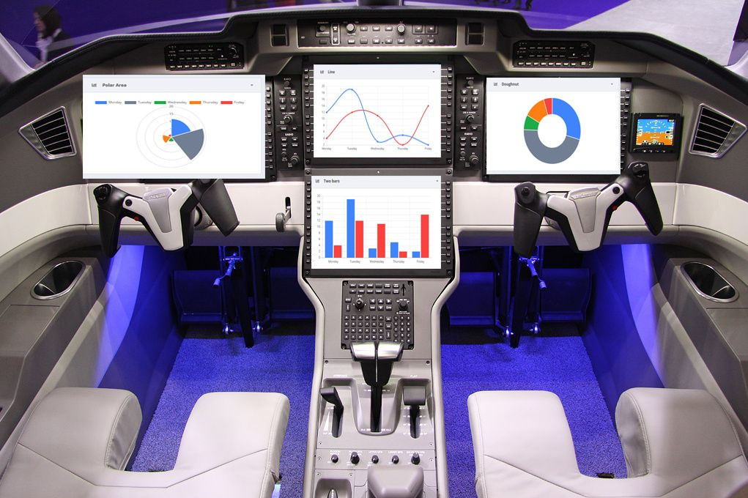
Monitoring display

Slide 8
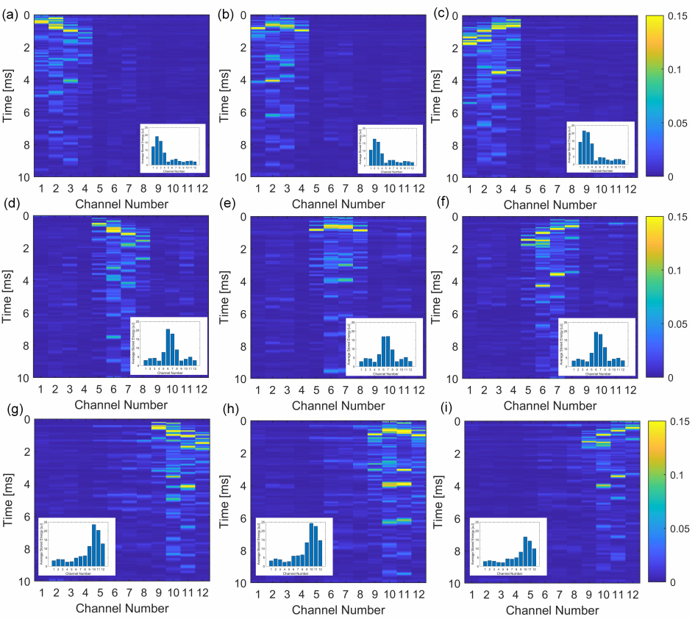
Monitoring display
Instantaneous and average stored energy for different sensors under impacts applied on different locations with the same input energy. The impact location can be identified by the variation of the colour distribution.

Slide 9
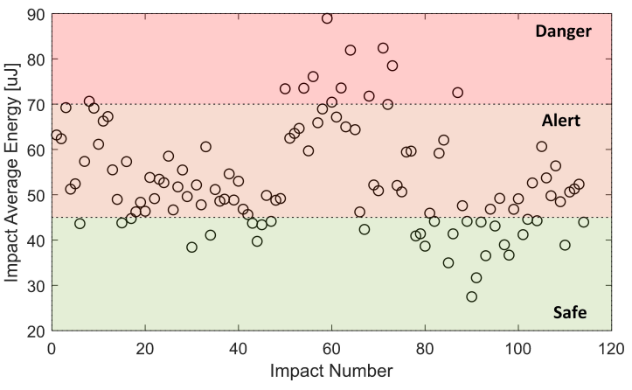
Monitoring display
Results of the classification of impact events based on the recorded impact response.

Slide 10


WHAT ABOUT SECURITY ?

Slide 11




What to consider ?
BANDWIDTH
CYBERSECURITY
SENSORS
AUTONOMY

Slide 12



Solutions
PRIVATE FREQUENCY
WAVE ENCRYPTION
MONITORING
USING LESS POWER (JEEVA)
Notes:
(monitoring : display the state of sensors)

Slide 13
Business Model
Cost
Market value
Sales
Revenue
Notes:
Market value : IoT and digitalisation of objects increase the demand for IoT devices, by 2025 the IoT market will reach 4,9 Billion Dollars
Cost : More Cables means more Cost, aircraft uses approximately 470km length, less IoT Wireless devices
Sales : IoT device market demand is growing
Revenue : More flexibility, more return on investment

Slide 14

Acknowledgement
Thanks for your attention

