Slide 1



We SDG’s:
Wijdane BENANI
Imane LAKBACHI
Zineb ESSAKHI
Siham CHETOUANI
Youssef MOUHAMADIN

Slide 2
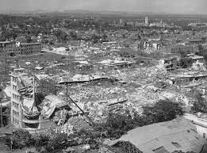
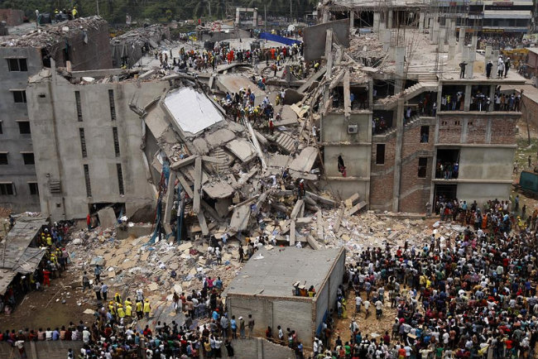

Slide 3


Slide 4
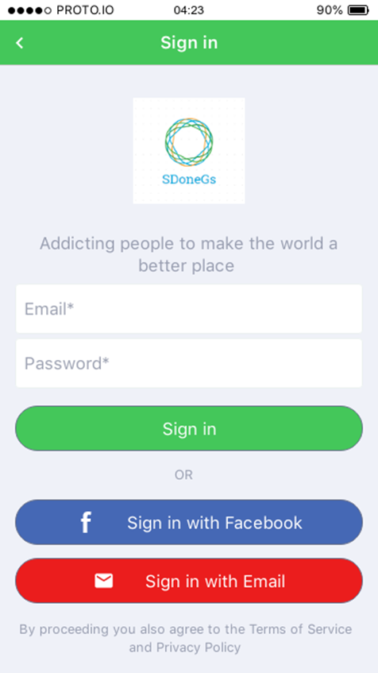
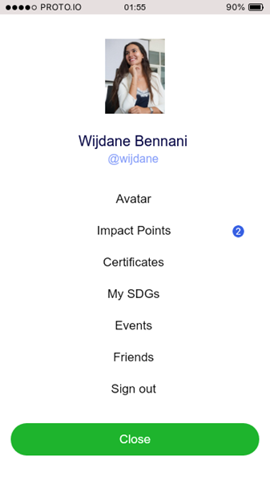


Slide 5
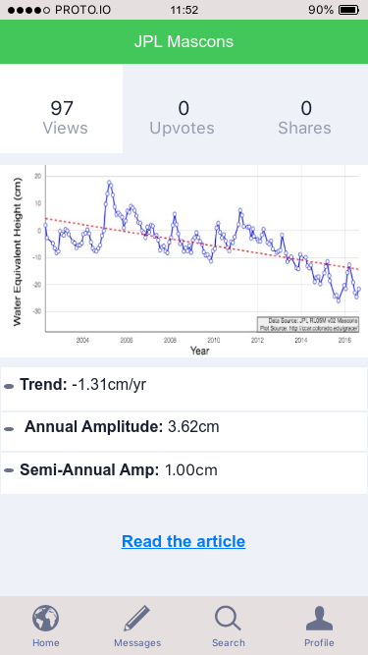
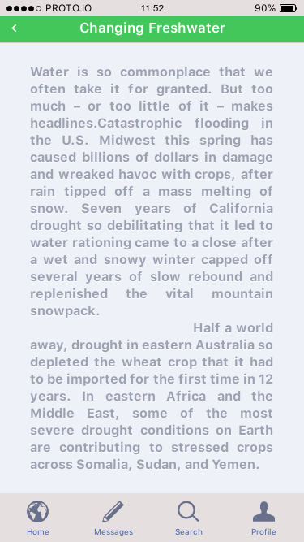

Slide 6



Slide 7
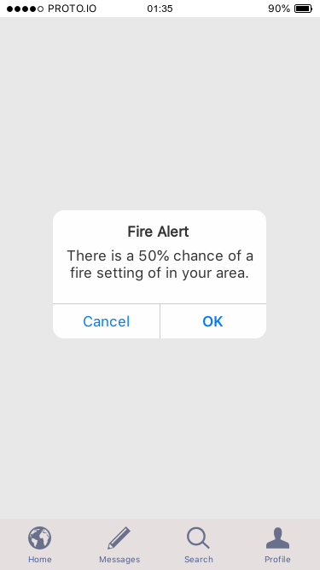
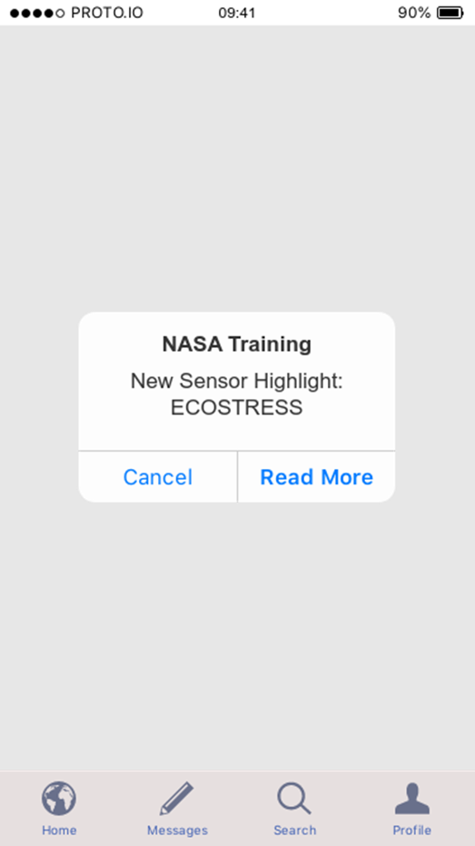

Slide 8

Localisation DATA

Slide 9
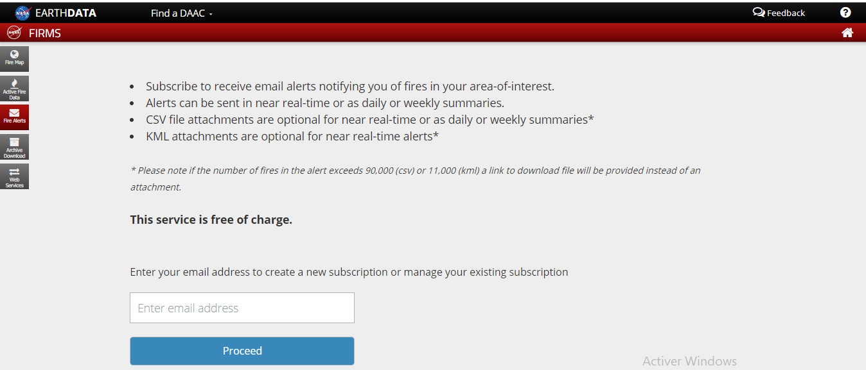
NASA’s fire information for resource management system (FIRMS) « fire alerts »

Slide 10
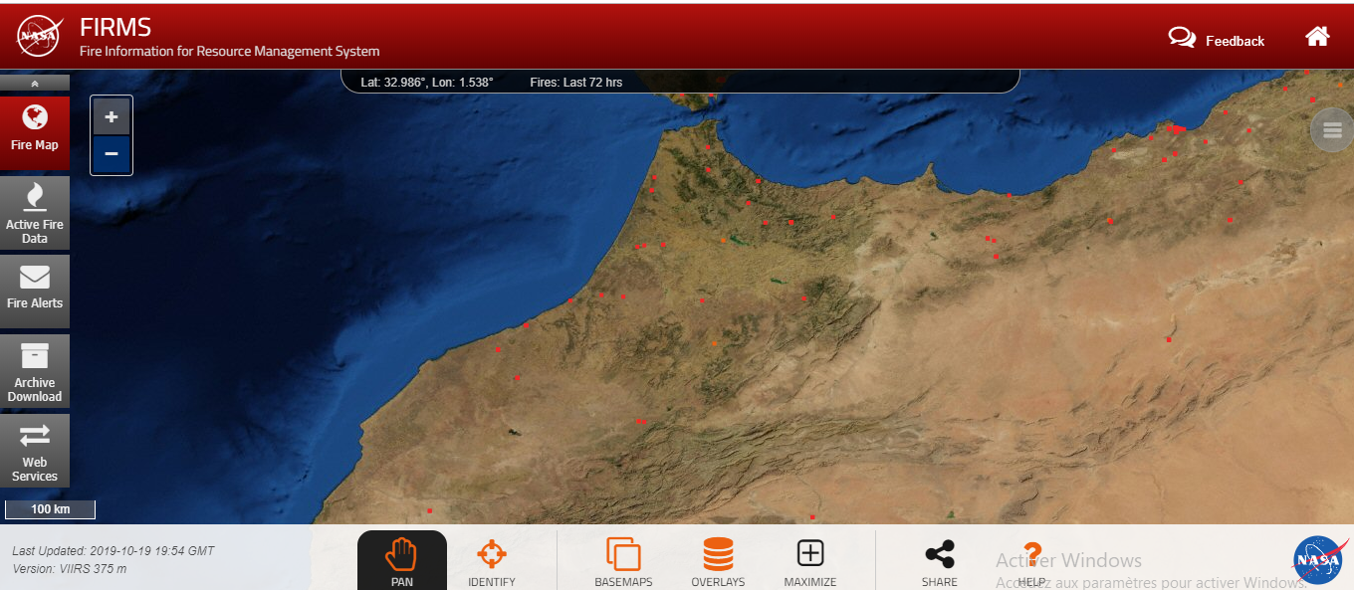
NASA’s fire information for resource management system(FIRMS) (NASA’s fire map)

Slide 11

Fire Location

Slide 12
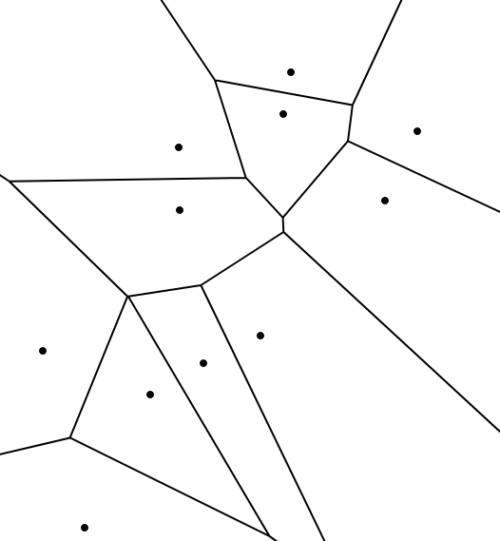
Voronoi diagram

Slide 13
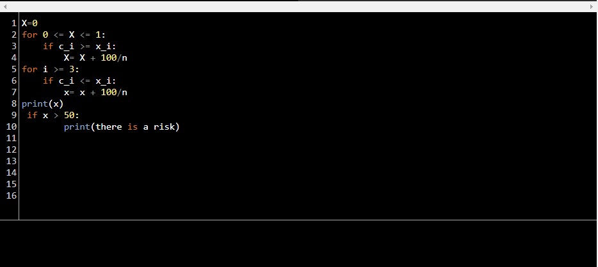
Algorithm
C0 = wind speed C1= Temperature C2= Humidity x0 = 50 x1= 40 x2= 40

Slide 14
Thank you for your attention!

