Slide 1
Penguins – ML-Agents
Àlex Weiland Lottner
ENTI (UB)
Dispositius d’E/S
alexweilandlottner@enti.cat

Slide 2
Introduction
Train penguins to feed their babies by picking up fish
Add killer whales into their hábitat
Train them to avoid those killer whales
Compare performance

Slide 3
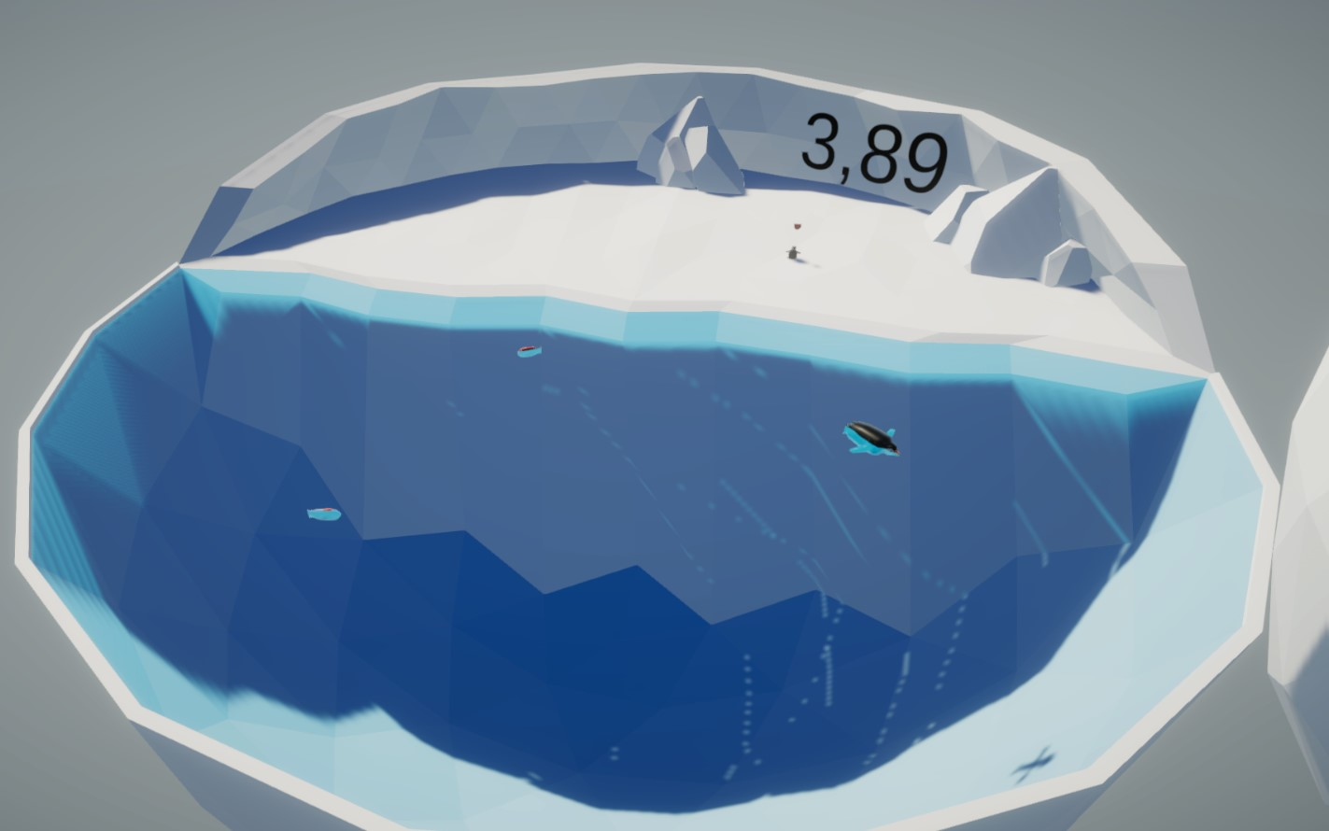
The penguin’s habitat
Current Reward
Baby
Penguin
Fish

Slide 4
The penguin agent
Actions
Move forward / stand still
Turn left / Straight forward / Turn right
Observations
Has fish in its belly?
Distance to it’s baby
Direction to it’s baby
Direction in which the penguin’s facing
Perception
Using Sphere casts
Detects objects with tag:
Baby
Fish
Untagged
Rewards
+1 -> Eating a fish
+1 -> Regurgitating fish

Slide 5
The penguin agent
Curriculum
Measure: by reward
Thresholds to switch lessons:
-0.1, 0.7, 1.7, 1.7, 1.7, 2.7, 2.7
Minimum length of lesson: 80
Signal smothing is enabled
Parameters:
Fish Speed: 0.0, 0.0, 0.0, 0.0, 0.0, 0.0, 0.5, 0.5
Feed Radius: 6.0, 5.0, 4.0, 3.0, 2.0, 1.0, 0.5, 0.2

Slide 6
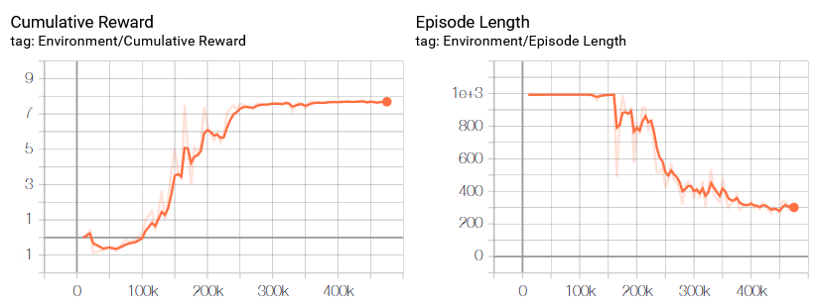
Performance

Slide 7
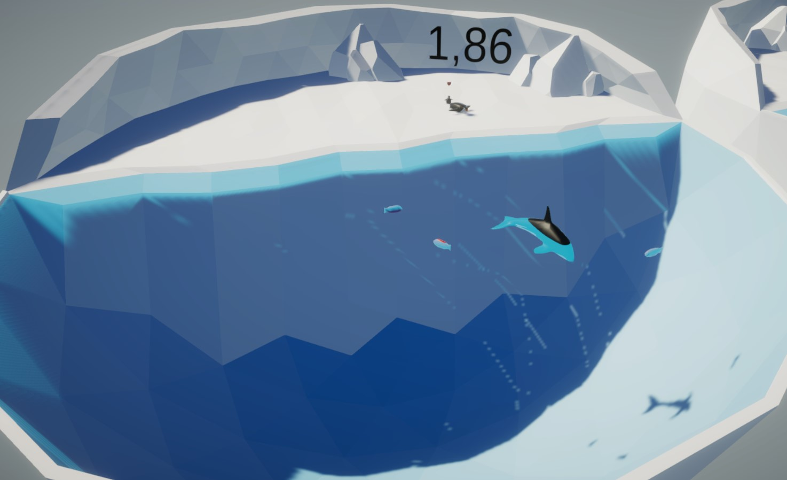
Danger approaches!
Killer whale
(a.k.a. Orca)

Slide 8
Updated Agent
Perception
Now additionally detects objects tagged “Orca”
Rewards
-3 -> Toucing a killer whale
Curriculum
New parameter:
Orca Speed: 0.0, 0.0, 0.0, 0.2, 0.3, 0.6, 1.2, 2.4

Slide 9
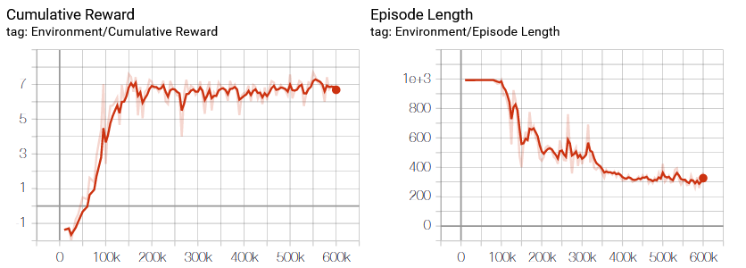
Updated performance

Slide 10
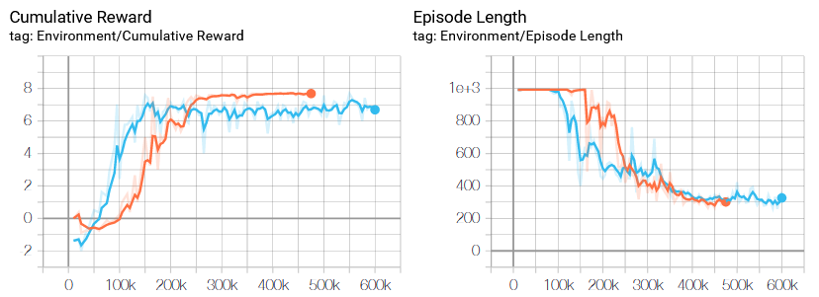
Comparison

Slide 11
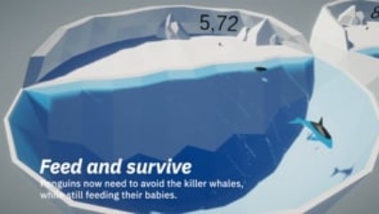
Video

Slide 12
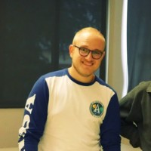
Thank you very much!
Àlex Weiland Lottner
alexweilandlottner@enti.cat

