Slide 1





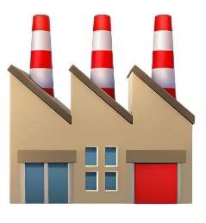


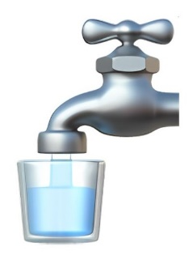

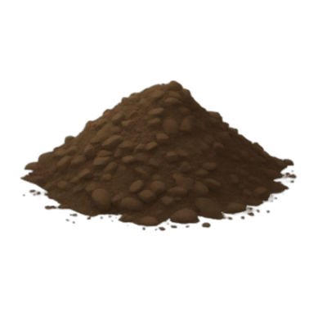

















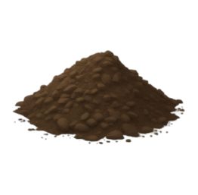

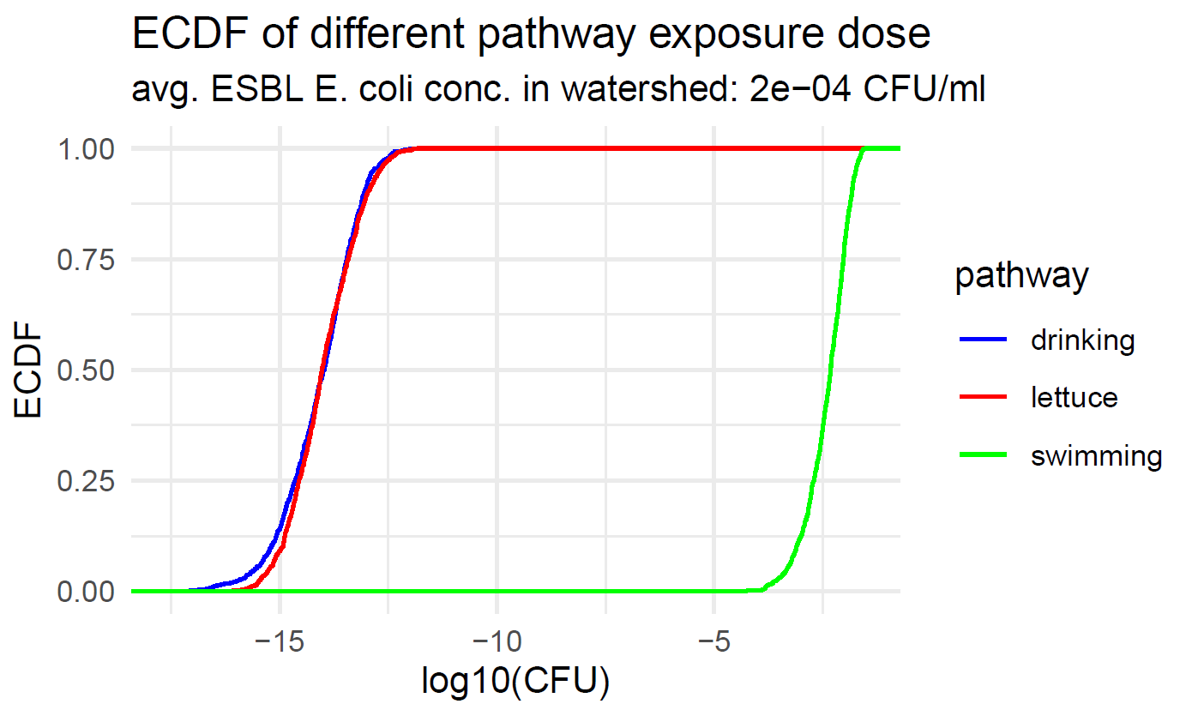





QMRA model to assess the human exposure to ESBL E. coli from poultry production through different environmental pathways
Subhasish Basak1, Nunzio Sarnino2, Roswitha Merle2, Lucie Collineau1 1. ANSES – Laboratoire de Lyon, France 2. Freie Universität Berlin, Germany
CONTEXT
PROJECT ENVIRE
CONSORTIUM AND FUNDING
Project duration: 2022-2025
Germany, France, Lithuania, Poland, Tunisia
Funded by the European Transnational Programme - JPIAMR-ACTION
OBJECTIVES
Reduce antimicrobial-resistant (AMR) bacteria spread from broiler chickens
Investigate the potential of various on-farm intervention measures
Reduce transmission and human exposure to ESBL E. coli from broiler chicken
WORKFLOW – WP 3
Quantitative Risk Assessment with pathways:
Incorporate on-farm intervention measures
FOOD-BORNE
ENVIRONMENTAL
OCCUPATIONAL
MATERIALS & METHODS ENVIRONMENTAL PATHWAYS
Fresh harvest
Drinking Water Treatment Plant
H
U
M
A
N
E
X
P
O
S
U
R
E
Farm
Decay
Watershed
Bathing site
Ground water
Decay
Agricultural
irrigation
WATERSHED CONTAMINATION
TRANSMISSION PATHWAYS
DYNAMICS of ESBL E. coli in environment
Poultry manure is used in agricultural lands
Surface runoff carries ESBL E. coli to nearby watershed
Watershed is contaminated from manure c.f. Sowah et al. (2020)
NO evidence: soil to fresh harvest contamination
NO evidence: soil to ground water contamination
Dynamics of ESBL E. coli in contaminated watershed Mancini (1978)
Decay in ESBL E. coli population due to environmental factors
Decay rate k := f ( temperature, radiation, salinity, light extinction, water depth )
Final E. coli concentration is based on time elasped before water usage
DYNAMICS of ESBL E. coli in manure soil watershed
Bacteria decay in soil Merchant et al. (2012), Phang et al. (2020)
Bacteria transport from soil to watershed Neitsch et al. (2011)
Work in Progress: Anaerobic digestion of poultry manure
Transmission pathways:
c.f. O’Flaherty et al. (2018, 2019)
Drinkng water treatement
Swimming in bathing sites
Agricultural harvest irrigation
Human exposure to ESBL E. coli:
100 ml of tap water consumption
1h of swimming (accidental ingestion)
100 g of fresh lettuce consumption
Probability of human ESBL E. coli carriage
PDR: Dose-response Furusawa et al. (2024)
RESULTS & PERSPECTIVES
Relative impact of different environmental pathways
1000 Monte Carlo simulations estimated the different pathway exposure
Recreational swimming has highest exposure among all 3 pathways
Tap water & lettuce consumption has much less exposure
NB: Soil – watershed dynamics of ESBL E. coli uses Sowah et al. (2020) Based on a simplified version of Neitsch et al. (2011) SWAT model
QRA module perspectives
Validation: Compare to existing literature O’Flaherty et al. (2018, 2019)
Robustness: Application of a SWAT model for user defined geography
Future work: Integration of anaerobic digestion experimental data
subhasish.basak@anses.fr
www.envire-project.de

