Slide 1


Environmental module
draft
Nunzio SARNINO and Subhasish BASAK
Lucie COLLINEAU

Slide 2
General framework

Slide 3
Computation of risk
Quantity of interest : For a particular broiler flock raised at a farm characterized by production parameters Ɵfarm, we want to estimate the risk or the probability of getting ESBL E. coli carriership for a human being exposed through one of the environmental subpathways that are treated with contaminated poultry manure coming form that farm.
Recreational swimming
Surface water
Manure
Human exposure
Soil
Fresh produce
Ground water
Tap water

Slide 4
Computation of risk
Quantity of interest : For a particular broiler flock raised at a farm characterized by production parameters Ɵfarm, we want to estimate the risk or the probability of getting ESBL E. coli carriership for a human being exposed through one of the environmental subpathways that are treated with contaminated poultry manure coming form that farm.
1
Recreational swimming
Surface water
SWAT
2
Manure
Human exposure
Soil
Fresh produce
3
Ground water
Tap water

Slide 5
Framework
Module assumptions:
The manure is applied once to the agricultural field, that eventually contaminates the surface water (lake)
The concentration of ESBL E. coli in the watershed is estimated using a SWAT model
Cmanure (in CFU/g) → Cinit (in CFU/ml)
Recreational swimming
Cmanure
Cinit
Manure
SWAT
Human exposure
Surface water
Fresh produce
Tap water

Slide 6
Framework
Module assumptions:
The manure is applied once to the agricultural field, that eventually contaminates the surface water (lake)
The concentration of ESBL E. coli in the watershed is estimated using a SWAT model
SWAT model for a particular geographical region :
Identifies the waterbody and the adjacent agricultural land
Uses the data:
Digital Elevation Model (DEM) : A 3D representation of the land providing a digital approximation of the Earth's topography
Land Use and Land Cover (LULC) data : Types of land use (e.g., agriculture, urban) and the physical surface cover (e.g., forests, grasslands)
Soil Data : Texture, depth, and hydraulic properties
Weather Data : Historical data (precipitation, temp., wind speed, humidity etc.)
Manure Application Data : Timings, protocols and methods
Water Quality Data
The SWAT model initializes
DEMs to define the waterbodies of interests and sub-basins
Next Hydrological Response Units (HRUs) needs to be define that combine land use, soil type, and slope classes for each sub-basin
Then the model is fed with the climate and environmental data

Slide 7
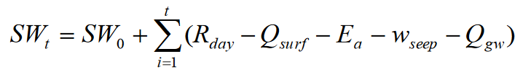
Bacteria transportation from soil to watershed Neitsch et al. (2011)
2:3.1 SOIL STRUCTURE
Soil is comprised of three phases—solid, liquid and gas. The solid phase consists of minerals and/or organic matter that forms the matrix or skeleton of the soil. Between the solid particles, soil pores are formed that hold the liquid and gas phases. The soil solution may fill the soil pores completely (saturated) or partially (unsaturated).
0.2.1 The hydrologic cycle as simulated by SWAT is based on the water balance equation
SURFACE RUNOFF (Q_surf)
Surface runoff, or overland flow, is flow that occurs along a sloping surface. Using daily or subdaily rainfall amounts, SWAT simulates surface runoff volumes and peak runoff rates for each HRU. SURFACE RUNOFF VOLUME is computed using a modification of the SCS curve number method (USDA Soil Conservation Service, 1972) .
4:4.1.2 bacteria (from soil solution) transported in surface runoff 4:4.2.2 bacteria (attached to sediments) transported in surface runoff 4:4.3 In large subbasins with a time of concentration greater than 1 day, only a portion of the surface runoff will reach the main channel on the day it is generated. The time of concentration (Tc) refers to the time it takes for water to travel from the most distant point in a HRU to watershed.

Slide 8
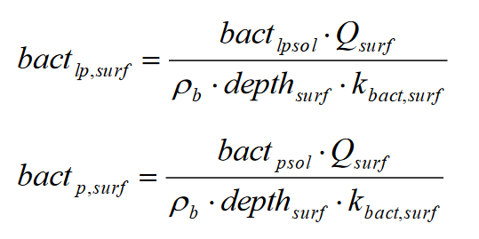
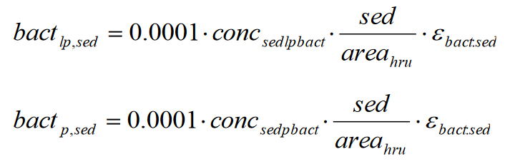
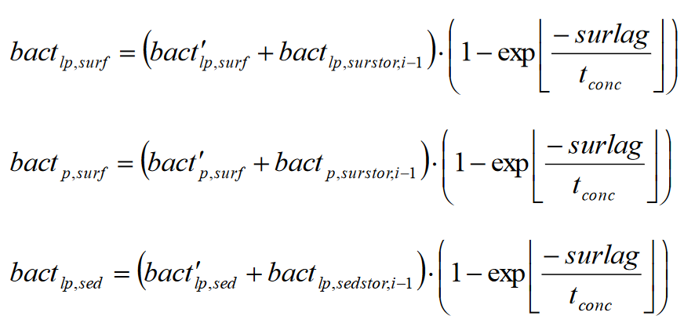
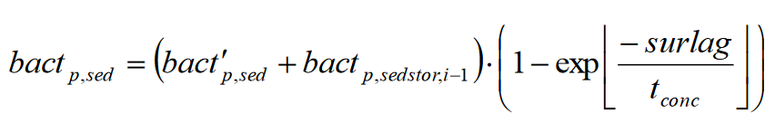
Bacteria transportation from soil to watershed Neitsch et al. (2011)
bacteria present in soil solution (CFU/m3)
surface runoff (mm)
soil partitioning coefficient (m3/Mg)
bacteria (from soil solution) transported in surface runoff
bacteria (attached to sediments) transported in surface runoff
amount of bacteria released in watershed

Slide 9
Bacteria transportation from soil to watershed Neitsch et al. (2011)
bacteria (from soil solution) transported in surface runoff
bacteria (attached to sediments) transported in surface runoff
amount of bacteria released in watershed

Slide 10
Bacteria transportation from soil to watershed Neitsch et al. (2011)
bacteria (from soil solution) transported in surface runoff
bacteria (attached to sediments) transported in surface runoff
amount of bacteria released in watershed

Slide 11
Environmental decay
Following O’Flaherty et al. (2019) the ESBL E. coli decays in the water and the decay rate depends on environmental parameters.
Mancini’s equation is used to compute the decay rate k
For each submodule the conc. Cwater(d) (in CFU/ml) is computed at timepoint d (in days) when the water is used
Cwater(d) = Cinit . exp(-kd)
Recreational swimming
Cdecay(dswim)
Cmanure
Cinit
Cdecay(dharvest)
Manure
SWAT
Human exposure
Surface water
Fresh produce
Cdecay(dDWTP)
Tap water
dharvest = 1, 2, …, nharvest days (nharvest = 14)
dswim = time between contamination and swimming ?
dDWTP = time to reach DWTP ~ 1-10 mins

Slide 12
Tap water consumption

Slide 13
Drinking Water Treatement Plant
Following O’Flaherty et al. (2018) different DWT protocols are implemented
After treatement concentation CDWTP is estimated for each protocol
Cwater (in CFU/ml) → CDWTP (in CFU/ml)
Cmanure
Cinit
Cdecay(dDWTP)
CDWTP
CDWTP x Wconsum
Manure
SWAT
Decay
Surface water
DWTP
Human exposure (in CFU)

Slide 14
Recreational swimming

Slide 15
Accidental ingestion while swimming
Following O’Flaherty et al. (2019)
Concentation Cbath is estimated for bathing area
Cwater (in CFU/ml) → Cbath (in CFU/ml)
Wingest for an hour of swimming
Cmanure
Cinit
Cdecay(dswim)
Cbath
Cbath x Wingest
Manure
SWAT
Decay
Surface water
Bathing site
Human exposure (in CFU)
Assume worst case scenario with dswim = 0

Slide 16
Consuming lettuce

Slide 17
Contamination of lettuce
Following O’Flaherty et al. (2019)
Irrigation is done daily with water conc. Cwater(dharvest), for dharvest = 1, 2, …, nharvest days (nharvest = 14)
Cmanure
Cadhesion(dharvest) in CFU/g
Pdecay(dharvest)
Cinit
Cdecay(dharvest)
Manure
SWAT
Decay
Surface water
Irrigation
Decay
1
1
Irrigation
Clettuce
Decay
Irrigation
2
Decay
2
3
Lettuce
3
Cadhesion(dharvest) = Cdecay(dharvest) x Wattach
Irrigation
Decay
nharvest
nharvest
Pdecay(t) = f . exp(-k1.t) + (1-f) . exp(-k2.t)
Survial proportion on timepoint t McKellar et al. (2014)
Cummulative O’Flaherty et al. (2019) accumulation + decay
Clettuce = Ʃdharvest Cadhesion(dharvest) . Pdecay(nharvest – dharvest + 1)
in CFU/g

Slide 18
Postharvest processing of lettuce
Following O’Flaherty et al. (2019)
Clettuce
Clettuce.post
Clettuce.wash
Clettuce.consum x Lconsum
Lettuce
Postharvest treatment
Consumer wasing
Human exposure (in CFU)
Washing with water
Consumption before expiry
De Giusti et al. (2010)
Clettuce.post X (1 - rwash)
rwash ~ Triangular(0.65, 0.99, 0.99)

