Slide 1
Farm module
Structure & Hypotheses

Slide 2
1 — Structure

Slide 3
Quantification of ESBL E.coli in broiler farms
Two hosts for ESBL E.coli
Broiler’s gut
Farm environment

Slide 4
Initial conditions in broiler farms
Two hosts for ESBL E.coli
Broiler’s gut
Farm environment
Positive broiler : 100 CFU
Negative brolier : 0 CFU
Clean farm : 0 CFU

Slide 5
Dynamics of ESBL E.coli in broiler farms
Feces ingestion
Broiler’s gut
Farm environment
Feces excretion

Slide 6
Dynamics of ESBL E.coli in broiler’s gut
Feces ingestion
Broiler’s gut
Farm environment
Growth
Ingestion
excretion
Feces excretion

Slide 7
Dynamics of ESBL E.coli in farm environment
Feces ingestion
Broiler’s gut
Farm environment
Growth
Ingestion
excretion
Decay
Ingestion
excretion
Feces excretion

Slide 8
2 — Model Hypotheses

Slide 9
Proposed Chronology
Hypothesis 1: Due to modeling constraint we propose a Discrete framework
Excretion
Growth
Transmission
Decay

Slide 10
Proposed Chronology
Hypothesis 1: Due to modeling constraint we propose a Discrete framework
Excretion
Growth
Transmission
Decay
Each step is executed once per day!

Slide 11
Two principle variables – INITIALIZES with values from day d
These two variables are UPDATED throughout these steps during one day
Excretion
Growth
Transmission
Decay
C_gut_i_d: total CFU of ESBL E. coli in gut of broiler i on day d
C_env_d: total CFU of ESBL E. coli in farm environment on day d

Slide 12
More variables – FIXED for the day
F_ingest_i_d: total Feces (g) ingested by broiler i on day d
F_gut_i_d := Feces produced (g) by broiler i on day d
F_env_d: total Feces (g) in farm environment on day d
F_env_inf_d: total contaminated Feces (g) in farm environment on day d
Excretion
Growth
Transmission
Decay
C_gut_i_d: total CFU of ESBL E. coli in gut of broiler i on day d
C_env_d: total CFU of ESBL E. coli in farm environment on day d

Slide 13
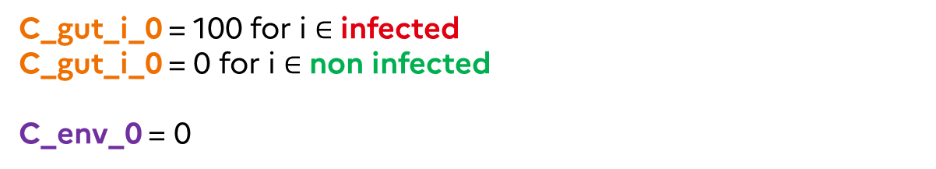
Variables – initial values for day 0
F_ingest_i_0 = 0
F_gut_i_0 = 0
F_env_0 = 0
F_env_inf_0 = 0
Excretion
Growth
Transmission
Decay
C_gut_i_0 = 100 for i $∈$ infected
C_gut_i_0 = 0 for i $∈$ non infected
C_env_0 = 0

Slide 14
2.05 — Fixed variables

Slide 15
Variables – simulated values for day d
F_ingest_i_d is simulated as Becker et al. (2019) for all i for d
F_gut_i_d is simulated using Ross 308 feeding data for all i for d
F_env_0 = 0
F_env_inf_0 = 0
Excretion
Growth
Transmission
Decay
C_gut_i_0 = 100 for i $∈$ infected
C_gut_i_0 = 0 for i $∈$ non infected
C_env_0 = 0

Slide 16
2.1 — Excretion

Slide 17
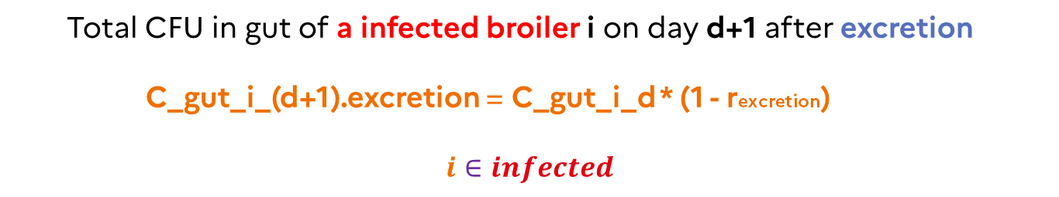
Excretion (in broilers gut)
rexcretion:= Excretion rate = 30% (Becker et al. (2022))
Excretion
Growth
Transmission
Decay
Total CFU in gut of a infected broiler i on day d+1 after excretion
C_gut_i_(d+1).excretion = C_gut_i_d * (1 - rexcretion)
$$ⅈ∈infected$$

Slide 18
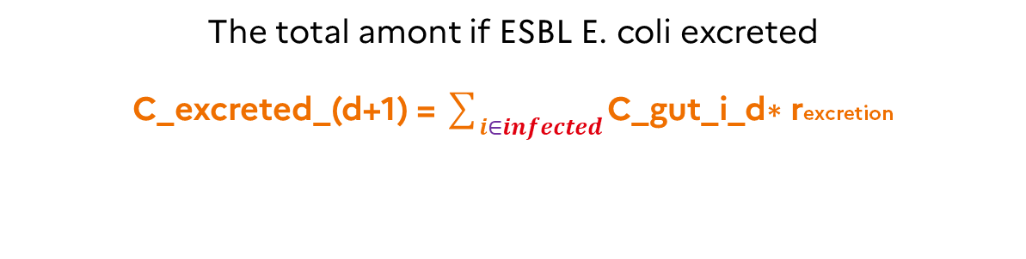
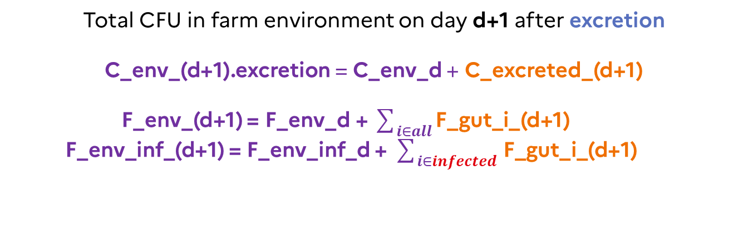
Excretion (in farm environment)
The total amont if ESBL E. coli excreted
C_excreted_(d+1) = $\sum_{ⅈ∈infected}{\text{C}\text{_}\text{gut}\text{_}\text{i}\text{_}\text{d}\text{∗ }\text{r}\text{excretion}}$
Excretion
Growth
Transmission
Decay
Total CFU in farm environment on day d+1 after excretion
C_env_(d+1).excretion = C_env_d + C_excreted_(d+1)
F_env_(d+1) = F_env_d + $\sum_{ⅈ∈all}{\text{F}\text{_}\text{gut}\text{_}\text{i}\text{_(}\text{d}\text{+1)}}$
F_env_inf_(d+1) = F_env_inf_d + $\sum_{ⅈ∈infected }{\text{F}\text{_}\text{gut}\text{_}\text{i}\text{_(}\text{d}\text{+1)}}$

Slide 19
2.2 — Growth

Slide 20
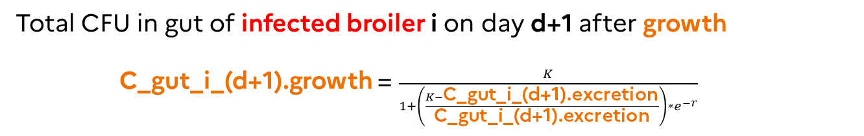
Growth (inside ALL infected broilers gut)
Hypothesis 1: The growth is modeled using a logistic model
Growth rate (r): Uniform(0, 5) log10 CFU (Becker et al. (2022))
Maximum carrying capacity (K): 1e10 * F_gut_i_(d+1)
Excretion
Growth
Transmission
Decay
Total CFU in gut of infected broiler i on day d+1 after growth
C_gut_i_(d+1).growth = $\frac{K}{1+\left(\frac{K−\text{C}\text{_}\text{gut}\text{_}\text{i}\text{_(}\text{d}\text{+1).}\text{excretion}}{\text{C}\text{_}\text{gut}\text{_}\text{i}\text{_(}\text{d}\text{+1).}\text{excretion}}\right)∗e^{−r}}$

Slide 21
Growth (in the farm environment)
No change in ESBL E. coli concentration in farm environment
Excretion
Growth
Transmission
Decay
Total CFU in farm environment on day d+1 after growth
C_env_(d+1).growth = C_env_(d+1).excretion

Slide 22
2.3 — Transmission

Slide 23
Transmission
All broilers ingest some feces F_ingest_i_(d+1)
Ingested feces can be contaminated or non contaminated
Broilers ingesting contaminated feces gets infected
Excretion
Growth
Transmission
Decay
Number of Newly infected broilers (Dame-Korevaar et al (2019))
E(Nnew infected_d+1) = Nsusceptible_d * (1 - exp(-foi_(d+1)))
foi_(d+1) := force of infection on day d+1 depends on
(C_env_(d+1).growth / F_env_inf_(d+1))

Slide 24
Day d+1 – Newly infected broilers gut
Newly infected broilers ingest contaminated feces
Hypothesis 2: Ingested feces amount is not added with gut feces due to small quantity of ingestion (for all broilers)
Excretion
Growth
Transmission
Decay
Total CFU in gut of Newly infected broiler i on day d+1 after transmission
C_gut_i_(d+1).transmission = C_gut_i_(d+1).growth
+ F_ingest_i_(d+1) * (C_env_(d+1).growth / F_env_inf_(d+1))

Slide 25
Day d+1 – Previously infected broilers gut
Hypothesis 3: Some of them might ingest contaminated feces but the ingested quantity of ESBL E.coli is ignored, compared to the quantity of ESBL E.coli already present in their gut.
UNDERESTIMATION of C_gut_i_(d+1).transmission
Excretion
Growth
Transmission
Decay
Total CFU in gut of Previously infected broiler i on day d+1 after transmission
C_gut_i_(d+1).transmission = C_gut_i_(d+1).growth

Slide 26
Day d+1 – Non infected broilers gut
Non infected broilers ingest non contaminated feces
Excretion
Growth
Transmission
Decay
Total CFU in gut of Non infected broiler i on day d+1 after transmission
C_gut_i_(d+1). transmission = C_gut_i_d.growth = 0

Slide 27
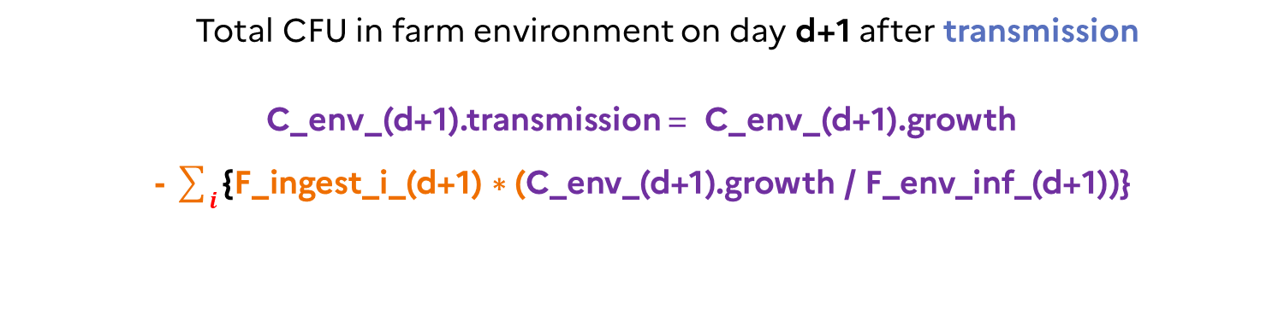
Day d+1 – Farm environment
Hypothesis 3.1: The unknown quantity of ESBL ingested by previously infected broilers is set ZERO. The source of the ingested ESBL by newly infected broilers is distributed according to the ingestion proportion of previously infected broilers
OVERESTIMATION of C_env_(d+1).transmission
Excretion
Growth
Transmission
Decay
Total CFU in farm environment on day d+1 after transmission
C_env_(d+1).transmission = C_env_(d+1).growth
- $\sum_{ⅈ}{\text{\{}\text{F}\text{_}\text{ingest}\text{_}\text{i}\text{_(}\text{d}\text{+1) ∗ (}\text{C}\text{_}\text{env}\text{_(}\text{d}\text{+1).}\text{growth} \text{/ }\text{F}\text{_}\text{env}\text{_}\text{inf}\text{_(}\text{d}\text{+1))\}}}$
Index i over Newly infected broilers

Slide 28
2.4 — Decay

Slide 29
Decay (in broilers gut)
No change in C_gut_i_(d+1) after decay
Excretion
Growth
Transmission
Decay
Total CFU in gut of broiler i on day d+1 after decay
C_gut_i_(d+1).decay = C_gut_i_(d+1).transmission
C_gut_i_(d+1)= C_gut_i_(d+1).decay

Slide 30
Decay (in farm environment)
rdecay:= Decay rate = 50% (Thomas et al. (2019))
Excretion
Growth
Transmission
Decay
Total CFU in farm environment on day d+1 after decay
C_env_(d+1).decay = C_env_(d+1).transmission * (1 - rdecay)
C_env_(d+1) = C_env_(d+1).decay

Slide 31
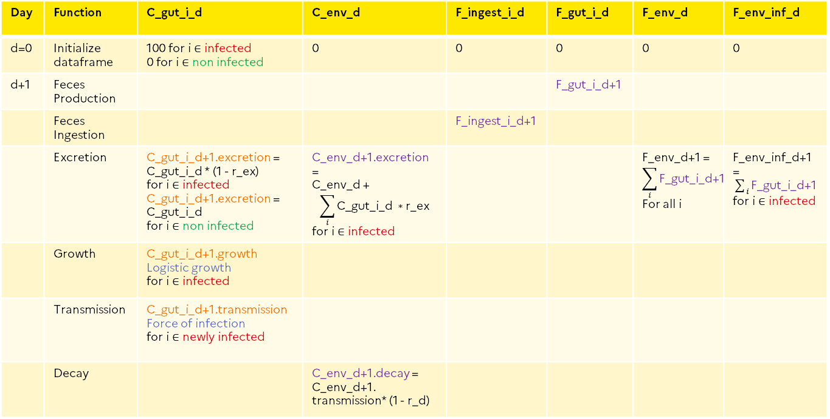
Day | Function | C_gut_i_d | C_env_d | F_ingest_i_d | F_gut_i_d | F_env_d | F_env_inf_d
d=0 | Initialize dataframe | 100 for i $∈$ infected 0 for i $∈$ non infected | 0 | 0 | 0 | 0 | 0
d+1 | Feces Production |  |  |  | F_gut_i_d+1
 | Feces Ingestion |  |  | F_ingest_i_d+1
 | Excretion | C_gut_i_d+1.excretion = C_gut_i_d * (1 - r_ex) for i $∈$ infected C_gut_i_d+1.excretion = C_gut_i_d for i $∈$ non infected | C_env_d+1.excretion = C_env_d + $$\sum_{ⅈ}{\text{C}\text{_}\text{gut}\text{_}\text{i}\text{_}\text{d} ∗\text{r}\text{_}\text{ex}}$$ for i $∈$ infected |  |  | F_env_d+1 = $$\sum_{ⅈ}{\text{F}\text{_}\text{gut}\text{_}\text{i}\text{_}\text{d}\text{+1}}$$ For all i | F_env_inf_d+1 = $\sum_{ⅈ}{\text{F}\text{_}\text{gut}\text{_}\text{i}\text{_}\text{d}\text{+1}}$ for i $∈$ infected
 | Growth | C_gut_i_d+1.growth Logistic growth for i $∈$ infected
 | Transmission | C_gut_i_d+1.transmission Force of infection for i $∈$ newly infected
 | Decay |  | C_env_d+1.decay = C_env_d+1. transmission* (1 - r_d)

