Slide 1

Quantitative assessment of ESBL-producing E. coli contamination, transmission dynamics, and evolution in broiler farms in the presence of on-farm intervention measures.
ModStatSAP Paris 2024
Nunzio SARNINO, Subhasish BASAK, Lucie COLLINEAU, Roswitha MERLE

Slide 2
1 — Context

Slide 3







JPIAMR project ENVIRE
Objective
Reduction of the selection and the spread of antimicrobial resistance (AMR) in broiler chickens and from chicken farms to the environment, and ultimately to humans.
Partners

Slide 4
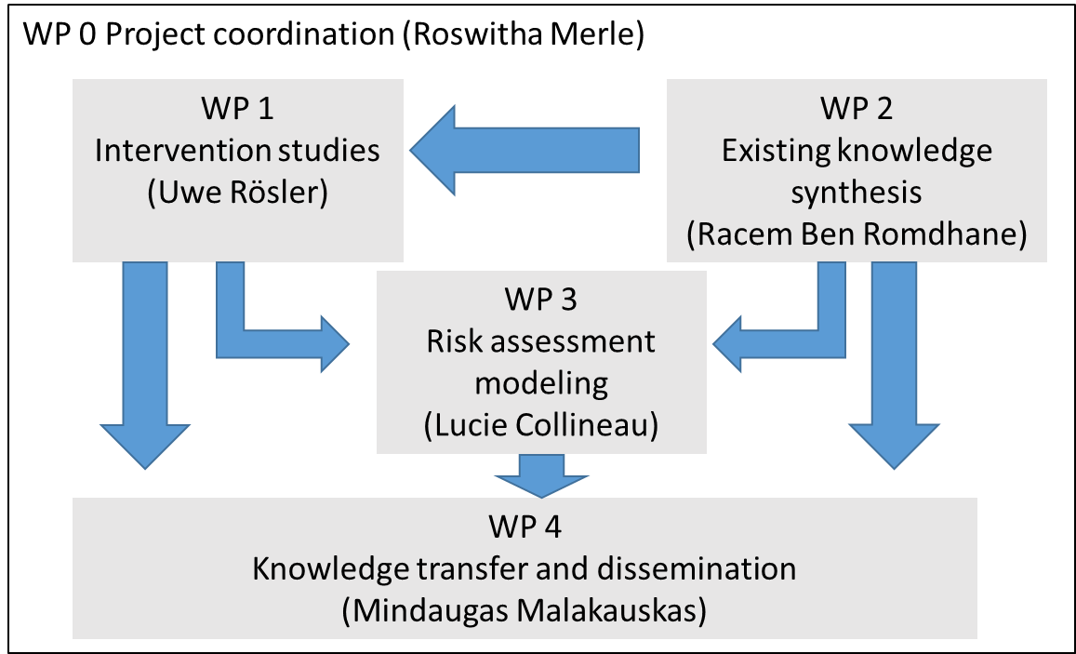
Articulation of Work Packages

Slide 5
ENVIRE WP 3
Partners
ANSES – Laboratoire de Lyon
FU Berlin
Objectives
Quantitative Microbial Risk Assessment of AMR in broiler production
Model foodborne, environmental and occupational pathways
Evaluate effects of different interventions
Resistances considered
Enterobacteriaceae resistant to 3rd- and 4th-generation cephalosporins (ESBL-producing E. coli)
Fluoroquinolones and colistin

Slide 6
Content
QMRA model
Joint work by FU Berlin and ANSES Lyon
Objectives and pathways
Farm module
Module implementation
Functionalities & priliminary results
Interventions
Experiments by WP1 partners
Data integration in QMRA model

Slide 7
1 — QMRA model

Slide 8
What is QMRA?
QMRA - Quantitative Microbial Risk Assessment
Assessing the risk of antibiotic resistance transmission
resistance is transmitted by resistant bacteria
E. coli producing Extended-Spectrum Beta-Lactamases (ESBL)
Broiler chicken human
ESBL E. coli

Slide 9
AMR transmission pathways
Environmental module
Surface water
Recreational exposure
Manure tank
Drinking water
Fresh produce
Fresh produce consumption
Foodborne module
Human exposure
Farm module
Slaughter
Processing
Home preparation
Chicken meat consumption
Interventions
Occupational module
Direct contact
Occupational exposure

Slide 10
2 — Farm module

Slide 11
Quantification of ESBL E. coli in broiler farms
Two hosts for ESBL E. coli
Broiler’s gut
Farm environment

Slide 12
Quantification of ESBL E. coli in broiler farms
Two hosts for ESBL E. coli
Broiler’s gut
Farm environment
Two origins for ESBL E. coli
Initially infected chickens
Flock depopulation (thinning)

Slide 13
Dynamics of ESBL E. coli in broiler farms
Feces ingestion
Broiler’s gut
Farm environment
Feces excretion

Slide 14
Dynamics of ESBL E. coli in farm environment
Feces ingestion
Broiler’s gut
Farm environment
Growth
Ingestion
excretion
Decay
Ingestion
excretion
Feces excretion

Slide 15
Discrete chronological framework
Excretion
Growth
Transmission
Decay

Slide 16
Discrete chronological framework
Each step is executed once per day
UPDATE the variables for each broiler
Excretion
Growth
Transmission
Decay
C_gut_i_d: total CFU of ESBL E. coli in gut of broiler i on day d
C_env_d: total CFU of ESBL E. coli in farm environment on day d

Slide 17
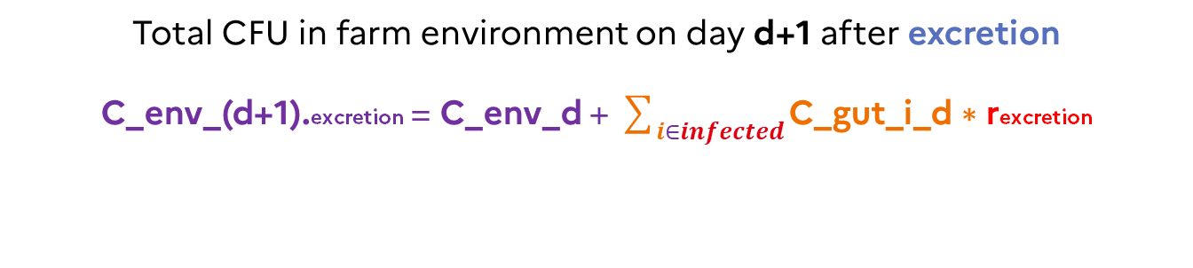
Excretion
E. coli excretion rate in feces rexcretion (Becker et al. 2022)
C_gut_i_(d+1).excretion = C_gut_i_d * (1 - rexcretion)
Excretion
Growth
Transmission
Decay
Total CFU in farm environment on day d+1 after excretion
C_env_(d+1).excretion = C_env_d + $\sum_{ⅈ∈infected}{\text{C}\text{_}\text{gut}\text{_}\text{i}\text{_}\text{d}\text{ ∗ }\text{r}\text{excretion}}$

Slide 18
Growth
A logistic growth is used with no lag phase
Growth rate r & Maximum carrying capacity K (Becker et al. 2022)
Excretion
Growth
Transmission
Decay
Total CFU in gut of infected broiler i on day d+1 after growth
C_gut_i_(d+1).excretion C_gut_i_(d+1).growth
Logistic
growth

Slide 19
Growth – Horizontal Gene Transfer
Plasmid transfer between resistant and non resistant E. coli (Fisher et al. 2014)
plasmid-dynamics modeled using ODEs

Slide 20
Growth – Horizontal Gene Transfer
Plasmid transfer between resistant and non resistant E. coli (Fisher et al. 2014)
plasmid-dynamics modeled using ODEs
Donor
Different conjugation rates
Donor – Recipient Transconjugant – Recipient
No plasmid loss
Same growth parameters
Assumptions
plasmid
Recipient
plasmid
Trans-
conjugant

Slide 21
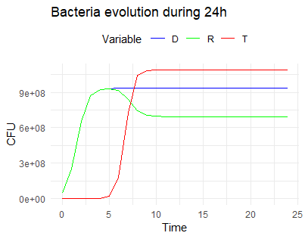
Growth – Horizontal Gene Transfer
Plasmid transfer between resistant and non resistant E. coli (Fisher et al. 2014)
plasmid-dynamics modeled using ODEs
Donor
dynamics
plasmid
Recipient
plasmid
Trans-
conjugant

Slide 22
Transmission
Susceptible Infected (SI) framework (Becker et al. 2022)
Transmission model (Dame-Korevaar et al. 2019)
Excretion
Growth
Transmission
Decay
Susceptible broilers infect themselves by ingesting infected feces
Force of infection foi depends on C_env_i_(d+1).growth

Slide 23
Decay
Environmental decay rate rdecay (Thomas et al. 2019)
Excretion
Growth
Transmission
Decay
Total CFU in farm environment on day d+1 after decay
C_env_(d+1).decay = C_env_(d+1).transmission * (1 - rdecay)

Slide 24
Farm module
Production duration 36 days
Excretion
Growth
Transmission
Decay
C_gut_i_d at d=36 flock prevalence
C_env_d at d=36 barn concentration

Slide 25
3 — Interventions

Slide 26
Interventions at farm
AntiBiotic free Production
Vaccination E.coli (Poulvac®)
Bacteriophages
Poland
Germany, Lithuania
Poland
Phytotherapy
Treatment of manure
Manure depollution (adsorption of residues using polymers)
Tunisia
France, Germany
Tunisia
Work In Progress!
Quantitative study of impacts of different interventions
Integration of intervention data in the QMRA model

Slide 27
4 — Perspectives

Slide 28
Perspectives - WIP!
Environmental module
Surface water
Recreational exposure
Manure tank
Drinking water
Fresh produce
Fresh produce consumption
Foodborne module
Human exposure
Farm module
Slaughter
Processing
Home preparation
Chicken meat consumption
Interventions
Occupational module
Direct contact
Occupational exposure

Slide 29
Thank you for your attention !
subhasish.basak@anses.fr

