Slide 1
Assessment of treatments to reduce the occurrence of AMR bacteria in chicken manure
ENVIRE status meeting – 6.6.2024
Group leader Dr. Tina Kabelitz
PhD student Aleksandra Atanasova Univ.-Prof. Dr. Thomas Amon
Univ.-Prof. Dr. Uwe Rösler

Slide 2
Content
Overview of the current status of the project
Planned activities
Quantification of Antibiotic Resistant Genes
Anaerobic digestion with different carbon sources and temperatures
Collaboration with project partners
Communication

Slide 3
Overview of the current status of the project
Anaerobic digestion experiment is finished. Processing data and writing publication.
Controls |  | Experiment in triplicates
 | Cellulose | Set 1 | Set 2 | Set 3 | Set 4
30° | 30° | 30° | 30°+Saw dust
37° | 37° |  |  | 37° | 37°+Saw dust
Chemical analysis
Beginning
End of the experiment
Chemical results
Biogas production (L/g manure or dry matter or organic dry matter)
Biogas content (re-calculation for ideal conditions)
Ammoniacal nitrogen (reactor inhibitor)
Volatile fatty acids

Slide 4
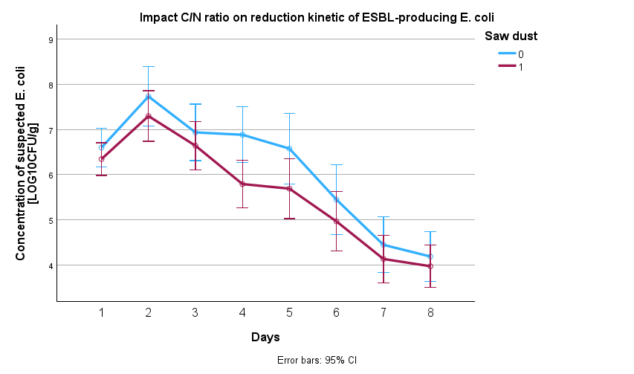
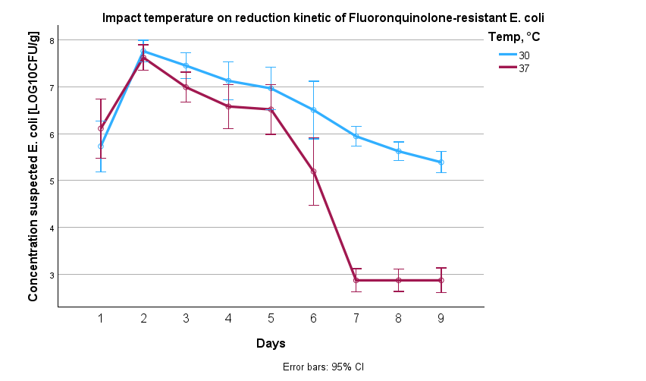
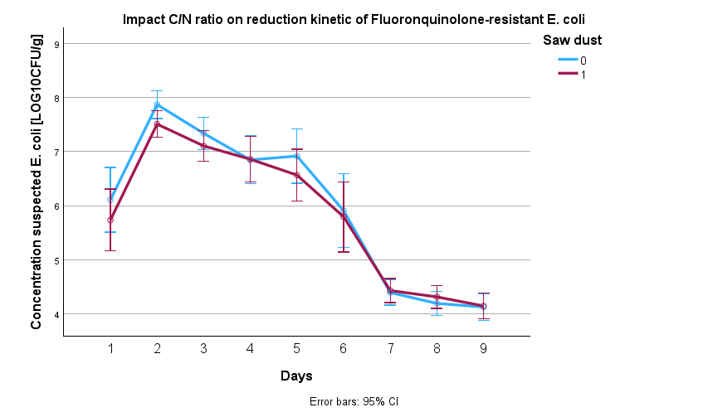
Overview of the current status of the project Microbiological results
Temperature has a main influence
Difference in C/N-ratio has no significant impact
Difference in reduction kinetics appear during the first 8 days of treatment, after 8 days differences are not significant

Slide 5
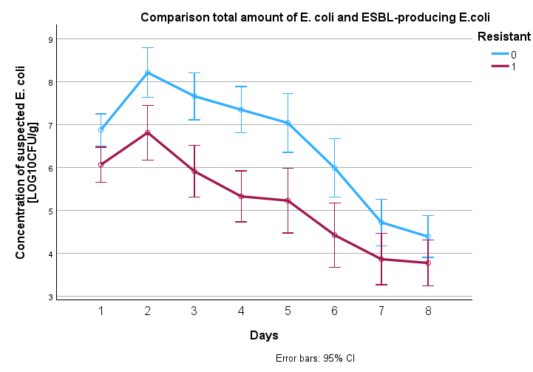
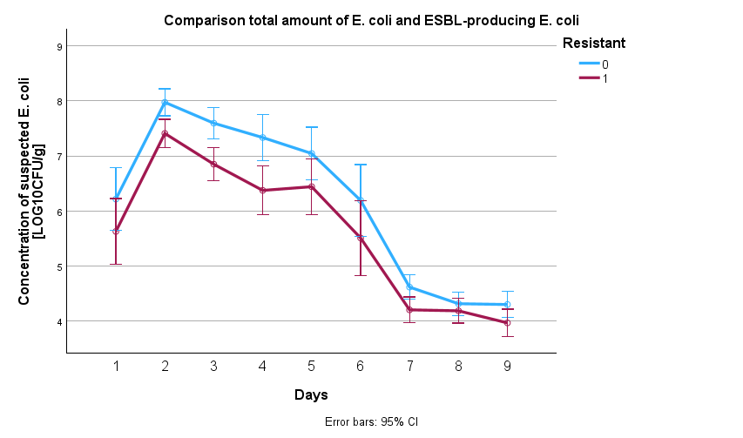
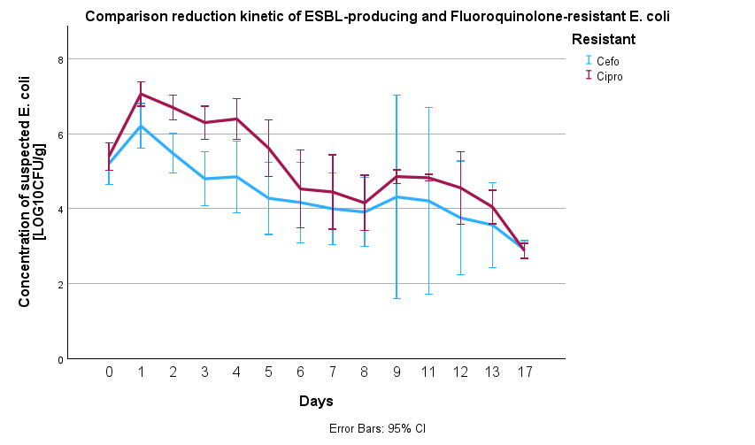
Overview of the current status of the project Microbiological results
Differences between total and resistant
E. coli are not significant

Slide 6
Planned activities
Phases of experiment | Time Experiments | 2024 |  |  |  |  |  |  | 2025
 |  | June | July | August | September | October | November | December | January | February | March | April
Literature and experiments | Literature searching |  |  |  |  | 28-29th of October ENVIRE autumn meeting in Paris
 | Learn laboratory methods
 | Anaerobic digestion (AD)
 | AD with different carbon sources
 | Quantification of ARGs
Writing and publication | Publication: Anaerobic digestion
 | Publication: AD with different carbon sources
 | Publication: Quantification of ARGs
 | Write thesis

Slide 7
Quantification of Antibiotic Resistance Genes
Investigate ARGs in anaerobic digestion samples from phase I
Start day 0
Day 6 (E. coli is not detectable in samples at 37°C)
Last day 12
Pure feces
sampled in the farm
qPCR
Sulfonamide, Tetracycline, Erytromycin, Fluoroquinolone
Detection of resistance genes by smartChip-qPCR
(Resistomap)
sul1, sul2, tetW, tetX, tetA, ermF, and aac(6′ )-lb, …

Slide 8
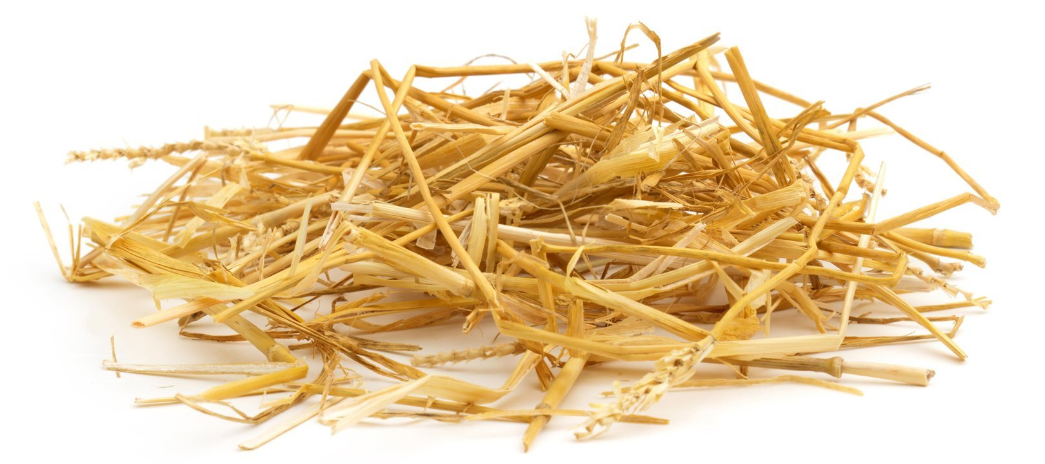




Anaerobic digestion with different carbon sources and temperature
test the influence of different carbon types natural, glucose, straw
test the temperature effect 37°C vs 12°C
inoculation with ESBL-producing E. coli (FU-10717) & Fluoroquinolone-resistant E. coli (to be selected)
natural chicken manure
manure + glucose (1:30)
manure + straw (1:30)
no manure
cellulose
#1
#2
#3
#1
#2
#3
#1
#2
#3
2x positive control
1x negative control

Slide 9

Collaboration with project partners
WP1 Intervention studies
FU ATB
WP3 Risk assessment modeling
The first result were transfered to risk assessment modeling
Update about presentations and posters
Update the current status of the research on website
WP4 Knowledge transfer and dissemination

Slide 10



Communication
Conferences:
October 9-11th the Zoonoses Symposium in Berlin and June 16-17th “Junior Scientist Zoonoses Meeting 2023” in Münster
On 17th and 18th of October was “RoKoCon2023” Robert Koch Doctoral Students Symposium.
Poster “Assessment of treatments to reduce the amount of antibiotic-resistant bacteria in chicken manure“ was nominated for the best poster prize.
10. Leipziger Doktorandenforum in Leipzig 13th of July
In December 4th was PhD day in ATB
Publication:
Assessment of effects in anaerobic digestion to reduce the amount of antibiotic-resistant bacteria in chicken manure August 2024
Quantification of Antibiotic Resistance Genes during anaerobic digestion January 2025
Assessment of effects of different carbon sources and temperature in anaerobic digestion to reduce the amount of antibiotic-resistant bacteria in chicken manure August 2025

Slide 11
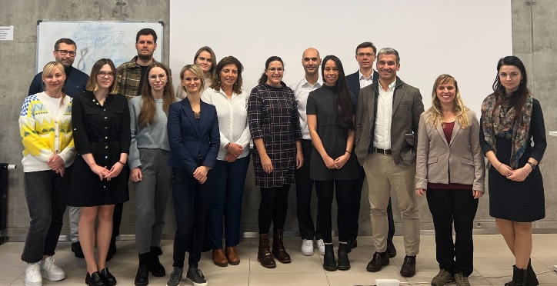

Thank you for attention
Thank to my supervisors
Supervisor Univ.-Prof. Dr. Thomas Amon
Dr. Tina Kabelitz
Leibniz-Institut für Agrartechnik und Bioökonomie
Supervisor Univ-Prof. Dr. med. vet. Uwe Rösler
Dr. med. vet. Anika Friese
Dr. Caroline Robé
Frei Universität, Berlin
Thank to the project Partners
French Agency for Food, Environmental and Occupational Health & Safety, France
Veterinary Academy of Lithuanian University of Health Sciences, Lithuania
University of Sousse, Tunisia
Wrocław University of Environmental and Life Sciences, Poland

