Slide 1











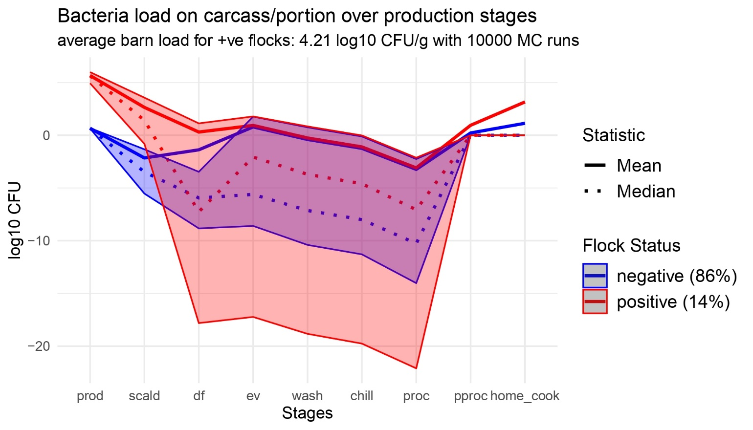
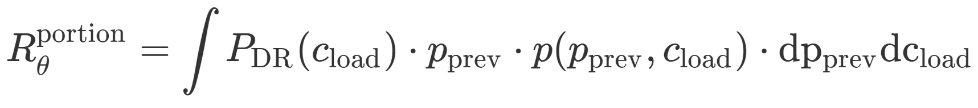
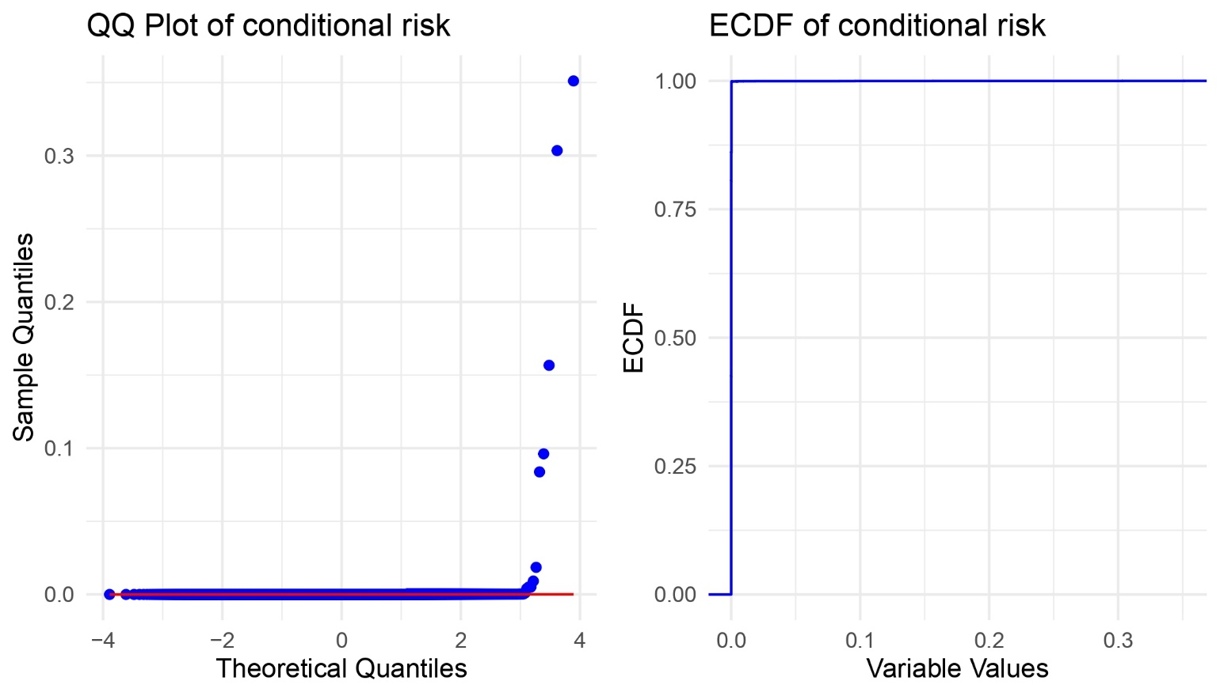
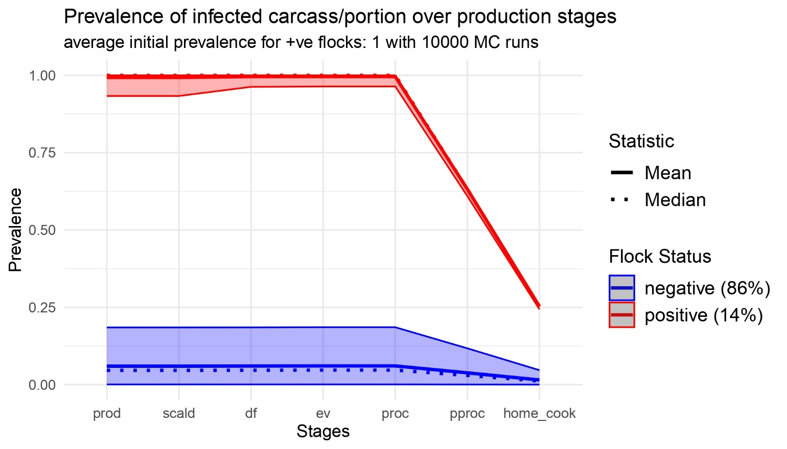





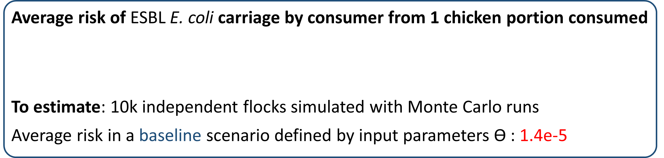
Quantification of human exposure to antimicrobial resistant E. coli using a farm-to-fork model in broiler chicken production. Subhasish Basak1, Nunzio Sarnino2, Roswitha Merle2, Lucie Collineau1 1. ANSES – Laboratoire de Lyon, France 2. Freie Universität Berlin, Germany
CONTEXT
PROJECT ENVIRE
CONSORTIUM AND FUNDING
Project duration: 2022-2025
Germany, France, Lithuania, Poland, Tunisia
Funded by the European Transnational Programme - JPIAMR-ACTION
OBJECTIVES
Reduce antimicrobial-resistant (AMR) bacteria spread from broiler chickens
Investigate the potential of various on-farm intervention measures
Reduce transmission and human exposure to ESBL E. coli from broiler chicken
WORKFLOW – WP 3
Quantitative Risk Assessment with pathways:
Incorporate on-farm intervention measures
FOOD-BORNE
ENVIRONMENTAL
OCCUPATIONAL
MATERIALS & METHODS FOOD-BORNE FARM-TO-FORK PATHWAY
Thinning
SI model
Barn
Load
Input
Production
Output
Scalding
Evisceration
Chilling
Post-processing
Excretion
Transmission
Horizontal
Gene
Transfer
WithinFlock
Prev.
OR
Defeathering
Washing
Portioning
Home cooking
Decay
Simulates within flock Prevalence (Pprev) and Load (Cload) on carcass/portion at each stage
FARM MODULE
FOOD-BORNE MODULE
DYNAMICS of ESBL E. coli in farm environment
Transmisson model Dame-Korevaar et al. (2020)
Horizontal Gene Transfer Fisher at al. (2019)
Susceptible-Infected model Becker et al. (2022)
DYNAMICS of ESBL E. coli in processing
Collineau et al. (2020) in ESBL E. coli setup
Updated with EU poultry farming practices
Simulates the processing of 1 chicken flock
Flock Risk from 1 chicken portion consumed
Prob. of ESBL E. coli carriage by consumer
Conditional on Pprev, Cload after cooking
PDR : Dose-Response Furusawa et al. (2024)
RESULTS & PERSPECTIVES
Average risk of ESBL E. coli carriage by consumer from 1 chicken portion consumed
To estimate: 10k independent flocks simulated with Monte Carlo runs
Average risk in a baseline scenario defined by input parameters Ɵ : 1.4e-5
HEAVY TAILED
Distribution
Quantile metrics ?
Difficult to interpret ?
Food-borne QRA module perspectives
Validation: Simulation results are comparable with Faverjon et al. (2022)
Calibration: Input parameters Ɵ can be adapted to different EU country protocols
Work in Progress: Integration of ENVIRE experimental data on interventions
subhasish.basak@anses.fr
www.envire-project.de

