Slide 1











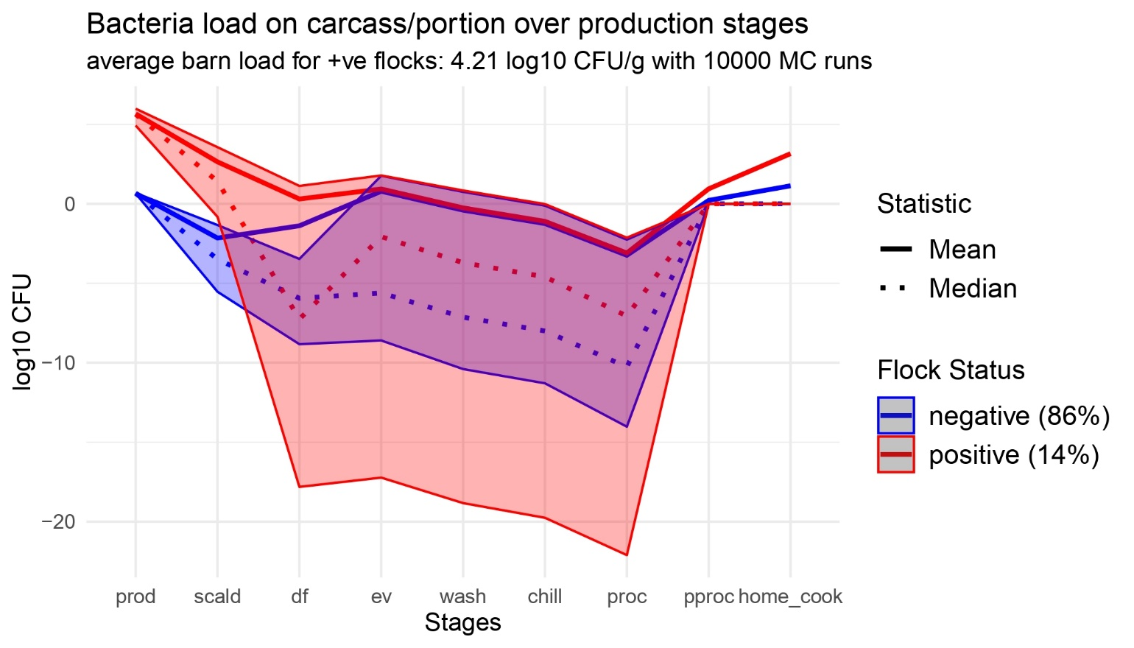
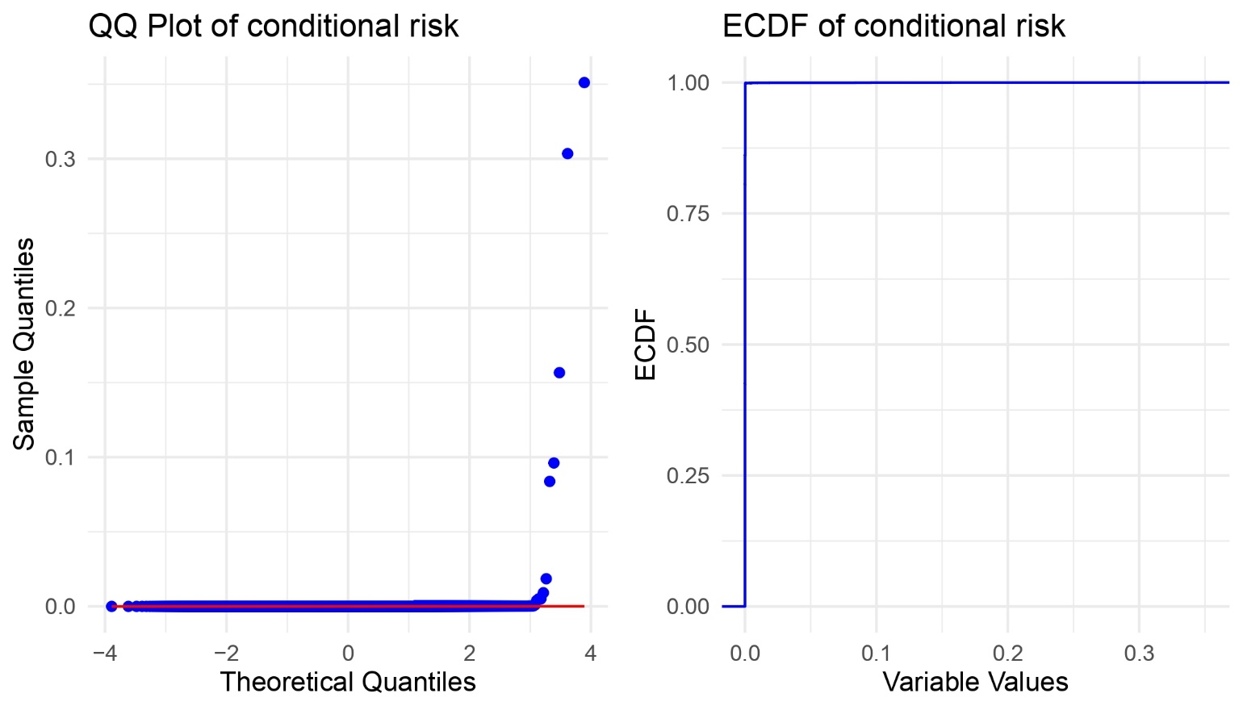
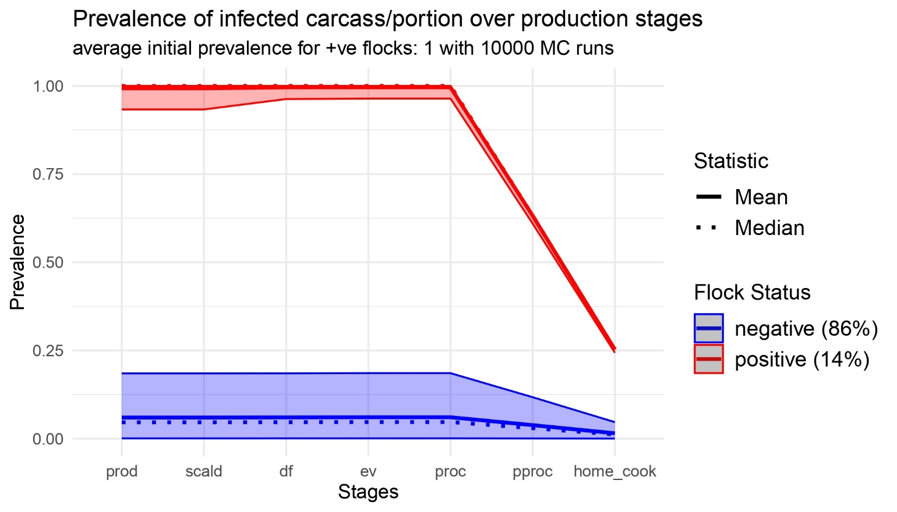





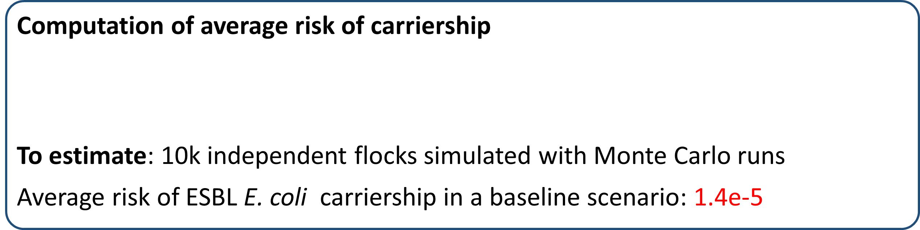
Quantification of human exposure to antimicrobial resistant E. coli using a farm-to-fork model in broiler chicken production. 1Subhasish Basak, 2Nunzio Sarnino, 2Roswitha Merle, 1Lucie Collineau 1. ANSES – Laboratoire de Lyon 2. Freie Universität Berlin
CONTEXT
PROJECT ENVIRE
CONSORTIUM AND FUNDING
Project duration: 2022-2025
Germany, France, Lithuania, Poland, Tunisia
Funded by the European Transnational Programme - JPIAMR-ACTION
OBJECTIVES
Reduce antimicrobial-resistant (AMR) bacteria spread from broiler chickens
Investigate the potential of various on-farm intervention measures
Reduce transmission and human exposure to ESBL E. Coli from broiler chicken
WORKFLOW – WP 3
Quantitative Risk Assessment with pathways:
Incorporate on-farm intervention measures
FOOD-BORNE
ENVIRONMENTAL
OCCUPATIONAL
MATERIALS & METHODS FOOD-BORNE FARM-TO-FORK PATHWAY
Thinning
SI model
Barn
Load
Input
Production
Output
OR
Scalding
Evisceration
Chilling
Post-processing
Excretion
Transmission
HGT
Growth
Flock
Prev.
Defeathering
Washing
Portioning
Home cooking
Decay
QRA model simulates flock Prevalence and carcass/portion Load at the end of each step
FARM MODULE
FOOD-BORNE MODULE
DYNAMICS of ESBL E. coli in farm environment
Transmisson model Dame-Korevaar et al. (2020)
Horizontal Gene Transfer Fisher at al. (2019)
Susceptible-Infected model Becker et al. (2022)
DYNAMICS of ESBL E. coli in production steps
Collineau et al. (2020) adapted to ESBL E. coli
Updated with EU poultry farming practices
The food-borne model replicates each stage
Risk from 1 chicken portion Probability of ESBL E. coli carriership
Conditional on final Prevalence, Load
Dose-response Furusawa et al. (2024)
RESULTS & PERSPECTIVES
Computation of average risk of carriership
To estimate: 10k independent flocks simulated with Monte Carlo runs
Average risk of ESBL E. coli carriership in a baseline scenario: 1.4e-5
HEAVY TAILED
Distribution
Quantile metrics ?
Difficult to interpret ?
Food-borne QRA model perspectives
Validation: Simulation results are comparable with Faverjon et al. (2022)
Calibration: Input parameters can be adapted to different EU country framework
Work in Progress: Integration of ENVIRE experimental data on interventions
subhasish.basak@anses.fr
www.envire-project.de

