Slide 1


Occupational module
THE first draft
Subhasish BASAK
Lucie COLLINEAU

Slide 2
General framework

Slide 3
Occupational module
Quantity of interest : For a particular broiler flock characterized by production parameters Ɵ = {Ɵfarm, Ɵfoodborne}, we want to estimate the risk of getting ESBL E. coli carriership for a worker working at processing stage s given the hygiene practice parameters H.
s = 1
s = 2
s = 3
s = 4
s = 5
s = 6
s = 7
s = 8
s = 9
Thinning
Clearing
Cleaning
Unloading
hanging
Post-bleeding
Post-df
Post-ev
Portioning
Concentration on an infected bird
Within flock prevalence
C_<step>_p
Prev_<step>_p
C_<step>_n = 0
Prev_<step>_n = 0
Farm module (Ɵfarm) outputs
C_prod_p
Prev_prod_p
C_prod_n
Prev_prod_n
C_df_p
Prev_df_p
C_df_n
Prev_df_n
C_ev_p
Prev_ev_p
C_ev_n
Prev_ev_n
C_por_p
Prev_por_p
C_por_n
Prev_por_n
Food-borne module (Ɵfoodborne) outputs
Food-borne module (Ɵfoodborne) outputs
Notes:
On est intéressé par la quantification de l'exposition des travailleurs à E. coli ESBL à différentes étapes de la production de poulets de chair.
Pour un lot spécifique de poulets de chair caractérisé par les paramètres de production Ɵ = {Ɵfarm, Ɵfoodborne} et les pratiques d'hygiène H, on cherche à estimer le risque ou la probabilité qu'un travailleur à l'étape de production s devienne porteur de E. coli BLSE. ici vous voyez les différentes étapes en jaunes où le travailleur est exposé aux bactéries par contact avec l'oiseau, la carcasse ou les équipements. s en rouge est l'indicateur pour chaque étape. pour chaque étape, nous calculons deux choses, la concentration des bactéries sur l‘objet contaminé et la prévalence dans le lot. d'autres modules qui calculent ces sorties.

Slide 4
Contamination pathways
The contamination pathway can be through direct contact of contaminated elemnts or through inhalation of air particles.
s = 1
s = 2
s = 3
s = 4
s = 5
s = 6
s = 7
s = 9
s = 9
Thinning
Clearing
Cleaning
Unloading
hanging
Post-bleeding
Post-df
Post-ev
Portioning
Contact-transmitted
Contact-transmitted
Airborne
Contact-transmitted
Contact-transmitted
Contact-transmitted
Contact-transmitted
Contact-transmitted
Contact-transmitted
100%
manual
60-70% automatic (2)
100%
manual
100%
manual
100%
manual
Airborne
100%
manual
100%
manual
80% automatic (2)
85%
electric stunning (1)
Data collected from Commission d’enquête sur les conditions d’abattage des animaux de boucherie dans les abattoirs français
Expert opinion Claire Chauvin ANSES

Slide 5
Number of workers
The number of workers according to the visite (0) of the slaughterhouse and literature review.
s = 1
s = 2
s = 3
s = 4
s = 5
s = 6
s = 7
s = 9
s = 9
Thinning
Clearing
Cleaning
Unloading
hanging
Post-bleeding
Post-df
Post-ev
Portioning
Contact-transmitted
Contact-transmitted
Airborne
Contact-transmitted
Contact-transmitted
Contact-transmitted
Contact-transmitted
Contact-transmitted
Contact-transmitted
Unif(7, 9) (1) manual
Unif(4, 5) (3) automatic
1 (0)
1 (0)
Triangular(3, 6, 13) (2)
Airborne
1 (0)
3 (0)
Unif(10, 12) (0)
1 (0)
Data collected form Enquête sur le ramassage des volailles conducted by the Filière avicole
Data collected form Huneau Salaun et al. (2019)
Data collected form Résultats technico-économiques et analyse des conditions de travail by the MSA

Slide 6
Number of workers
Data collected form Enquête sur le ramassage des volailles conducted by the Filière avicole
Data collected form Huneau Salaun et al. (2019)
Data collected form Résultats technico-économiques et analyse des conditions de travail by the MSA
Expert opinion Alfredo
s = 1
s = 2
s = 3
s = 4
s = 5
s = 6
Thinning
Clearing
Cleaning
hanging
evisceration
Portioning
Contact-transmitted
Contact-transmitted
Airborne
Contact-transmitted
Contact-transmitted
Contact-transmitted
Standard harvest 1000m2 24000 broilers (1)
1 truck driver
Airborne
20-30 person (4)
7-9 person (1) manual
4-5 person (3) automatic
Triangular(3, 6, 13) (2)
Line speed Trianguar(1100, 6000, 13500) broilers/h (2)
6-22 birds per minute per worker (2)
Assume no contamination for automatic
Clearing and thinning w/ same persons (4)

Slide 7

Computation of concentation
Under each step there are several contaminated items which comes to human contact
We compute the average concentration on each such item during a production process of the flock
s = 1
s = 2
s = 3
s = 4
s = 5
s = 6
Thinning
Clearing
Cleaning
hanging
evisceration
Portioning
Infected birds
Infected birds
dust
Infected birds
carcass
carcass
dust
Transmission rate
Adhikari et al. (2020)
surface
knife
Notes:
Ici (en couleur rosée), on a identifié les objets contaminés qui sont exposés au personnel travaillant à chaque étape.
Ce sont soit les poultes infectés, soit les cages, plateaux ou équipements d'abattoir contaminés.
On calcule la concentration sur chaque objet en utilisant les taux de transmission sur les sorties des modules Farm et Foodborne.

Slide 8
Exposure assessment
The cross contamination (+ve to –ve flock) is already taken into account in the food-borne module
s = 1
s = 2
s = 3
s = 4
s = 5
s = 6
Thinning
Clearing
Cleaning
hanging
evisceration
Portioning
Infected birds
Infected birds
dust
Infected birds
carcass
surface
knife
Worker
Worker
Worker
No Cross contamination

Slide 9
Exposure assessment
The transmission rates for single contact taken from literature
s = 1
s = 2
s = 3
s = 4
s = 5
s = 6
Thinning
Clearing
Cleaning
hanging
evisceration
Portioning
Infected birds
Infected birds
dust
Infected birds
carcass
surface
t_meat
knife
t_bird
t_bird
t_bird
Worker
Worker
t_board
Worker
t_knife
t
Cs
Cw
Per cm2
Per cm2
Notes:
Le taux de transmission indique la proportion de bactéries transférées sur les mains du personnel après un seul contact avec l'objet contaminé, c'est-à-dire après avoir touché l'objet une seule fois.

Slide 10
Transmission parameters
The worker gloves/hands gets contaminated from the contaminated item in following rates:
Symbol | Contaminated item | Source | Value (% transfer) | Remark
t_meat | Carcass | Chen et al. (2001) Adhikari et al. (2020) | logNormal mean 0,98, 0,64 | Meat to finger tips
t_bird | Infected bird | Same as above ? | Same as above ? | No literature found
t_board | Cutting board | Lopez et al. (2013) Adhikari et al. (2020) | Triangular(30.4, 53.3, 98) | Cutting board to finger tips
t_cage | Cage | King et al. (2020) also | Same as above | Same as above
t_knife | Knife | Lopez et al. (2013) Adhikari et al. (2020) | Triangular(29.4, 54.1, 99) | Knife to finger tips

Slide 11
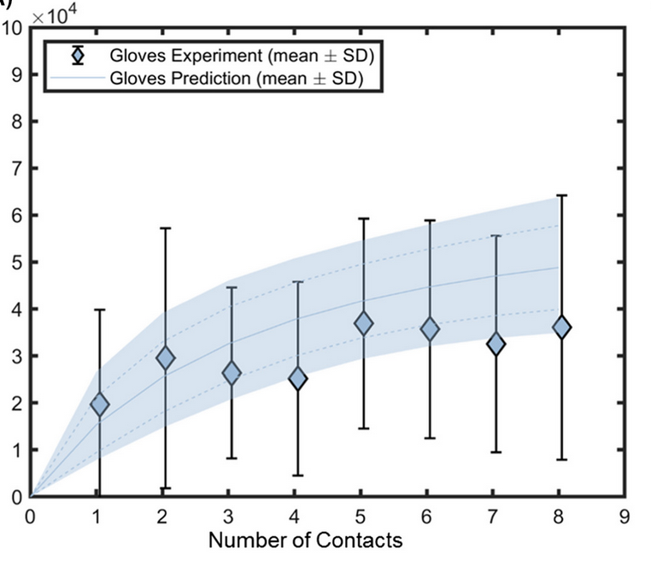
Sequential surface contact
The transmission of bacteria is higher for multiple touches with the contaminated surfaces
s = 1
s = 2
s = 3
s = 5
s = 6
s = 7
Thinning
Clearing
Cleaning
hanging
evisceration
Portioning
Infected birds
Infected birds
dust
Infected birds
carcass
surface
knife
Worker
Worker
Worker
Equilibrium after ~5-6 contacts King et al. (2020)
For n < n_touch (no. of touches per hand with area Af = 450 cm2)
Cw,n = Cw,n-1 + t * [Cs * Af - Cw,n-1]
Notes:
Mais ce qui nous intéresse principalement, c'est qu'il n'y a pas un seul contact entre les mains du travailleur et l'objet contaminé. En effet, l'objet est touché plusieurs fois, et cela doit être pris en compte pour calculer la concentration finale sur les mains.
Nous avons trouvé un article qui a étudié le même sujet et a montré qu'un équilibre est atteint après environ 5 à 6 contacts.
On vas utiliser une équation dynamique qui tient compte du nombre de fois que l'objet contaminé a été touché par le travailleur. Par addition cumulative, cette méthode permet de déterminer la concentration finale. Pour cela, nous avons besoin d'une estimation du nombre de contacts pour chaque travailleur et chaque type d'objet contaminé.

Slide 12
Hygiene and biosecurity parameters
C_worker_s
Gloves
Assumptions are imposed using hygiene practice parameters H
p_air := P[Air-borne transmission] = 0
E_mask := Worker wearing mask
E_glove := Worker wearing gloves
E_handwash := Worker washed hands afterwards
E_touch := Worker touches their lips with gloves
q_mask := proportion of bacteria passing through mask
q_glove := proportion of bacteria passing through gloves
q_wash := proportion of bacteria passing through handwash
q_lips := Transmission rate from hand/gloves/mask to lips
C_lips_s := ESBL E. coli concentration on worker’s lips working in stage s
C_worker_s := ESBL E. coli concentration on worker’s hand working in stage s
C_lips_s is a random variable depending on the events E and the r.v. C_worker_s
Compute average concentraion C_lips_s_bar on stage s worker’s lips given touch: C_lips_s_bar = E[C_lips_s | 1_{E_touch} = 1, c_worker_s]
= f(q_mask, q_glove, q_wash, q_lips, P[E_mask], P[E_glove], P[E_handwash], c_worker_s)
E_glove
q_glove
Hands
E_wash
Wash
q_wash
E_mask
Mask
q_mask
Lips
C_lips_s_bar

Slide 13
Hygiene and biosecurity parameters H
Symbol | Description | Source | Values (no log) & remarks
q_mask | proportion of bacteria passing through mask | Leonas et al. (2003) | 0,015 average over 6 BFT of E. coli
q_wash | proportion of bacteria passing through handwash | Racicot et al. (2013) | 0,048 protocol 2 for Coliforms (no log)
q_glove | proportion of bacteria passing through gloves | Montville et al. (2000) | 0,095 adj. mean from a gamma (5.91, 0.40, -5) log10 % transfer
q_lips | Transmission rate from hand/gloves/mask to lips | Gibson et al. (2002) | 0,246 rate of finger tips -> lips will be used as a substitute
P[E_mask] | Probability of a worker wearing mask | User input | 0,9
P[E_glove] | Probability of a worker wearing gloves | User input | 0,9
P[E_handwash] | Probability of a worker washed hands afterwards | User input | 0,9
P[E_touch] | Probability of a worker touches their lips with gloves | User input | 1,0 since the risk is computed given the event E_touch occurs
Uncertainty on parameter values are ignored for now!

Slide 14
Computation of risk
Quantity of interest : For a particular broiler flock characterized by production parameters Ɵ = {Ɵfarm, Ɵfoodborne}, we want to estimate the risk or the probability of getting ESBL E. coli carriership for a worker worker working at processing stage s given the hygiene practice parameters H.
C_lips_s_bar: Expected concentration of ESBL E. coli on a stage s worker lips given H
PDR : Beta Poisson dose-response for ESBL E. coli carriership Fisher et al. (2024)
Flock risk conditional on average concentration on lips of worker and prevalence of contaminated elemnets:
Rtouch,s(C_lips_s_bar, Prev) = PDR(C_lips_s_bar) * Prev
Average risk given input parameters Ɵ:
RƟ,s = E[Rtouch,s]

