Slide 1
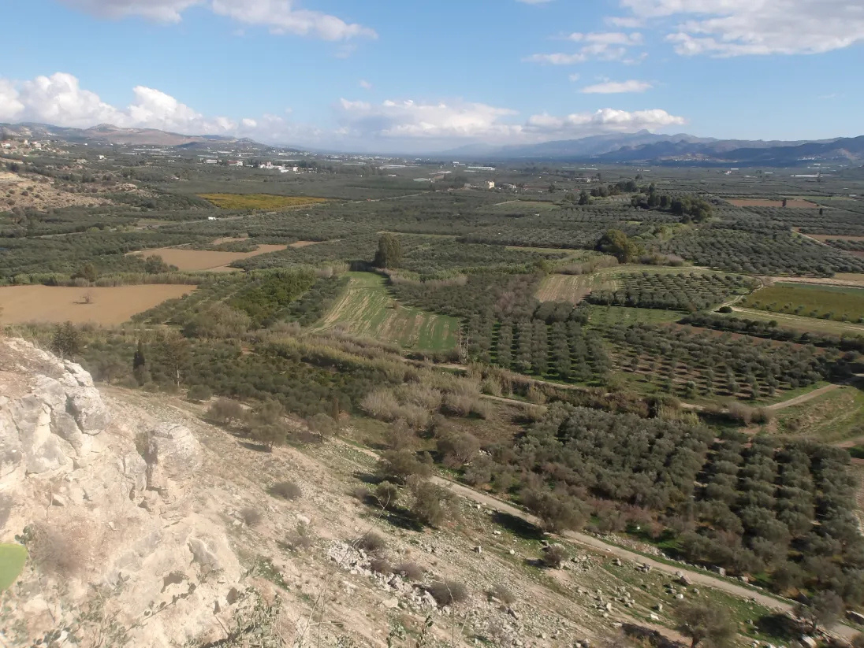
KULURI
No harvest lost
for lack of hands.
EU Agri Hackathon · Challenge 3: Flowing Data, Empowered Collaboration
Co-founders: Linda Angulo López · Maria Filippou · Ayushman Bhaba Padhy · Juan Zotes Orcajo

Slide 2
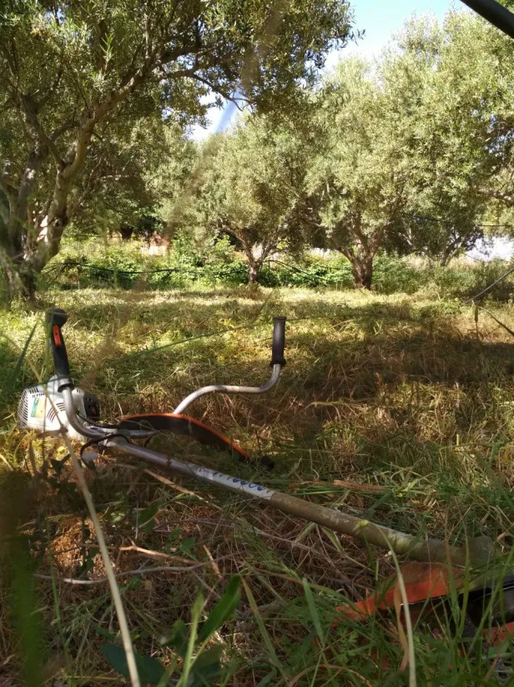
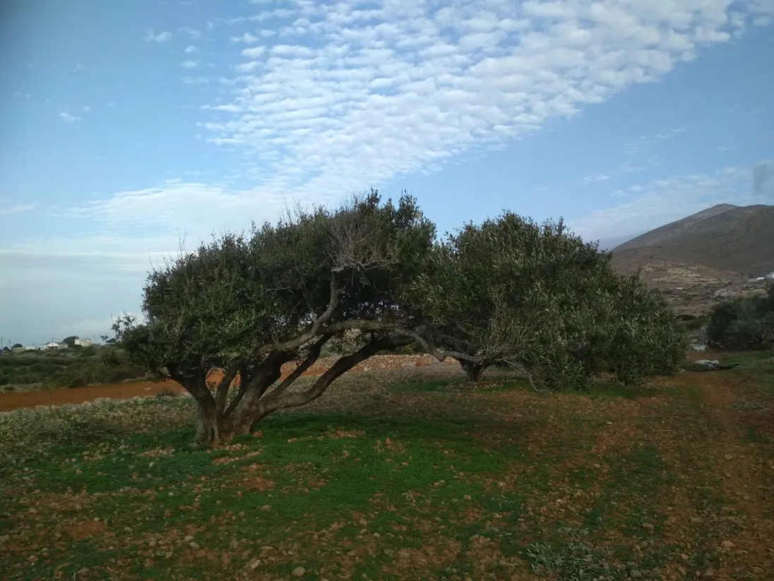
5:47 a.m., Kastelli Valley, Crete
Nikos, 35 · seasonal worker
Last season: no contract, 3 days unpaid.
Maria · organic olive grower
Trees 100+ years old. Needs 4 workers in 2 weeks.

Slide 3
Maria and Nikos are not alone
95k
10k+
39%
olive families in Crete
workers missing each harvest
of EU farmers share no data digitally
Since 2025, CAP payments depend on fair labour (social conditionality). Proof is still on paper.

Slide 4
Where farmers and workers:
  find each other,
  agree, and
  hold to it.
FIND
AGREE
HOLD
Profiles, job posts, matching
Clear terms before anyone shows up
Signed, recorded, can't be quietly changed
Everything else follows from these three.

Slide 5
Maria and Nikos open Kuluri
1
MARIA
employer
2
3
4
Job Post
1
NIKOS
worker
Match in hours
Transparent agreement
Shared record
Profile - CV

Slide 6
▶
90-SECOND PRODUCT FILM
Scan to try Kuluri

Slide 7
What changed for Maria and Nikos
BEFORE
WITH KULURI
Finding workers
weeks
hours
Terms
verbal
transparent
Worker pay
unclear
agreed upfront
Proof
paper
can’t be changed

Slide 8
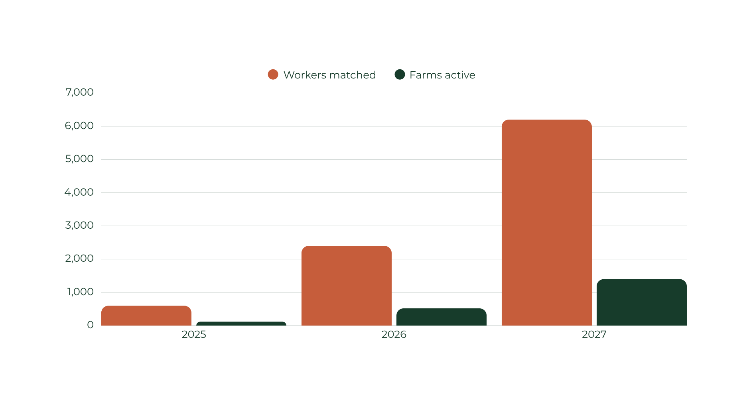
Growing harvest by harvest in Crete
Workers matched • Farms active

Slide 9
Free for people. Paid by those who benefit.
Launch: EU grants (e.g. ESF+, EIT Food) · Local business ads (~€360 / season)
WHO
WHAT
PRICE
Workers
Fair work + own agreements
Always €0
Farmers
Agreements + season report
First 10 free, then €0.20 each
€8 / season (year 1 free)
or Prime €10 / month
Co-ops
Full crews on all member farms
→ bigger harvest
→ more oil for the co-op
Year 1 free
then €1,200+ / year
Grants launch us. The agreement keeps us running. Workers always free.

Slide 10
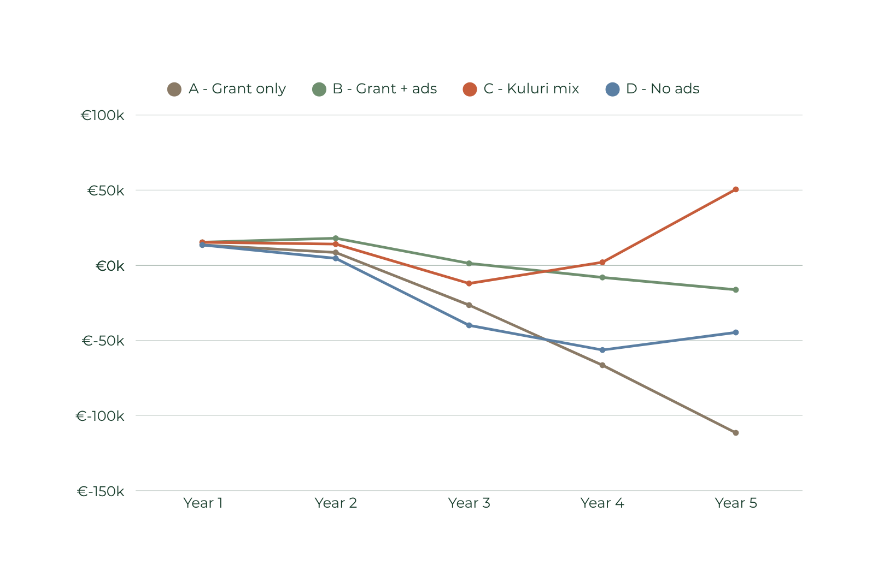
4 funding paths: which one should we bet on?
¿POSSIBLE BACKUP?
Profit after costs · cumulative, 5 years (€k)
+€50k
C · base case, year 5
A · Grant only
Grant covers part of costs
B · Grant + ads
Ads alone don't cover costs
C · Kuluri mix
Grants + ads +
agreements + reports
D · No ads
Profitable from Y5, slower
Ads also bring local businesses customers in the low season · Illustrative figures

Slide 11
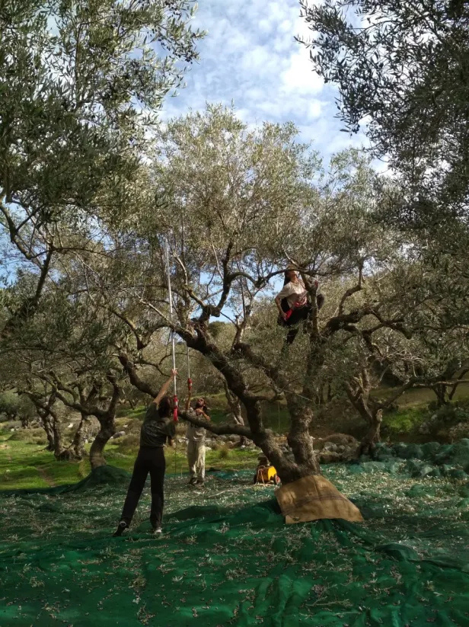
Next October,
5:47 a.m.
Nikos: “I’m coming back, Maria.”
No harvest lost for lack of hands.
Our ask: €20k + 1 pilot co-op → live for the Oct 2027 harvest
KULURI · a Social Cooperative Enterprise

Slide 12
Why us
Linda Angulo López
Maria Filippou
Ayushman Bhaba Padhy
Juan Zotes Orcajo
[Role in Kuluri]
[Role in Kuluri]
[Role in Kuluri]
[Role in Kuluri]
[Share a personal brief description]
[Share a personal brief description]
[Share a personal brief description]
[Share a personal brief description]
[One sentence: why this team can deliver the next harvest]
[Contact: email · website · QR]

Slide 13
Next 12 months
BACKUP
Nov 2026 – Feb 2027
Test with Maria and a few workers in this harvest
Mar – Jun 2027
Apply for the grant, sign the pilot co-op
Jul – Sep 2027
Train the co-op, bring its members on board
Oct 2027
First full harvest with Kuluri
Next October, 5:47 a.m.: Nikos is back.

Slide 14
How Hold works
BACKUP
1
2
3
4
Maria and Nikos accept the terms in the app
Kuluri stores a fingerprint of the agreement, not personal data
Both see the same version. Any change shows.
Export it for ERGANI or a CAP check when needed
No crypto · no personal data on the chain · ≈ €0 per agreement

Slide 15
Challenge 3: data control
BACKUP
PAIN
KULURI
Fragmented calls
One shared flow
Opaque decisions
Consent by design
Locked platforms
Portable records
No feedback loop
Live local insight

Slide 16
Competition: find · agree · hold
BACKUP
FIND
AGREE
HOLD
Job boards, Facebook groups
✓
✗
✗
WhatsApp, phone calls
✓
Verbal only
✗
Agro-U (Greece)
✓
✓ hiring papers
Official filing
ERGANI app (Greek state)
✗
✓ jobs ≤ 2 days
✓ state record
Farm-work voucher (ergósimo)
✗
✗
Paper voucher
KULURI
✓
✓ whole season
✓ shared, can't change
Others do one or two. Kuluri does all three.
ERGANI app: July 2026, contracts up to 2 days · Agro-U: matching + hiring paperwork (Thessaloniki, 2020)

Slide 17
How we estimated the numbers
BACKUP
1 · Market size (TAM → SOM)
6 · Bottom-up costs
95k olive families → 28.5k hire → 9k users by Y5
Part-time developer ≈ half a Greek salary (€40k)
2 · Adoption curve (Rogers)
7 · Grant probability
Innovators + early adopters = 16% by Y3
€20k / year, 70–80% chance (ESF+, EIT Food)
3 · Freemium conversion
8 · First Chicago method
3% pay for Prime (benchmark 2–5%)
Bear 30% · Base 50% · Bull 20% → C: +€21k
4 · Comparable prices
9 · Monte Carlo (10,000 runs)
Farm software €450–950 / year → co-op €1,200
C profitable in year 5 in 94% of runs
5 · Value for co-ops
10 · NPV at 40% (VC hurdle rate)
Pays back if harvest grows 0.4% (96 t × €4.60/kg)
C: +€13.5k · A and D negative
C: +€50k in base case · 47% chance all early losses are recovered by year 5

Slide 18
Costs and risks
BACKUP
YEAR 1 COST
RISK ANSWER
Company + accountant
€2,500
Low adoption
Co-design in villages
Legal + GDPR
€1,500
Data misuse
Consent + minimisation
Tech, marketing, tools
€2,500
Seasonality
Co-op subscriptions
Total
≈ €6,500
Trust
Human support

Slide 19
Everyone in the chain will win
BACKUP
FARM OWNERS
hands harvests on time, owns data
CO-OPS
season-long jobs, increase in crop selling
KULURI
WORKERS
fair terms + proof,
ability to grow professionally
BUYERS
verified fair labour conditions
PUBLIC ADMINISTRATION
simpler & trustable reporting tracking

Slide 20
Who advertises on Kuluri
BACKUP
Olive mills
Win farmers early
Rooms to rent
Empty in winter
Farm stores
Pre-harvest sales
Transport
Reach far groves
Machine repair
Urgent fixes
Workwear
Gloves & boots
Accountants
Register workers
Tavernas
Feed harvest crews
Oil buyers
Buy after milling
Money transfer
Send pay home
~€360 / season · 6 → 60 → 120 advertisers (Y1 → Y3 → Y5)
No loans, no gambling

Slide 21
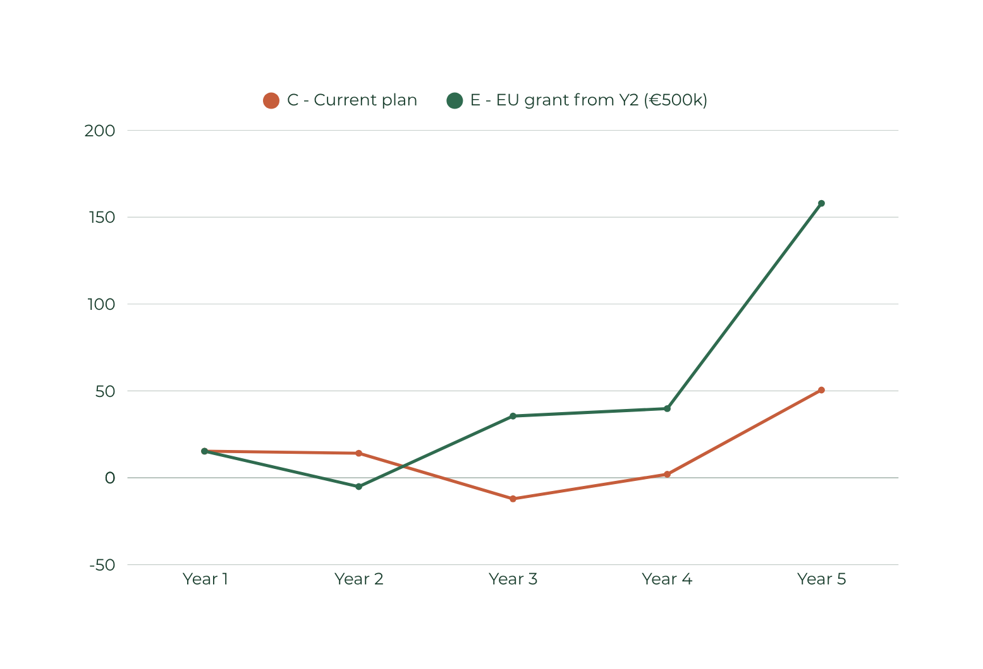
If we win: bigger market, bigger profit
BACKUP
Profit after costs · cumulative, 5 years (€k)
+€158k
E · cumulative, year 5
C · Current plan
€40k grants · Crete only
Year 5: +€50k
E · €500k EU grant (Y2)
Crete Y1 → Greece from Y3
Year 5: +€158k
Small dip: −€5k (Y2)
Farmers Y5: 22k vs 9k
€500k = ESF+ social-innovation size (€200k–1M) · 20% co-funding: half in-kind, half founding co-ops · Illustrative

