Slide 1
Inside Git Hub Alex Benns
Github

Slide 2
Git
What is it:
Is a version control system
Uses snapshots to create a mini file system
Every commit takes a snapshot of what the files are at that moment and stores a reference to that snapshot.
files that have not changed, just contain a link to the previously stored file.

Slide 3
Git Criticisms
Complex information model
Has files, a working tree, an index, a local repository, a remote repository, remotes commits, treeishes, branches, a stash…
Command line syntax
Shortcuts (alone): “git pull” is exactly to “git fetch” then “git merge”
HOWEVER “git branch” with “git checkout”: “git checkout –b

Slide 4
GitHub...Who..What..When?
Who:
Founded by Tom Preston-Werner, Chris Wanstrath, and PJ Hyett
What is it
Uses Git Version Control system
Collaborative
Cloud storage
When
Site went live April 10th, 2008

Slide 5
Beginnings
Preston and Wanstrath started it to fill a need for git hosting collaboration
Preston was introduced to git by Dave Fayram friend and coworker at Powerset.
Original distributed git method was to setup Unix machines and use that as an ad-hoc solution.
Not Ideal

Slide 6
Competition
repo.or.cz
Limited
Poorly designed
Clunky interface (yes it is worse)
Limited support (open source)
Poor updates
Free (with no paid subscriber option)
Little- to-no business interest
No private collaboration

Slide 7
Github: Start-up
Preston and Wanstrath
Created a market, rather than entered
Took time to catch on
Adoption of git still in early stages
Preston continued to work at Powerset
Wanstrath continued work as a Rails consultant

Slide 8
Git Hub Goes Live
Start 4 people (now 239 in <6 years)
Twitter
Used as an instant feedback tool
Check if site unreachable (China)
Site slow
Feature: ego boost
Monitoring by support
Ability to move annoying bugs to short list

Slide 9
Rapid Improvement
Just after launch
Adding new features paramount
Stability of site secondary
Assumed first users will forgive failures easier than later users.
Updates of up to ten times in one afternoon common
Now:
More focus on stability enhancements

Slide 10
Expansion from Community
Hiring based on community involvement
Tekkub (support): was hired
Provided support to users
Very active on Github
Sent feedback continuously
Scott Chacon (full-time developer):
Hired after Preston heard him speak at a Ruby meetup.

Slide 11
Github Investors
Investors (beginning):
No outside investment was allowed in the startup
Outside investment meant a loss of control, and restricted decision making
Venture Capital (now):
Andreessen Horowitz (July 9, 2012)
Develop better products
Technology focused venture group

Slide 12
Moderately Interesting Stats
Current employees
239 globally: from “code hackers…to office pioneers”
Currently there are 5.9 million users
Working on 10.9 million repositories
According to trafficestimate.com
Over 30 days: 52,408,000
Average Per day: 1,746,933

Slide 13

WHAT IS THAT??!!
An octocat…
That HAS to be an
interesting story.
Preston was
looking for a good
image for a 404 page and found this, and purchased limited use license for $50, (now exclusively owned).

Slide 14
GitHub Criticism
Pricing:
Private repositories are expensive…
$50 for 50 repositories (down from $100)
$7 for 5 repositories
Vulnerable to DDOSs’ (fixed?)
Pushes can fail silently (somewhat fixed)
Buttons…Buttons…BUTTONS. WHERE ARE THE BUTTONS?

Slide 15
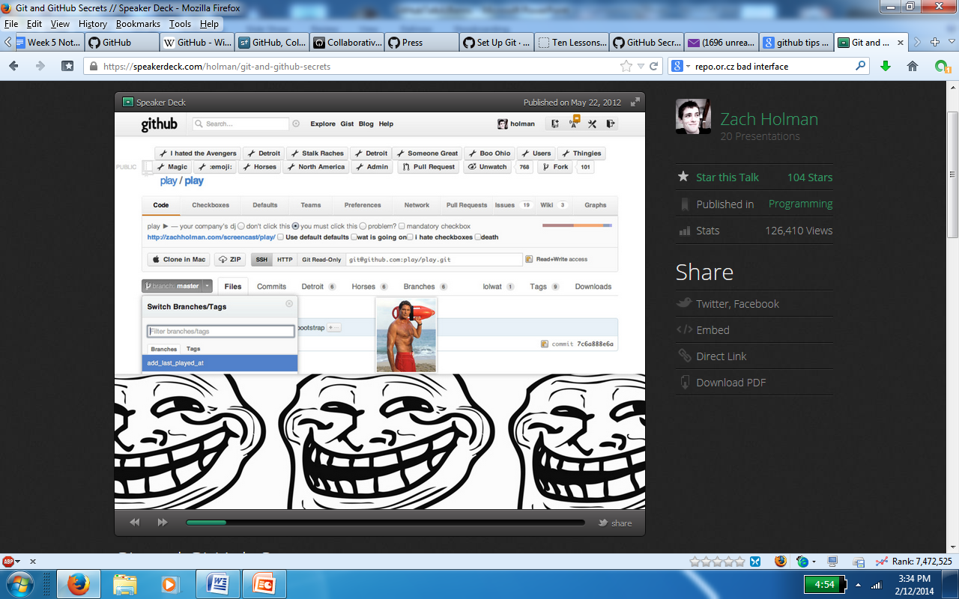
Why isn’t there a button?!!?

Slide 16
Github’s Somewhat Secrets
Whitespace remover:
Got a commit that includes a lot of new whitespace?
USE: ?w=1 in the URL
Cross-Repository Issue References
Reference issues between repositories
USE: user/repository#number

Slide 17
Secrets cont…
Quick navigation
From the repository's home page,
type w to bring up a
quick filter panel which is displayed for your branches.
Inside of your repository, type t
quick file selector displayed
Select your file, hit enter

Slide 18
Secrets End
.dff, .patch
Files that can update source code
Generate quick diff and patch files
ADD: .diff or .patch at the end of the URL for a commit page, Pull Request, or Compare View
Plaintext view displayed
Shortcuts:
Quickly find shortcuts
? On most pages will display the shortcuts

Slide 19

Sources (list them)
https://github.com/about/
http://tom.preston-werner.com/2011/03/29/ten-lessons-from-githubs-first-year.html
https://help.github.com/articles/set-up-git
https://github.com/blog/967-github-secrets
http://repo.or.cz/
https://speakerdeck.com/holman/git-and-github-secrets

Slide 20
Sources cont…
http://www.quora.com/GitHub/What-is-the-story-behind-GitHub%E2%80%99s-octocat-mascot
http://pando.com/2013/07/08/original-github-octocat-designer-simon-oxley-on-his-famous-creation-i-dont-remember-drawing-it/
http://git-scm.com/book/ch1-3.html
http://steveko.wordpress.com/2012/02/24/10-things-i-hate-about-git/
http://www.lostdecadegames.com/goodbye-github-hello-aws/

