Slide 1
MongoDB and NoSQL Brian Troncone

Slide 2
History of NoSQL
The term “NoSQL” first appeared in 1998 when Carlo Strossi invented a database that did not user SQL for querying
In 2009 Rackspace hosted a conference titled “NoSQL”, main theme was to discuss document based distributed databases. The name stuck.

Slide 3
Types of NoSQL DBs
Document Store-JSON style data store
Key-Value Store- Schema-less, key along with data.
Column Store-columns are key value pairs
Graph Databases-use matrix view of underlying data

Slide 4
Popular Choices
MongoDB (document store)
CouchDB (document store)
Redis (key-value store)
Cassandra (wide-column store)

Slide 5
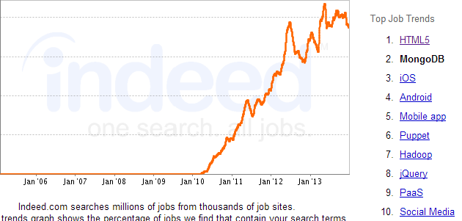
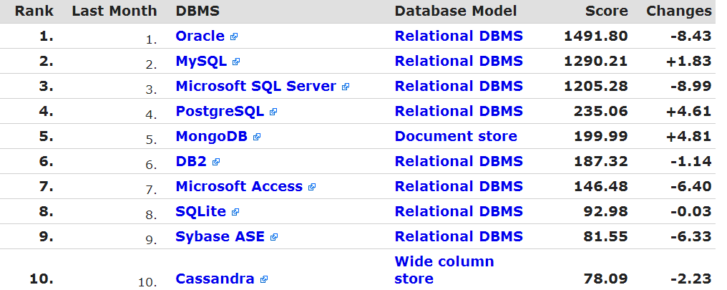
Trending
Some info

Slide 6




Trending Cont. (Mongo)

Slide 7
So what is NoSQL?
Typically, when we think of databases we think of…
Tables?
Columns?
Rows?
Rigid Schema?
NoSQL features NO tables, columns, rows, and in most cases Schema

Slide 8
Enter MongoDB
Data is stored in documents
Collections are a set of documents
Data is stored as BSON
BSON is binary JSON, which supports embedding of documents and arrays within other documents and arrays

Slide 9
MongoDB Shell
MongoDB and its collections are interacted with through the Mongo Shell using Javascript.
Not limited to single commands, entire scripts can be run
Used for administrative task, analyzing data, fixing a modifying documents, etc.

Slide 10
Command Examples
GoTo DB: “use [dbname]”
List Collections: “show collections”
Insert: db.foo.insert({name: “Joe”, age: 26})
Find: db.foo.find({name: “Joe”})
Update: db.foo.update({name: “Joe”}, {name: “Joe Joe”})

Slide 11
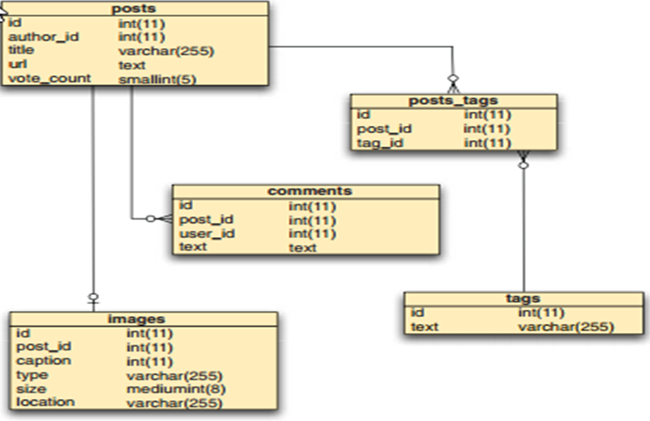
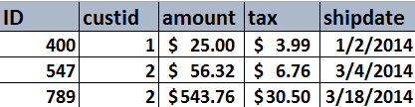
Relational DB Example

Slide 12
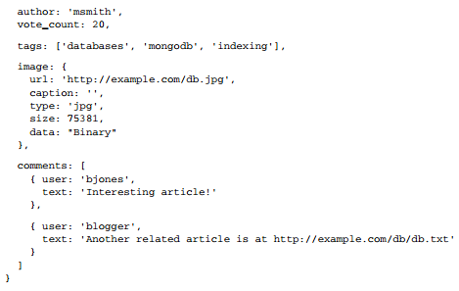
MongoDB Example

Slide 13
Relational Locking
To ensure consistency rows and tables must be locked, allowing 1 write access at time.
Increased locking time means less reads/writes per second
Higher transaction latency
= Slower application

Slide 14
Scaling Relational
Denormalizing tables, locks are taken on less tables
Relax consistency, allowing for reading of data before fully committed
This sacrifices consistency guaranteed of relational engine

Slide 15
Scaling MongoDB
Inherently schema-less
What does this mean?
No rows, no tables, no columns, no relationships between tables
Writes are performed on a single document
Document updates 1 at a time
No cross-collection locking

Slide 16
Scaling MongoDB cont.
Locks are never extended between servers
Concept of “eventual consistency” allows for MUCH quicker write times
Server returns control to application quickly
If higher consistency is needed settings can be adjusted for your application

Slide 17
When to use RDB
When licenses have already been paid (typically enterprise)
Most of surrounding talent is relational DB trained
Guaranteed consistency
Varied reporting and querying

Slide 18
When to use NoSQL
“In the startup world right now NoSQL databases are somewhere between hot and assumed.” –Andrew Brust
Web scale, simple storage and retrieval
Open source, costs scale with employee base not customer base
Big Data- Fast reads important, consistency not a problem

Slide 19

Sources (list them)
http://www.mongodb.com
http://www.indeed.com
http://www.wikipedia.com
Pluralsight

