Slide 1

Google Polymer By: Joe Woodcox

Slide 2
Why Material Design?
A material metaphor is the unifying theory of a rationalized space and a system of motion. The material is grounded in tactile reality, inspired by the study of paper and ink.
The fundamentals of light, surface, and movement are key to conveying how objects move, interact, and exist in space and in relation to each other, and the user interaction with web components.

Slide 3
What is Polymer?
Polymer is a JavaScript framework for building Web Components, which, at their most basic level, are a way to package up styling and functionality into new, custom HTML tags that can be easily reused or shared with others.

Slide 4
How is Polymer related to material design?
Polymer is the embodiment of material design for the web.
The Polymer team works closely with the design teams behind material design.
Polymer played a key role in material design’s development.
The goal of polymer is to unify web design across multiple platforms seamless much like bootstrap’s mobile first platform except customizable across all devices.

Slide 5
Why design across all devices is difficult?
Inputs are different
Mouse events are only fired after the touch sequence ends.
Click events are not fired if the content of the page changes in a mousemove or mouseover event.
These incompatibilities lead to applications having to listen to 2 sets of events, mouse on desktop and touch on mobile.
Polymer-gestures provides a set of normalized events, which behave the same no matter what the source. It doesn’t matter if you click or touch.

Slide 6
How is Polymer different from Twitter’s Bootstrap or Adobe’s Topcoat?
Bootstrap and Topcoat are awesome CSS/UI libraries, but Polymer also has it’s own set of shiny UI components, the core power of Polymer is geared towards developers interested in building web applications on top of Web Component technologies, or customizing your elements for reuse instead of just prepackaged elements.

Slide 7
Polymer supports Evergreen Browsers
Concept of an Evergreen Web Browser was introduced by a core developer of jQuery
An Evergreen Web Browser is a web browser that automatically updates itself on startup.
It solves the problem where people don't check for, or download updates to their web browsers and, thus, run a web browser with security holes and bugs.
For us, we won't have to support old web browsers with different versions of code.

Slide 8
3D Web Components
In the physical world, objects can be stacked or affixed to one another, but cannot pass through one another.
Objects cast shadows and reflect light.
Applying 3D to objects in material design helps create a spatial model that can be consistently applied across apps in ways that are familiar to users.

Slide 9
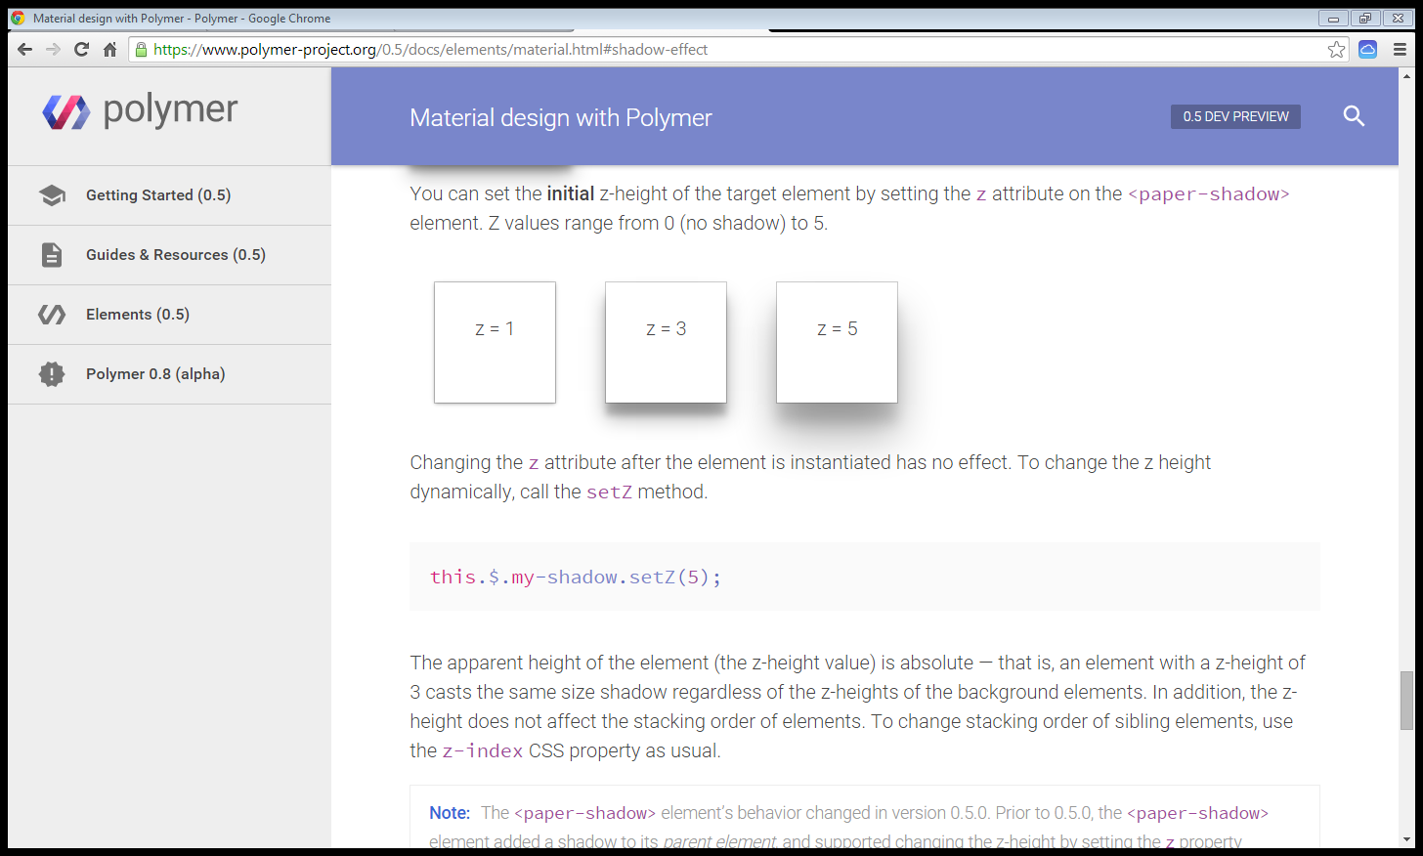
Elements
Example of Material Design w/Polymer
Shadow Elements(aka. Paper Elements)

Slide 10
Resting Elevation
All material objects have a resting elevation, whether the object is a small component or a sheet that spans the entire display.
Applying 3D to objects in material design helps create a spatial model that can be consistently applied across apps in ways that are familiar to users.

Slide 11
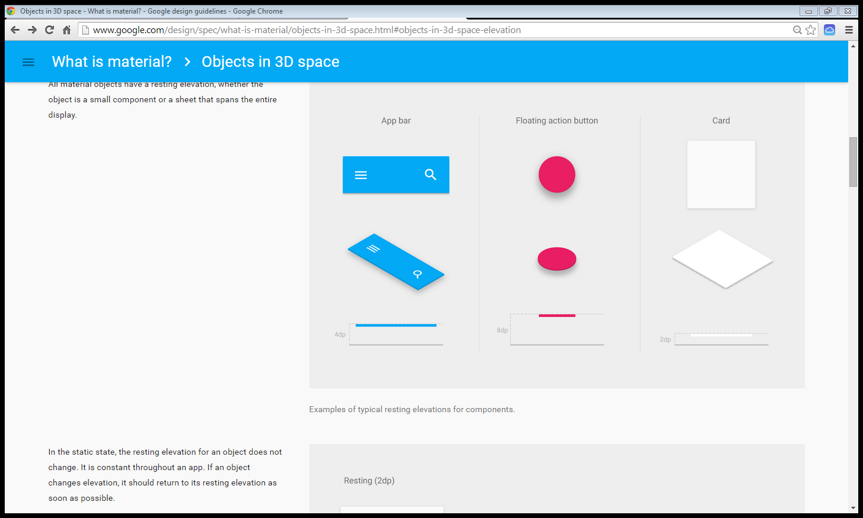
Web Components
Resting Elevations

Slide 12
Why Shadows and Elevations are Awesome
Without a shadow, there is nothing to indicate that the floating action button is a separate surface from the background.
It looks like a circle on top of a square.
With a raised elevation, we can scroll a page underneath of a floating elevation button dynamically with the ability to press the button anytime.

Slide 13
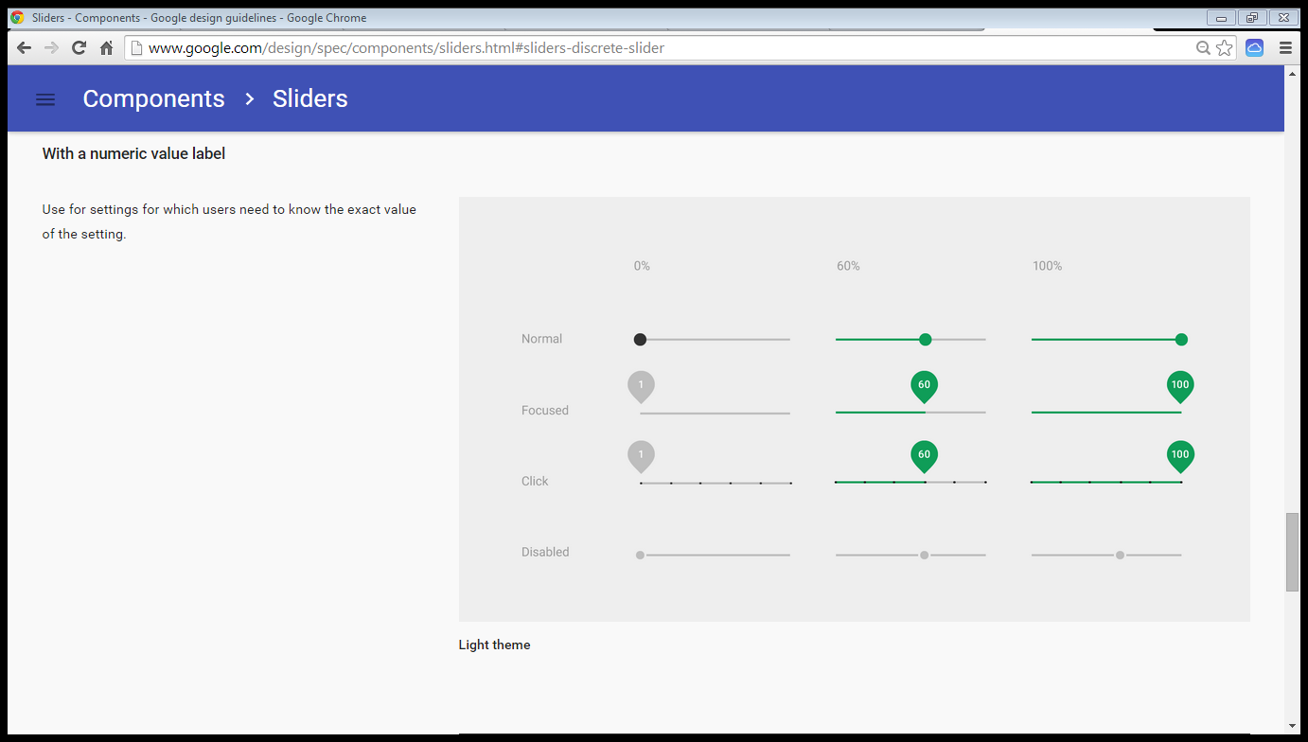
Sliders

Slide 14
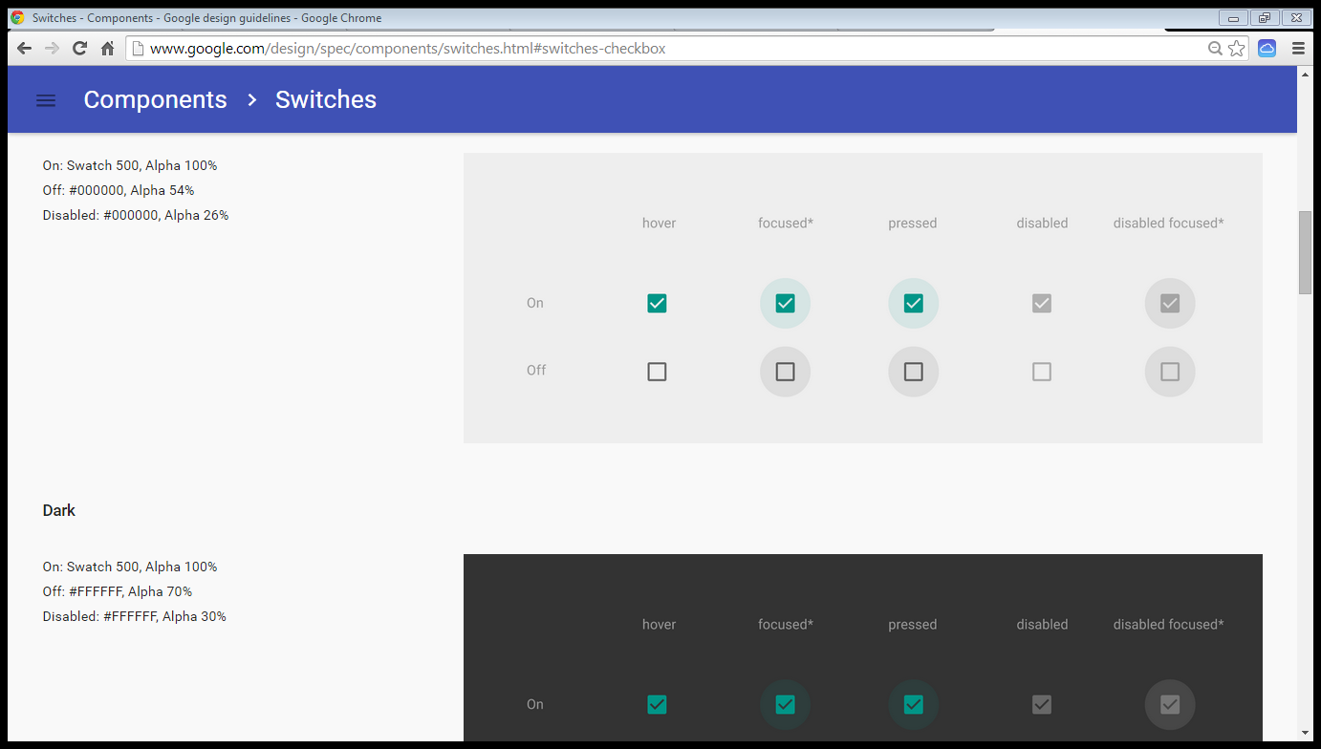
Switches

Slide 15
Surface Reaction
Upon receiving an input event, the system provides an instantaneous visual confirmation at the point of contact.
The core visual mechanism to express this contact is the Touch Ripple. This device articulates the attack and duration of a touch event.

Slide 16
Radial Reaction
All user-initiated actions have an epicenter; the place or places where their intent enters the system. State changes across the screen should trigger progressively as their distance to the point of contact increases, creating a ripple of action.

Slide 17
Radial Reaction
All user-initiated actions have an epicenter; the place or places where their intent enters the system. State changes across the screen should trigger progressively as their distance to the point of contact increases, creating a ripple of action.

Slide 18
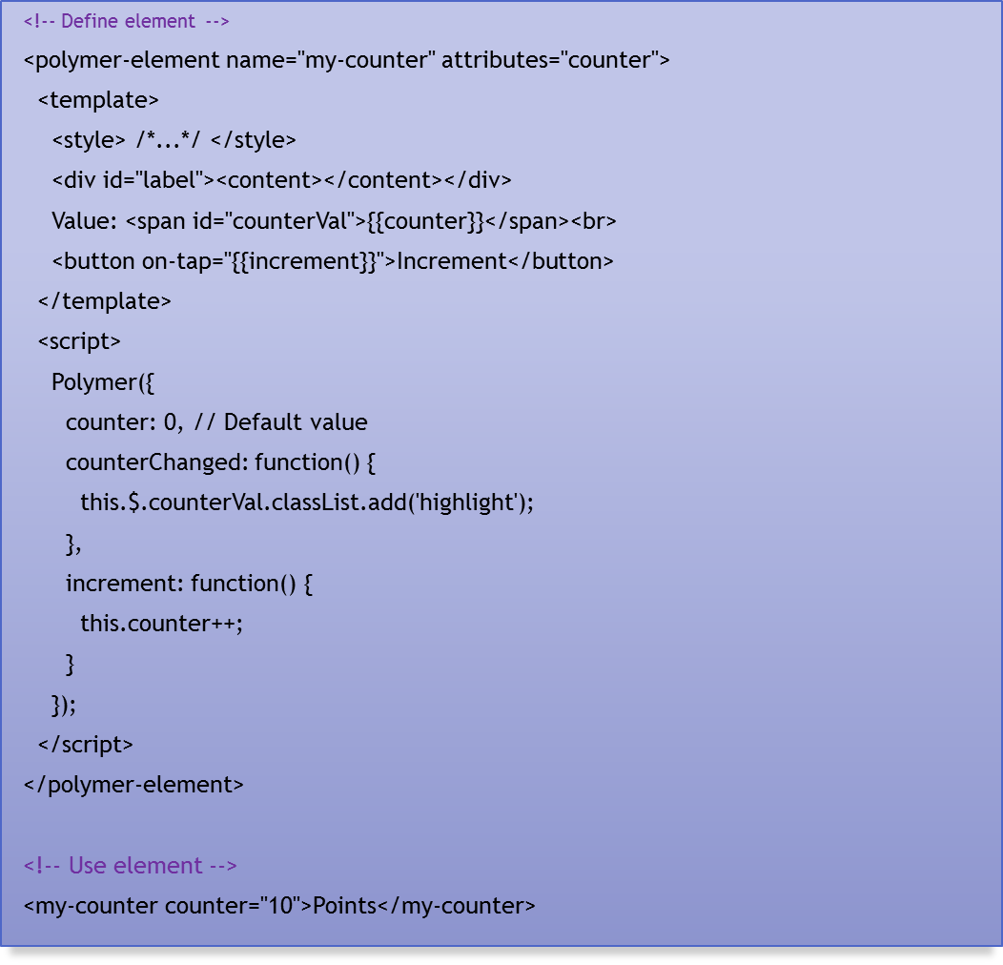
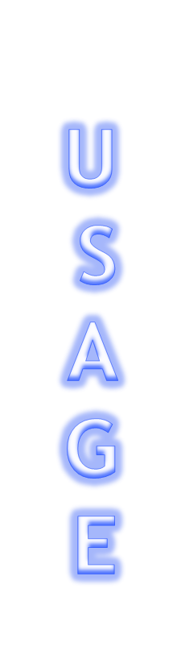

Slide 19
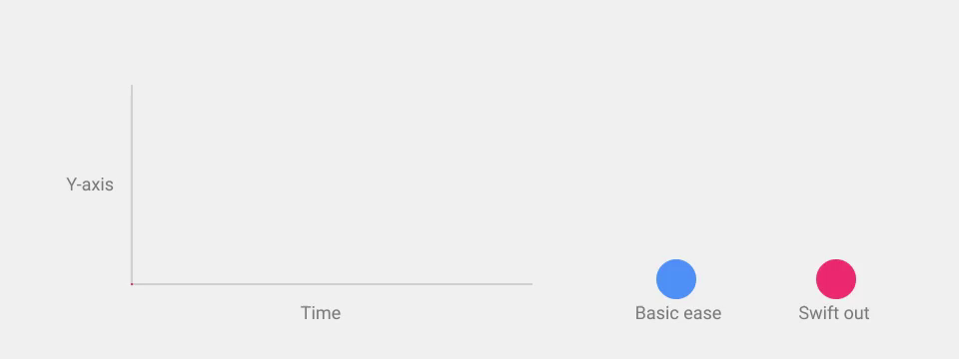


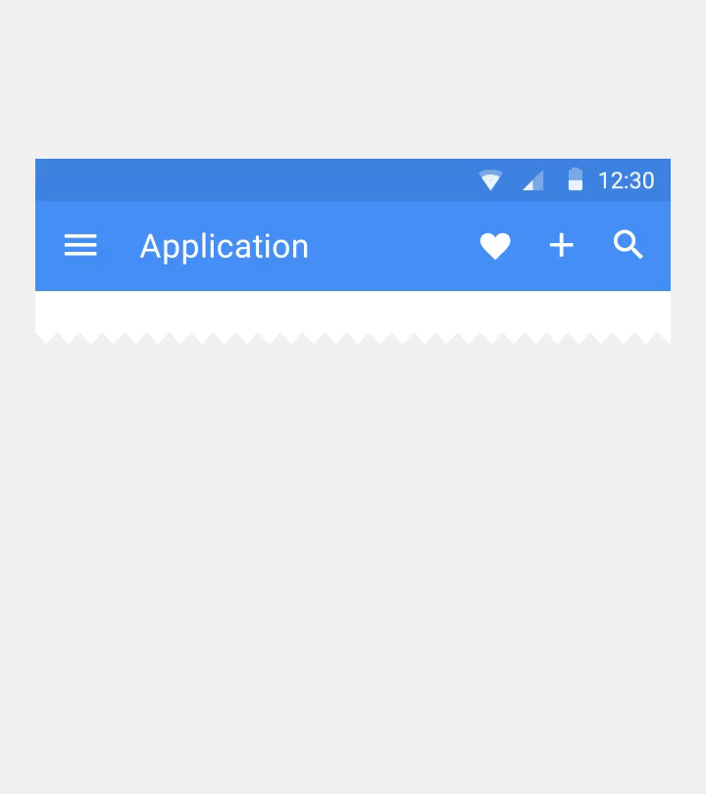
Animations
Animation with abrupt starts and stops or rapid changes in direction appears unnatural and can be an unexpected and unpleasant disruption for the user.

Slide 20

Sources (list them)
http://www.google.com/design/spec/what-is-material/objects-in-3d-space.html#
https://www.polymer-project.org/0.5/resources/faq.html
http://www.yeti.co/blog/evergreen-web-browser/
http://www.google.com/design/spec/animation/responsive-interaction.html#

