Slide 1
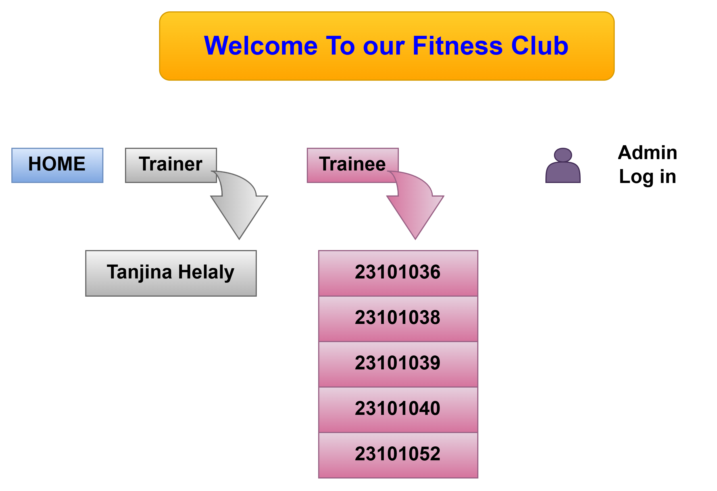

Slide 2
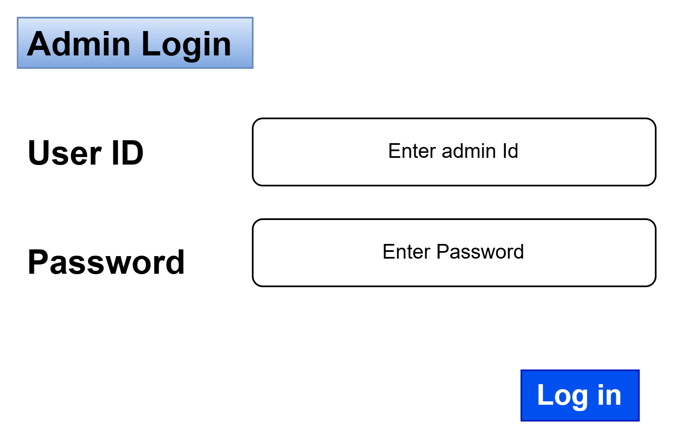

Slide 3
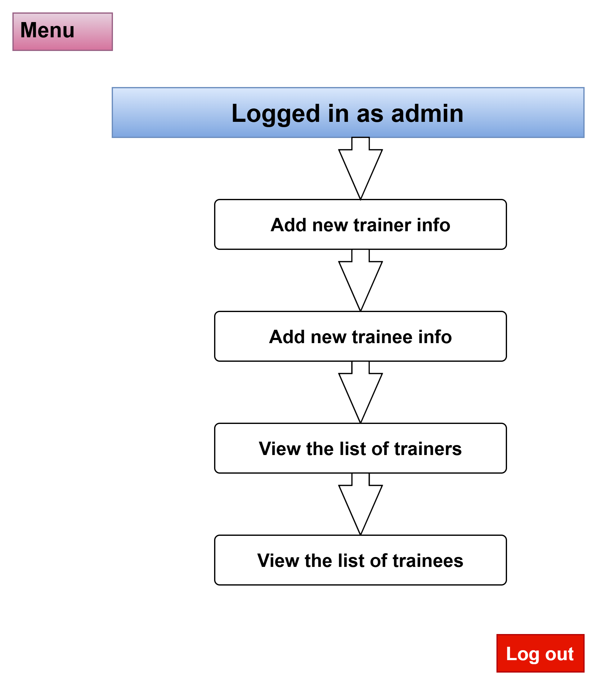

Slide 4
Add new Trainer info
Menu
Logout
Name
Age
Height
Weight
Year of Experience
Back
Save

Slide 5
Add new Trainee info
Menu
Logout
Name
Age
Height
Weight
Back
Save

Slide 6
Trainer
Menu
Logout
View the list
Show
Trainee
Show
Back

Slide 7
Trainer login
Menu
Enter ID
Enter Trainer ID
Login
Back

Slide 8
Set Workout Plan
Menu
Logout
Cycling
Pull up
Push up
Bicep curl
Shoulder Press
Back
Save

Slide 9
Add Workout Item
Menu
Logout
Dumbbell
Barbell
Cable Machine
Smith Machine
Resistance Band
Back
Save

Slide 10
Menu
Logout
View the list of trainees
View the Progress of trainee
Show
Enter ID
Show
Name | ID
Progress
Back

Slide 11
Accept a request
Menu
Logout
View the trainee requests
Show
Name | ID
Trainee ID
Accept
Back

Slide 12
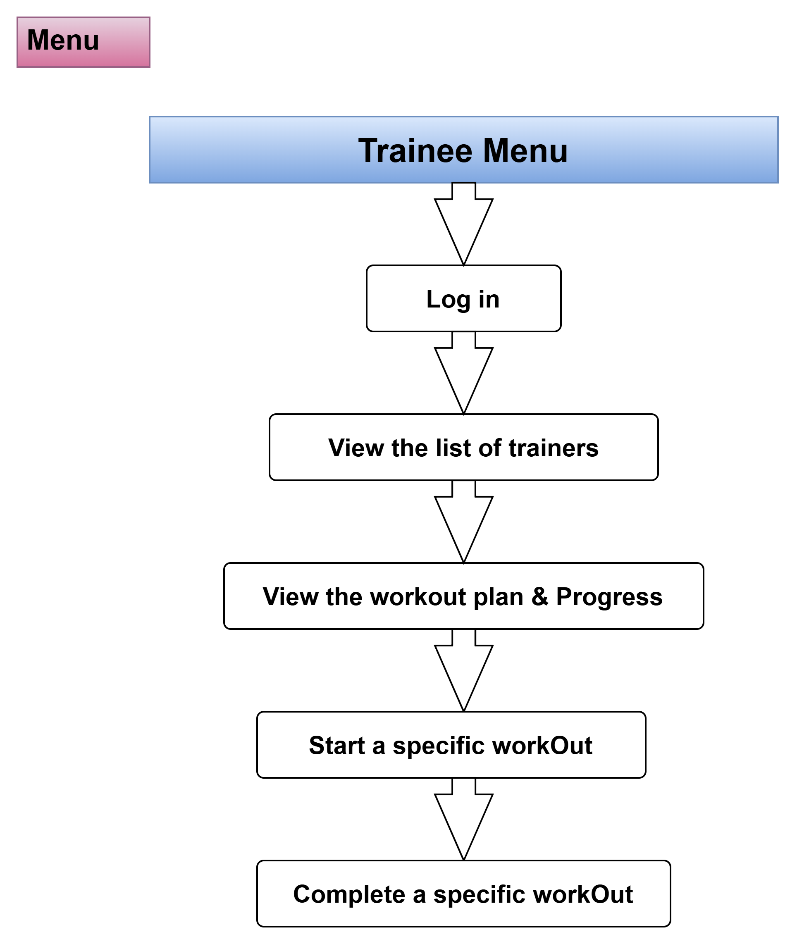

Slide 13
Menu
Enter ID
Enter Trainee ID
Back
Login

Slide 14
Menu
Logout
View the list of trainers
Show
Send a request to a trainer
Trainer Name
Trainer ID
Back
Request

Slide 15
Menu
Logout
View the workout plan and progress
Show
Plan | Progress
Back

Slide 16
Menu
Logout
Start a specific workout
Type
Complete a specific workout
Name
Type
Enter
Back

