Slide 1
ESBM: An Entity Summarization Benchmark
Qingxia Liu¹, Gong Cheng¹, Kalpa Gunaratna², and Yuzhong Qu¹
¹ National Key Laboratory for Novel Software Technology, Nanjing University, China
² Samsung Research America, Mountain View CA, USA

Slide 2
Outline
Introduction
Creating ESBM
Analyzing ESBM
Evaluating with ESBM
Conclusion

Slide 3
Entity Summarization
Description of Tim Berners-Lee:
<Tim Berners Lee, alias, “TimBL”>
<Tim Berners Lee, name, “Tim Berners-Lee”>
<Tim Berners Lee, givenName, “Tim”>
<Tim Berners Lee, birthYear, “1955”>
<Tim Berners Lee, birthDate, “1955-06-08”>
<Tim Berners Lee, birthPlace, England>
<Tim Berners Lee, birthPlace, London>
<Tim Berners Lee, type, People Educated At Emanuel School>
<Tim Berners Lee, type, Scientist>
<Tim Berners-Lee, child, Ben Berners-Lee>
<Tim Berners-Lee, child, Alice Berners-Lee>
<Conway Berners-Lee, child, Tim Berners-Lee>
<Weaving the Web, author, Tim Berners-Lee>
<Tabulator, author, Tim Berners-Lee>
<Paul Otlet, influenced, Tim Berners-Lee>
<John Postel, influenced, Tim Berners-Lee>
<World Wide Web, developer, Tim Berners-Lee>
<World Wide Web Foundation, foundedBy, Tim Berners-Lee>
<World Wide Web Foundation, keyPerson, Tim Berners-Lee>
<Tim Berners Lee, type, Living People>
<Tim Berners Lee, type, Person>
<Tim Berners Lee, type, Agent>
<Tim Berners-Lee, award, Royal Society>
<Tim Berners-Lee, award, Royal Academy of Engineering >
<Tim Berners-Lee, award, Order of Merit>
<Tim Berners-Lee, award, Royal Order of the British Empire>
<Tim Berners-Lee, spouse, Rosemary Leith>
Summary:
<Tim Berners Lee, birthDate, “1955-06-08”>
<Tim Berners Lee, birthPlace, England>
<Tim Berners Lee, type, Scientist>
<Tim Berners-Lee, award, Royal Society>
<World Wide Web, developer, Tim Berners-Lee>

Slide 4
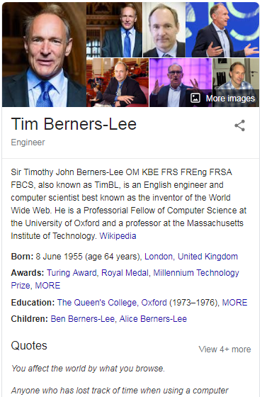
Entity Summarization
RDF Data: T
triple t∈T: <subj, pred, obj>
Entity Description: Desc(e)
Desc(e) ={t∈T: subj(t)=e or obj(t)=e}
triple t∈Desc(e): <e, property, value>
values: class, entity, literal
Entity Summarization (ES): S(e, k)
S⊆Desc(e) , |S|≤k
properties
values
Scientist
Person
England
type
Royal Society
birthPlace
type
Weaving the Web
author
Tim Berners-Lee
award
influenced
birthDate
“1955-06-08”
Paul Otlet
name
influenced
givenName
birthYear
John Postel
“1955”
“Tim”
“Tim Berners-Lee”
Notes:
a set of RDF triples in T which describes entity e

Slide 5
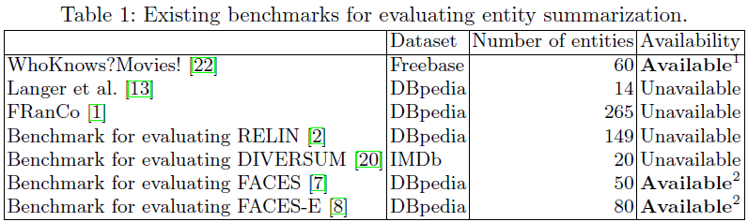
Existing Benchmarks
Limitations
Task specificness
Single dataset
Small size
Triple incomprehensiveness
¹ http://yovisto.com/labs/iswc2012
² http://wiki.knoesis.org/index.php/FACES

Slide 6
Our Work
Motivation
Research Challenges for Entity Summarization:
Lack of good benchmarks
Lack of evaluation efforts
Contributions
Created an Entity Sumarization Benchmark (ESBM v1.2)
overcoming the limitations of existing benchmarks
meeting the desiderata for a successful benchmark
Evaluated entity summarizers with ESBM
made the most extensive evaluation effort to date
evaluated 9 existing general-purpose entity summarizers
evaluated 1 supervised learning-based entity summarizer for reference

Slide 7
Creating ESBM

Slide 8
Design Goals
To satisfy seven desiderata for a successful benchmark^{[18]}
accessibility, affordability, clarity, relevance, solvability, portability, scalability
To overcome limitations of available benchmarks
General-purpose summaries
Including class-, entity-, literal-valued triples
Multiple datasets
Currently largest available benchmark
[18] Sim, S.E., Easterbrook, S.M., Holt, R.C.: Using benchmarking to advance research: A challenge to software engineering. In: ICSE 2003. pp. 74{83 (2003).
Notes:
Task specificness
Single dataset
Small size
Triple incomprehensiveness

Slide 9
Entity Descriptions
Datasets
DBpedia
imported dump files: instance types, instance types transitive, YAGO types, mappingbased literals, mappingbased objects, labels, images, homepages, persondata, geo coordinates mappingbased, and article categories
LinkedMDB
removed triples: owl:sameAs
Entities
sampled from seven large classes:
DBpedia: Agent, Event, Location, Species, Work
LinkedMDB: Film, Person
Triples per entity
By class: 25.88-52.44 triples
Overall: 37.62 triples
Notes:
25.88-52.44 depending on the class

Slide 10
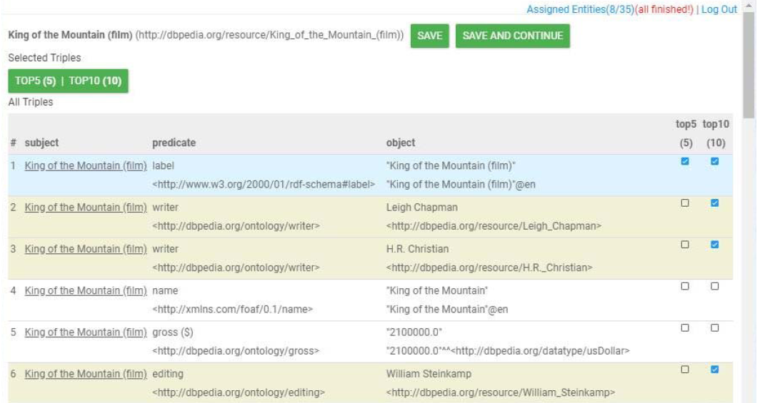
Ground-Truth Summaries
Task
30 users
each assigned 35 entities
175 entities
each assigned to 6 users
Each user created two
summaries for each entity
for k=5 and k=10
Total
6 top-5 summaries
and 6 top-10 summaries
for each entity
175*6*2=2100 ground-truth summaries

Slide 11
The ESBM Benchmark
Usage
ESBM v1.2: specified training-validation-test splits for 5-fold cross validation
Early versions: EYRE 2018 workshop, EYRE 2019 workshop
Desiderata
Accessibility: permanent identifier on w3id.org
Affordability: open-source, example code for evaluation
Clarity: documented clearly and concisely
Relevance: entities sampled from real datasets
Solvability: not trivial and not too difficult
Portability: any general-purpose entity summarizer that can process RDF data
Scalability: reasonably large and diverse to evaluate mature entity summarizers

Slide 12
Analyzing ESBM

Slide 13
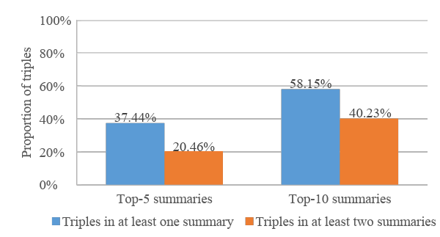
Basic Statistics
175 entities, 6584 triples, 2100 ground-truth summaries
Proportion of triples been selected into ground-truth summaries
Overlap between top-5 and top-10 summaries
Overlap: 4.91 triples
Top-5
summary
Top-10
summary
Notes:
175 entities, 6584 triples
37.44% in top-5, 58.15% in top-10
20.46% and 40.23% by different participants for top-5, top-10
overlap between top-5 and top-10: 4.91 triples
(created by the same participant for the same entity)
(4.80-4.99 triples, depending on the class)
the top-5 summary is usually a subset of the top-10 summary

Slide 14
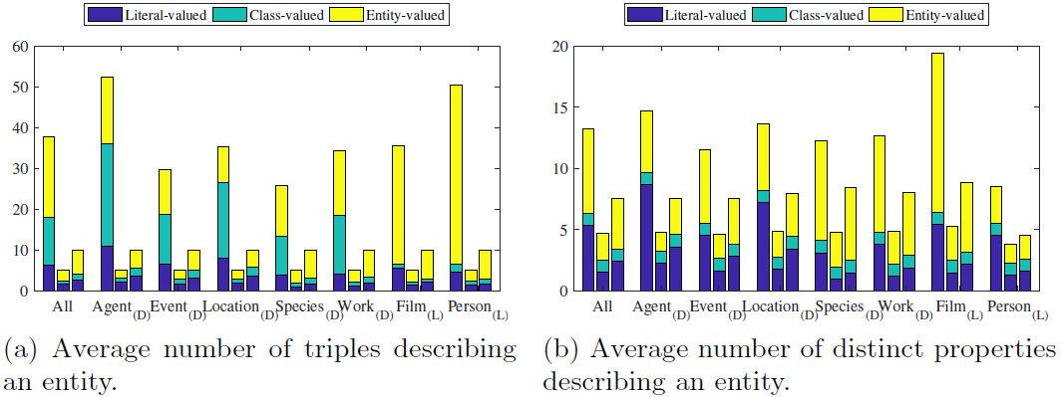
Triple Composition
Literal-valued triples constitute a large proportion in ground-truth summaries.
30% in top-5 ground-truth summaries and 25% in top-10 summaries
Participants are not inclined to select multiple values of a property.
The average number of distinct properties in top-5 ground-truth summaries is 4.70 (very close to 5)
Three bars in each group: Entity descriptions, Top-5 ground-truth summaries, Top-10 ground-truth summaries

Slide 15
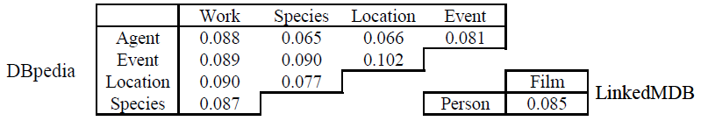
Entity Heterogeneity
Entity Description
Jaccard similarity between property sets from each pair of classes is very low.

Slide 16
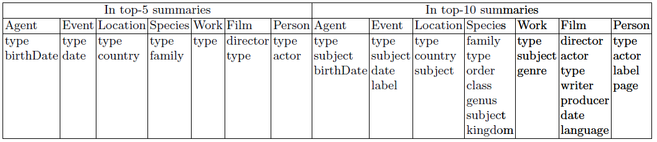
Entity Heterogeneity
Ground-truth Summaries
Popular properties:
properties that appear in >50% ground truth summaries for each class
Only 1~2/13.24 properties are popular in top-5 ground-truth summaries
The importance of properties is generally contextualized by concrete entities.
Notes:
Universal properties & class-specific properties

Slide 17
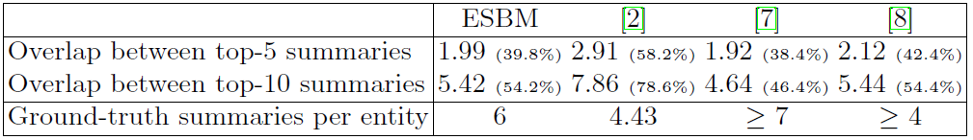
Inter-Rater Agreement
Average overlap between 6 ground-truth summaries
Moderate degree of agreement
Comparable with those reported for other benchmarks
[2] Cheng, G., Tran, T., Qu, Y.: RELIN: relatedness and informativeness-based centrality for entity summarization. In: ISWC 2011, Part I. pp. 114-129 (2011).
[7] Gunaratna, K., Thirunarayan, K., Sheth, A.P.: FACES: diversity-aware entity summarization using incremental hierarchical conceptual clustering. In: AAAI 2015. pp. 116-122 (2015).
[8] Gunaratna, K., Thirunarayan, K., Sheth, A.P., Cheng, G.: Gleaning types for literals in RDF triples with application to entity summarization. In: ESWC 2016. pp. 85-100 (2016).

Slide 18
Evaluating with ESBM

Slide 19
Participating Entity Summarizers
Existing Entity Summarizers
RELIN, DIVERSUM, LinkSUM, FACES, FACES-E, CD
MPSUM, BAFREC, KAFCA
ORACLE Entity Summarizer
k triples that are selected by the most participants into ground-truth summaries
Supervised Learning-Based Entity Summarizer
6 models:
SMOreg, LinearRegression, MultilayerPerceptron, AdditiveRegression, REPTree, RandomForest
7 features:
gf_{T}(global frequency of property), lf(local frequency of property), vf_{T}(frequency of value), si(self-information of triple)
isC(value is class), isE(value is entity), isL(value is literal)

Slide 20

Settings
Evaluation Criteria
S_{m}: machine-generated entity summary
S_{h} : human-made ground-truth summary
P≠R if |S_{m}|<|S_{h} |=k

Slide 21
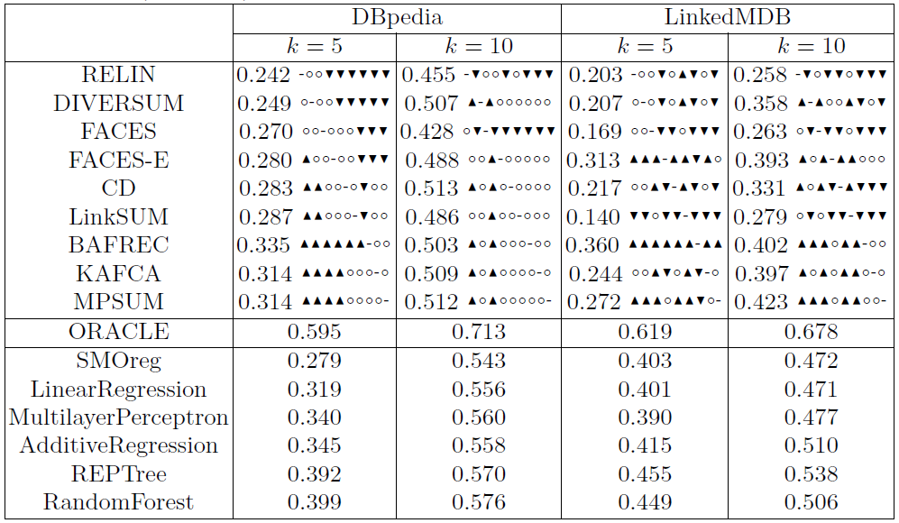
Overall Results

Slide 22
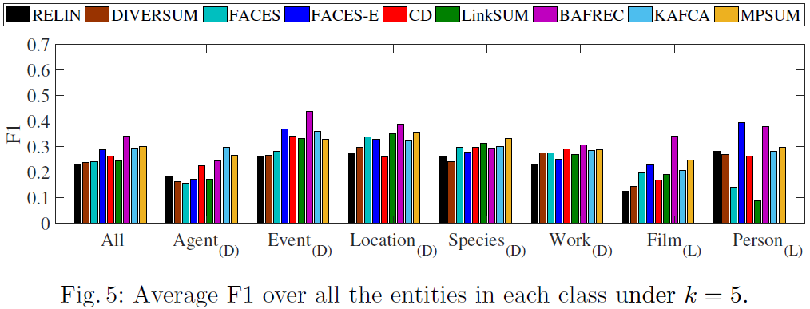
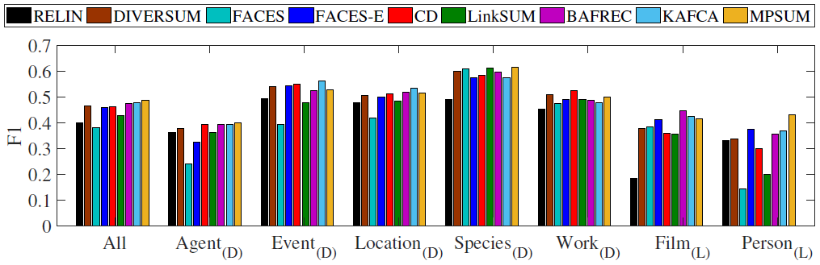
Results on Different Entity Types
k=5
k=10

Slide 23
Results of Supervised Learning
F1 results
RandomForest, REPTree achieve the highest F1.
Four methods outperform all the existing entity summarizers.
Two methods only fail to outperform existing entity summarizers in one setting.
Demonstrated the powerfulness of supervised learning for entity summarization.

Slide 24
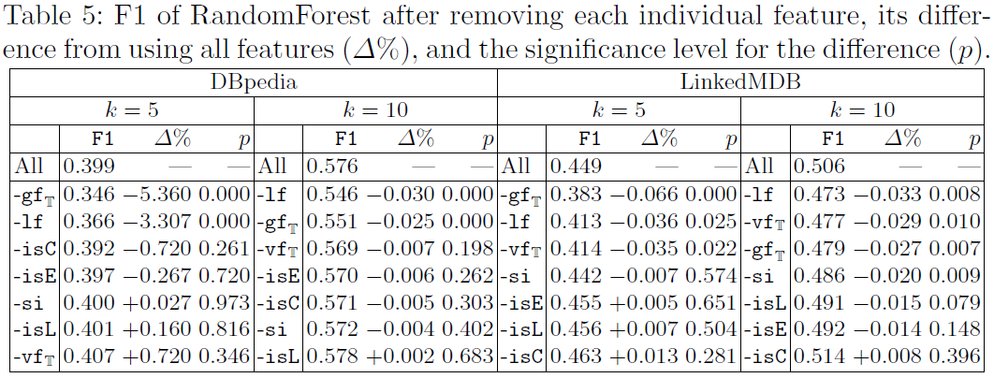
Results of Supervised Learning
Features
for each t=<e, p,v> in Desc(e):
gf_{T}: # triples in the dataset where p appears
lf: # triples in Desc(e) where p appears
vf_{T}: # triples in dataset where v appears
si: self-information of triple t
isC: whether v is a class
isE: whether v is an entity
isL: whether v is a literal
Results
significantly effective: gf_{T}, lf
for LinkedMDB: vf_{T}, si
not significant: isC, isE, isL
Notes:
7 features
effective: gf_T, lf;
only effective on LMDB: vf_T, si;
not significant: isC, isE, isL;

Slide 25
Summary of Evaluation Results
Existing entity summarizers
Leading systems: BAFREC, MPSUM
Supervised Learning method
Outperforms existing entity summarizers
Comparing with ORACLE
Still a large gap for improvement
Entity summarization on ESBM is a non-trivial task.

Slide 26
Conclusion

Slide 27
Limitations
Evaluation Criteria
semantic overlap between triples
Representativeness of Ground Truth
general-purpose VS. task-specific
Form of Ground Truth
set-based VS. scoring-based

Slide 28
Take-home Message
Contributions
Created an Entity Summarization Benchmark: ESBM
overcoming the limitations of existing benchmarks
Evaluated entity summarizers with ESBM
the most extensive evaluation effort to date
ESBM
The currently largest available benchmark for entity summarization
Entity summarization on ESBM is a non-trivial task
Permanent link: https://w3id.org/esbm/
GitHub repository: nju-websoft/ESBM
An Upcoming Paper
Junyou Li, Gong Cheng, Qingxia Liu, Wen Zhang, Evgeny Kharlamov, Kalpa Gunaratna, Huajun Chen. Neural Entity Summarization with Joint Encoding and Weak Supervision. IJCAI-PRICAI 2020
Deep learning based
Significantly outperformed all the existing systems on ESBM

Slide 29
Thank you !
Questions ?

