Slide 1
Modeling Human Migration Patterns during Drought Conditions in La Guajira, Colombia
Sibren Isaacman
Loyola University Maryland
Vanessa Frias-Martinez University of Maryland
Enrique Frias-Martinez Telefonica Research

Slide 2
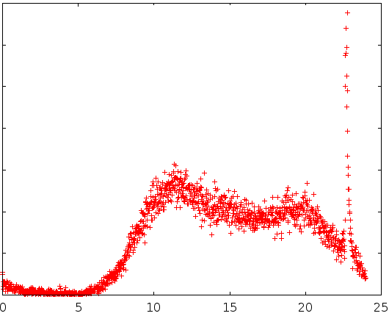
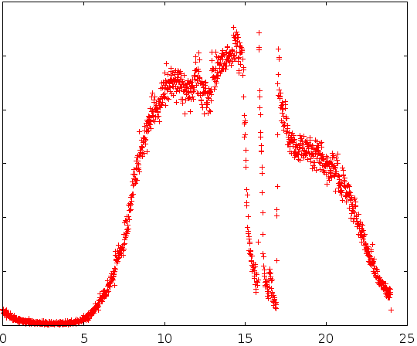
Modeling events
Relatively easy to spot in calling patterns
Disasters are commonly modelled
Cell phone records
Other location-based services
Finding climate change effects is harder

Slide 3
Finding and Modeling Climate Migration
Survey data show migration/climate link
Both short- and long-term
Migration patterns may be spotted in cell phone traces
This work: combine those facts
Cell phone records detect population loss in drought stricken region
Models of mobility enhanced to model climate migration

Slide 4
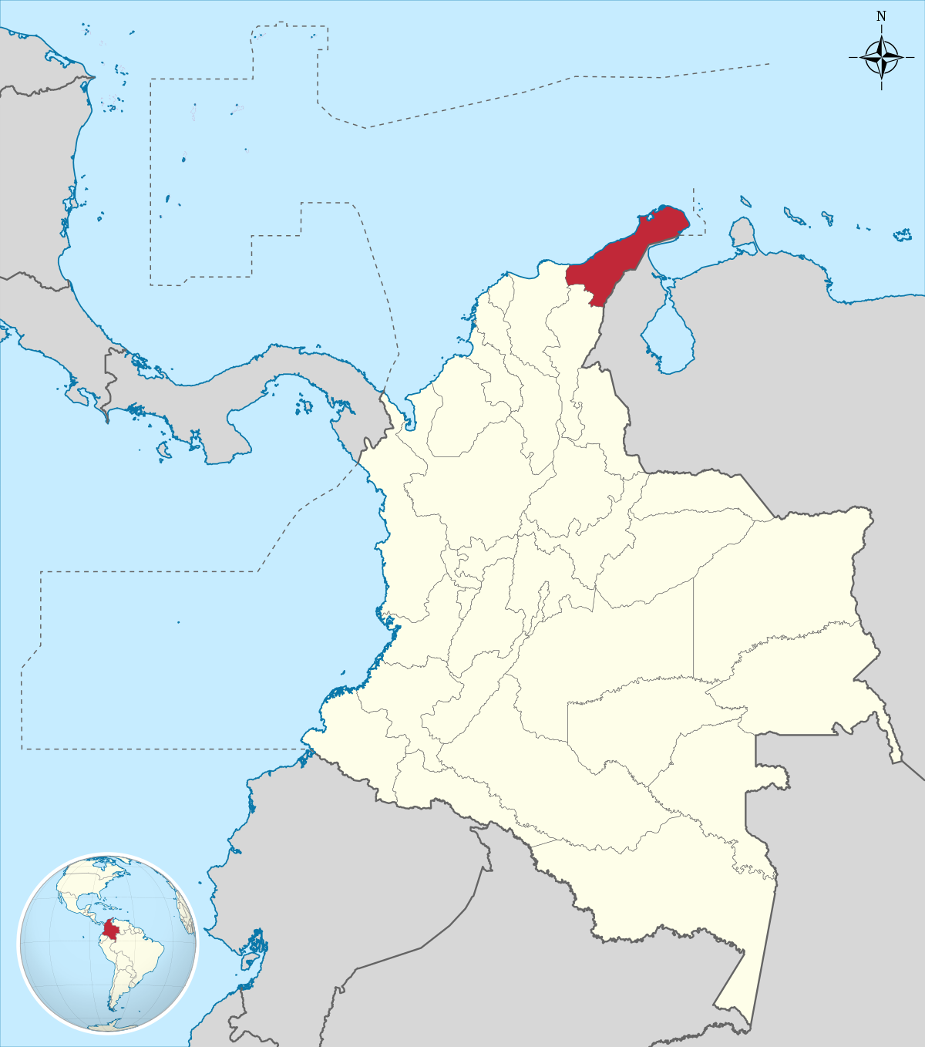
La Guajira, Colombia
Department in Colombia
Population: 900,000
Area: 20,848 km²
Drought induced state of emergency declared Feb. 2014

Slide 5
Call Data Available
Dec. 2013 – May 2014
Call Record for Anonymized users
Tower Location
Course Grain Approximation of user location
Time
Filtered to users making at least 1 call in La Guajira
150,000 users
69 million calls

Slide 6
Finding Home
Most frequent Tower on weeknights
Low population density mean distributed towers
Weekend behavior assumed un-representative
Weeks without data maintain previous home location
Weeks prior to initial call retroactively assignment first home

Slide 7
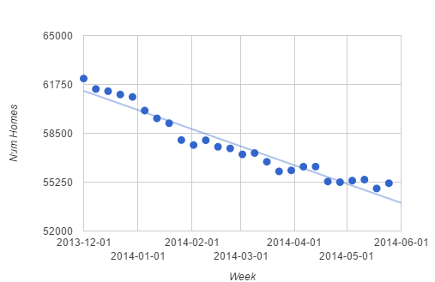
People Left Home…
R²=0.93 – 10% of the population left

Slide 8
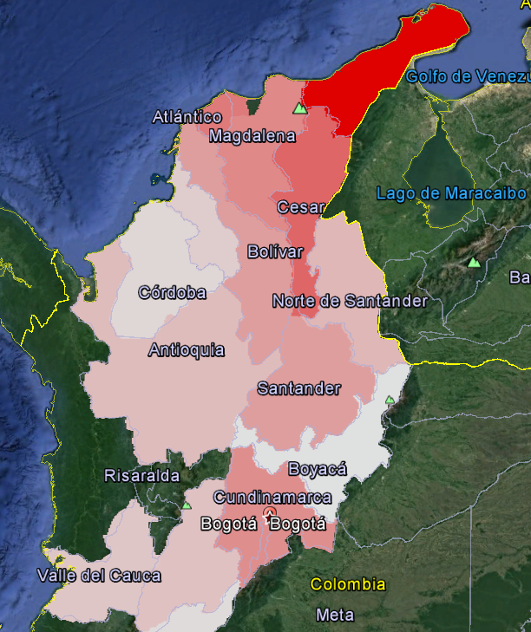
…but traveled “predictably”
90% of people leaving home stay in La Guajira
Migrants stay close to original home
High density cities disproportionately popular

Slide 9
“Traditional” Movement Models
Ask the question: “How many people commute from A to B”?
Gravity Model Attraction
Increased by number of people at B
Decreased by distance
Exponential Law
Power Law
Radiation Model Attraction
Increased by number of people at B
Decreased by “intervening opportunities”
Total people between A and B

Slide 10
Using the Models
Populations from Census
Distances from centroid of department
Number of migrants from number of new homes each week
“Correctness” as Common Part of Commuters (CPC)
Actual new home locations vs. predicted
O-D Matrix with only La Guajira as an origin
0-1 metric of entries in common
Calculated Weekly
Turned “Beta” parameter for optimal performance

Slide 11
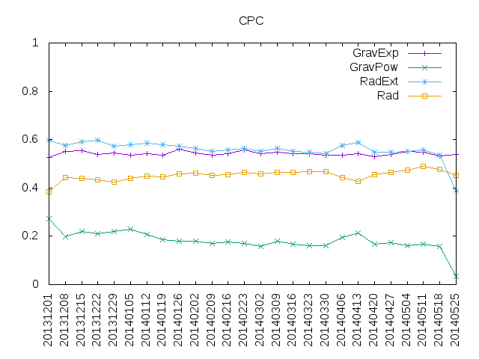
Base Model Performance
GravExp and RadExt predict about 60%

Slide 12
Rainfall metrics as “intervening” modifier
Rainfall data from Colombian Nation Weather Service
Matrix of provincial rainfall totals
Aggregated Weekly
Scaled and added to intervening opportunities
Prior weeks’ data added in
Opp_{ij}’=∑α*rain_{ij}+Opp_{ij}

Slide 13
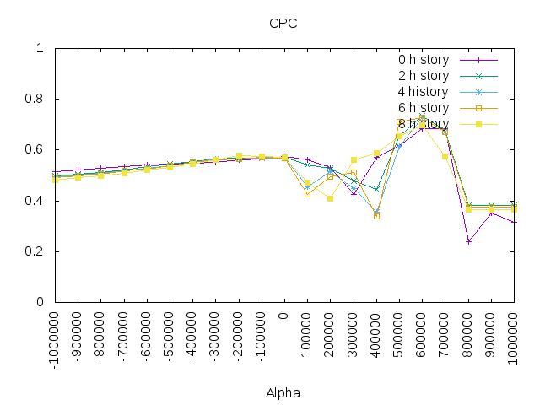
Rainfall’s effect on a random week
Vast potential (up to 0.78)
History doesn’t matter much

Slide 14
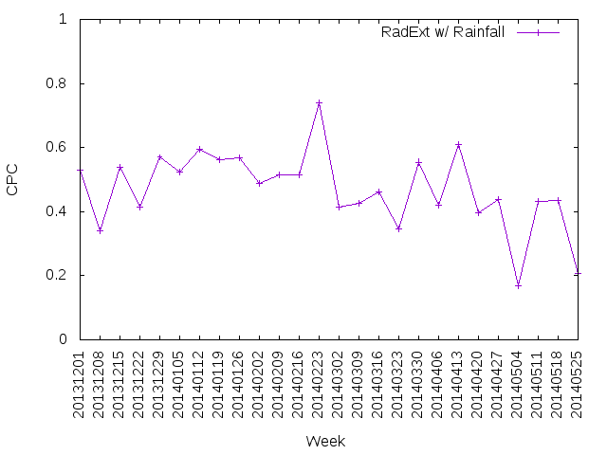
Normalizing the Weather Model
Tuning to a single week not generalizable
Total rainfall varies
Alpha not unitless
Normalize population and weekly rainfall

Slide 15
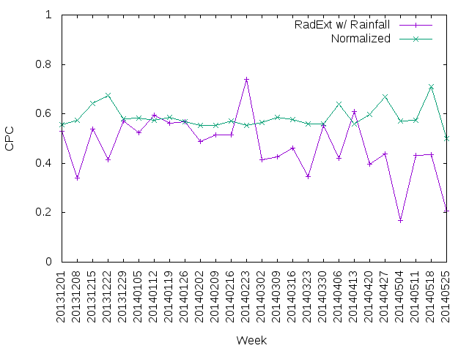
Normalized results = more stable behavior

Slide 16
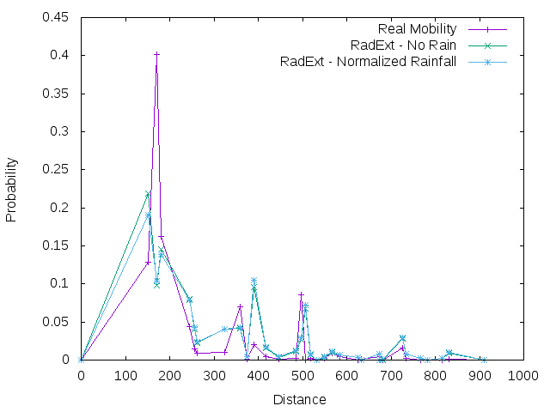
Impact of Rainfall on the model
Misses this peak
Improves shorter distances
4.5% improvement in RSS

Slide 17
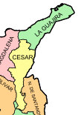
Why we missed that peak
Large Urban Area
Department Centroid

Slide 18
Conclusions
Migration during climate change can be seen in CDRs
10% decrease in population
Both at municipal and state levels
Radiation models work fairly well
Economic and social factors in those models work for drought
Rainfall can offer minor improvements
4.5% improvement in RSS

Slide 19
Modeling Human Migration Patterns during Drought Conditions in La Guajira, Colombia
Sibren Isaacman
Loyola University Maryland
Vanessa Frias-Martinez University of Maryland
Enrique Frias-Martinez Telefonica Research

