Slide 1
Template Views

Slide 2
static
dynamic
vs
JavaScript
HTML
JPEG, PNG
mp4, MOV
Django Templates
JavaScript
Notes:
STATIC html and css files. That is, The file will always appear in the same way, and you cannot have users. However, that is not what we want. We would like different users to have a different experience, and we would like videos and courses to upload automatically without us having to change the HTML file. That is called DYNAMIC files. However, we must still use some static files, but we will learn more about the use of static files later. Let's take one step at a time
We will be mainly working with two ways of dynamically changing the HTML page: Django Templates and JavaScript

Slide 3
{% Template tags %}
{% if <condition> %} {% elif %} {% else %} {% endif %}
{% for <var_name> in <iterable> %} {% endfor %}
{% load <module_name> %}
{% extends %}
{% block <block_name> %} {% endblock <block_name> %}
Notes:
Django TemplatesYou see that the template_name has a ".html" extension, but inside that file you see syntax that does not belong to HTML, CSS, nor JavaScript, like {% load static %}. This is the magical Python code that we can insert into the HTML. The Django TemplateView class parses through the file in the background and exectues the code in between {% %}. All of the {% %} get deleted in the end, so we are left with pure HTML syntax.
{% if <condition> %} {% elif %} {% else %} {% endif %}{% for <var_name> in <iterable> %} {% endfor %} Yeah since we don't have Python indentation syntax in HTML, we must tell Django when to stop the if. Same for “for”.
{% load <module_name> %}"load" means kinda like "import". However, you cannot simply import numpy with "load numpy". You can only import certain modules that are special for templates. The most common ones are "static" and "i18n". "static" is to get the URL for static files, and "i18n" imports the "trans" function for translation. i18n stands for InternationalizatioN because there are 18 letters between i and n haha
{% extends %}{% block <block_name> %} {% endblock <block_name> %}Let's see if you guess what these are for by playing with the file.

Slide 4
Static files

Slide 5
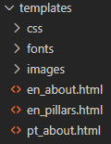
Conventional Way
Problems
How will Django know which files are private (.py, .yaml, .html) and which are available for everyone ( .css, .js)?
How does the path css/styles.css fit into our urls.py scheme?

Slide 6
What Django does
Externally serving files
Explicitly telling Django which files are static in settings.STATICFILES_DIRS
Bundling all those static files together into a static folder called STATIC_ROOT
Adding them to our urls.py in an extension called STATIC_URL
python manage.py collectstatic

Slide 7
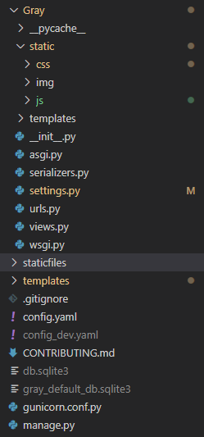
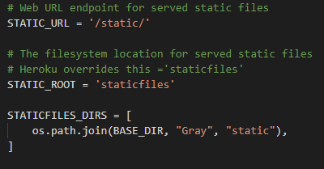
Static files in settings.py

Slide 8
python manage.py collectstatic
Look inside every path in STATICFILES_DIRS
Copy every single file into STATIC_ROOT
Give them additional ID’s so that there is no conflict
We may later reference them with href="/static/<file_path_with_ID>”
Or, more simply, with href=“{% static ‘<file_path_original_name>’ %}”

