Slide 1

Introduction to EOAFRICA R&D facility and the innovation lab
face 2 face workshop Soil Moisture and Inland Water Monitoring with Satellite Radar
Dar es Salaam, Tanzania, 19th October 2023
Roelof Rietbroek, Paul Vermunt

Slide 2
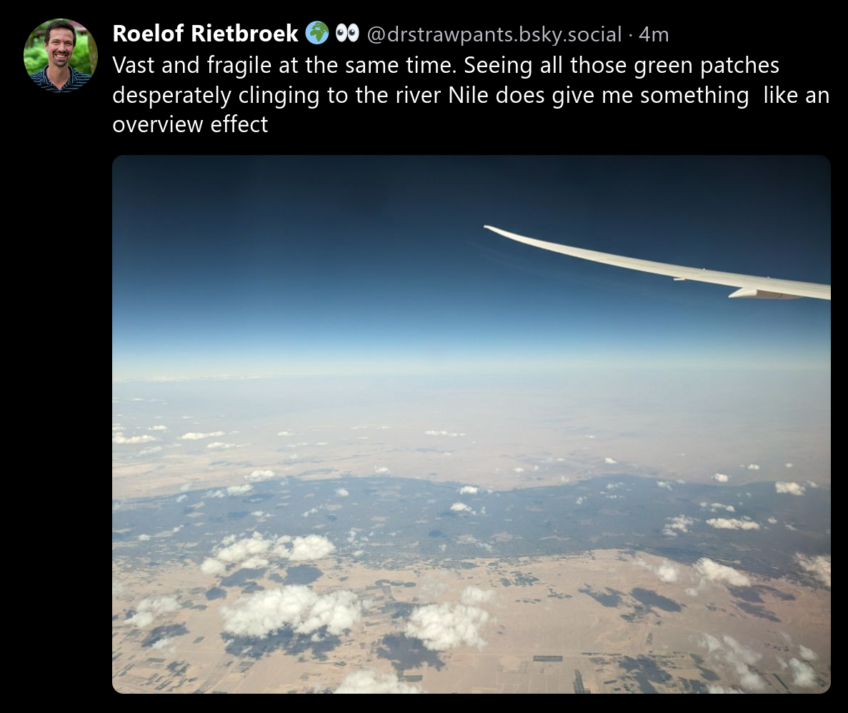
A personal note

Slide 3
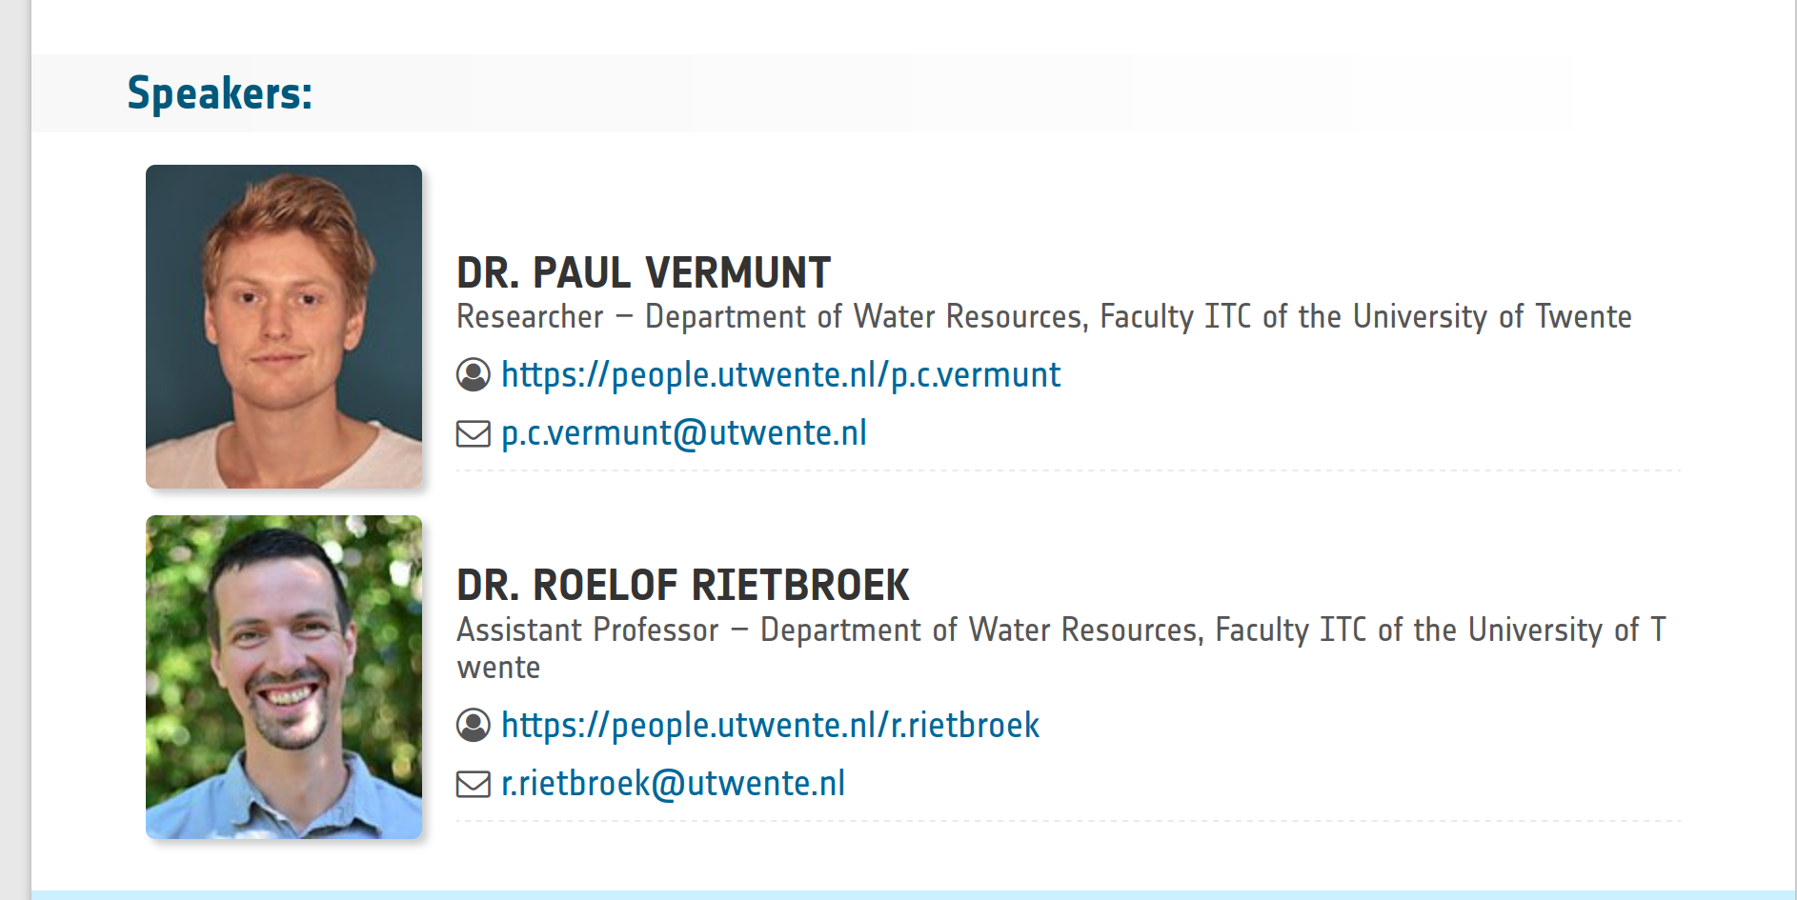
Who are we?
Notes:
Please raise your hand if you’re working in
* academia/practioners/government/other?
* field: agriculture/water management/climate studies/other?

Slide 4
This week
Intro to the Innovation lab
Soil Moisture (Tuesday and Wednesday)
Radar altimetry (Thursday and Friday)
Purpose: lower the barrier for you to work with satellite data

Slide 5
Today: get to know the Innovation lab
What is Jupyter Lab?
Cloning git repositories
Taking control: Creating your own (conda) environment
  Installing extra tools
Some exploratory exercises
  Using xarray? Rasterio?, (geo)-Pandas?

Slide 6
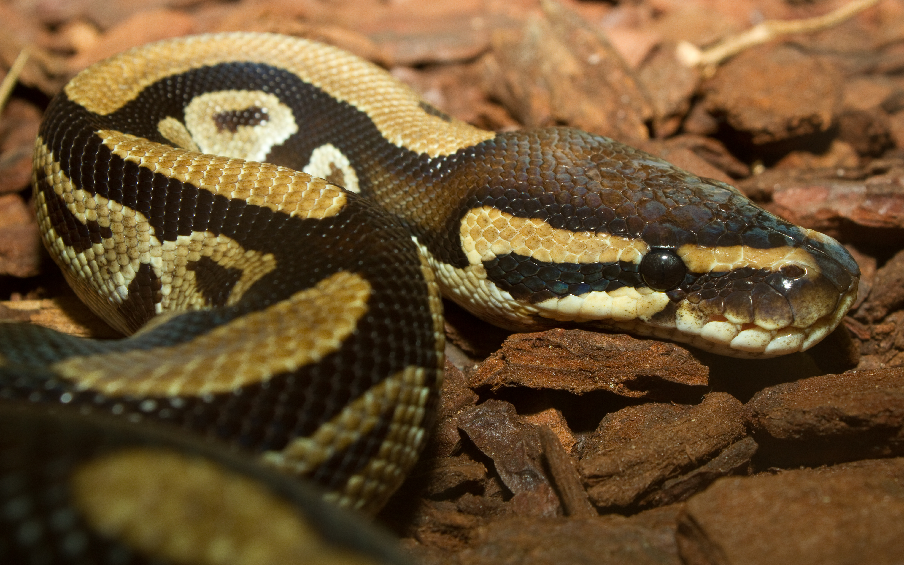
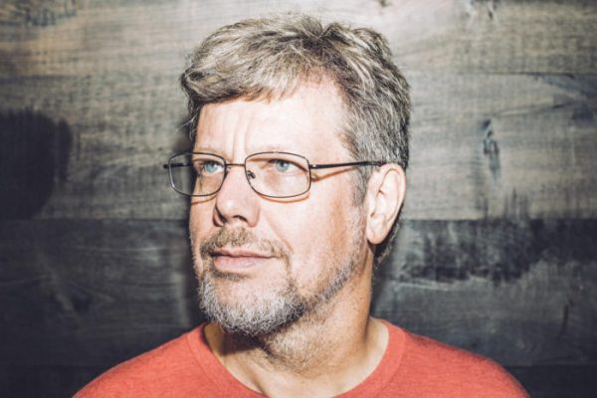
First assignment: team up
Rate you python skills:
1 < -- > 5
Pair up while mixing your skills

Slide 7
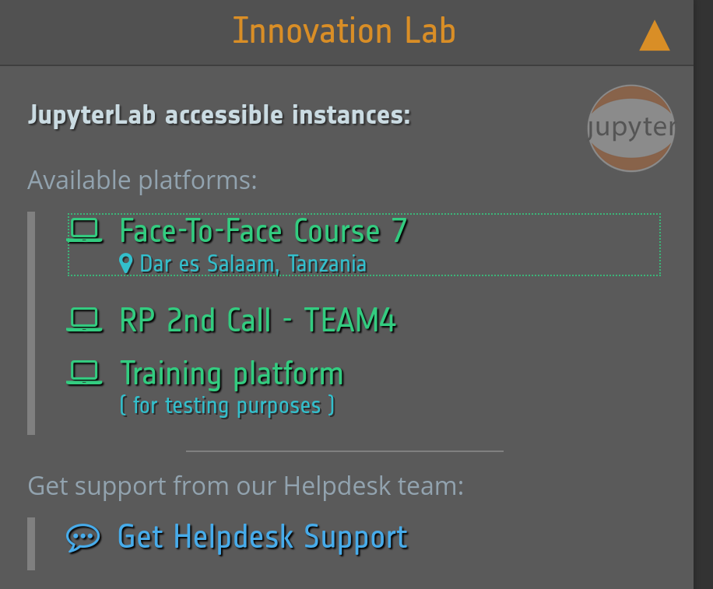
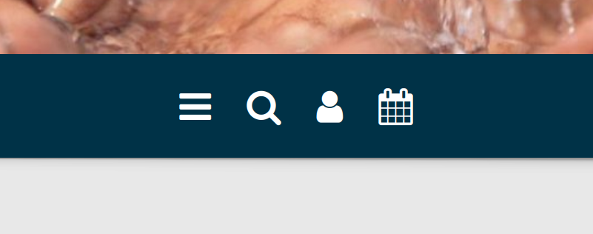
Log in to the innovation lab
https://www.eoafrica-rd.org/

Slide 8
What is in the folders?
Explore the folders
Where do you have write access?
How can you share data with other participants?
What are ‘your’ folders (i.e. not visible to others)?

Slide 9
Clone a git repo containing a Jupyterlab intro
Clone an EOAfrica repository with a Jupyterlab explainer
  Repository location (Courtesy: Longzhu Shen): https://github.com/EOAfrica/JupyterLab_Intro
  Two ways possible
    Through the git extension
    Through a terminal
  Did you succeed?

Slide 10

Let’s have a look at the Jupyterlab intro

Slide 11
Set up a conda/pip environment
As a user you may find that some packages are not installed
  Ask the admin? (takes a lot of time..)
But you can also create your own local installation
  Using Python venv module: light, but python packages only
  Or using anaconda/miniconda: heavier but also allows installation of other packages
  You can tell jupyterLab to grab your own environment instead of the existing one
Let’s try that..
  But first clone another git repository

Slide 12
Exploratory assignment
There is a lot of data in the eodata folder
Pick a dataset of interest
Use a notebook to create a plot of a datasets and document your findings
Some python packages can be usefu:
  Xarray
  Rasterio
  Matplotlib
Share (copy) your notebook in the shared folder
Explore a notebook from somebody else

