Slide 1

Remote sensing of rivers and lake water heights (part II)
face 2 face workshop Soil Moisture and Inland Water Monitoring with Satellite Radar
Dar es Salaam, Tanzania, 19th October 2023
Roelof Rietbroek

Slide 2
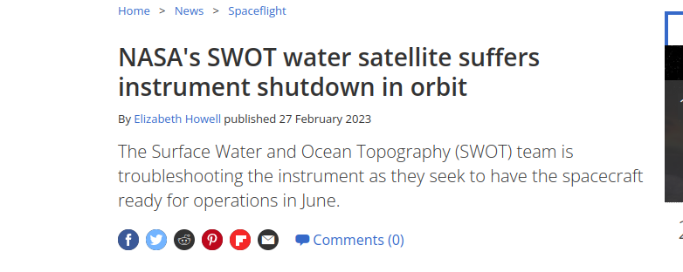
SWOT worries?

Slide 3
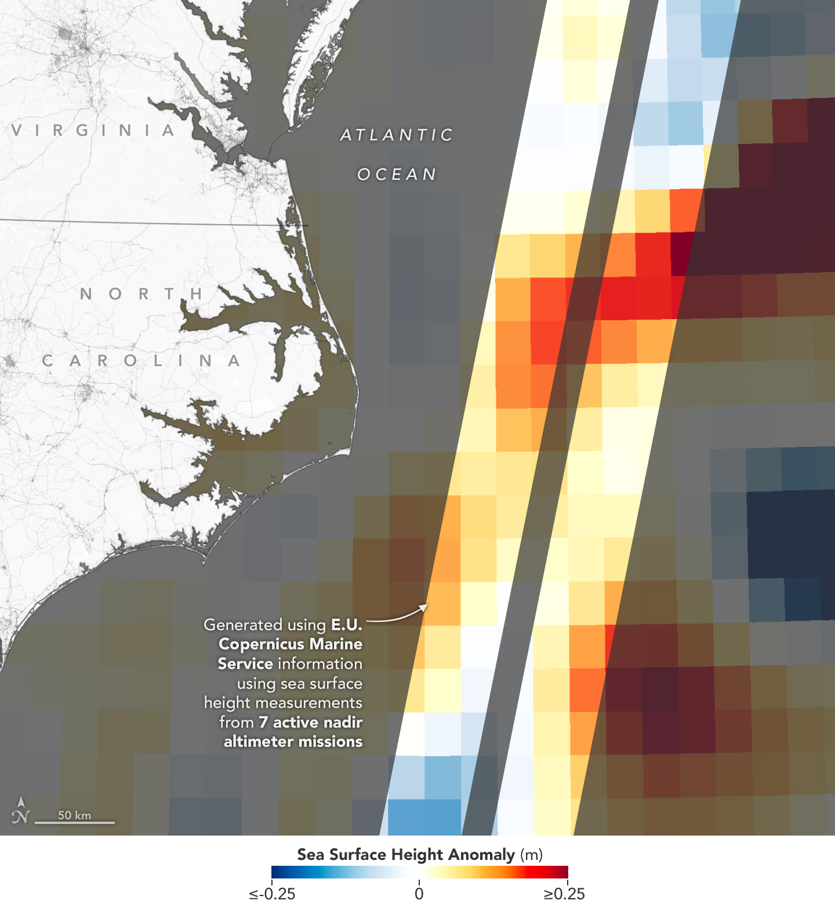
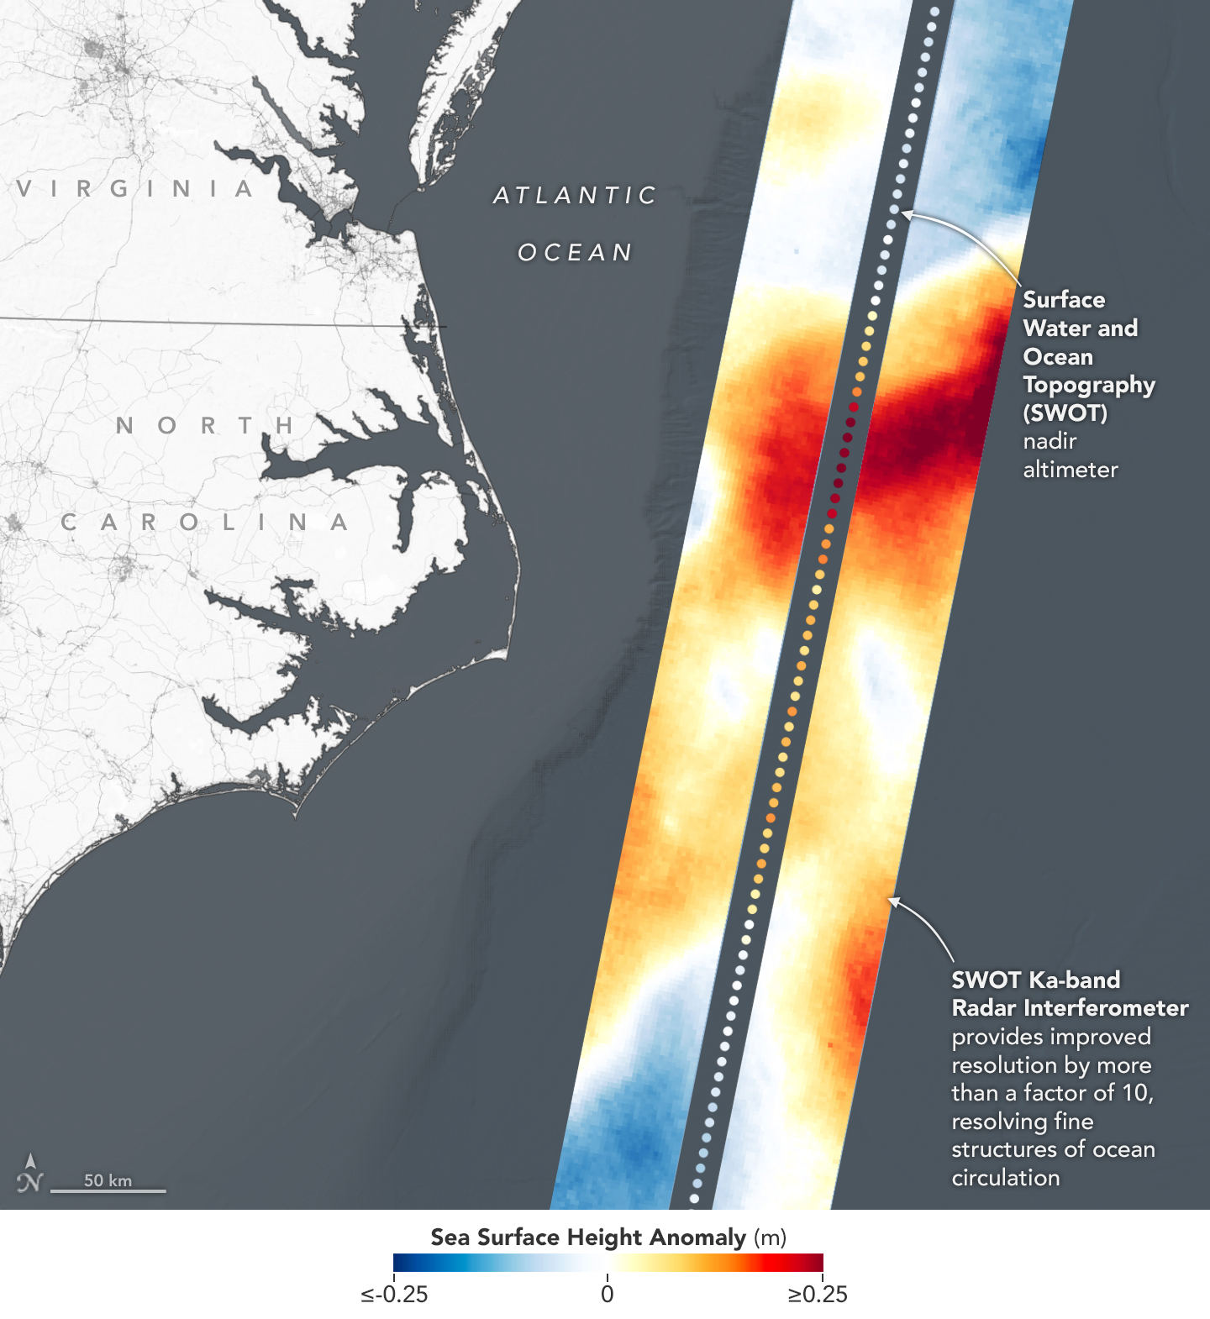
SWOT first results of Karin instrument

Slide 4
Today (& tomorrow → today)
Motivation of measuring lake and river heights from space
Principles of radar altimetry
  “conventional” radar altimetry (pulse limited)
  “modern” radar altimetry (beam limited)
  Geophysical corrections

Slide 5
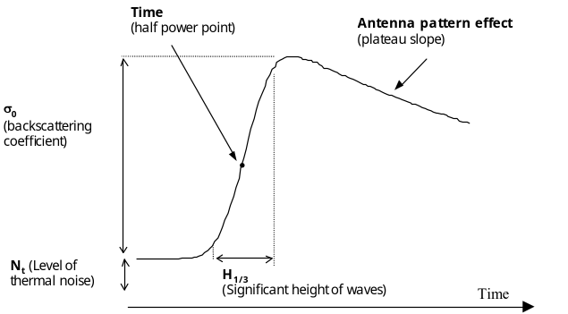
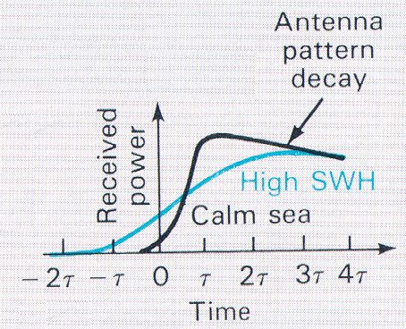
Recap: building a waveform
Pulse repetition frequency ~ 2 kHz
  Collect over an integration time (20Hz)
X-axis: Chirps are deramped and binned according to their delta t (range gates)
Y-axis: Average the received pulses (power) in 20 Hz blocks (y-axis)
Pulse-limited: Chirp bandwidth (B) determines range resolution:
  Dr =c/(2B). So B=320Mhz resolves to 0.468m (3 nanosec) range resolution
  When a waveform has 128 gates, how large is the “range window”?
Over the ocean: the waveform can be modelled wit an analytical ‘Brown model`
)
)
)
)
)
)
)
Standard (ocean) retracker gate is aligned to fixed gate (e.g. 32.5)
Ground resolution cell (3-5 km)
Image Credit Keith Raney

Slide 6
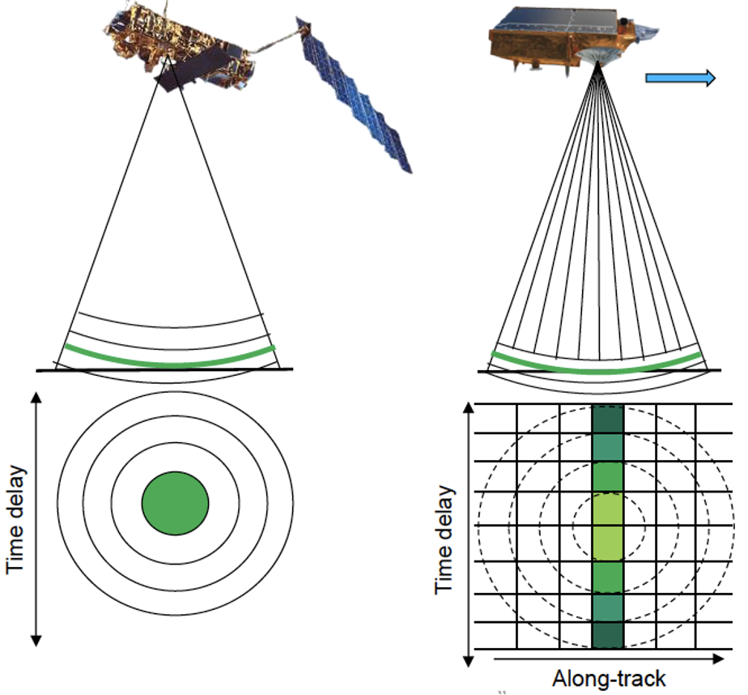
Conventional versus SAR altimetry
Conventional (or Low resolution mode): pulse limited
SAR (or delayed doppler): pulse limited cross-track but beam limited along track
How can we assign reflections to alongtrack bins???
Image Credit: Felix Müller

Slide 7
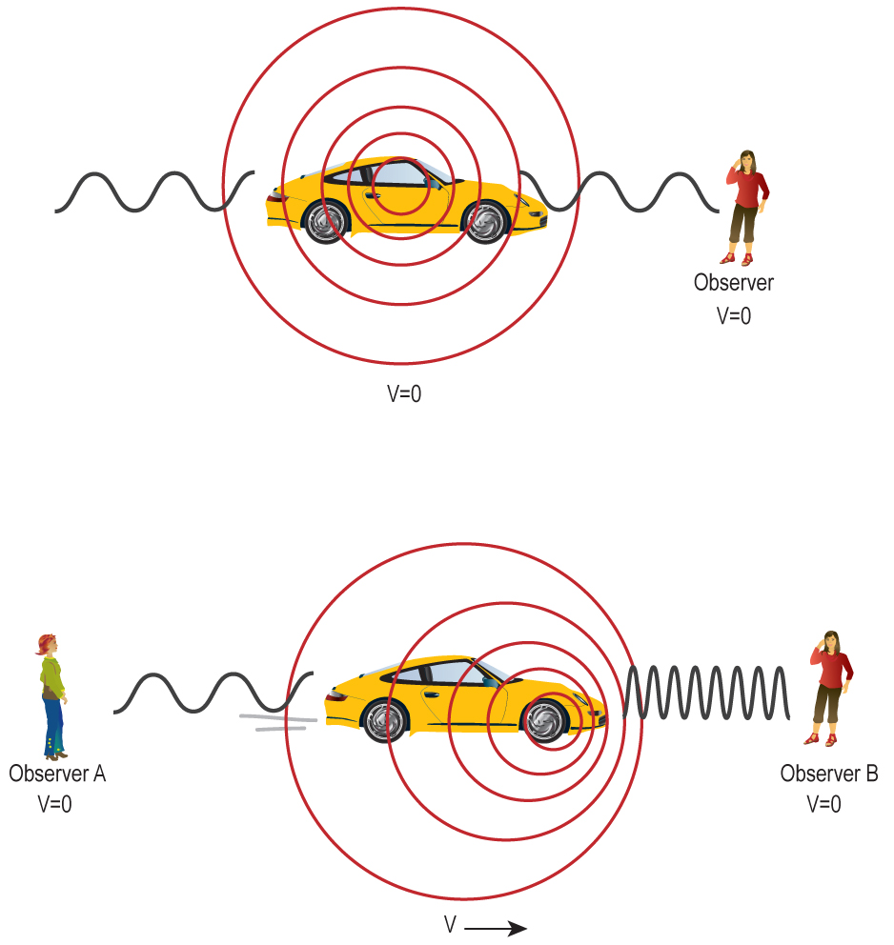
Measuring the Doppler shift
Frequency shift of a electromagnetic wave depends on relative velocity
How would this be noticeable in the reflected chirps?
Image Credit: NASA

Slide 8
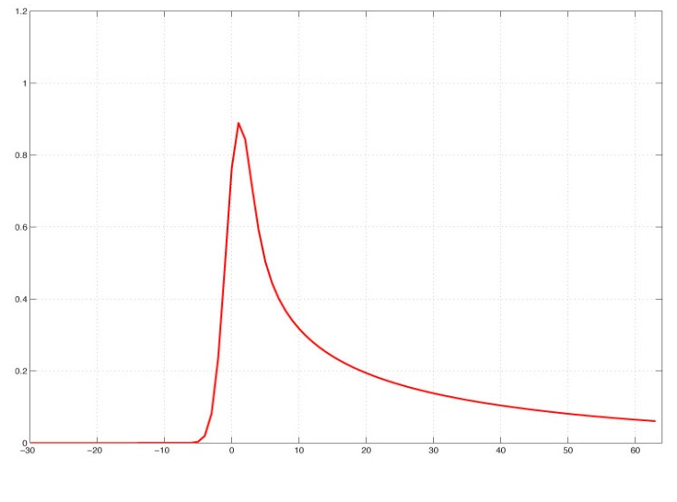
SAR altimetry (delay doppler altimetry)
Synthetic aperture
Doppler shift of chirps depend on along-track location (steady surface)
PRF: 17800 Hz
Bursts: 85.7hz (Np=64 pulses)
)
)
)
V_{s/c}
)
)
)
)
1D multi-looked
20Hz waveform
128 gates
Ground Resolution Cell (~300m, indepent of SWH)
Original animation by Keith Raney

Slide 9
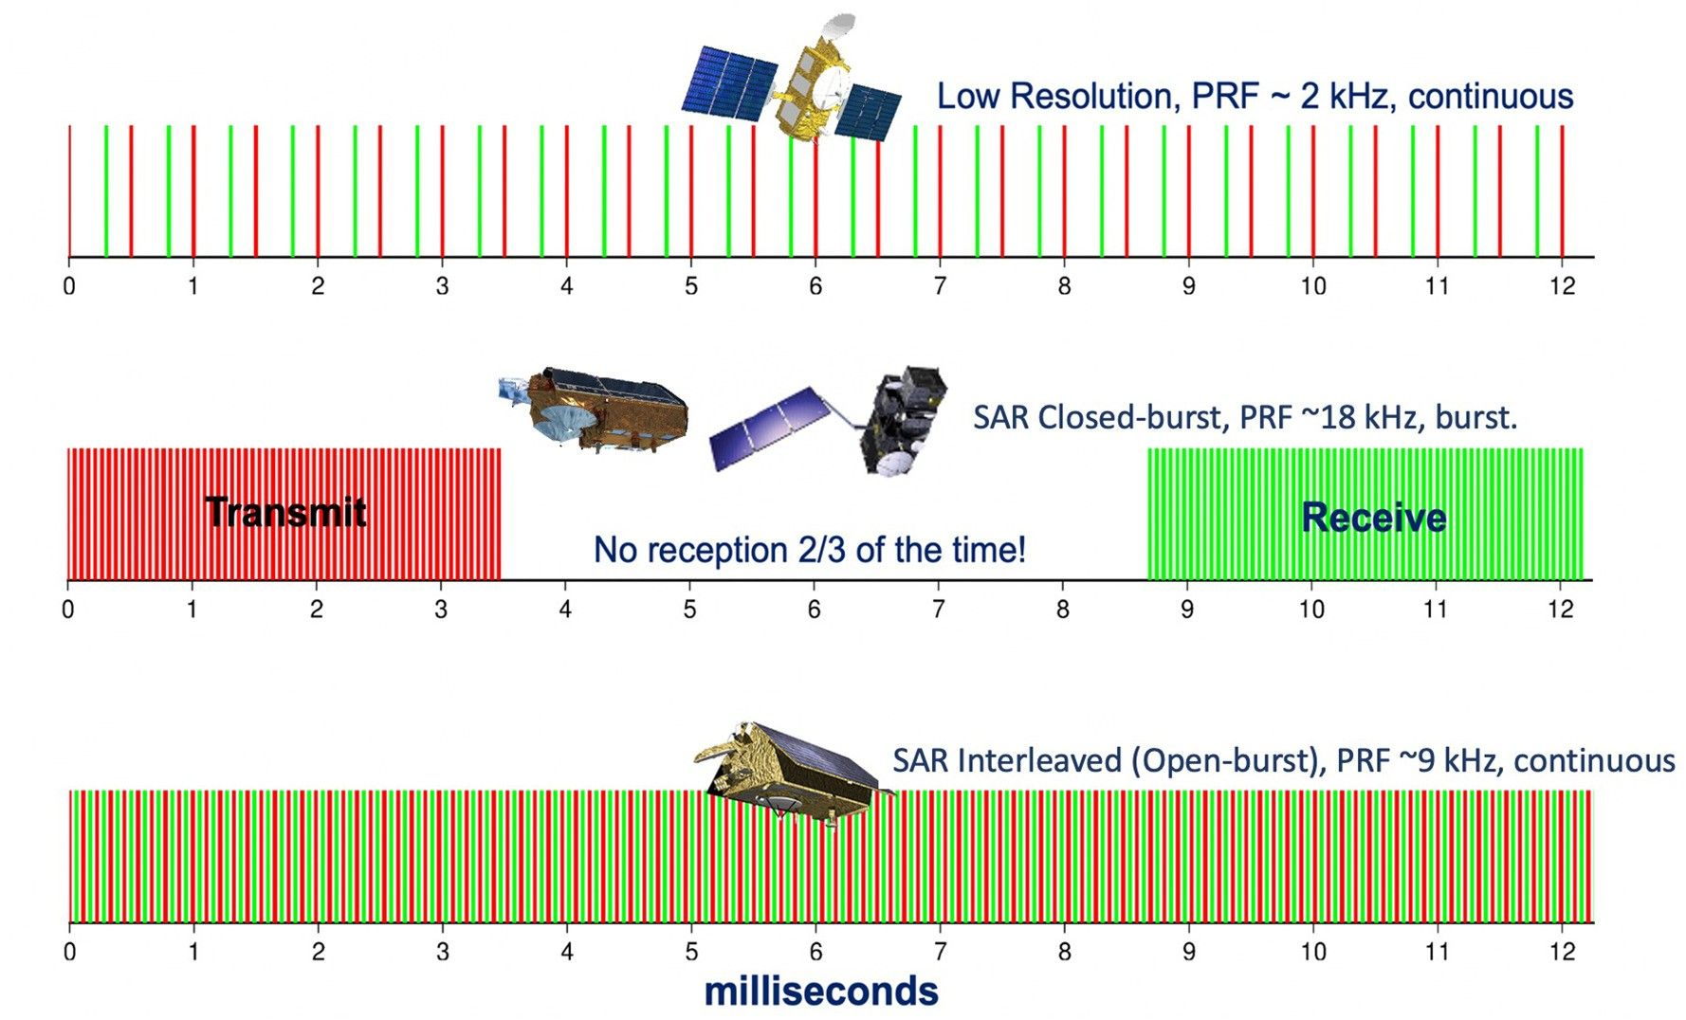
Design of pulses & bursts
Different satellites have different transmission schemes
Modern satellites: interleaved pulses
Modern satellites also offer an pseudo “low resolution mode” product
Exercise: compute satellite distance travelled (speed is ~7km/s) for a round trip versus pulse duration
Echo ~ 4.6 ms later
Donlon et al. 2021

Slide 10
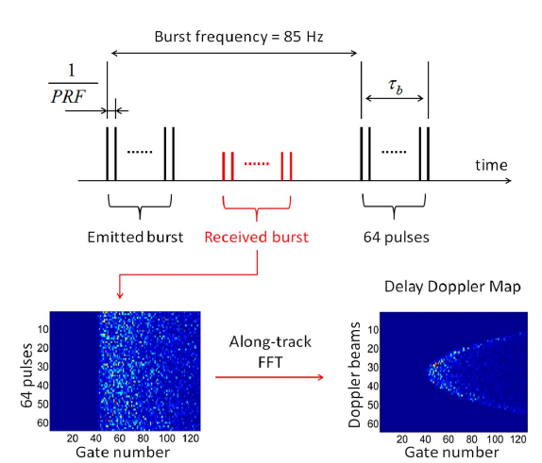
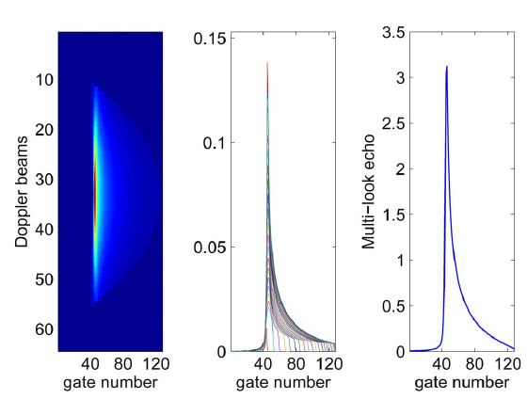
Building SAR waveforms
More involved due to moving satellite platform and burst processing
Fast fourier transform maps received echos on along track doppler bins (64)
Corrections for (known) target movement aligns the front
“Multi-looking” sums sub-waveforms to increase accuracy
SAR waveforms are generally ‘pointier’ than those from conventional pulse-limited altimetry
Retracking methods can than be applied to estimate range
Halimi et al. 2014

Slide 11
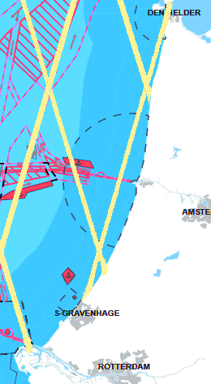
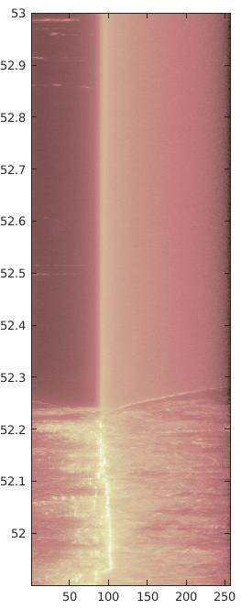
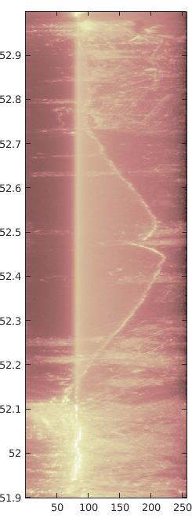
Example coastal SAR waveforms
Images: Frithjof Ehlers TU Delft
SAR altimetry allows higher along-track resolution
Echos come from sea but also beaches, dunes, buildings etc.
Challenge is to retrack the hi-res waveform for correct signal of interest
orbit 370
orbit 279
latitude (deg)
log(power)
range gate
55

Slide 12
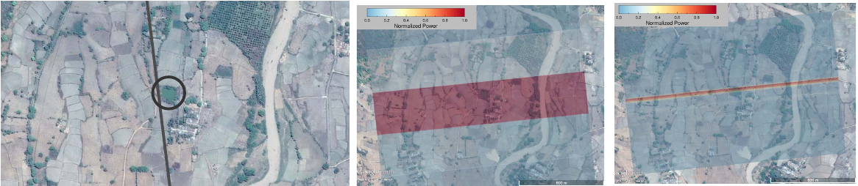
Recent developments: fully-focused SAR
Coherent targets are illuminated over ~2s (~1.4km track)
Idea is to process echos (‘focus’) over a larger exposure time at once
Larger synthetic aperture → higher along-track resolution (in theory 0.5 meter!)
From Egido and Smith 2017

Slide 13
Applying (Geophysical) corrections
So you have range estimates, what now?

Slide 14
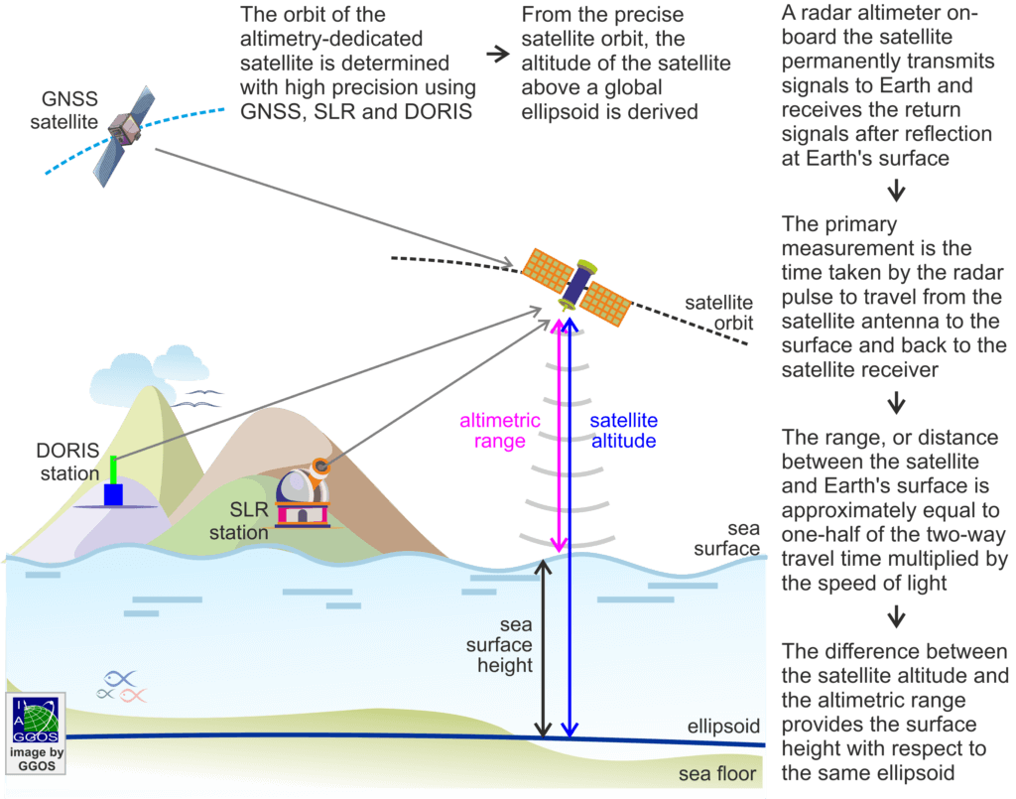
Sea (water) surface height
Altimetry provides heights relative to an ellipsoid
Various corrections need to be applied

Slide 15
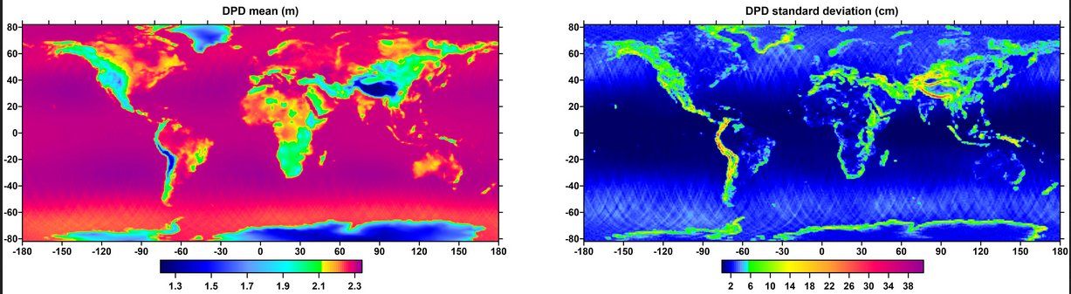
Path delay due to dry troposphere
dry troposphere correction (DTC)
  Absolute value ~2.3m varies by 0.2m
  Latitude dependency
Usually based on atmosphere model output (ECMWF, NCEP..)
Saastamoinen model depends on surface pressure, surface height and latitude
Dry-path delay from Fernandez et al. 2021

Slide 16
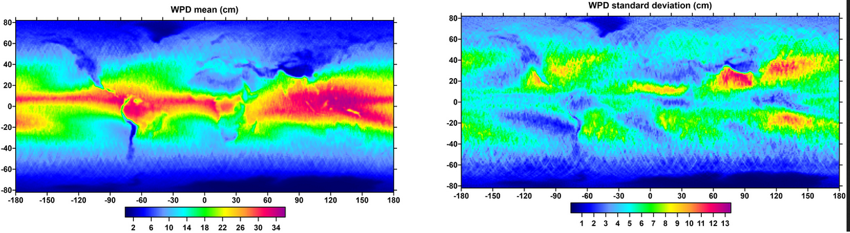
Path delay due to atmospheric moisture
wet troposphere correction (WTC)
  Absolute value < 50cm
  Spatially and temporally variable
Preferably based on onboard-radiometer data or (locally) GNSS derived watervapour
But not all satellites carry a radiometer so for those corrections using model data need to be used
TCWV: total tropospheric water vapour,Tm: tropospheric temperature
wet-path delay from Fernandez et al. 2021

Slide 17
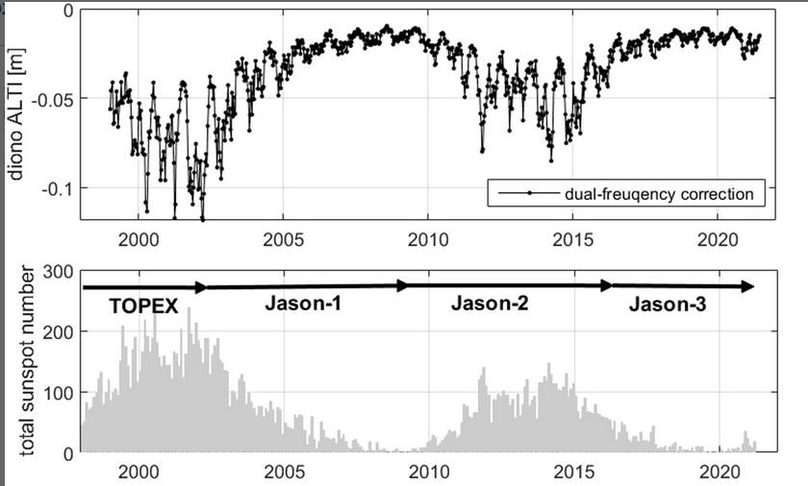
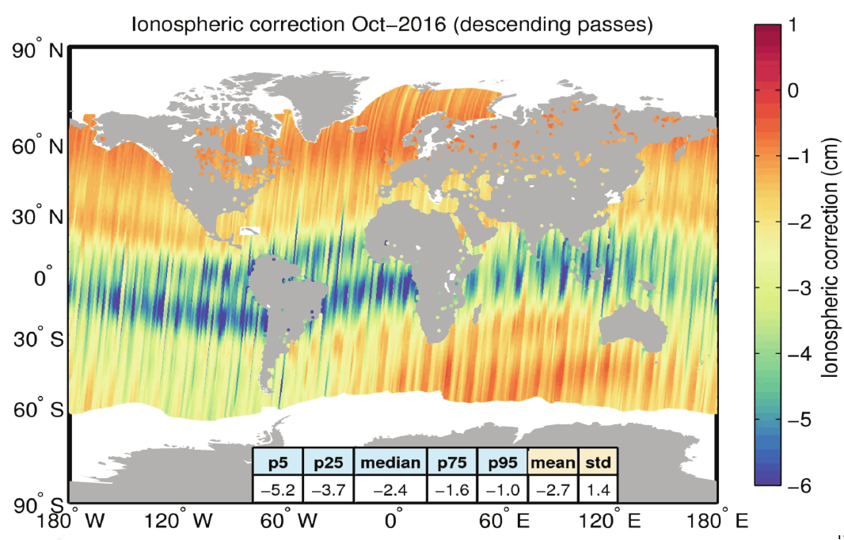
Ionospheric corrections (IC)
Dettmering et al 2021
Charged particles (electrons) in the ionosphere cause delays for electromagnetic waves
  Absolute value 2 -20cm +/-2cm
  Varies spatially (correlates with magnetic field)
  11 year cycle
Strong frequency dependence allows them to be computed to first order on dual-frequency platforms (e.g. C + K band)
Single freq satellites need corrections using ionospheric models (e.g. GIM)
Image: Jérôme Benveniste

Slide 18
Sea state bias
Sea surface creates a bias towards the troughs
Sea surface state also influences waveform retracking → tracker bias
Skewness of waves (non-symmetry)
Order of magnitude ~10-20 cm
Usually corrected for with emprical models. E.g. computed SWH (from retracking), but other methods exists too (using e.g. wave model data)
Large uncertainty for ocean applications but less relevant for inland water
Troughs are better reflectors than peaks

Slide 19
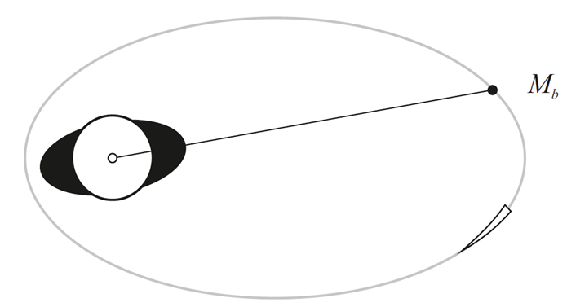
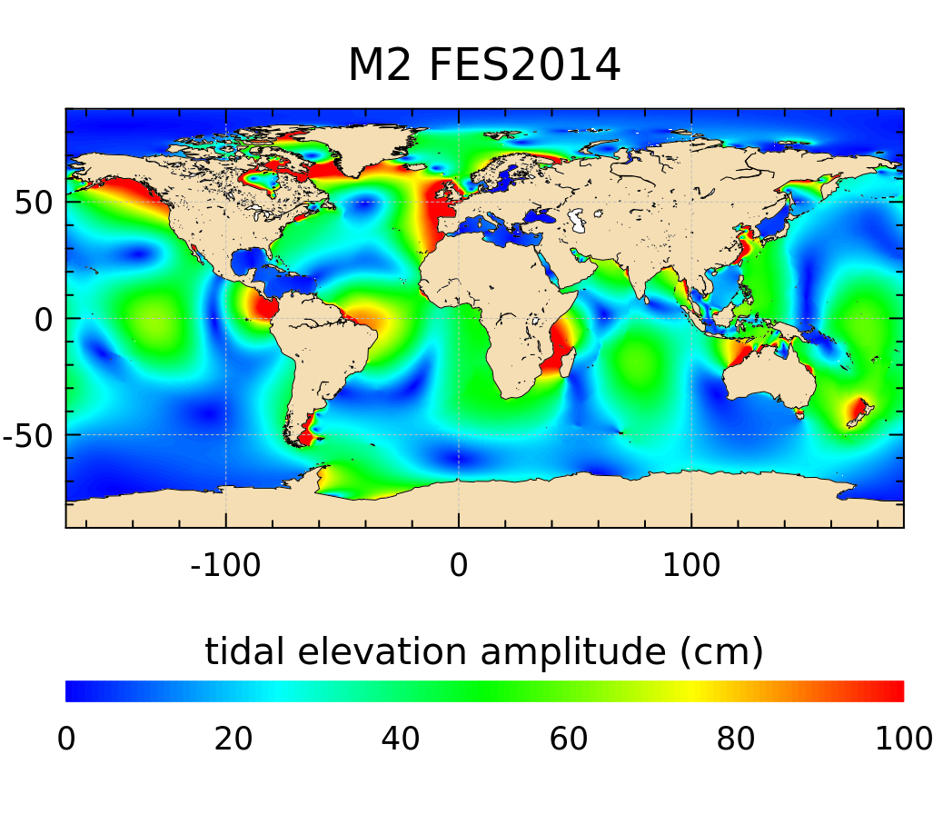
Tidal corrections
Tidal effects
  Ocean tides
  Solid earth tide
  Pole tide (~14 month fluctuations in Earth rotation)
    Solid earth
    Ocean
  Tidal loading (ocean tides deforming the Earth’s crust)
Corrections, based on (empirical) models are often provided in altimetry files, not all of them may be applicable to inland altimetry
Radar altimetry is also used to compute ocean tide models (e.g. eot20 https://essd.copernicus.org/articles/13/3869/2021/)

Slide 20
Dynamic atmosphere correction
Short term (< 20 days) ocean response to wind and pressure (order of centimeters)
Corrections usually provided derived from barotropic ocean models
Averaged ocean
surface pressure

Slide 21
Your take home points?
SAR altimetry is pulse limited cross-track and beam limited along-track
The principle of SAR altimetry is that the velocity of the satellite creates a doppler effect relative to the surface
Standard delay doppler can achieve an along-track resolution of 300m
Fully focused SAR can theoretically even go to 0.5 m
In order to get meaningful surface water heigths: several corrections need to be applied
  Wet and dry troposphere corrections
  Ionospheric correction
  Sea state bias
  Tides
  Dynamic atmosphere corrections
Which of these corrections can be derived from onboard observations?

