Slide 1

Remote sensing of rivers and lake water heights (part I)
face 2 face workshop Soil Moisture and Inland Water Monitoring with Satellite Radar
Dar es Salaam, Tanzania, 19th October 2023
Roelof Rietbroek

Slide 2

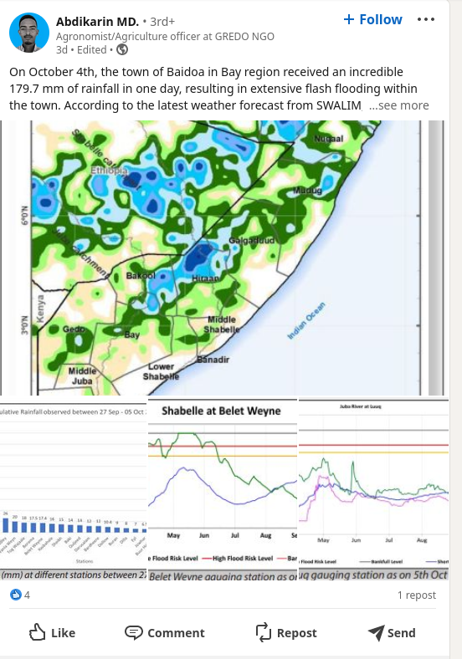
Intensification of the water cycle
Flash floods October 2023
After a multiyear drought in the Horn of Africa
180 mm of rain in one day...

Slide 3
Today (& tomorrow)
Motivation of measuring lake and river heights from space
Principles of radar altimetry
  “conventional” radar altimetry (pulse limited)
  “modern” radar altimetry (beam limited)
  Geophysical corrections

Slide 4
Surface water heights
Water height potentially provides information on water cycle parameters:
  River discharge
  Lake capacity and extent
In situ measurements (not always possible/available)
  Point measurements
  High temporal resolution (min → )
Satellite platforms: lidar (e.g. icesat), radar altimetry (covered in this module)
  Comprehensive (near global) spatial coverage
  Low temporal resolution (10 days → )

Slide 5
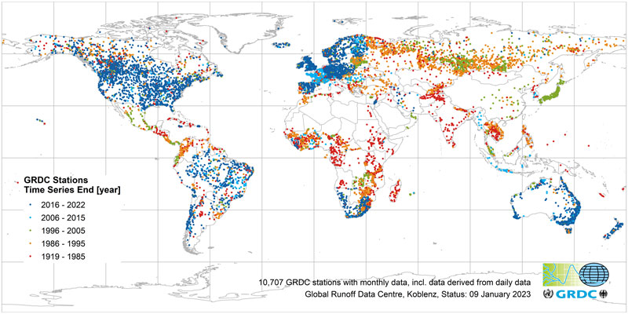
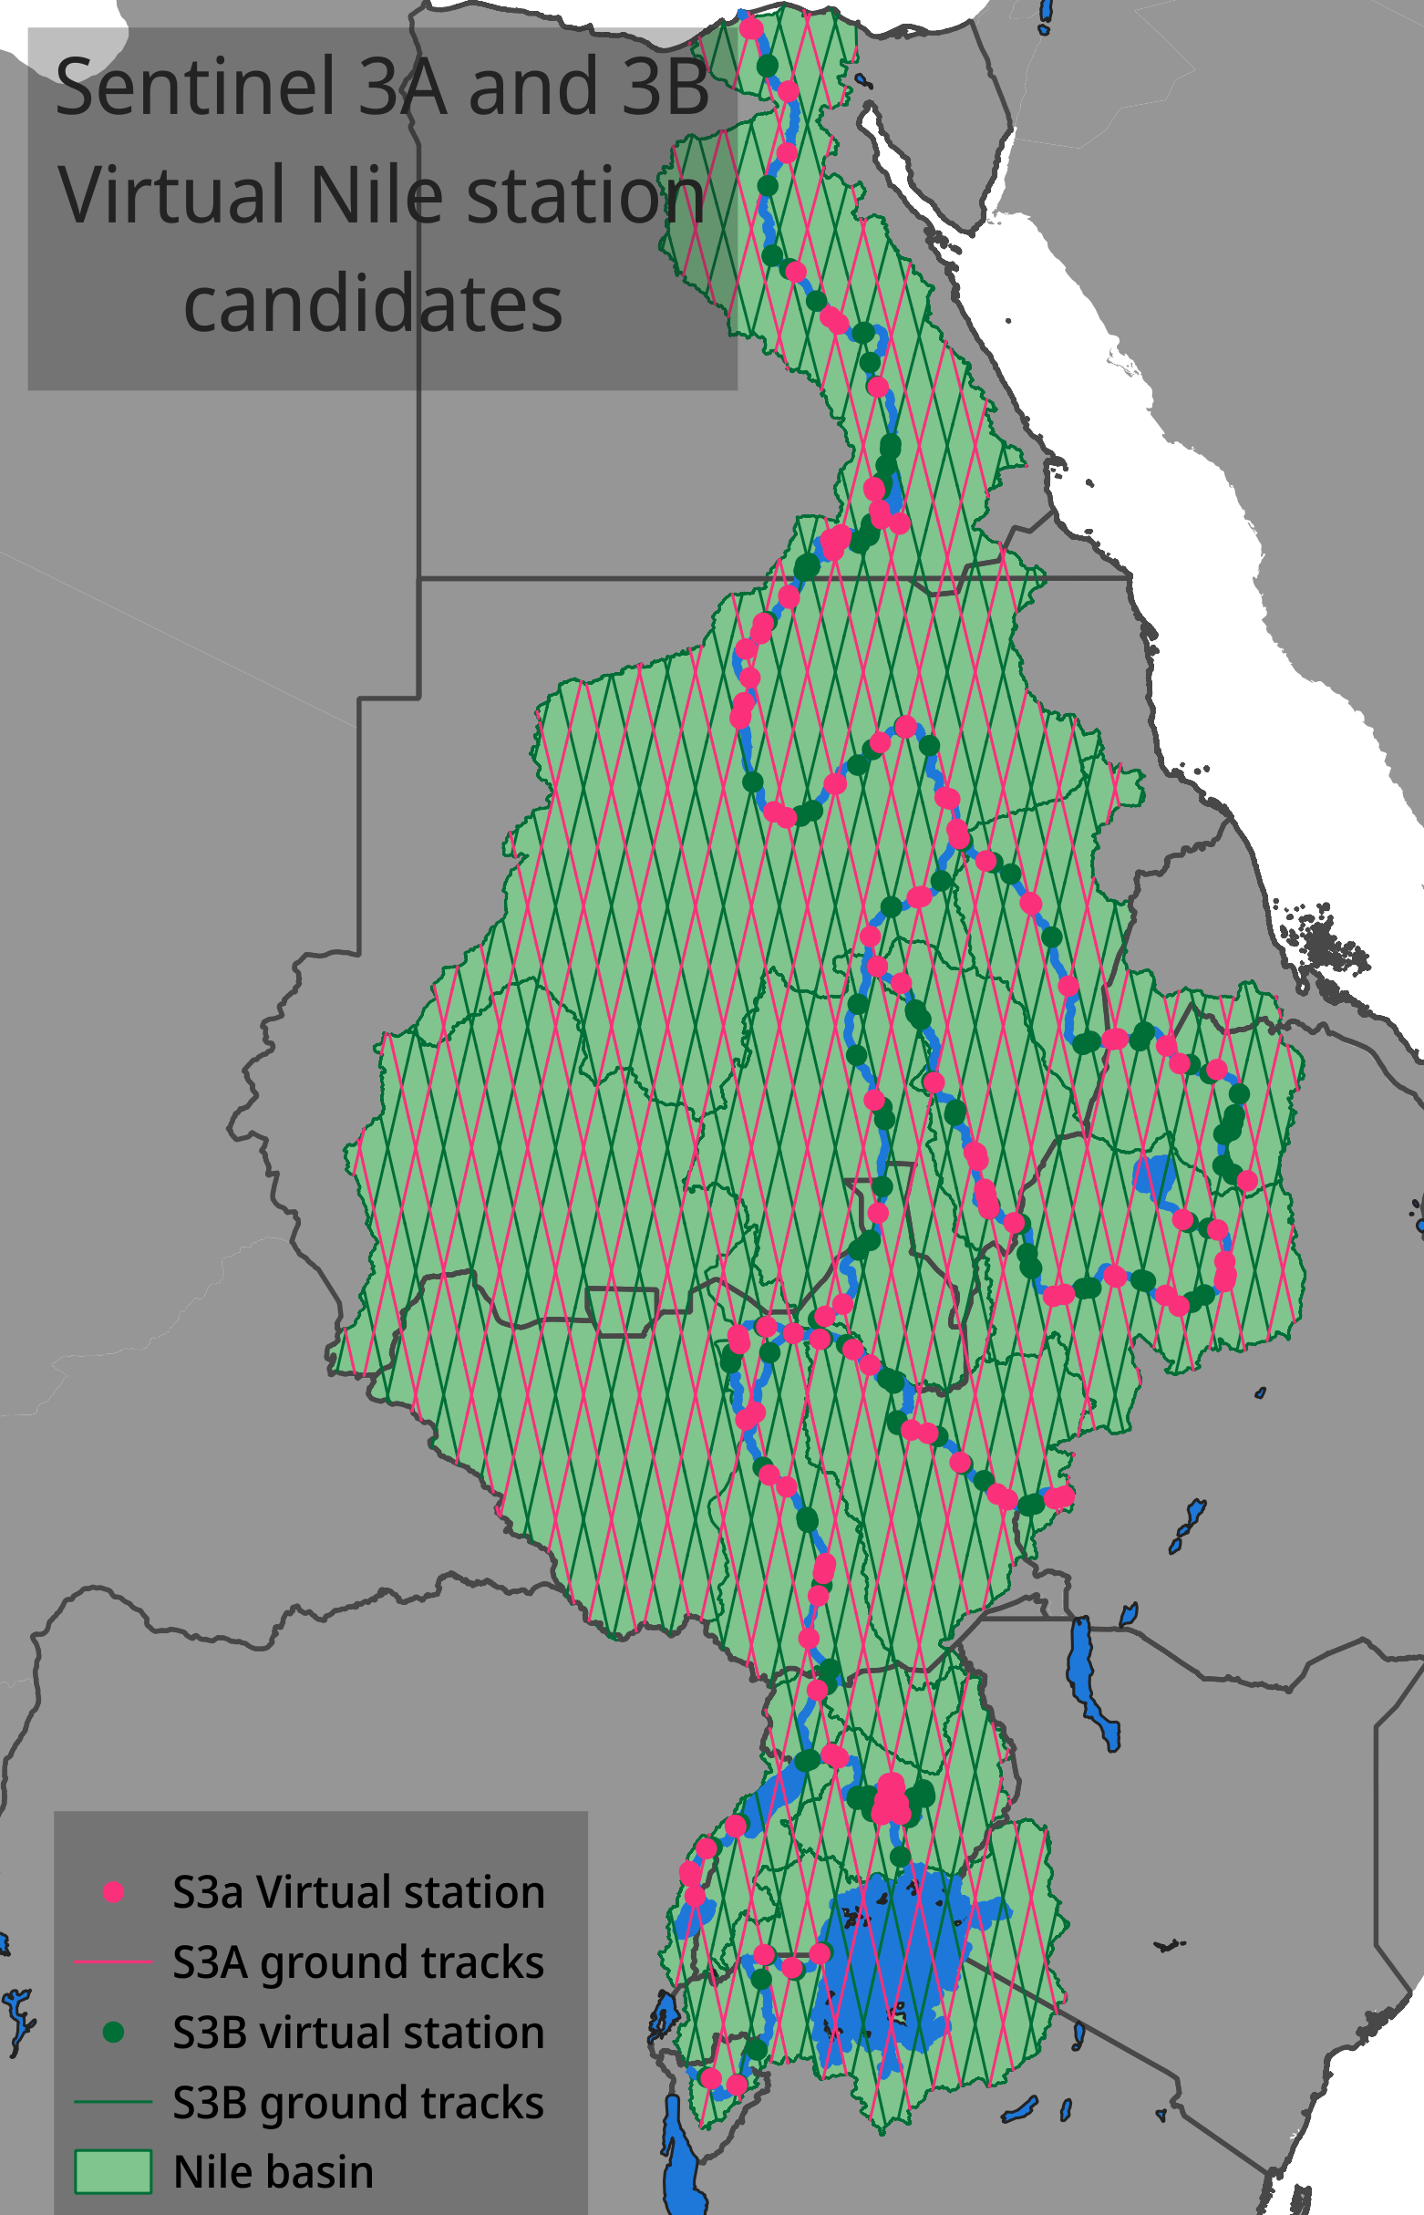
Remote sensing of rivers
It’s becoming increasingly difficult to obtain recent in situ discharge data in many rivers of the world

Slide 6
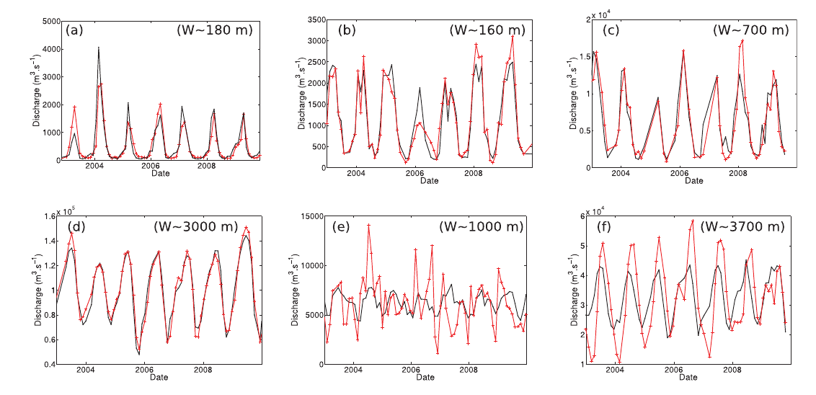
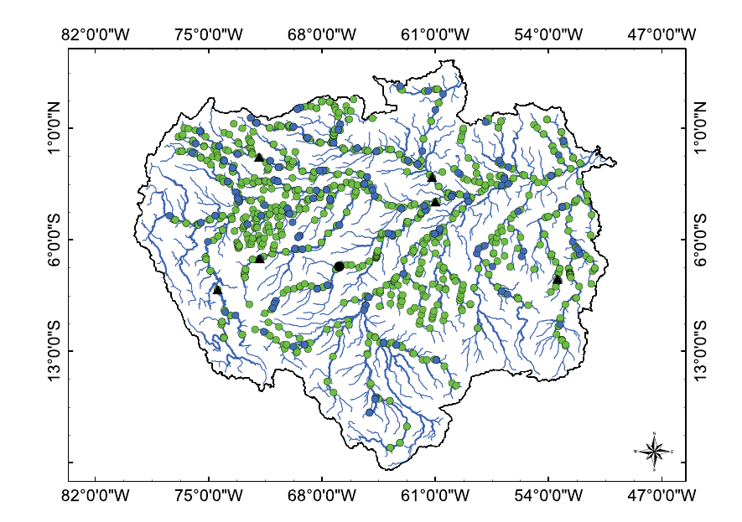
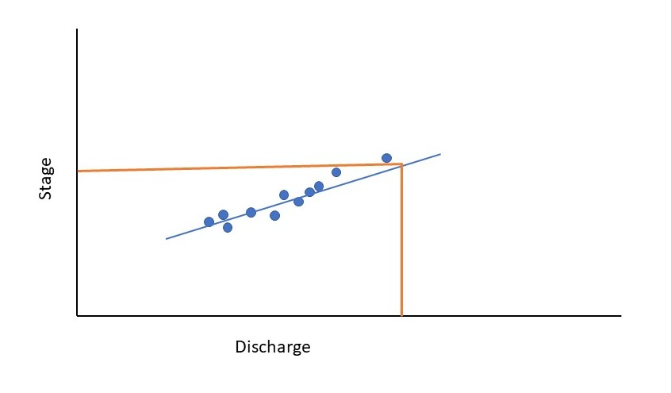
River discharge from radar altimetry
Source: USGS WY-MT WSC
Red: from gauges, black: from altimetry
Paris et al. 2016, Stage-discharge rating curves based on satellite altimetry
and modeled discharge in the Amazon basin
Paris et al. 2016, Stage-discharge rating curves based on satellite altimetry
and modeled discharge in the Amazon basin

Slide 7
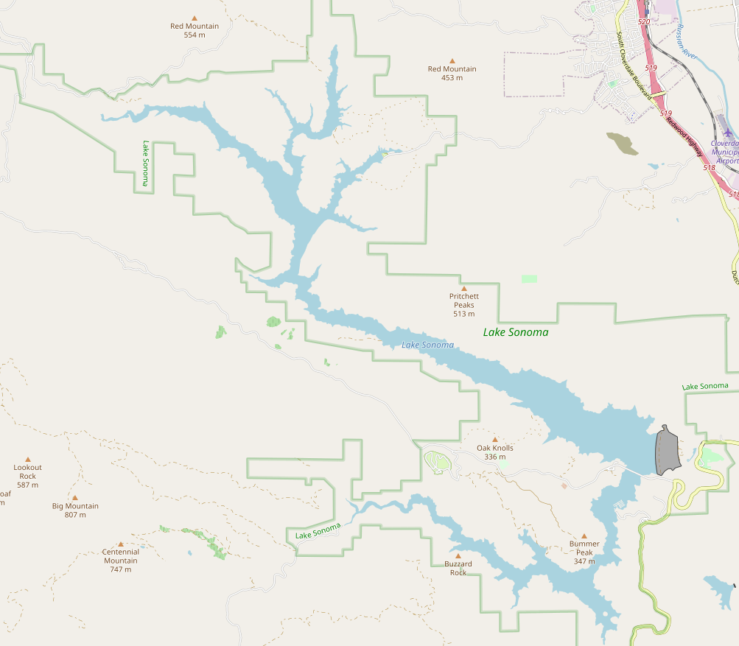
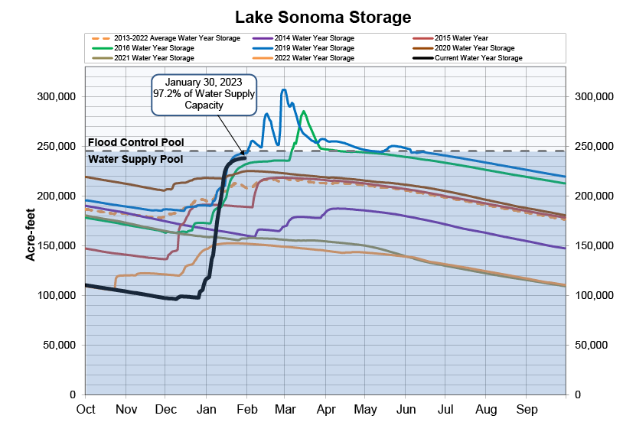
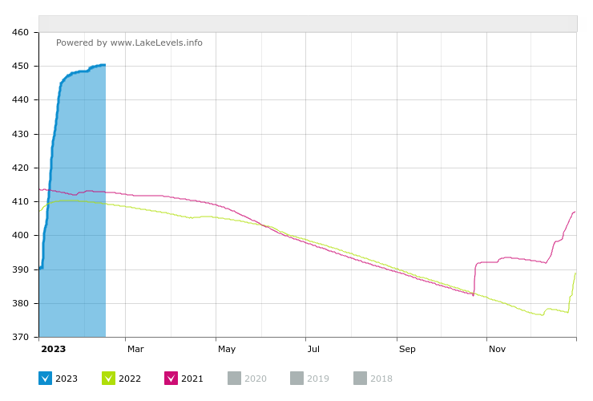
Water management with Lake elevation-area-volume
https://www.sonomawater.org/current-water-supply-levels

Slide 8
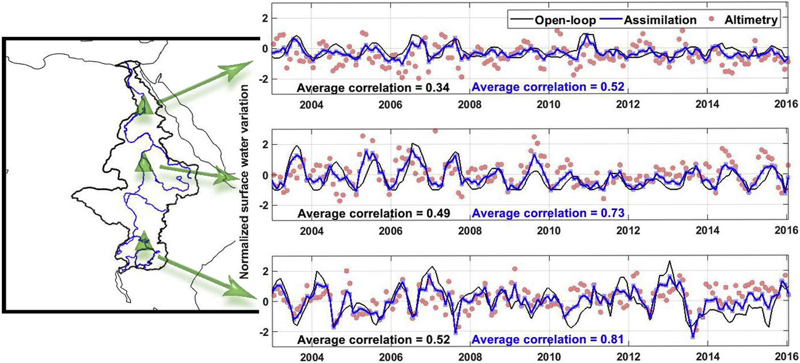
Potential for data assimilation
Khaki et al 2020, data assimilation of radar altimetry in the W3A hydrological model

Slide 9
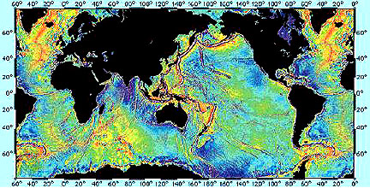
A first look at the ocean with seasat (1978)
What is shown here?
Geoid
Sea mount
Seasat (1978) marine geoid. credit JPL

Slide 10
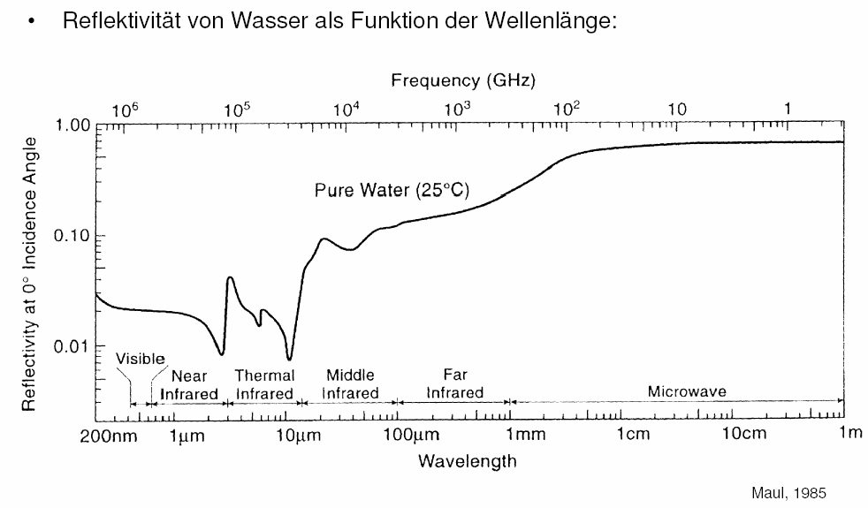
Why radar (microwaves)?
In nadir direction: microwaves reflect well on water
Bands used in radar altimetry
  S Band 1.55 – 4.20 GHz
  C 4.20 - 5.75 GHz
  X 5.75 – 10.9 GHz
  Ku Band 10.9 - 22.0 GHz
  Ka Band 35 GHz
Reflectivity from water as a function of wavelength
Sentinel-6
Ku
C
Ka
W3RA
KaRin (SWOT)

Slide 11
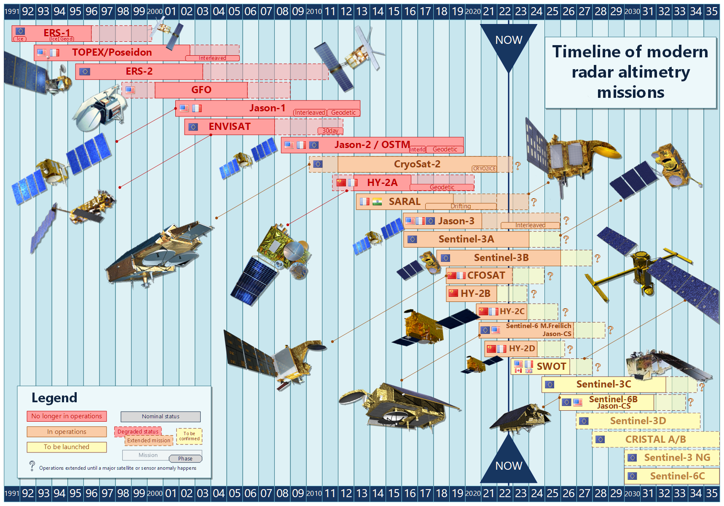
Radar altimetry since the 1990’s
Mainly ocean focused (geoid, bathymetry, sea surface variations, sea level)
International efforts
Aviso+ (2022)

Slide 12
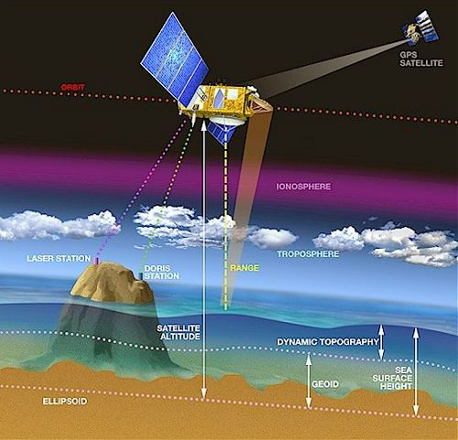
What would an altimeter system need to function?
Orbit (altitude above ellipsoid)
Range
(Geophysical) corrections (ionosphere,atmosphere, sea state bias, tides, ...)

Slide 13
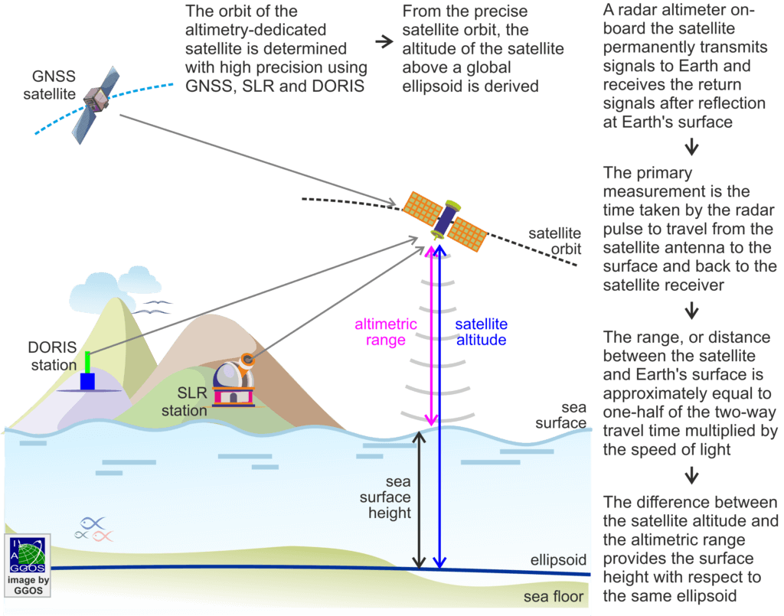
Sea (water) surface height
Altimetry provides heights relative to an ellipsoid
Various corrections need to be applied (discussed in the second part)

Slide 14
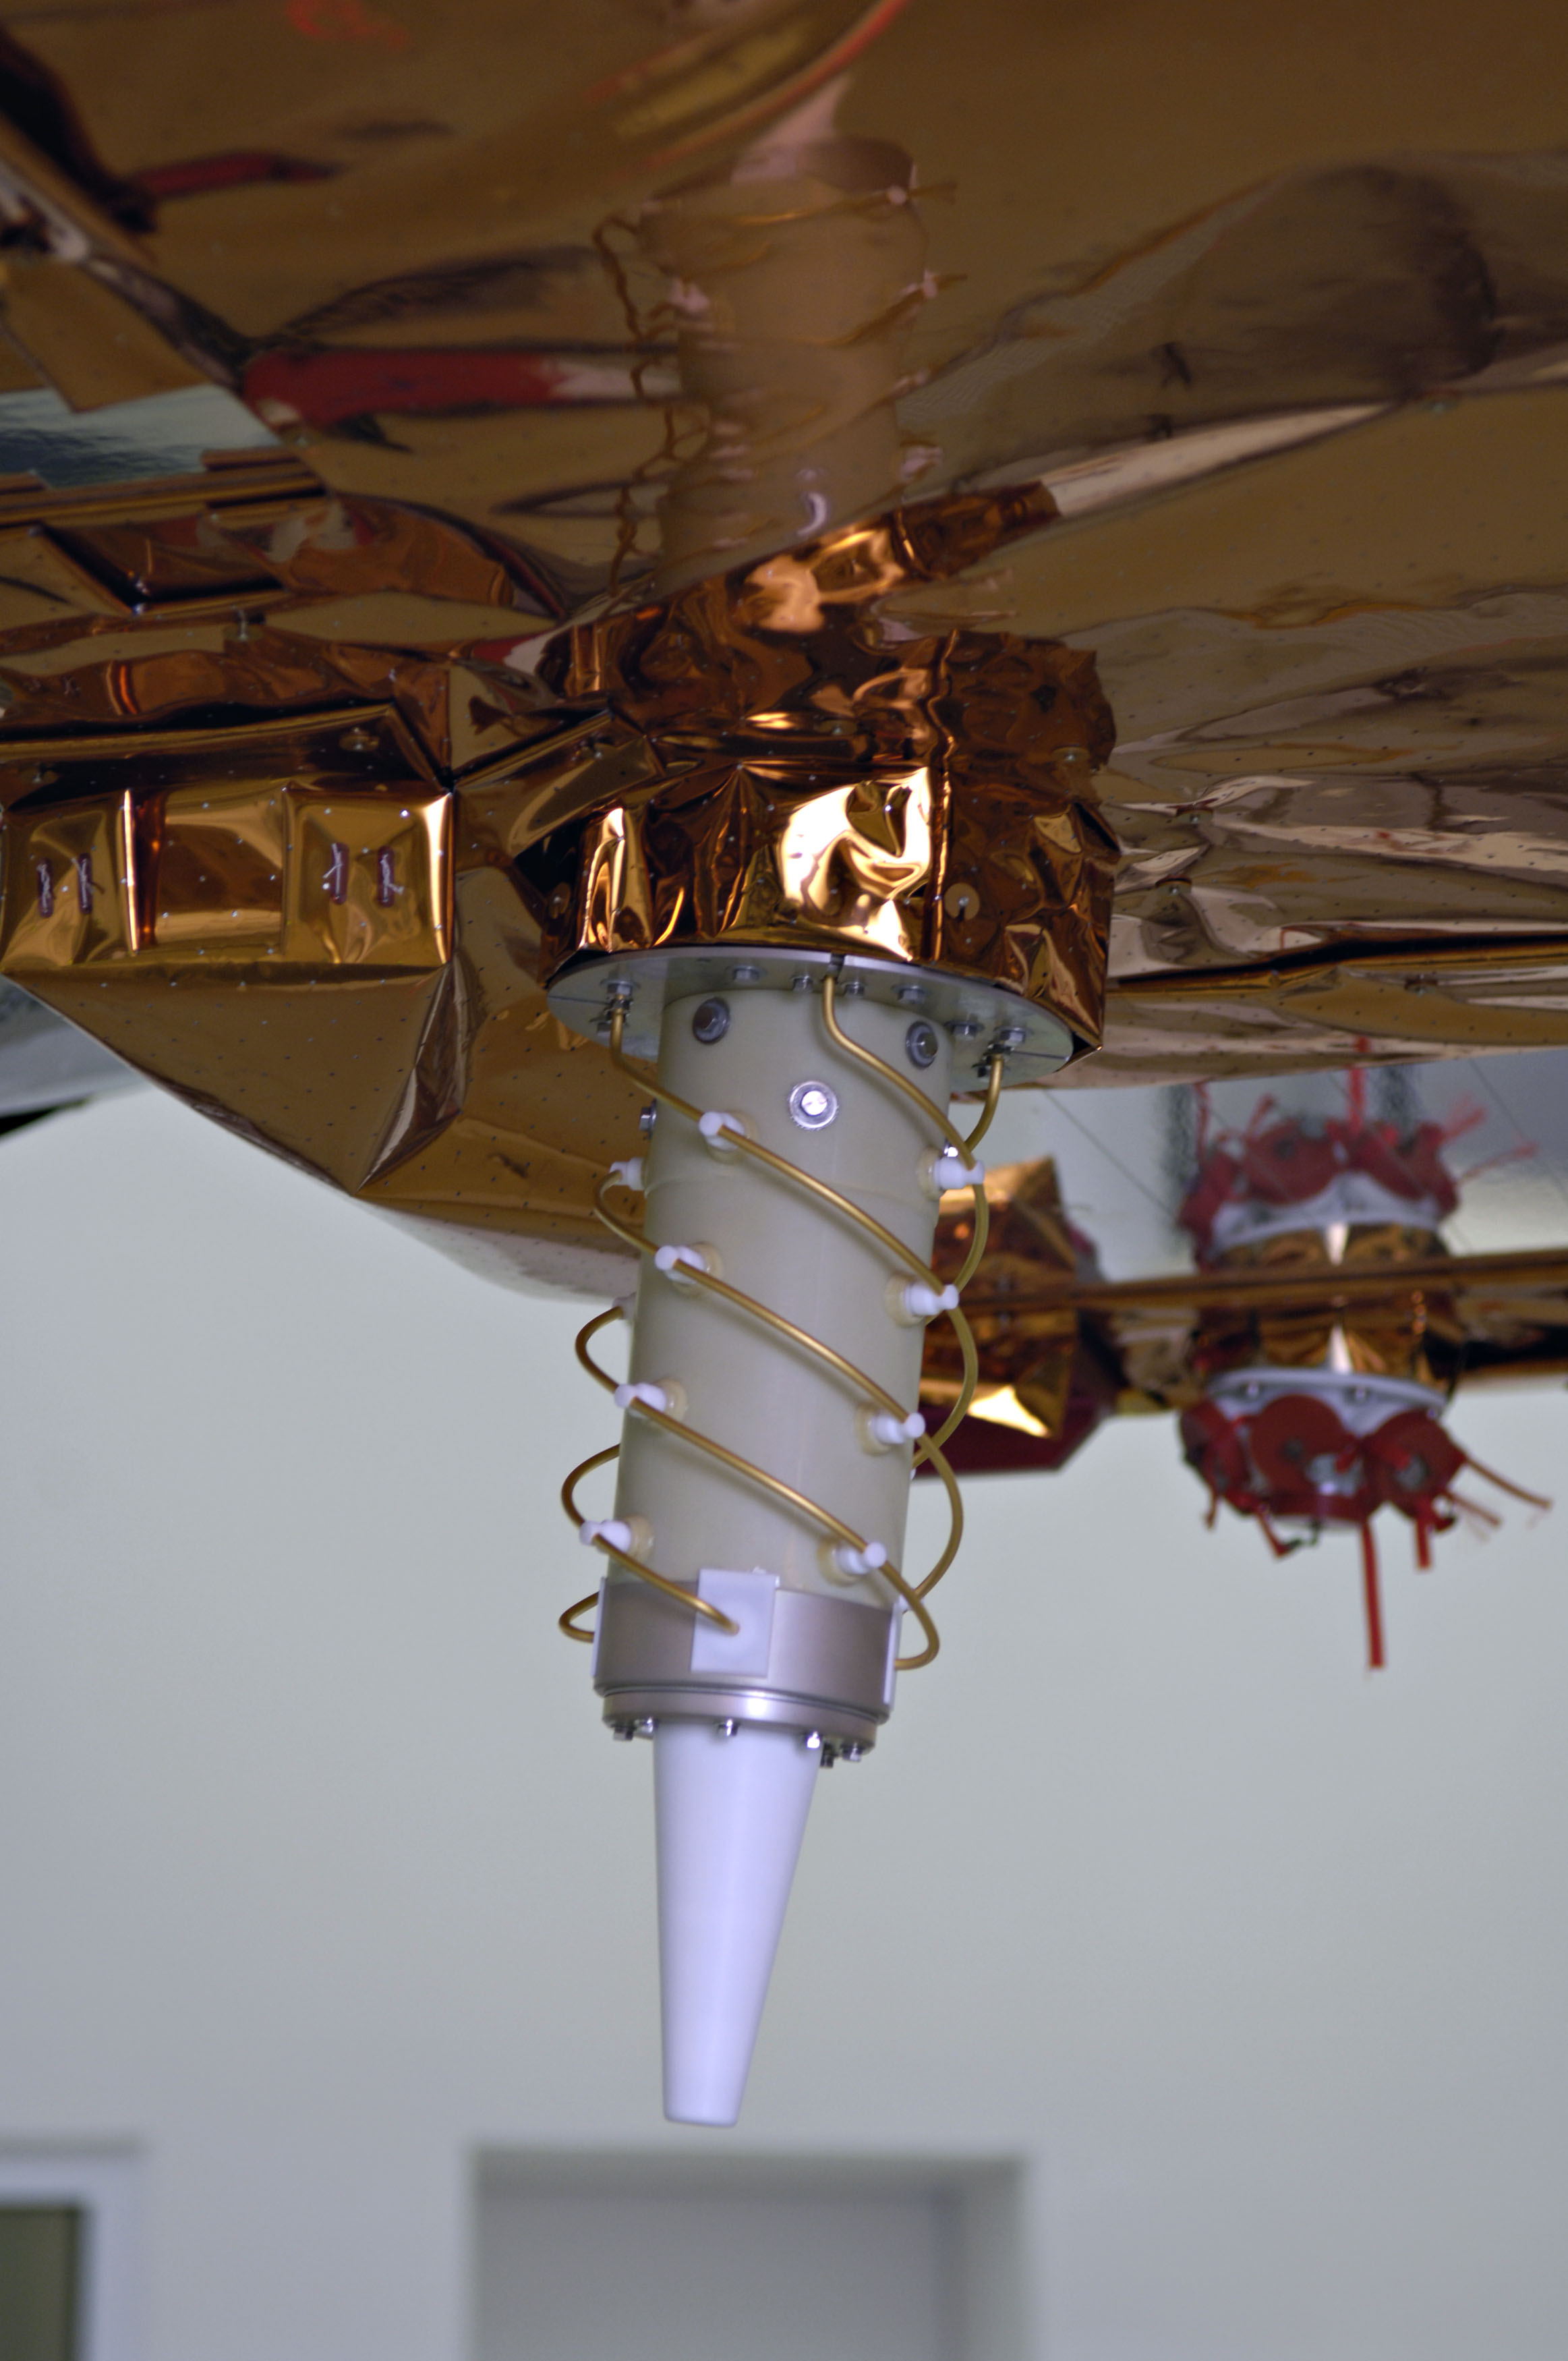
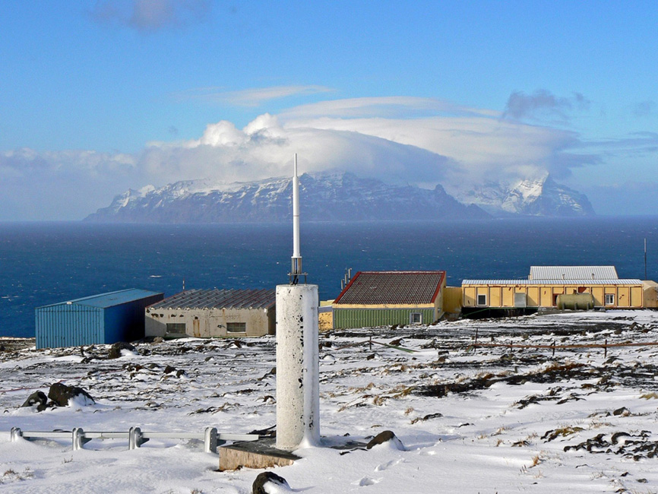
Precise Orbit Determination
Doppler Orbitography and Radio-positioning Integrated by Satellite (DORIS)
Dual freq system with ground beacons
Observes line-of-sight range changes
Orbit + gravity field determination possible when collecting many beacon signals
DORIS station on the remote Crozet Island (credit: IGN France)

Slide 15
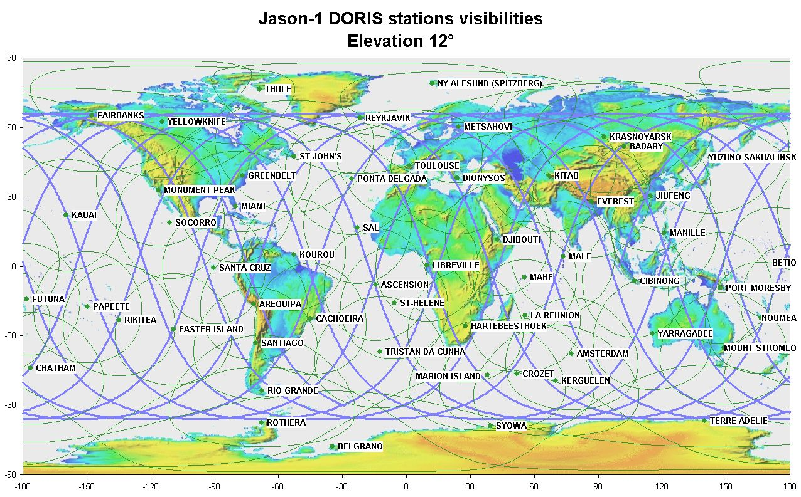
Precise Orbit Determination
DORIS: radial orbit errors ~2cm
Orbit errors can correlate along track

Slide 16
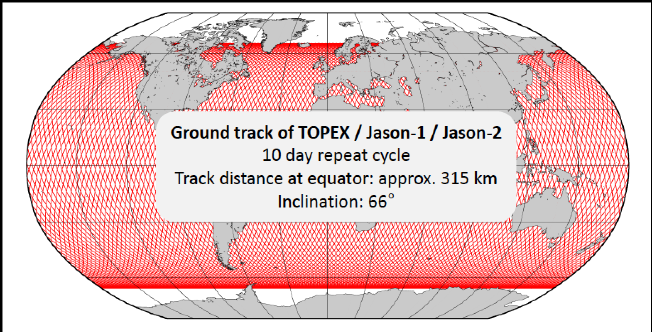
TOPEX (NASA)-like orbit
Inclination: 66°
Height above equator: ~1350 km
Repeat cycle: optimal (day) for oceanography :10, for Geodetic phase ~300
Quick revisit times
No high latitude data
Image courtesy: L. Fenoglio

Slide 17
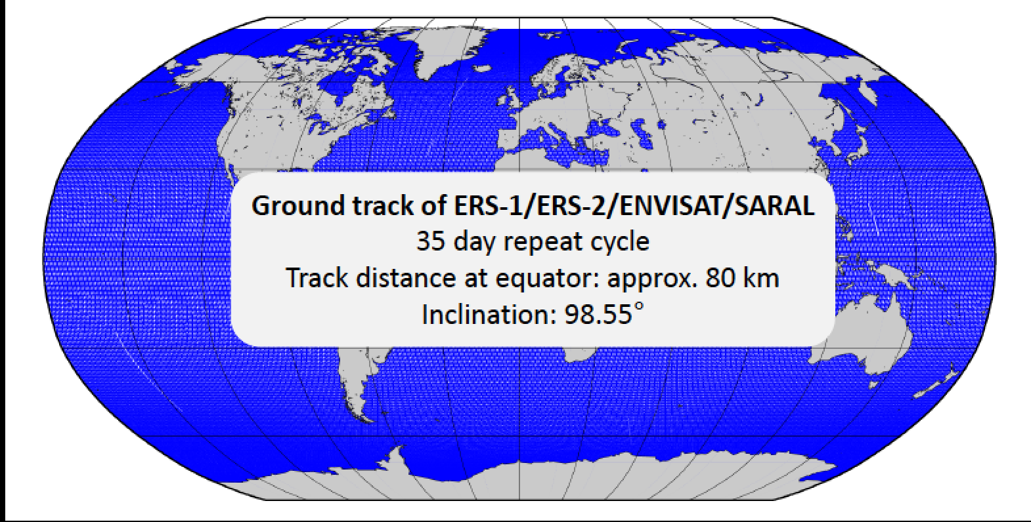
Envisat (ESA)-like orbit
Inclination: 98° (ESA)
Height above equator :~800 km
Repeat cycle: optimal (day) for oceanography : ~35 days
Higher latitudes visited
Longer revisit times
Image courtesy: L. Fenoglio

Slide 18
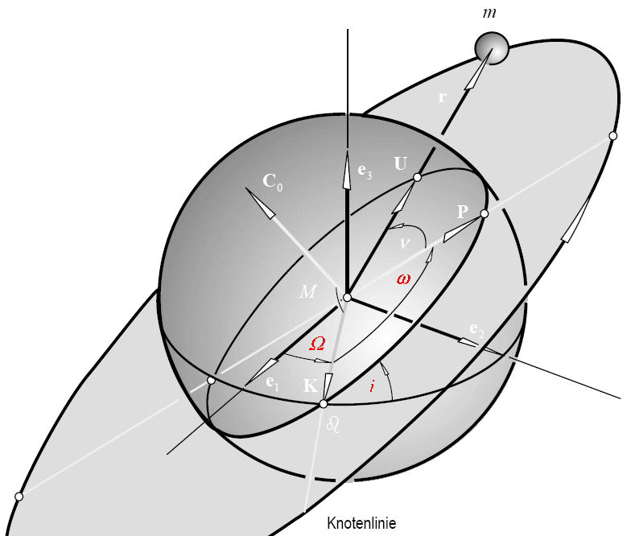
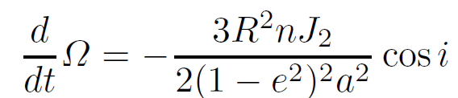
Orbit design
Trade off between revisit time and coverage
Inclination and height can be tuned to design repeat-orbits
  Ellipsoidal flattening of the Earth allows tuning the rotation of the orbital plane
For rivers and lakes:
  Better to have high temporal or high spatial resolution?

Slide 19
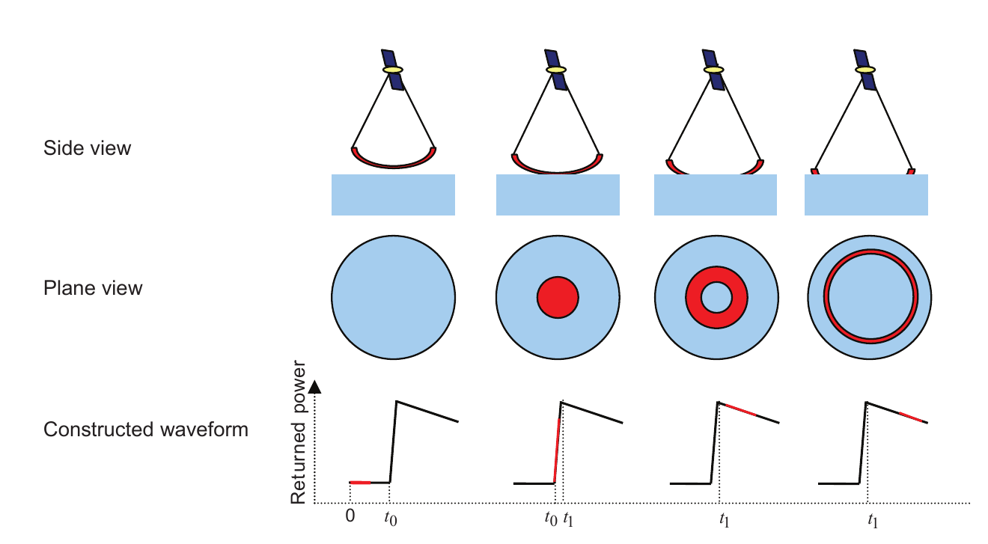
Pulse limited (conventional) altimetry
Active radar pulse is transmitted
Antenna senses arrival of echos (h=Tc/2)
How short would a pulse need to be for 5cm resolution?
~0.3 nanoseconds: But this is not technically possible..
Source: M. Tourian 2009

Slide 20
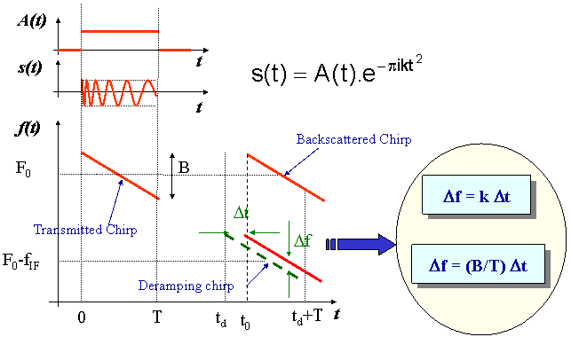
Solution: Use chirps (woop woop!)
A chirp is transmitted
On board instrument generates a delayed “deramping” chirp to compare received chirps with
The mixed signal has a constant frequency which is a measure of the time delay
(see also supplied notebook)
Source: http://www.altimetry.info

Slide 21
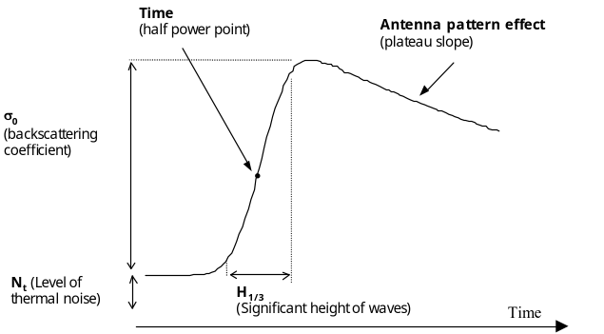
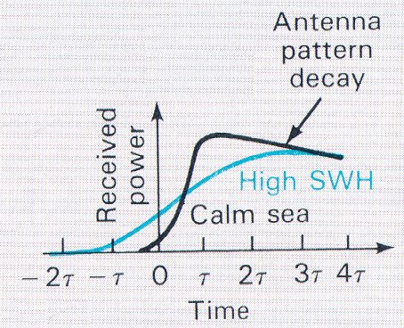
Building a waveform
)
)
)
)
)
)
)
Pulse repetition frequency ~ 2 kHz
  Collect over an integration time (20Hz)
X-axis: Chirps are deramped and binned according to their delta t (range gates)
Y-axis: Average the received pulses (power) in 20 Hz blocks (y-axis)
Pulse-limited: Chirp bandwidth (B) determines range resolution:
  Dr =c/(2B). So B=320Mhz resolves to 0.468m (3 nanosec) range resolution
  When a waveform has 128 gates, how large is the “range window”?
Over the ocean: the waveform can be modelled with an analytical ‘Brown model`
Standard (ocean) retracker gate is aligned to fixed gate (e.g. 32.5)
Ground resolution cell (3-5 km)
Image Credit Keith Raney

Slide 22
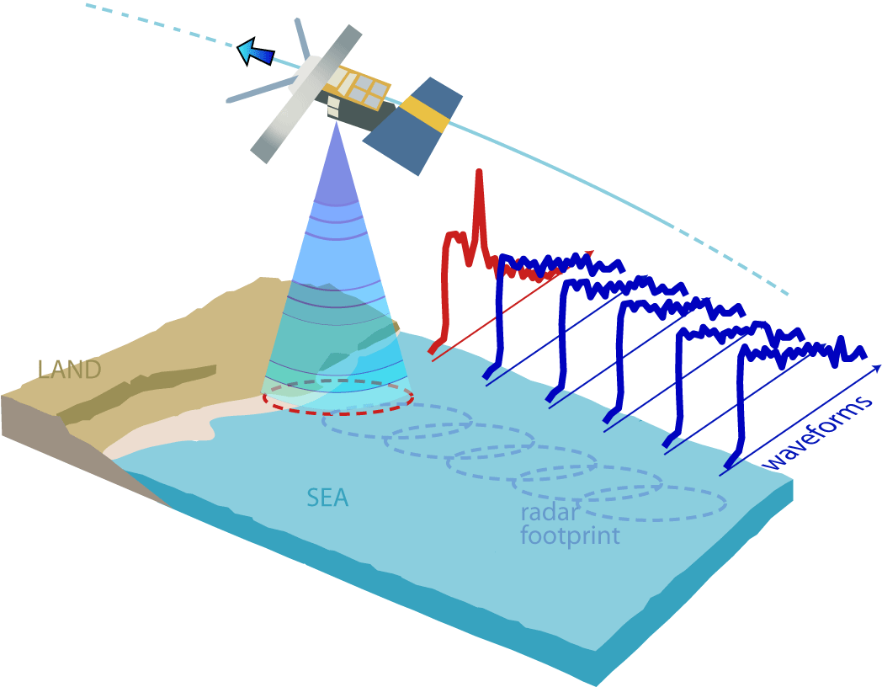
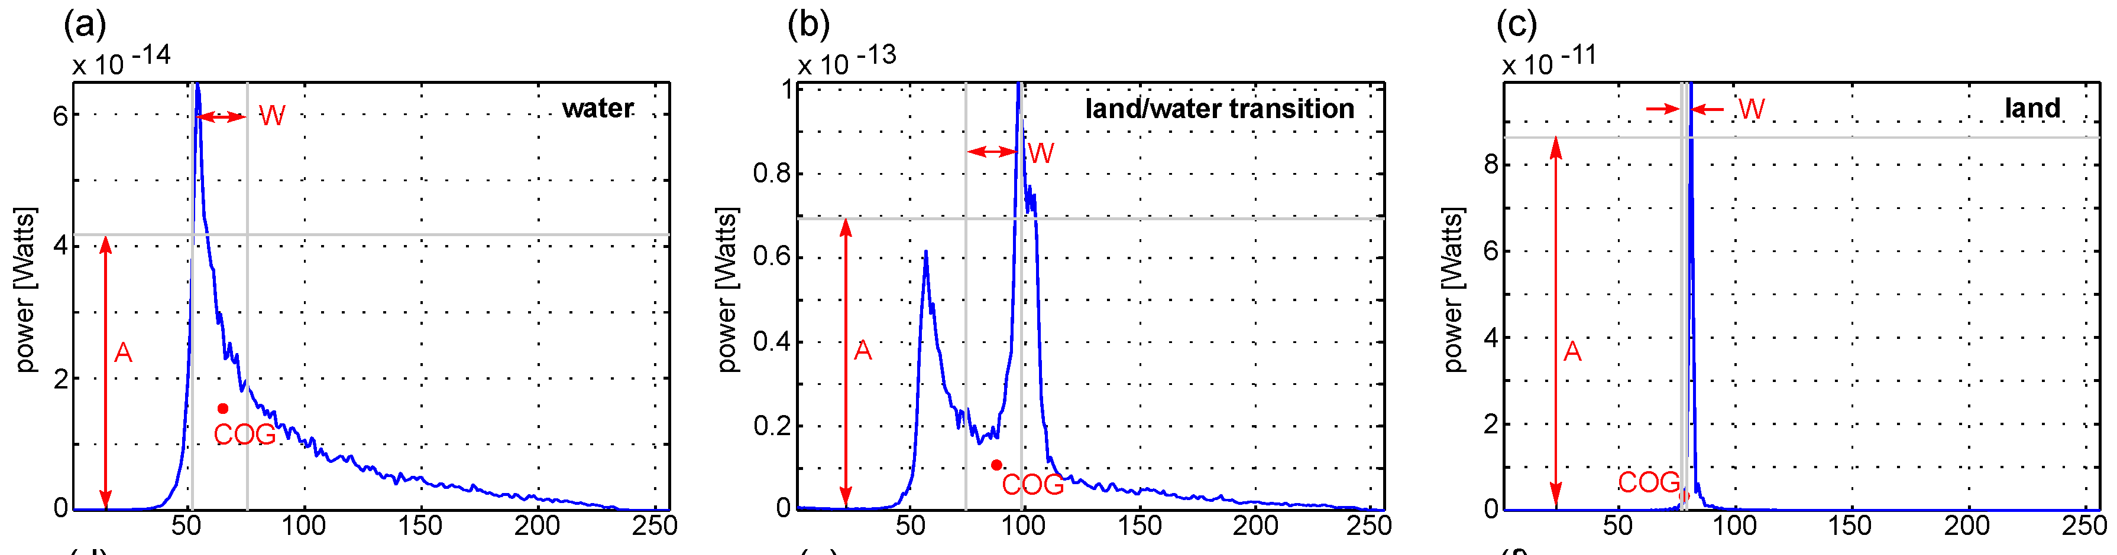
Naughty (inland) waveforms

Slide 23
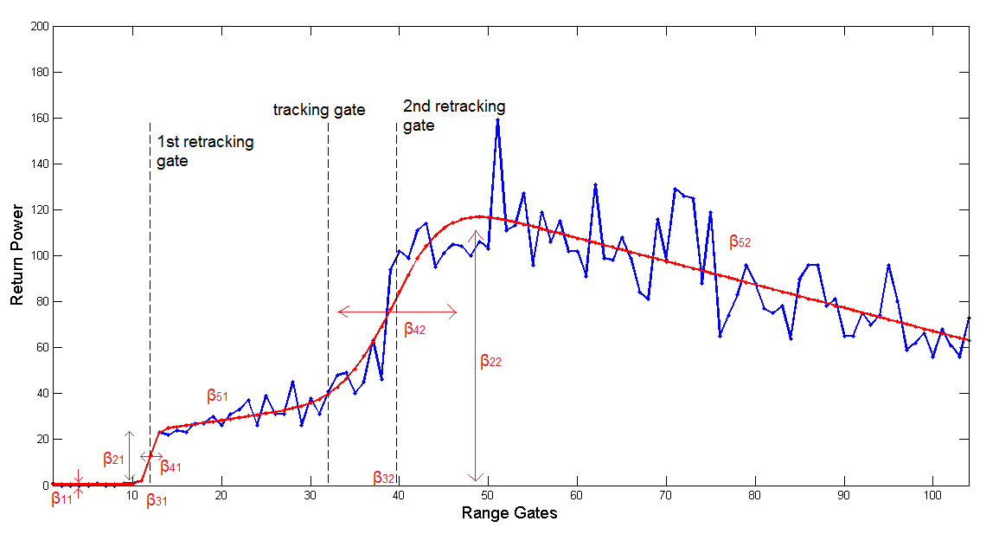
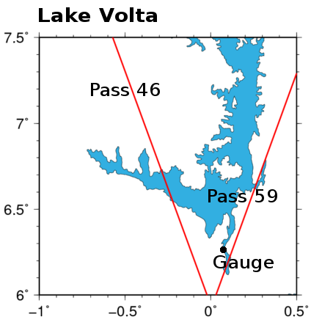
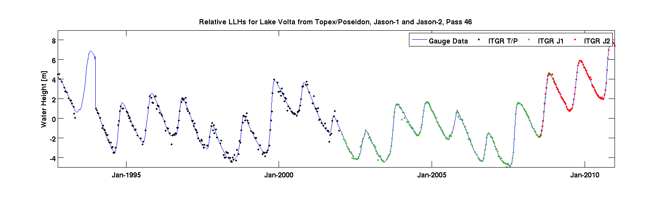
Retracking: (reprocessing waveforms)
Msc-thesis Bernd Uebbing

Slide 24
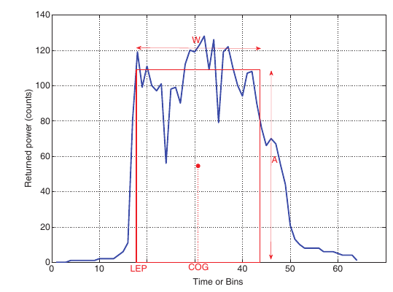
Exercise: OCOG retracker
Offset Center of Gravity retracker (OCOG), Wingham et al 1986
Originates from ice altimetry
Idea:
  compute an equivalent rectangle (WxA) and center of gravity (COG) of that rectangle.
  Use leading edge position (LEP) as the range gate representative of the reflecting surface

Slide 25
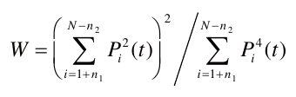
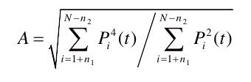
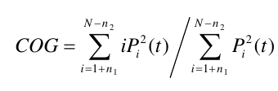
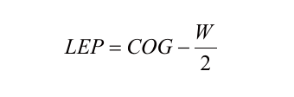
Exercise: OCOG retracker

Slide 26
Your take home points?
(remote) observation of river and lake heights: provide information for water resources (management)
Radar altimetry requires knowledge of the orbit, range, and corrections
The radar altimeter sends out chirps at the pulse repetition rate (e.g. 20 Khz)
In pulse limited altimetry the chirp bandwidth limits the (vertical) resolution.
Waveforms are build by ‘counting’ reflected chirps and assigning them to range gates
Waveforms over the ocean and land have different shapes

