Slide 1
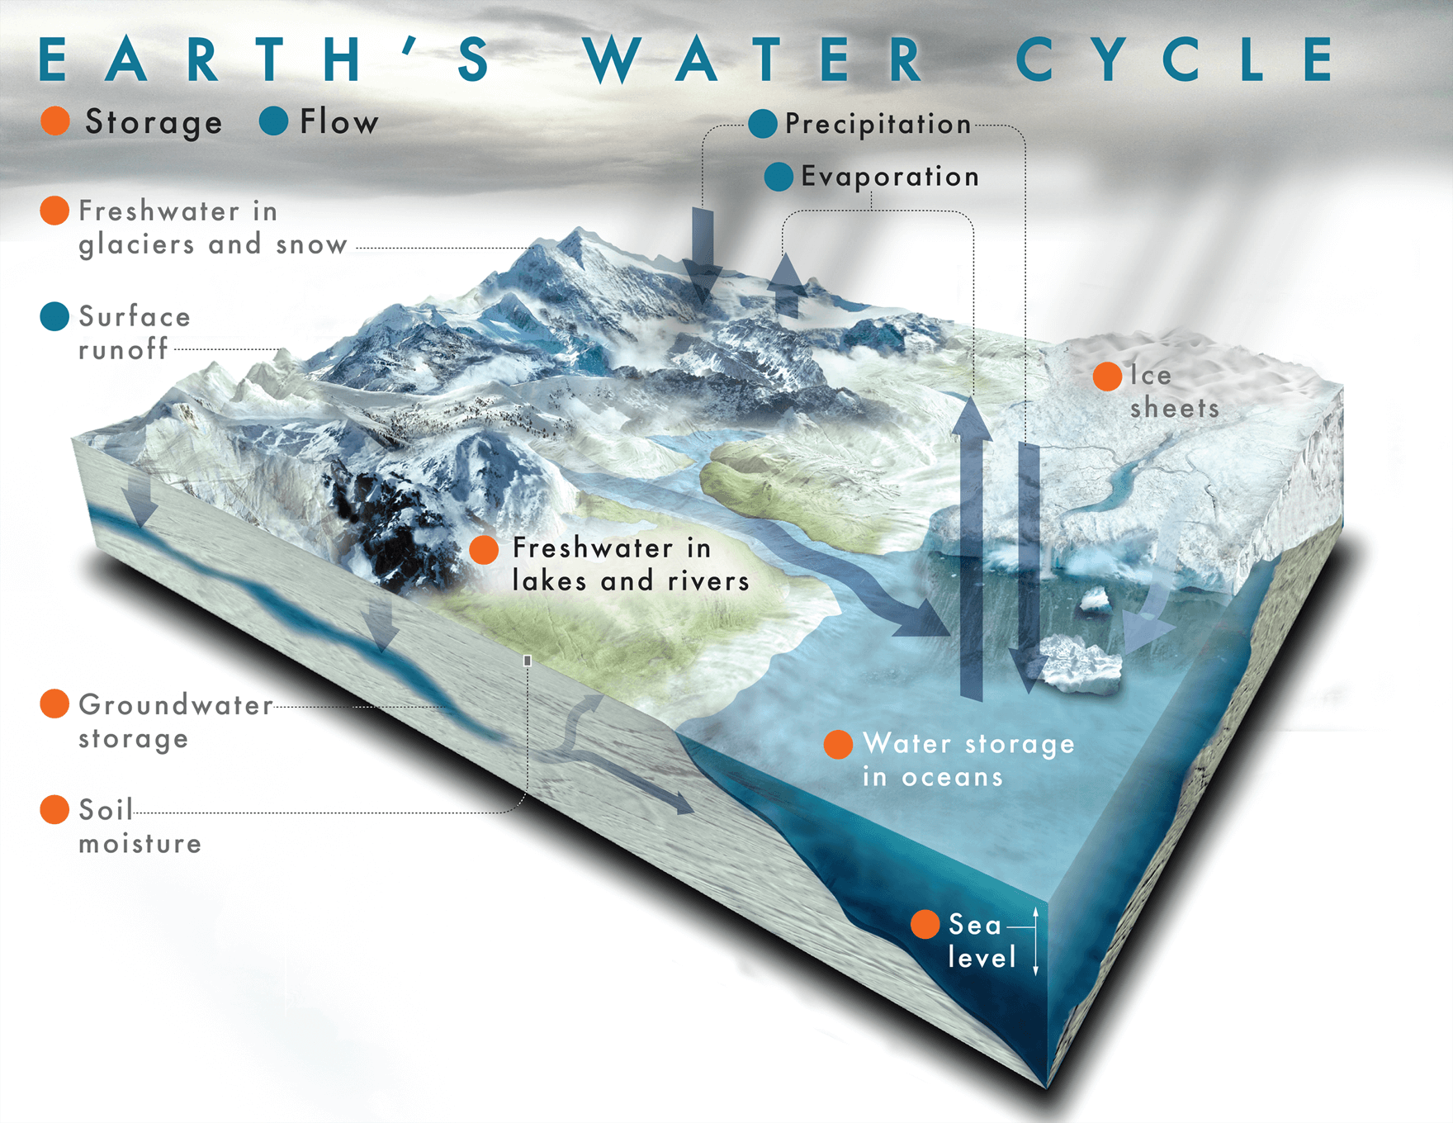
W3: Terrestrial Water Storage
OC10: Water budgets from Space, R. Rietbroek

Slide 2
What will we cover?
Concept of terrestrial water storage (TWS)
Observing TWS with satellite gravimetry
Current and future missions
Working with satellite gravity data

Slide 3
Concept of terrestrial water storage (TWS)

Slide 4
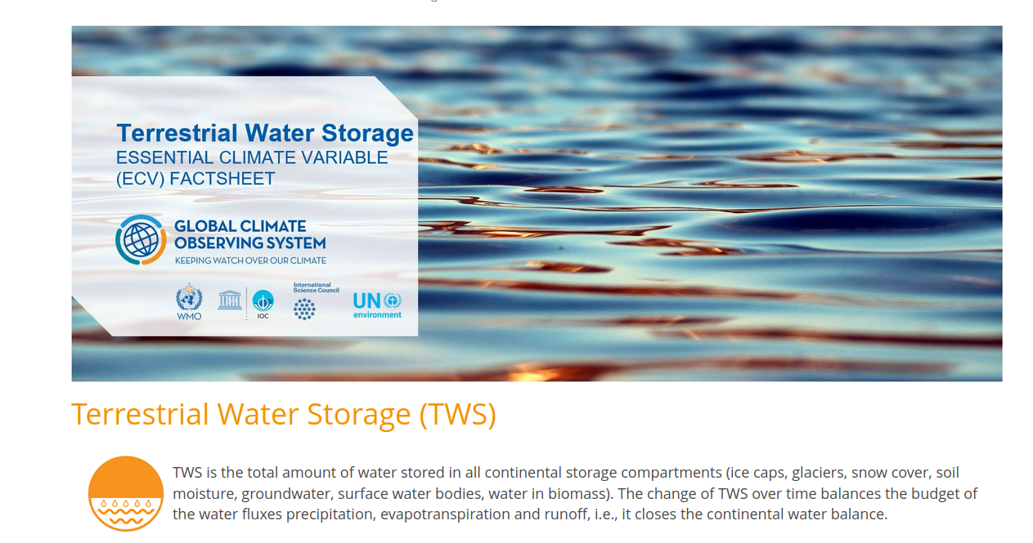
Terrestrial Water Storage is an essential climate variable (ECV)
TWS is an official GCOS ECV since 2022
ECV’s:
  55 defined by GCOS (Global Climate Observing System)
  variables that critically contributes to the characterization of Earth’s climate
  Strong incentive for strategic Monitoring/modelling (e.g. helps in directing mission design)

Slide 5
Terrestrial Water Storage is an essential climate variable (ECV)
TWS is the total amount of water stored in all continental storage compartments (ice caps, glaciers, snow cover, soil moisture, groundwater, surface water bodies, water in biomass). The change of TWS over time balances the budget of the water fluxes precipitation, evapotranspiration and runoff, i.e., it closes the continental water balance. TWS changes thus represent the net effect of climate variability and climate change as well as of anthropogenic impacts on the water cycle.
TWS is an aggregate measure of continental water storage (liquid/solid)
It’s time derivate is a FLUX (e.g. in m3/s)
Often expressed in m ( layer of equivalent water height )
Typical variations: 0-40mm of water height change
Time scales: days - years

Slide 6
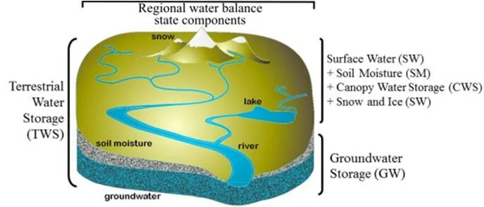
Tws is an aggregate variable
Ouma et al 2015

Slide 7
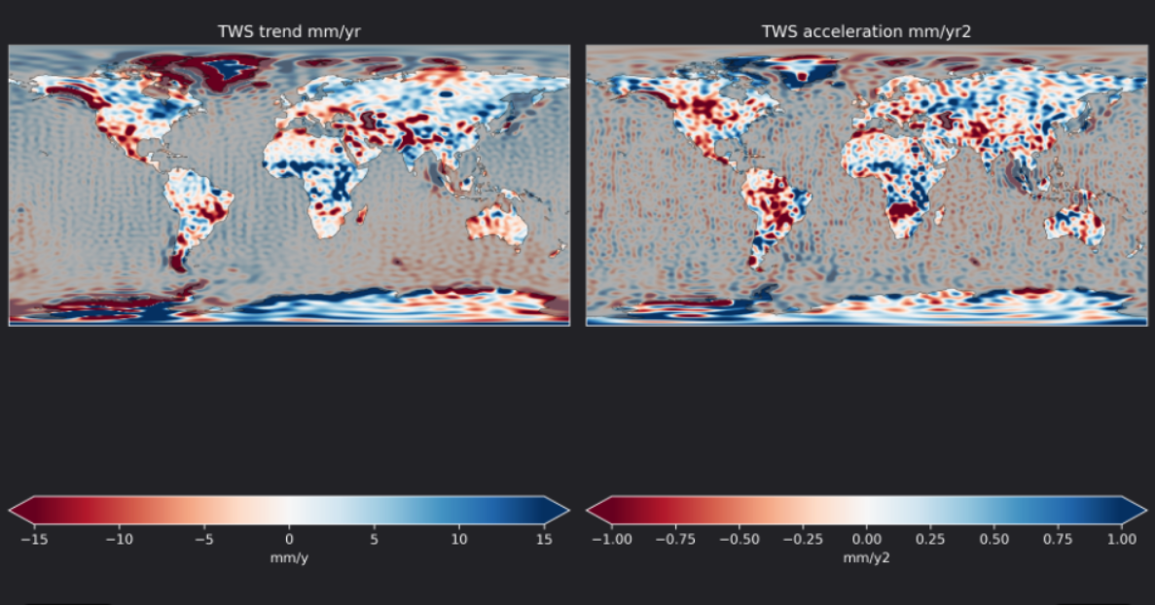
Can you spot TWS trend hotspots?

Slide 8
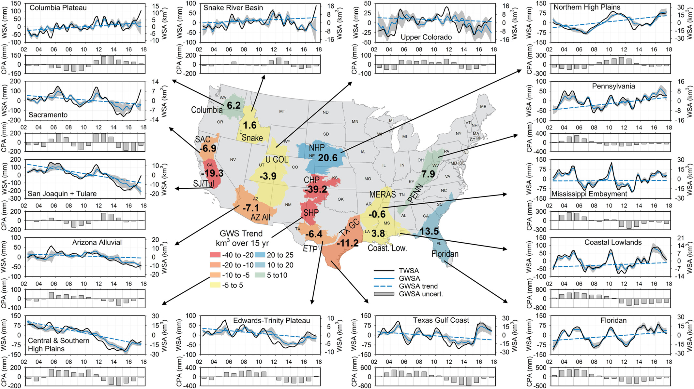
Example of using TWS: US Groundwater changes from GRACE/GRACE-FO
Aquifer mass changes can be observed from gravity changes
Net US decrease 90 km^3 over 15 years, but signs vary per aquifer
Groundwater peaks (Blue) are damped relative to terrestrial water storage (black), why?
Retrieving groundwater from TWS requires stripping away other components (soild moisture , surface water, snow,..)
GRACE/GRACE-FO are gravity missions. How can they be sensitive for TWS?
From Rateb et al. 2020, Water resources research. WSA: water storage anomaly, CPA:cumulative precipitation anomaly

Slide 9
Observing TWS with satellite gravimetry

Slide 10
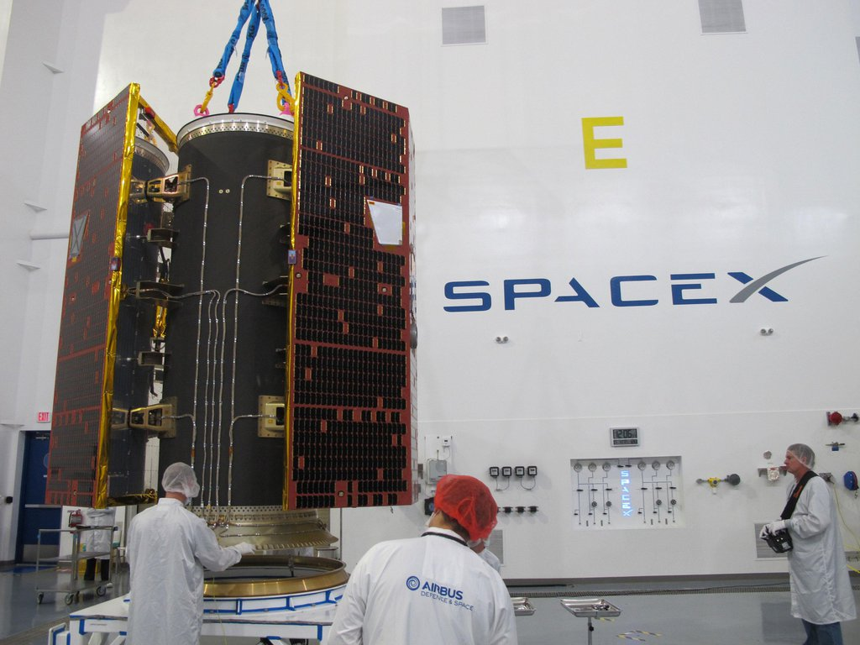
How does gravity relate to TWS? → quick intro to geodesy
We're not talking about the Hollywood version of
'gravity'

Slide 11
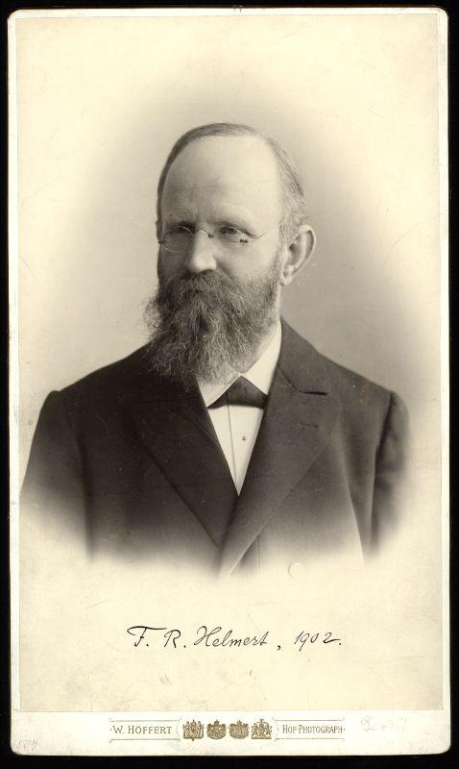
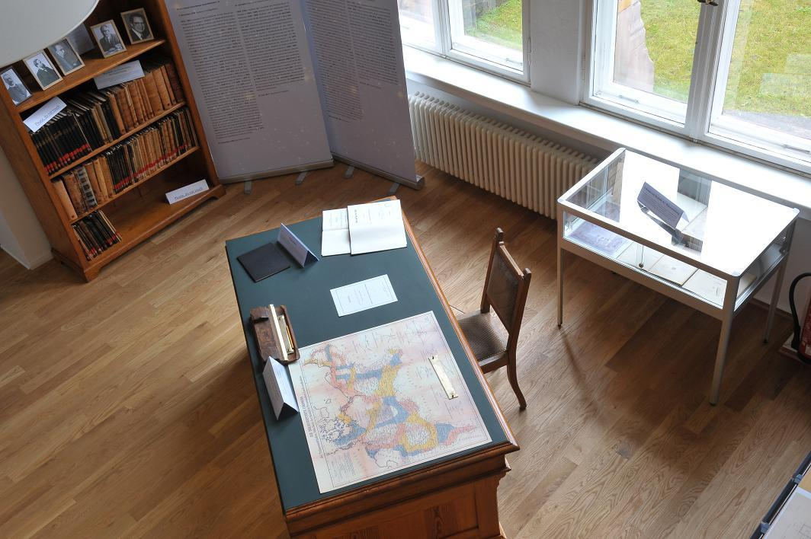
Classical definition of Geodesy
Friedrich Robert Helmert (1880): Geodesy is the science concerned with the study of the shape and size of the earth in the geometric sense as well as with the form of the equipotential surfaces of the gravity potential
Still relevant and well ahead of his time
Friedrich Robert Helmert
Helmert's desk (GFZ, Potsdam)

Slide 12
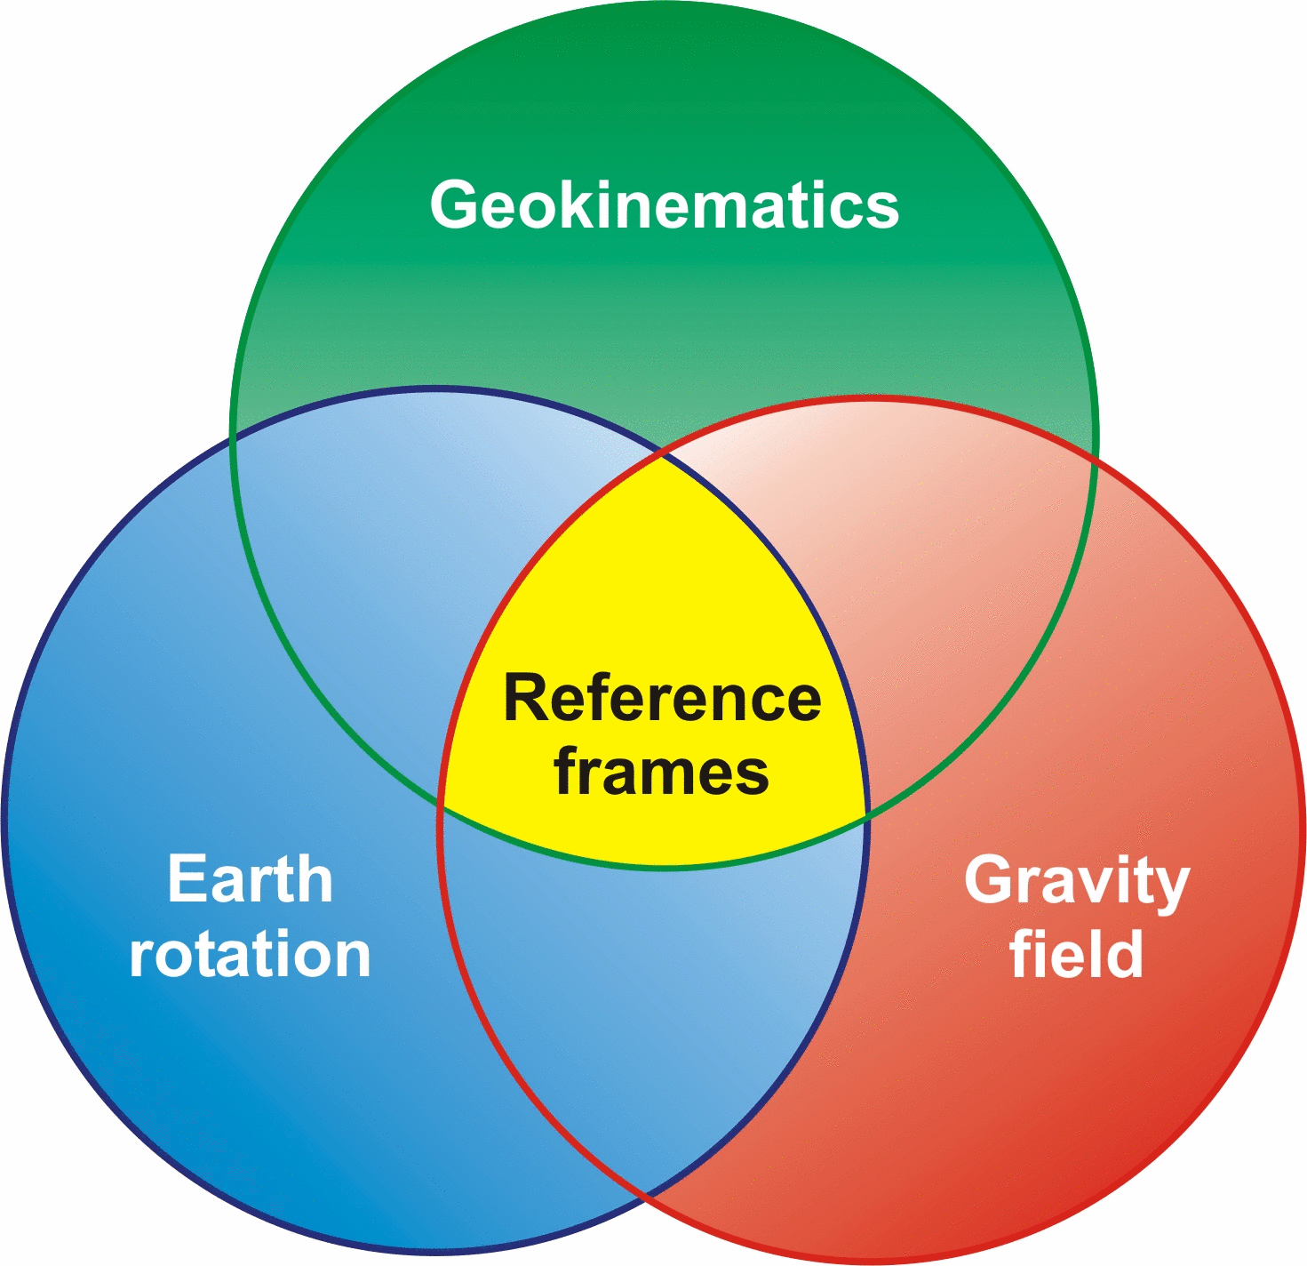
The three pillars of Geodesy
Geokinematics: study the shape of the Earth and its deformations over time)
Earth rotation: position and rate of the rotation axis and angular momentum axis w.r.t. to stars and crust
Gravity: the (possibly time-variable) gravitational field of non-homogenous objects
Reference frames: Definition and realization of Celestial and or Earth-fixed reference systems/frames
Source: www.iag-ggos.org

Slide 13
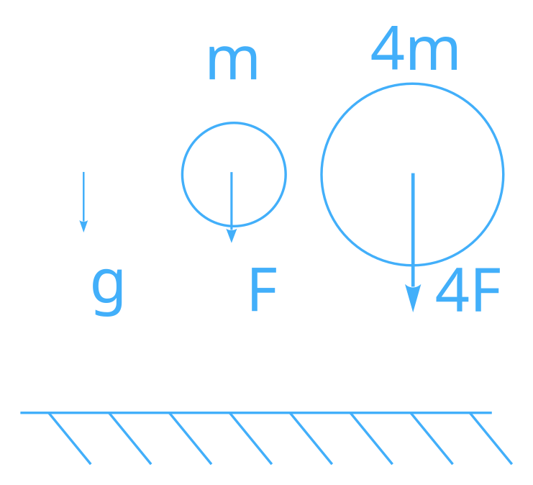
Force versus Acceleration
Gravitational force for objects in free fall:
To change the magnitude or direction of an object’s velocity, a force is needed
Force equals (gravitational) acceleration times mass
Gravitational acceleration is independent of the mass of the (falling) object
  But depends on mass of attracting body
It’s more convenient to describe the gravity field of an attracting body in terms of acceleration!
How to determine gravity g?

Slide 14
What influences gravity?
Magnitude of gravity
9.807246731 … m/s²
Gal mGal µGal (1 Gal =1cm/s²⁾
Relativity, 1mm height change
Ocean topography, polar motion
Nearby large buildings, hydrology
Earth and Ocean tides, 1m height change
Large reservoirs
Internal mass distribution
Mountain, ocean trench, 1km height
Flattening and rotation

Slide 15
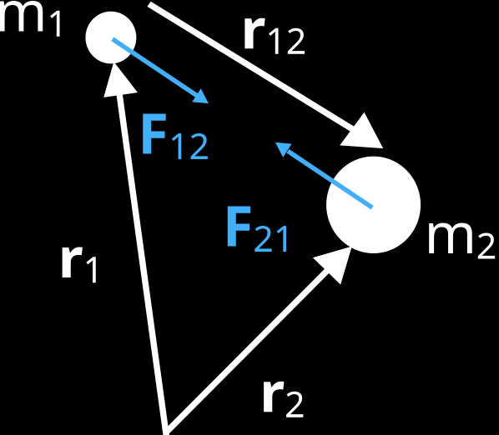
Newton’s law of gravitation
Gravitational force →
  proportional to both masses
  Inversely-proportional to square of distance
Action = Reaction →
Gravitational constant →

Slide 16
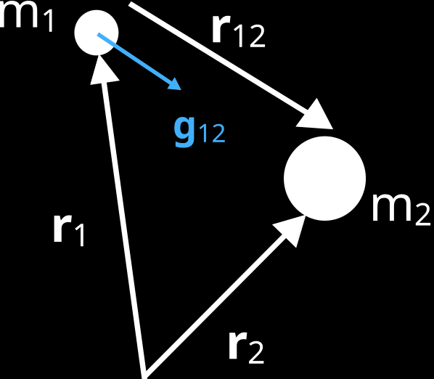
Describe the gravitational field of a central body in terms of acceleration (m2 >> m1)
Acceleration for a point mass:
More complex bodies: apply superposition principle
  Addition of multiple point masses
  Introduction of a density function

Slide 17
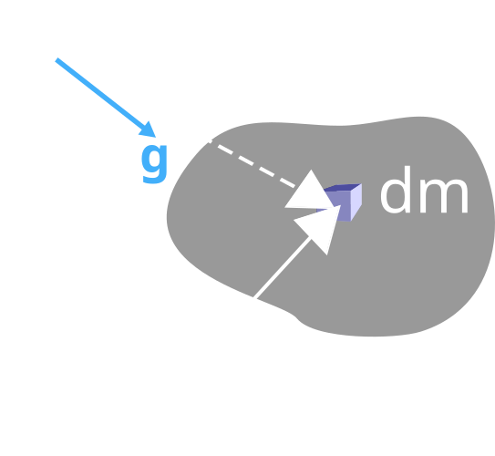
Integrate density to obtain the gravitational field
Addition of multiple point masses
Introduction of a density function (uh oh, do we even know this?)
g points along local plumbline
Is there a better choice for the reference frame origin?

Slide 18
Key idea to keep in mind
The Earth’s mass distribution changes over time (TWS!) and thus create a time variable gravity field:

Slide 19
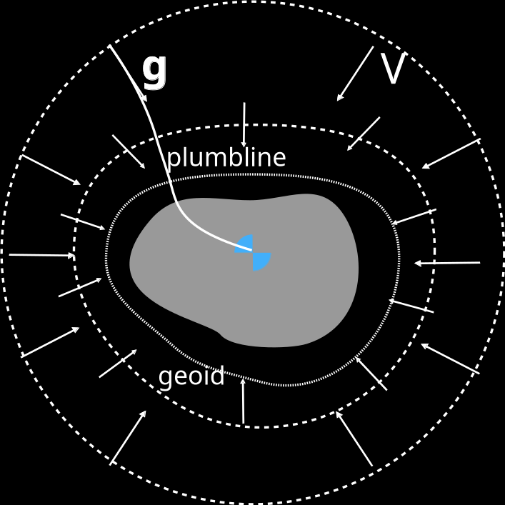
Properties of g?
Does g point to the center of mass?
  only in special cases
  from infinity
How quickly does g vanish going to infinity?
  with the second power of distance from the center of mass
Does g generate a conservative force?
  Yes, it must therefore generate a potential field
  gravity follows plumblines and is orthogonal to equipotential surfaces
  the geoid is special (coincides with an ocean surface at rest)
Equipotential surfaces

Slide 20
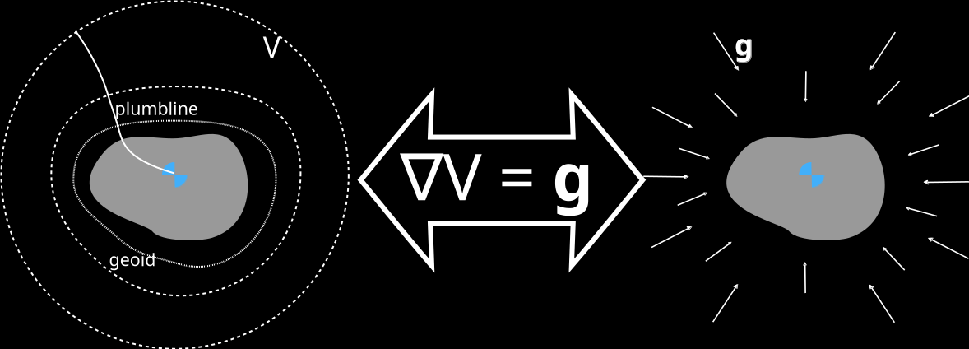
Potential versus Gravity
Potential V
Scalar field
unit m² /s²
not directly observable
Mathematical aid
Gravity g
Vector field
unit m/s²
Observable
Gradient of the Potential

Slide 21
Potential versus gravity from infinite distance
No matter how complex the body is: from a distance it looks like a point mass

Slide 22
How does gravity affect orbits?

Slide 23

Throwing a stone
What is the shape of the path?
  Parabola is a good approximation
but g is not constant (neither magnitude or direction)
What happens if we increase horizontal velocity, V?

Slide 24
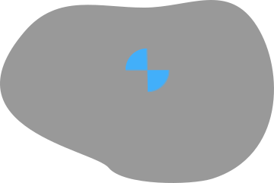
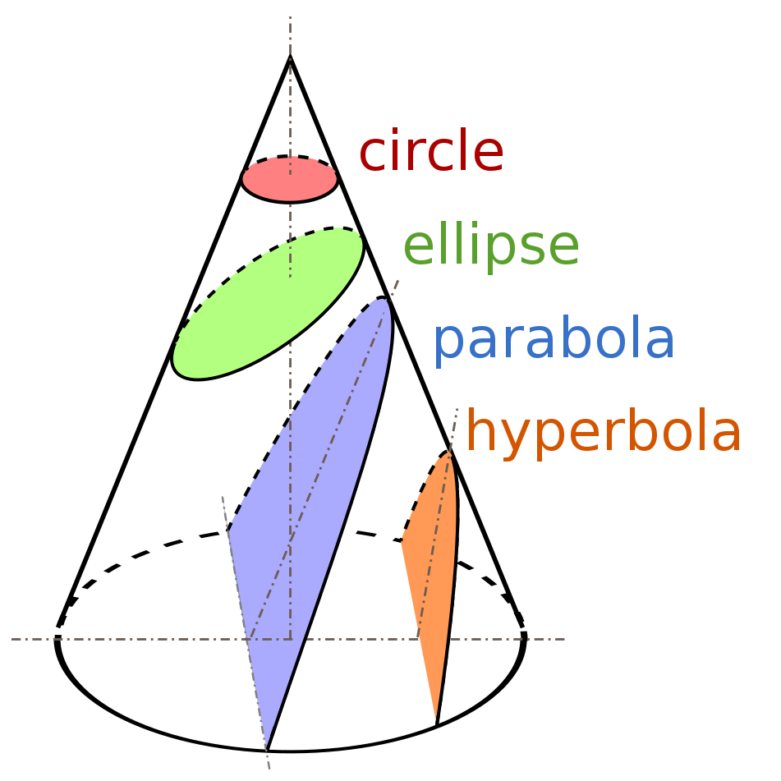
Orbital paths
V
With increasing V
  Orbit
  Escape Orbit
Earth as a point mass
  Kepler orbit
  Conical sections
circle
Ellipse
Parabola
Hyperbola

Slide 25
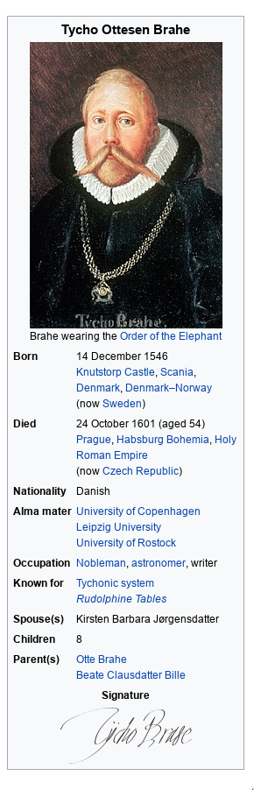
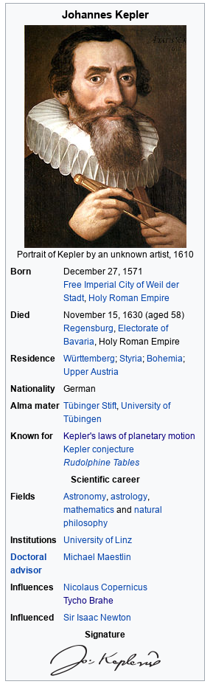
How do we know? Painstaking work from Tycho Brahe and Johannes Kepler
Tycho Brahe→ compiled a comprehensive database of astronomical observations
Johannes Kepler → explained these astronomical observations with his 3 laws of planetary motion
Kepler was the assistant and follow up of Brahe during his time in Prague
wikipedia

Slide 26
Intermediate Lessons learned
Geodesy is build around three pillars: Shape,earth rotation and gravity
We can describe the gravitational field in terms of acceleration
Or better: in terms of gravitational potential from which we can derive the vectorial gravity anywhere
The potential field can visualized by equipotential surfaces wrapped around the central body
Orbits around point masses (e.g. Earth around the Sun) are described by Kepler orbits (conical sections)

Slide 27
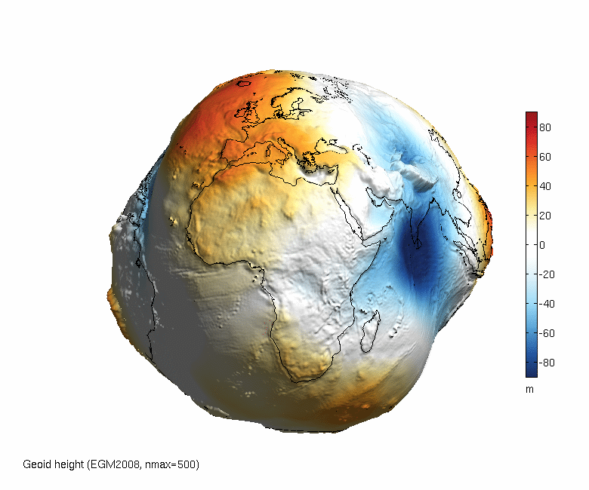
The Earth as a potato (aka Geoid)
Geoid (surface of the ocean in rest sea without motion)
Natural choice as a reference surface (where is 0m height?)
max -100 meter difference from Ellipsoid
Equipotential surface: Paths along the geoid do not involve work
Visible in the geoid: Tectonics, mantle convection, bathymetry, topography
asus.cas.cz

Slide 28
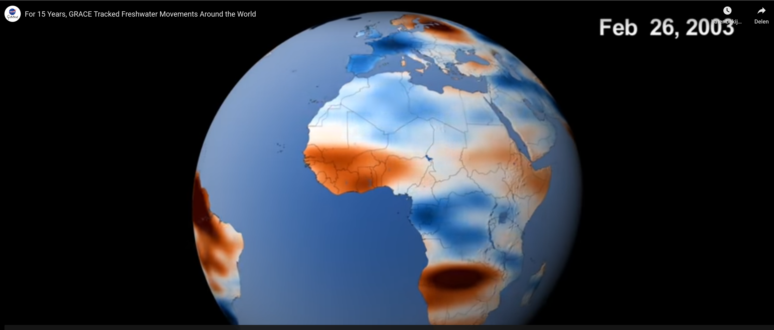
But there is a time variable component!
Tides
Hydrological water cycle
Atmosphere
Ocean
Solid Earth (e.g. Earthquakes,..)
Highly variable sub-daily to inter-annual
3 orders of magnitude smaller than the static field
Most changes occur in a thin layer at the surface of the Earth ( ~15km thick)
video link

Slide 29
Video opens up more questions
How can satellite gravimetry measure water height changes?
  after all, there is an infinite number of density distributions which generate the same external gravity field
How does one separate all those different contributions (soil moisture, surface and groundwater, atmosphere)?
Why does the gravity field from GRACE look so smoothed?

Slide 30
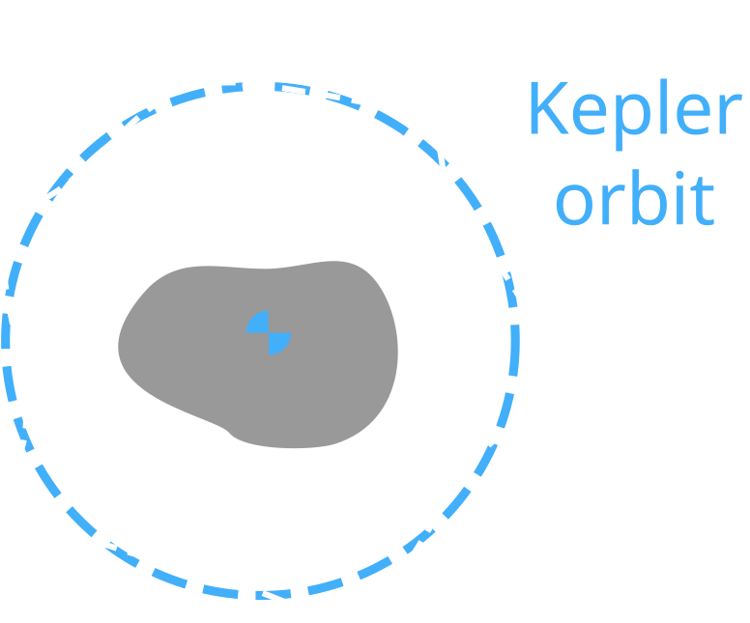
Principle of Satellite Gravimetry
Anomalies from a perfect Kepler orbit contain gravity field information
Anomalies decreases for higher orbital altitudes
Largest gravity anomaly?
  The Earth’s flattening
← Precise orbit determination ←
Satellite orbit
(position, velocity)
Gravity field
(potential, gravity)
→ Gravity field estimation →

Slide 31
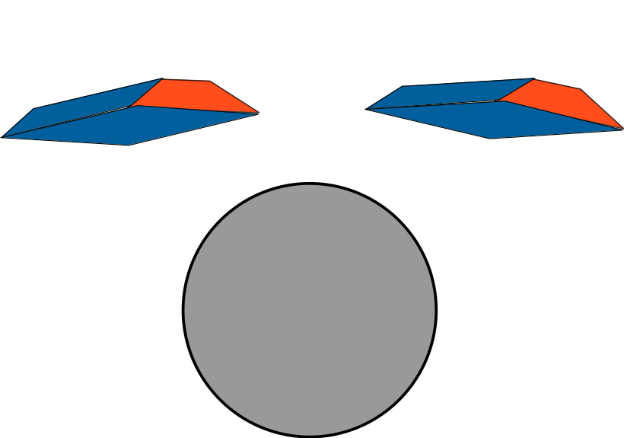
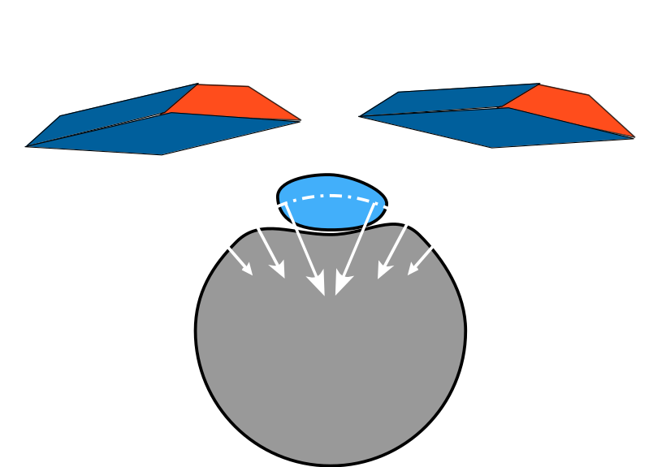
Surface load (e.g. TWS) and satellite gravimetry
Surface load causes
  A direct change in gravity
  an indirect response due to deformation of the solid Earth
Terrestrial (total) Water Storage can be retrieved from satellite orbits when:
  We assume mass change occurs in a thin layer
  We have a dense coverage of accurate orbit measurements (e.g. from GNSS or range instruments)
  We know the mechanical properties of the solid Earth

Slide 32
Current and future gravity missions

Slide 33
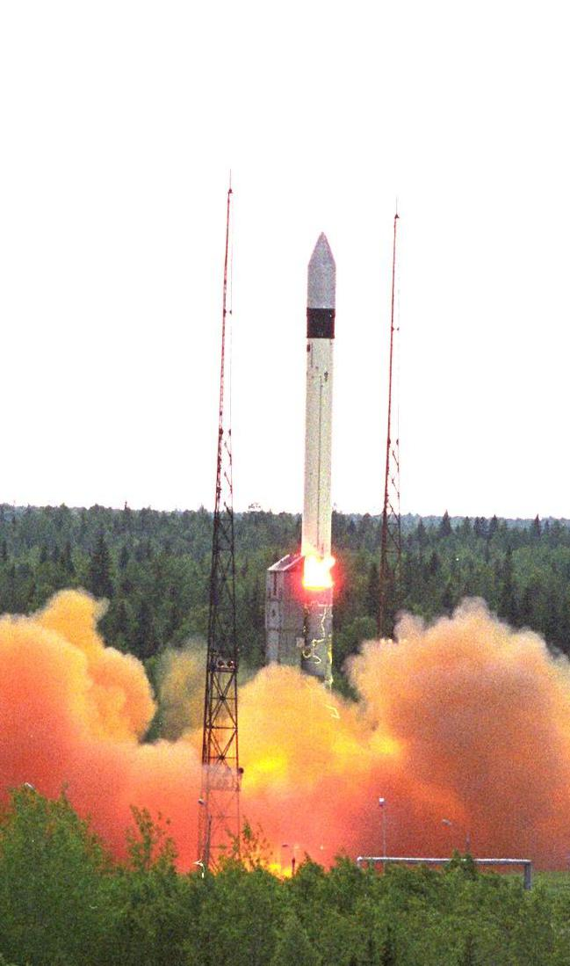
GRACE Mission (2002 - 2017)
Launch March 2002, Plesetsk (Rockot, reused ICBM)
End Nov/Dec 2017
Orbit height: 500km (350 km during last phase)
Satellite separation:~250km
Orbital period: 94 min
Inclination: 89 degs

Slide 34
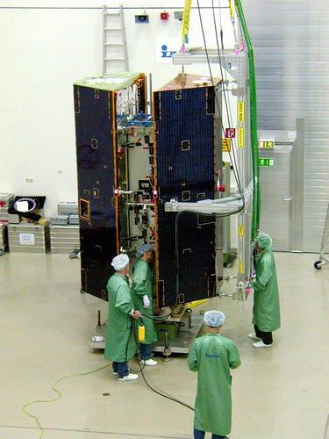
GRACE Mission cont’d
Mission life time: 5 yrs!
Satellite weight: 460kg+34kg fuel
Power 160W
Microwave ranging instrument (σ < 1 μm/s)
Accelerometer (σ = 3e-10 m/s2)
Global positioning System (σ = 2 - 3 cm)
NASA: 97 million USD, DLR: 30 million USD

Slide 35
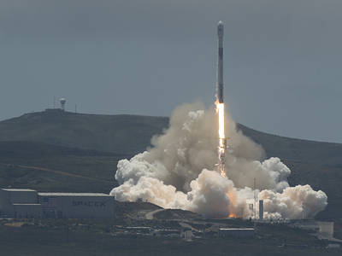
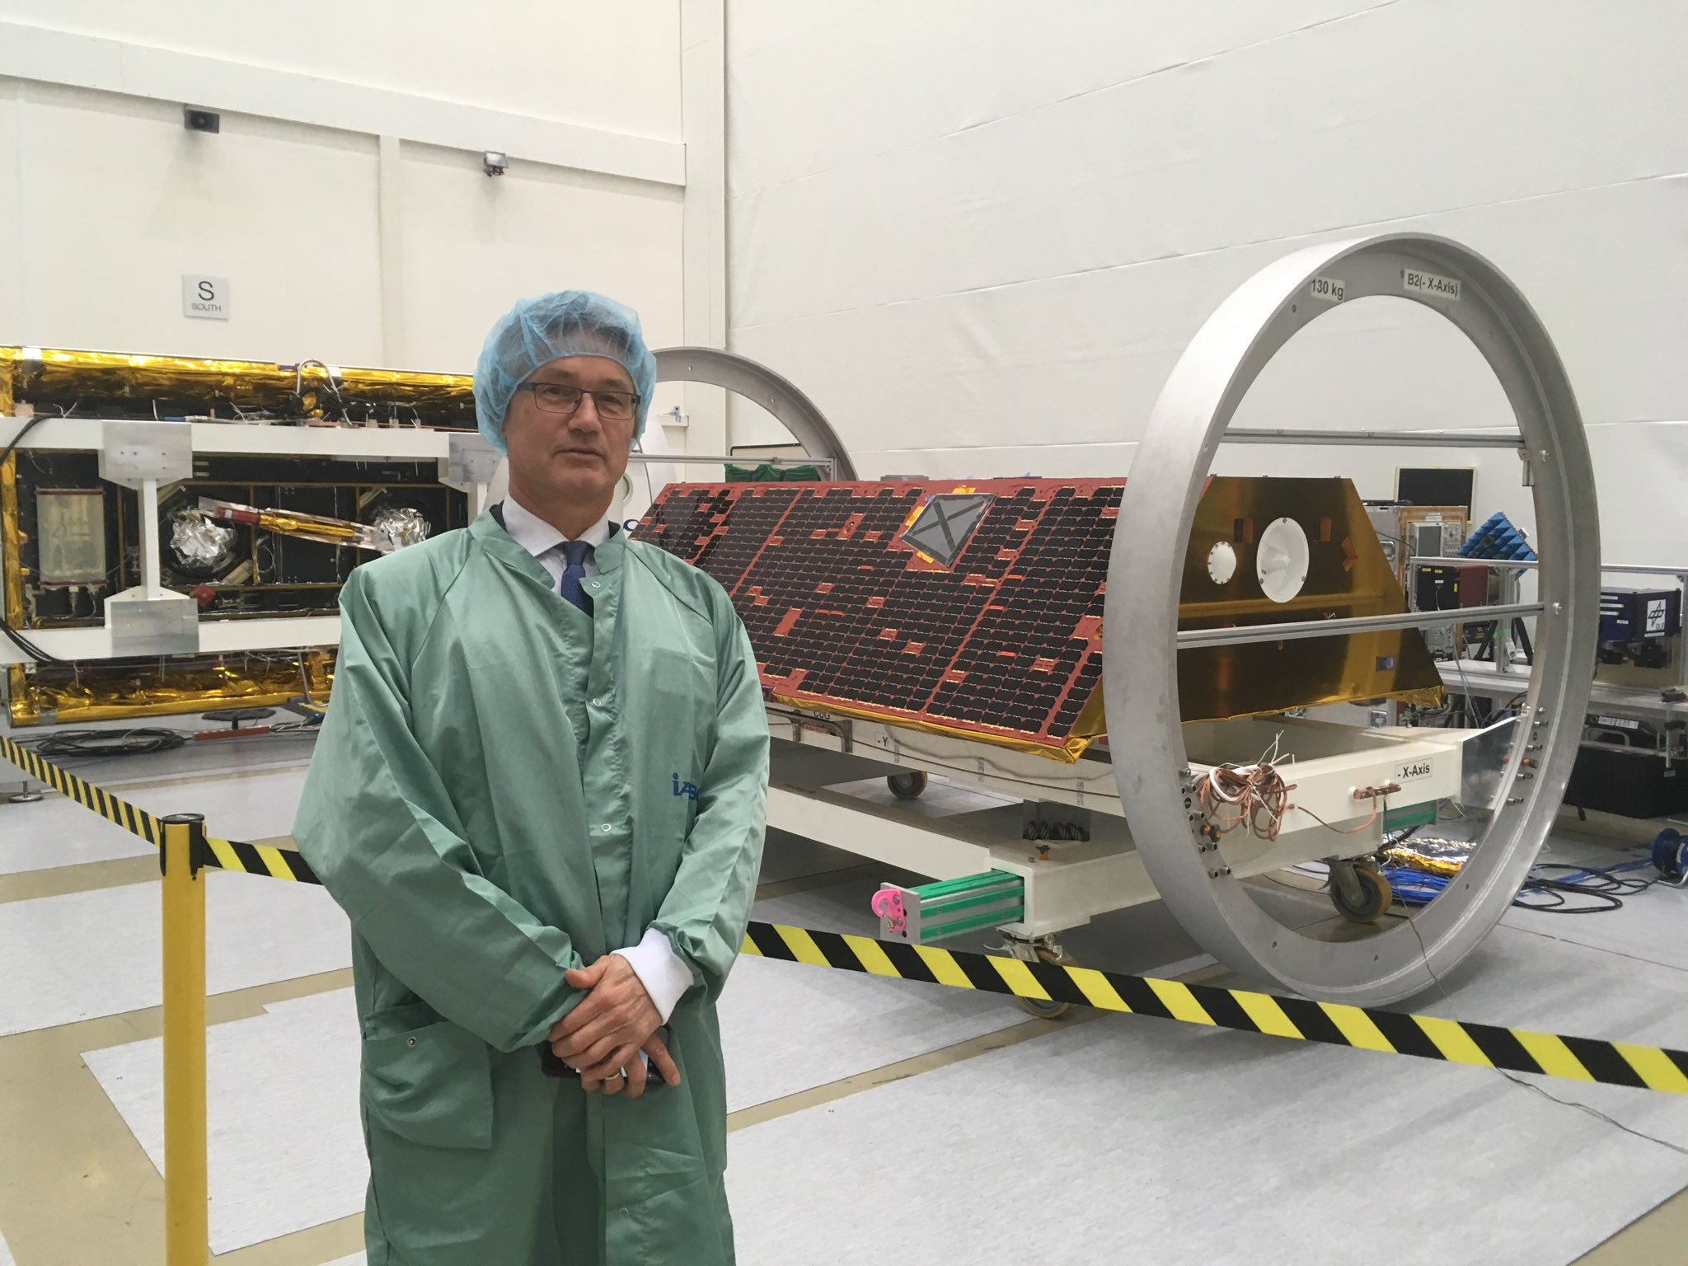
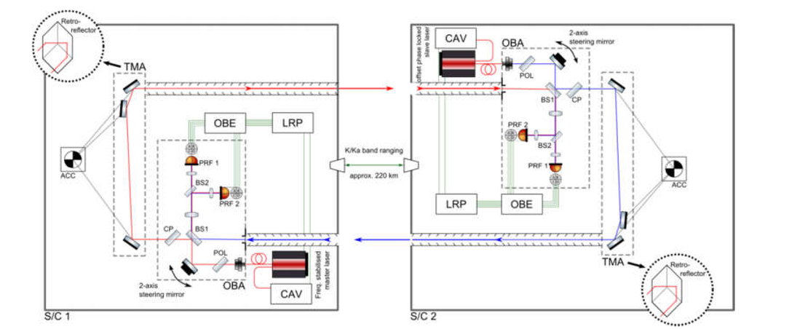
GRACE Follow on Mission
Launched: May 22, 2018
Piggy-back with Iridium satellites on Falcon launcher
Demonstrator: Laser interferometer for intersatellite
ranging (~10x more accurate)

Slide 36
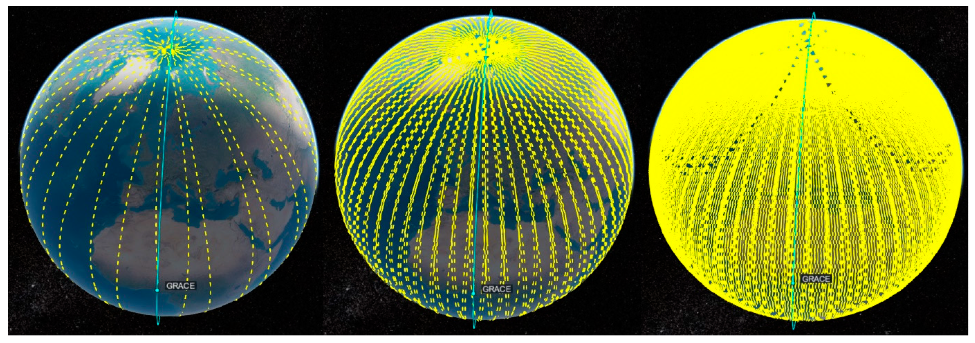
Sampling/groundtracks
GRACE and GRACE-FO are in a polar orbit
Spatial resolution is linked to averaging interval
Short term hydrology poses challenges for satellite gravimetry in terms of spatiotemporal resolution
Fatolazadeh et al. 2022

Slide 37
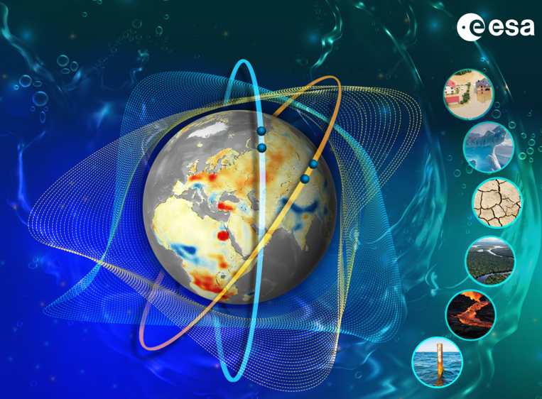
MAGIC (GRACE-C + NGGM)
2 upcoming satellite pairs (Collaborate with NASA)
  GRACE-C (Continuity) (NASA-DLR) 2028
  NGGM (ESA), 2032
Mass-change And Geosciences International Constellation (MAGIC)
Two simultaneous pairs at different inclination (‘Bender’ configuration)
@ 150 km spatial resolution in 10 days
@300km in 3 days
  Relevance for shortlived events such as flooding

Slide 38
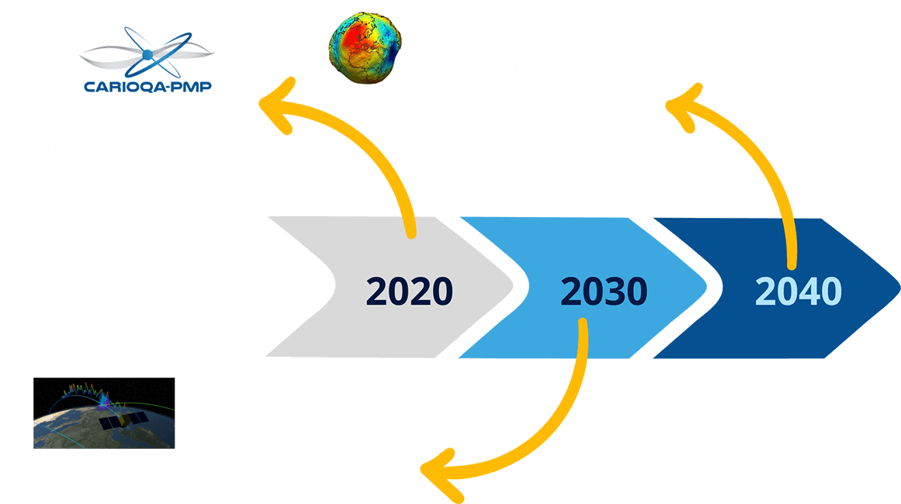
Quantum gravimeters in space
Accelerometer noise is currently a bottleneck
Quantum (Cold Atom Rubidium Interferometers) based accelerometers are being developed for future missions
Launch Pathfinder mission before end of the decade to test potential

Slide 39
Working with satellite gravity data

Slide 40
Data products
Level 1a/b: along track orbit data
Level 2: Spherical harmonic coefficients of the gravity field
Level3: gridded products (filtered), or different discretizations

Slide 41
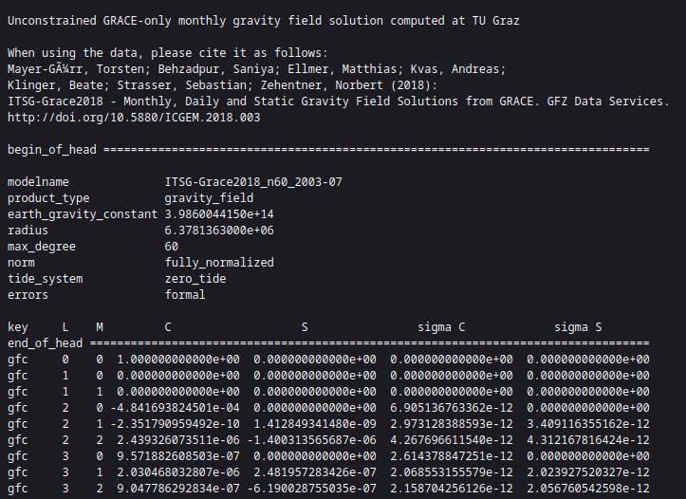
Working with monthly Level 2 GRACE/GRACE-FO products...

Slide 42
Gravity products are provided as Stokes Coefficients
The actual information of the gravity field is contained in Cnm, Snm (unitless)
The challenge with satellite gravimetry, strong attenuation of Potential with satellite altitude and degree:

Slide 43


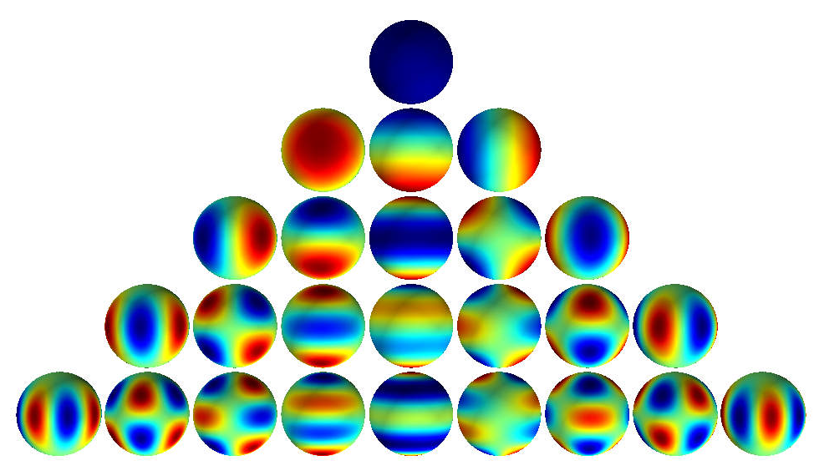
Gravity potential and spherical harmonics
m
n
Spherical harmonics (bases function) are solutions of the Laplace equations!
Higher degree (n) and order (m) allows resolving finer details of the gravity field
  Resolution ~40000km/(2*maxdegree)
Source:
www.csc.kth.se/~fpokorny

Slide 44


Conversion to terrestrial water storage change
Use anomalies (relative to a static gravity field)
No dependency on radius, TWS represent a layer (in meter) of equivalent water height at the Earth’s surface
Where can the (indirect) effect of Earth deformation be found?
We assume that the mass variations of the gravity anomalies originate in an infinitely thin shell at the surface of the Earth (e.g. water,ice, air)

Slide 45
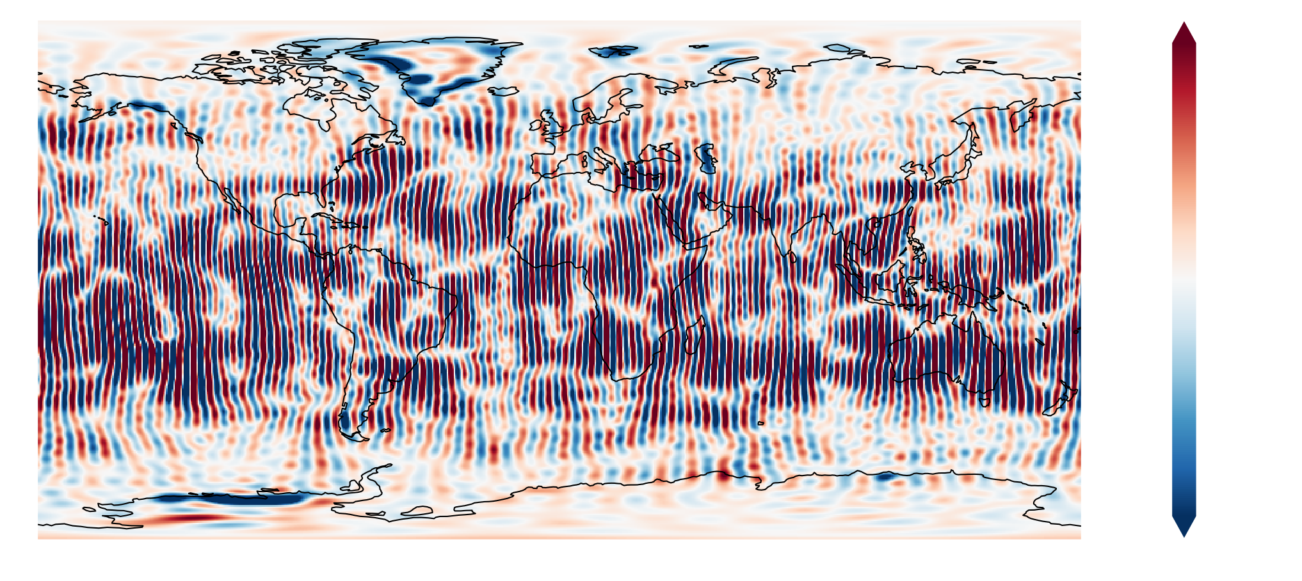
Stripes→ Spatial/spectral filters are needed

Slide 46


Working with Level 2 GRACE/GRACE-FO products (tutorial)
Other corrections needed (see tutorial)
  Degree Coefficients 1 are missing
  Coefficients with large n are too noisy and spatial filters are needed
  Replace flattening coefficient (n=2,m=0) with that from Satellite Laser Ranging (better)
  Static gravity field needs to be subtracted
  For Ocean applications the a priori background model needs to be restored
Many options available, but may be overwhelming for new users
Alternatively, Level 3/4 data (e.g. gridded, specific applications), Downside: no choice in spatial smoothing possible
You can find level 3/4 products here:
  Gravis service (Germany)
  Tellus website (US)
https://github.com/ITC-Water-Resources/shxarray

Slide 47
Main take-home points
Terrestrial water storage (TWS) is a recognized Essential climate variable
TWS is an aggregates water storage changes of different compartments of continental storage
The time variable parts of TWS is detectable in the gravity field of the Earth
The time-variable gravity field is very weak relative to the static anomalies
Observed orbit anomalies provide information on the gravity field of the Earth
GRACE and GRACE-FO carry inter-satellite ranging instruments which provide more information than just the orbits from GNSS tracking

