Slide 1
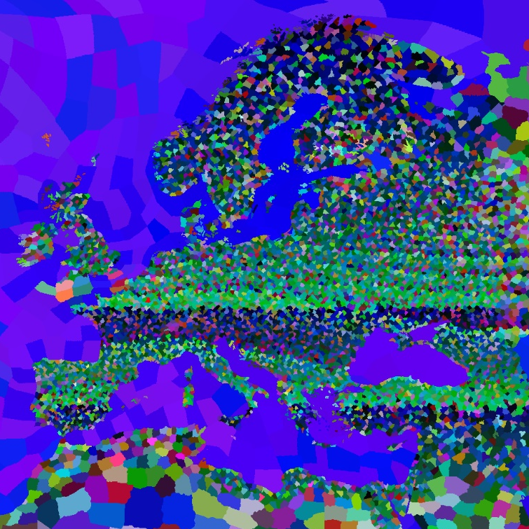

EOE’s MAP MOD
All Codes are generated by
PYTHON
10000+ States 1200%
19000+ Provinces 150%
More Straits
More Resources
More Victory Points
More Tiles for Urban
*You need a powerful computer
Powered by PowerPoint

