Slide 1
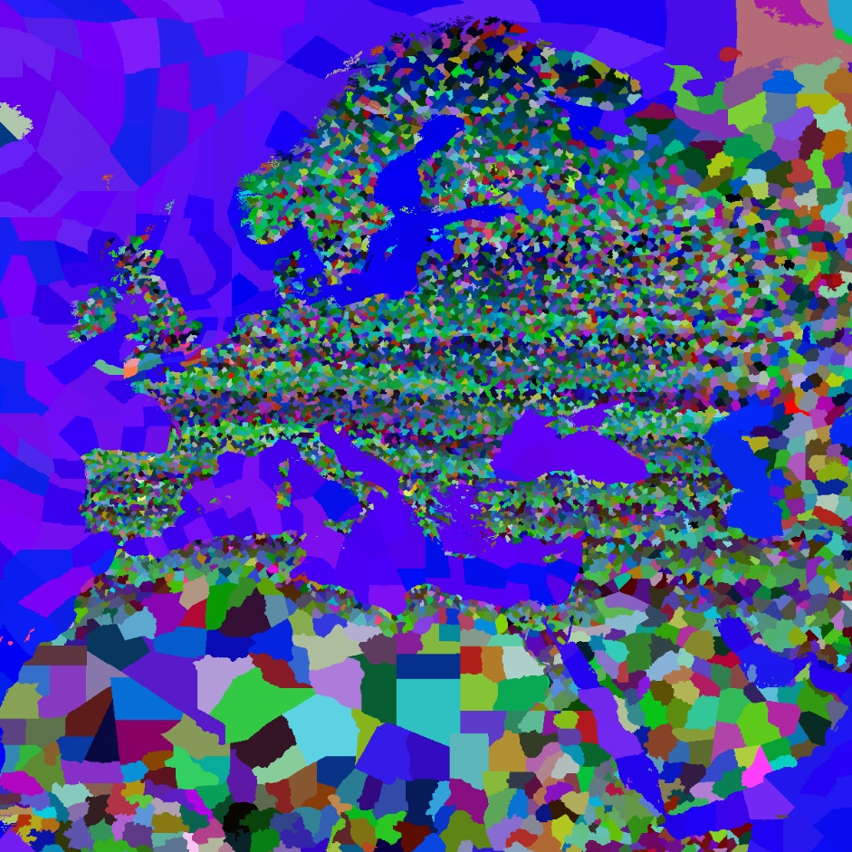

EOE’s
STANDARED
MAP MOD
All Codes are generated by
PYTHON
1200% States
18000+Provinces
*You need a powerful computer
*Powered by PowerPoint

