Slide 1
Scotian Shelf Climatology
Summary Analysis of Climatology used in IML QC for Scotian Shelf data

Slide 2
Background
During Summer 2019, Groundfish and Fixed station data at BIO is being ‘rebooted’
Using IML QC procedures, E. Chisholm is flagging and QC’ing historical BioChem data
Certain flags arise for data outside of Climatology, which is concerning
Climatology was created by G. Lazin when performing initial reboot of AZMP data
AZMP data was used to create scotia shelf climatology that IML was lacking
The goal of this investigation would be to ensure the climatology accurately represented scotia shelf conditions year round, when only spring and fall AZMP surveys were used to create it

Slide 3
Data
Climatology tests are called in stage 3 of IML QC (B_control_Q_GL.m(B_stage3_Q.m))
B_stage3_Q.m calls two .mat data files (B_stage3_Q_BIO.mat, Petrie.mat)
Test 35 looks at temperature and salinity climatology, Test 36 looks at nutrient climatology
Climatology for both tests are contained in B_stage3_Q_BIO.mat, Petrie.mat only contains temperature and salinity data
Data for test 35 matches in both data files

Slide 4
Test 35
Temperature and Salinity

Slide 5
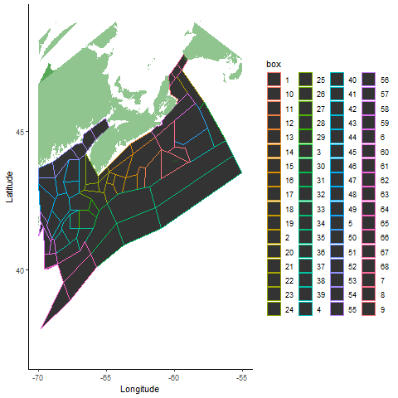
Climatology boxes on the scotia shelf for test 35

Slide 6
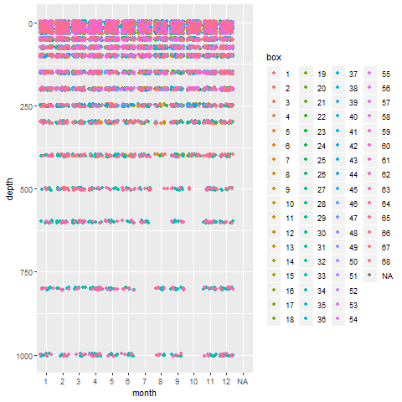
Temperature and salinity sampling effort (values available in climatology)

Slide 7
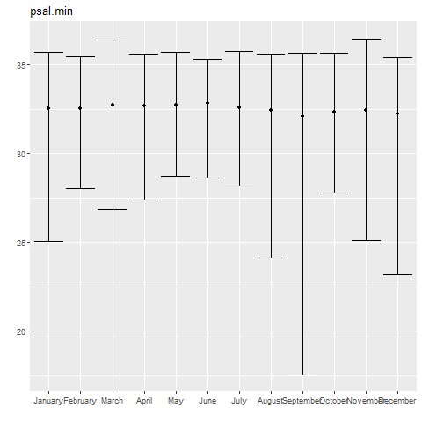
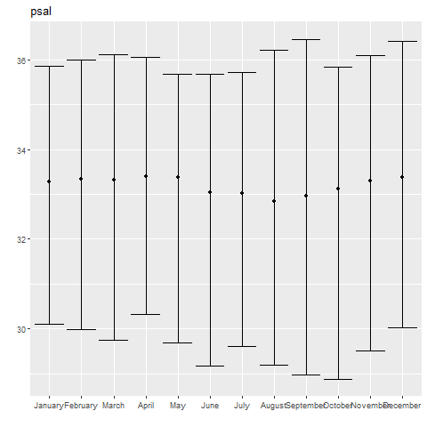
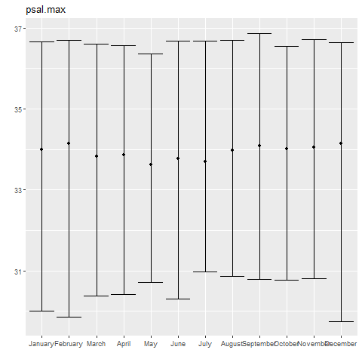
Salinity
Minimum salinity climatology showing mean, min and max for all boxes per month
Average salinity climatology showing mean, min and max for all boxes per month
Maximum salinity climatology showing mean, min and max for all boxes per month

Slide 8
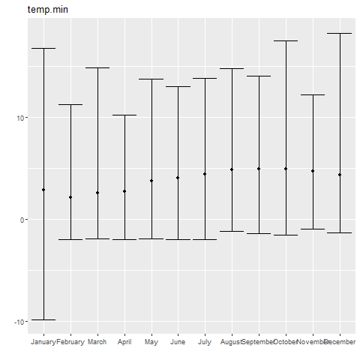
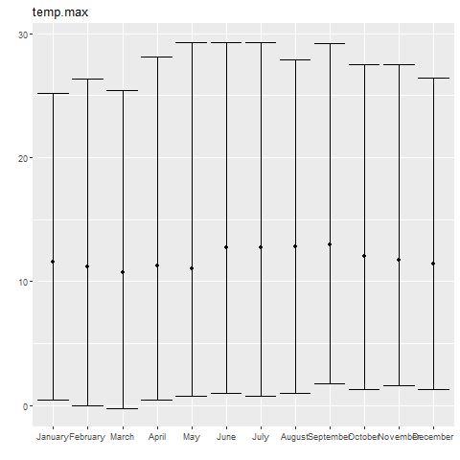
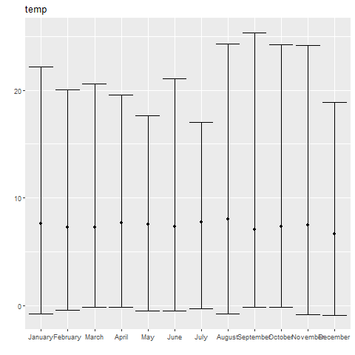
Temperature
Minimum temperature climatology showing mean, min and max for all boxes per month
Average temperature climatology showing mean, min and max for all boxes per month
Maximum temperature climatology showing mean, min and max for all boxes per month

Slide 9
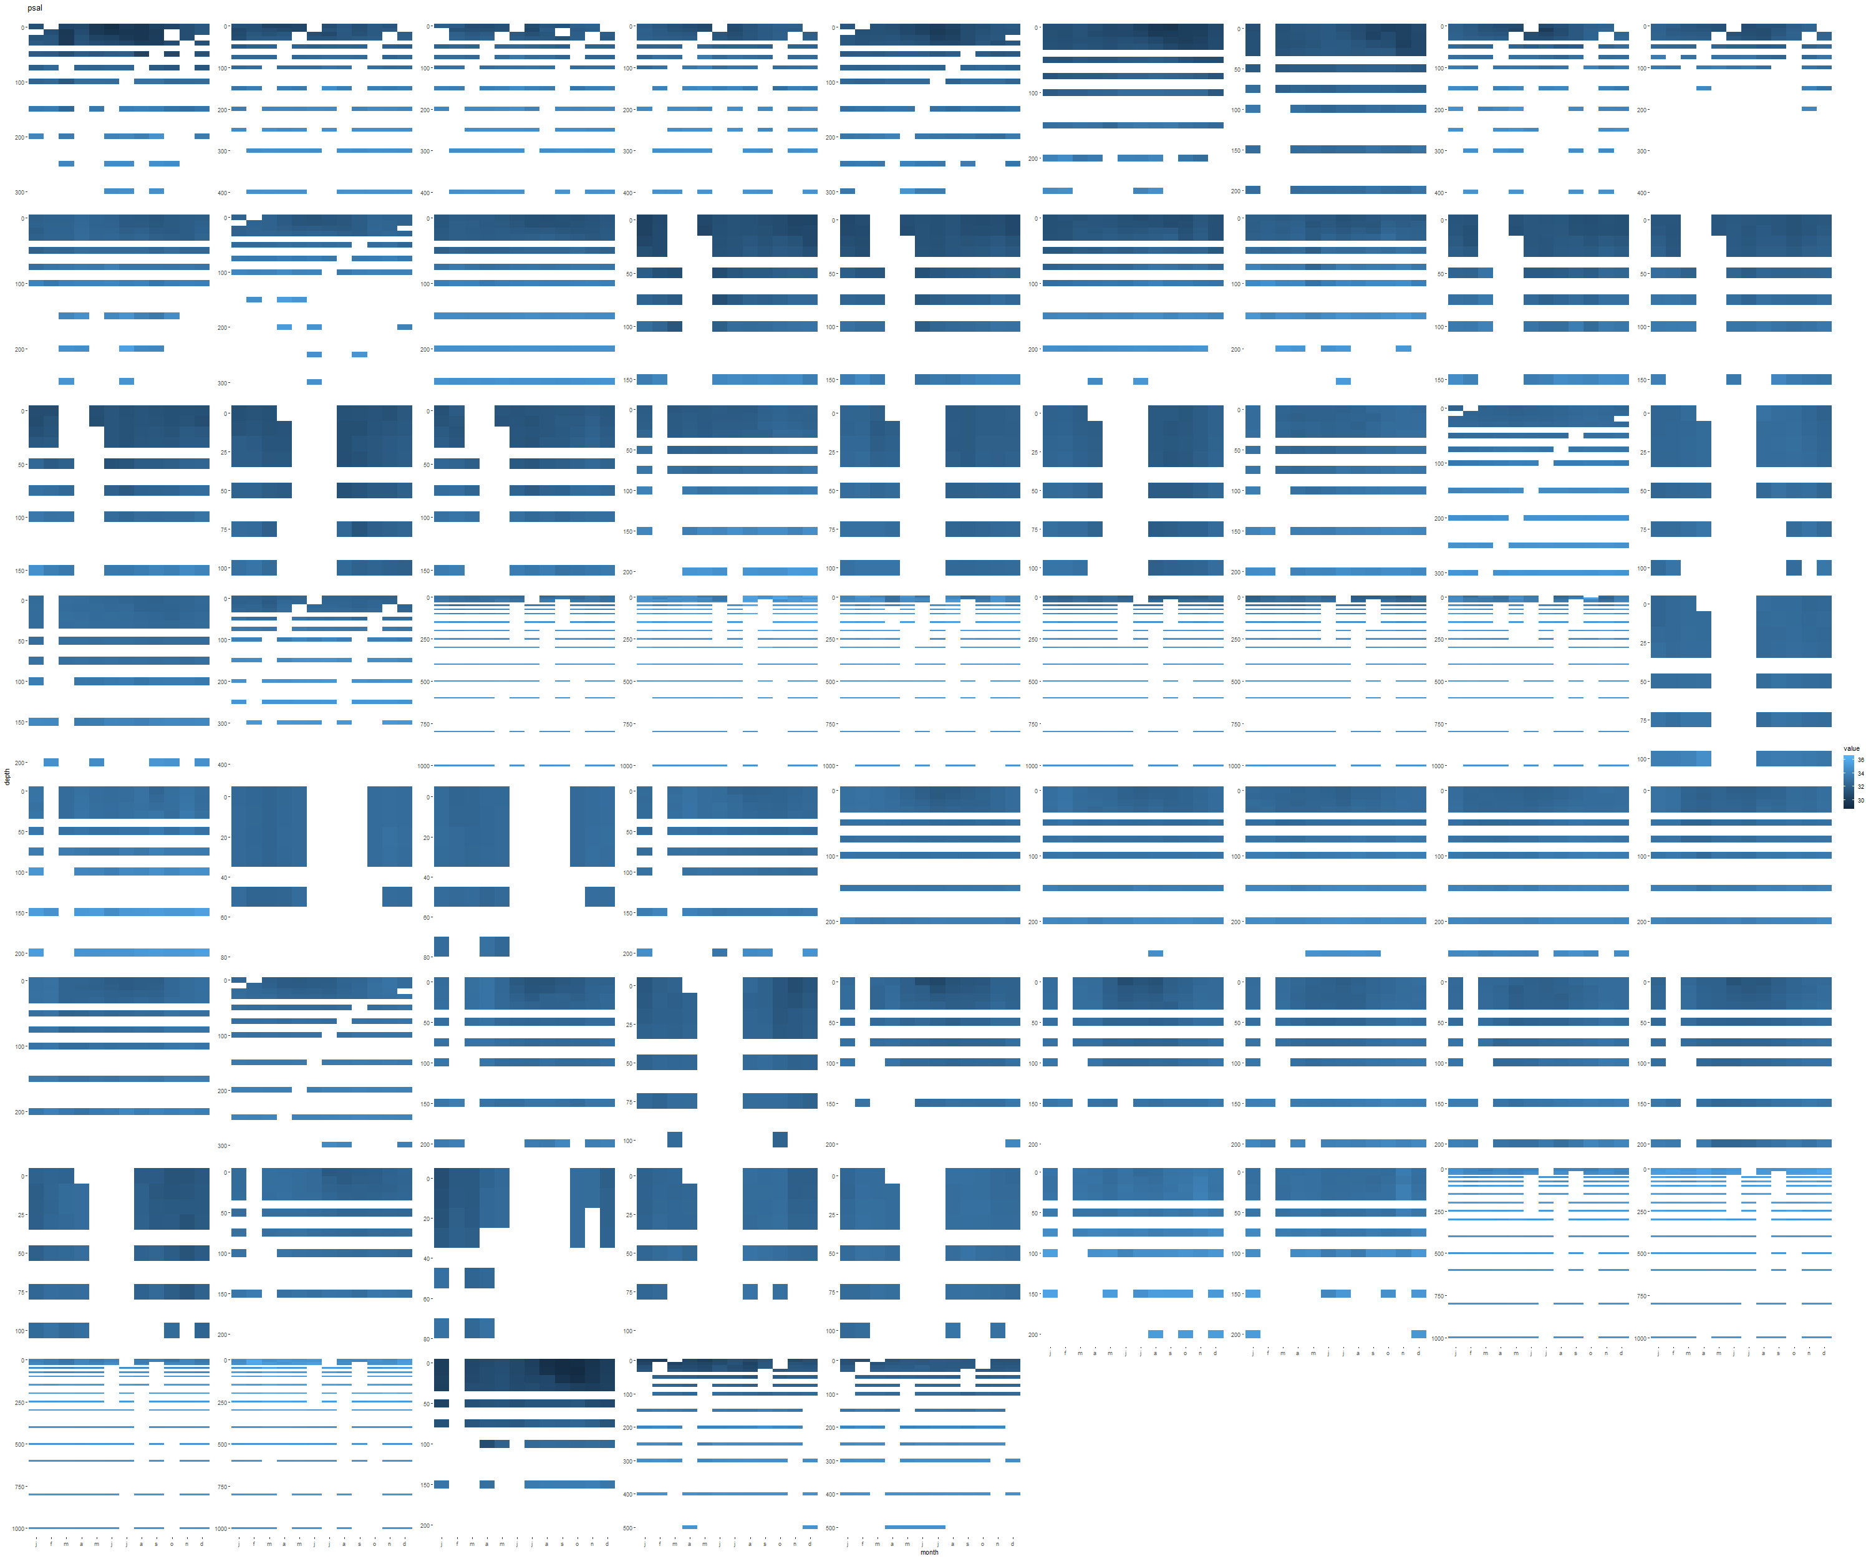
Average salinity climatology values, gridded by box where x axis is month of year and y axis is depth.
Note the consistent lack of data during summer months

Slide 10
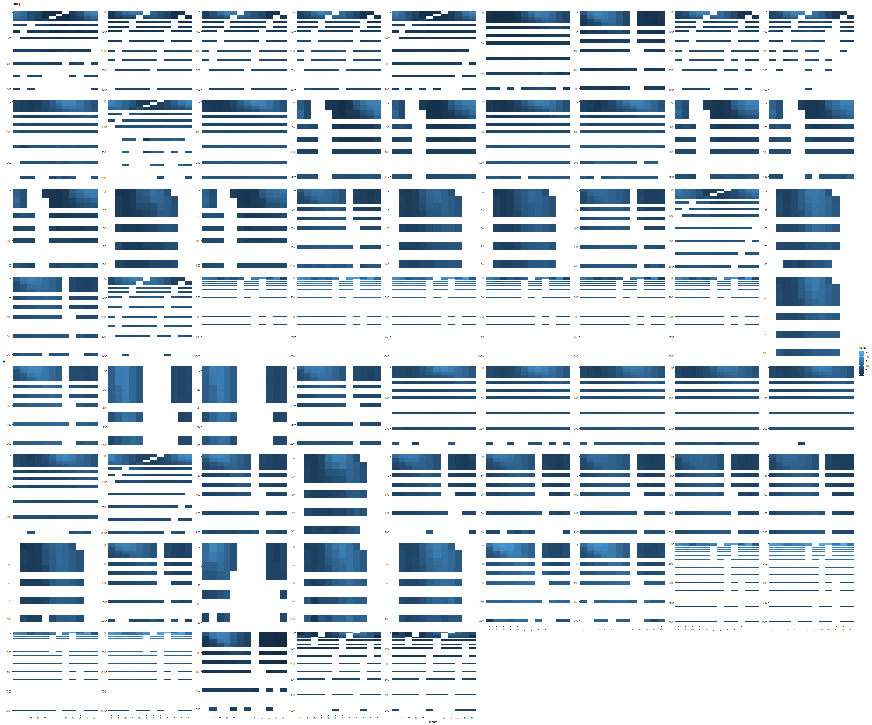
Average temperature climatology values, gridded by box where x axis is month of year and y axis is depth.
Note the consistent lack of data during summer months

Slide 11
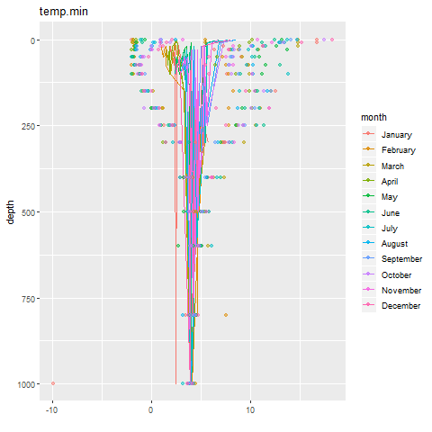
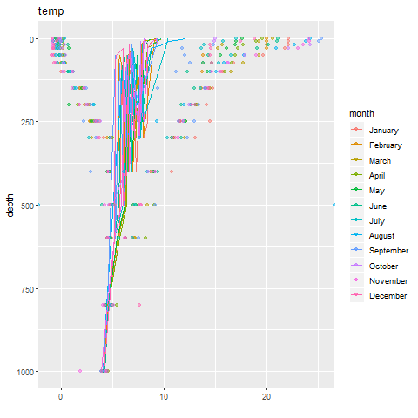
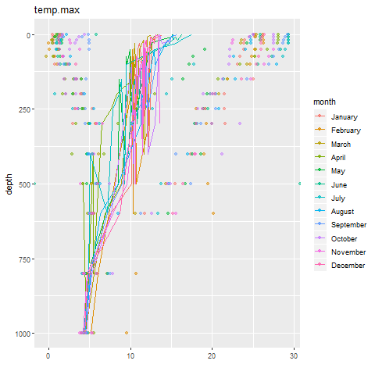
Temperature
Temperature climatology profiles (minimum, average, maximum), where dots represent min and max ranges, colored by month

Slide 12
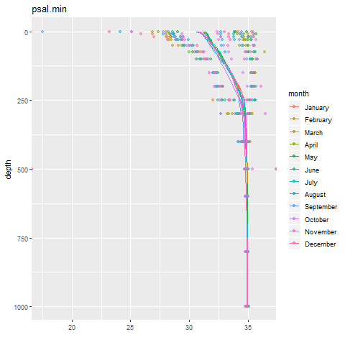
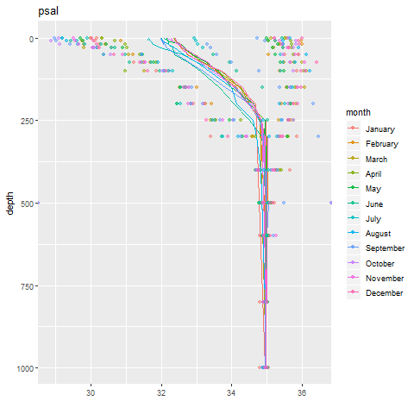
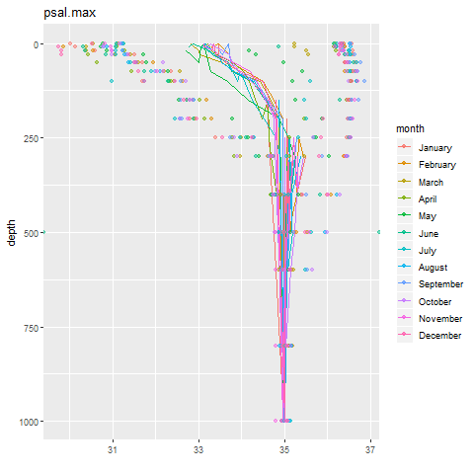
Salinity
Salinity climatology profiles (minimum, average, maximum), where dots represent min and max ranges, colored by month

Slide 13
Test 36
Nitrate, Phosphate, Silicate, Chlorophyll

Slide 14
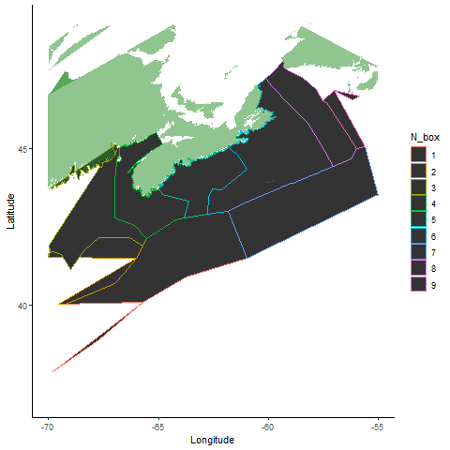
Climatology boxes on the scotia shelf for test 36

Slide 15
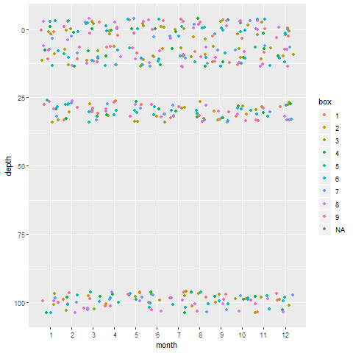
Nutrient sampling effort (values available in climatology)

Slide 16
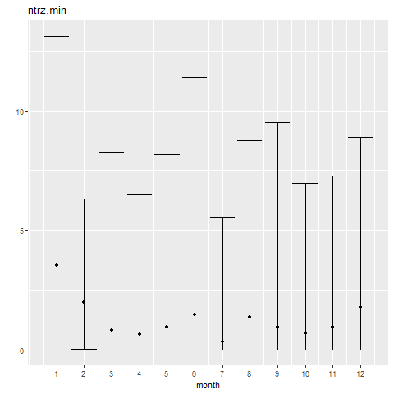
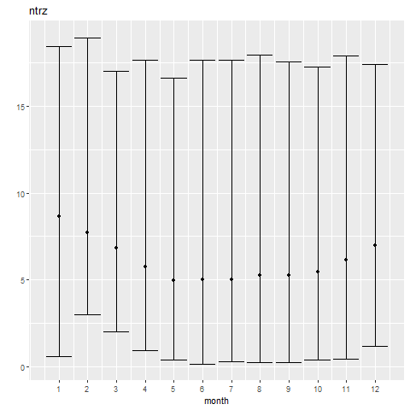
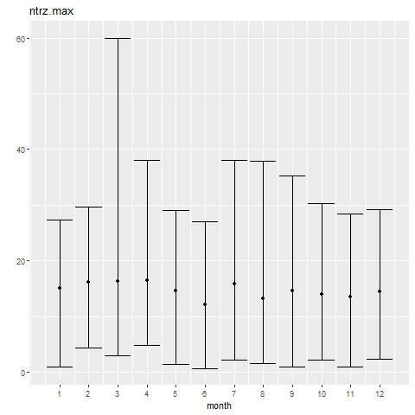
Nitrate

Slide 17
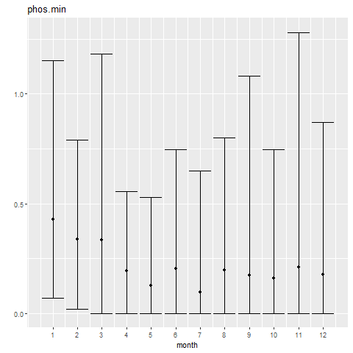
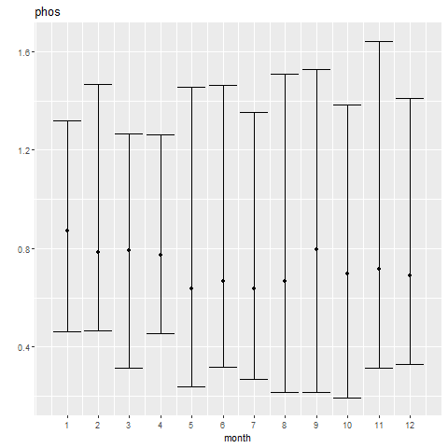
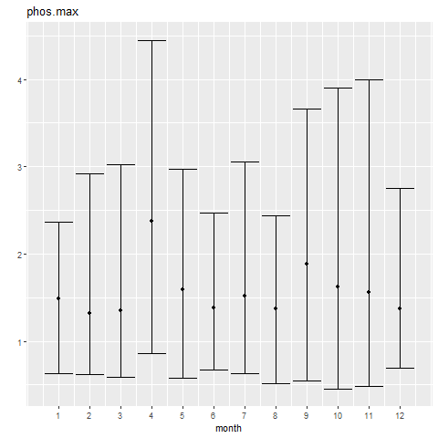
Phosphate

Slide 18
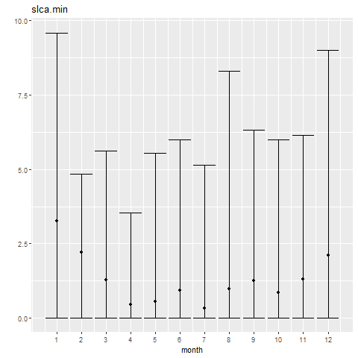
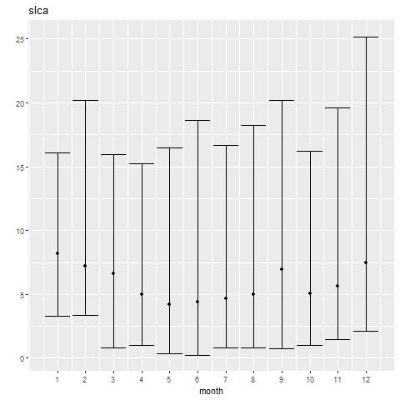
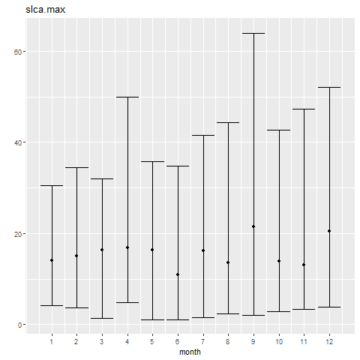
Silicate

Slide 19
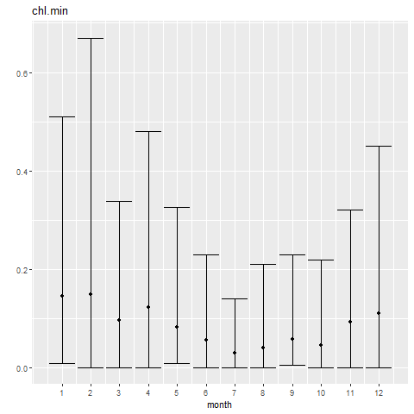
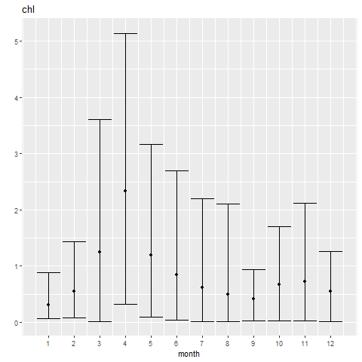
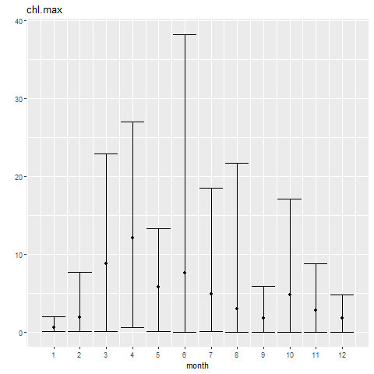
Chlorophyll

Slide 20
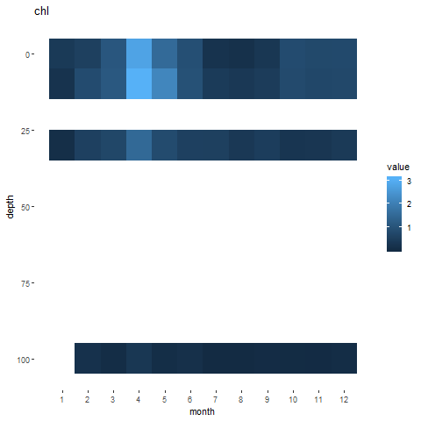
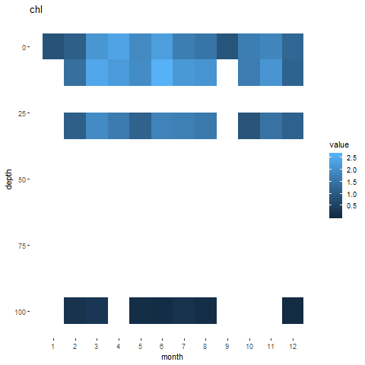
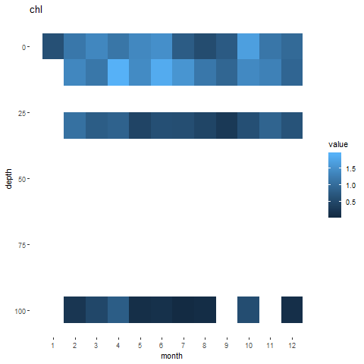
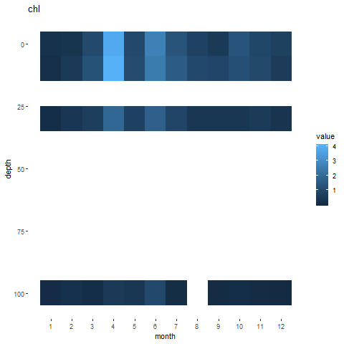
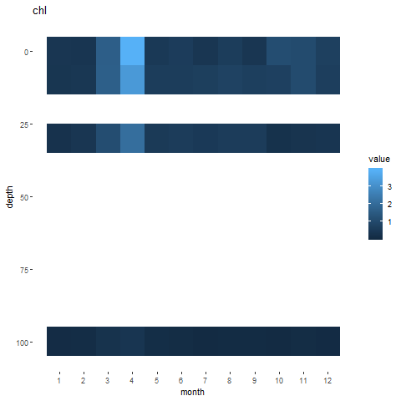
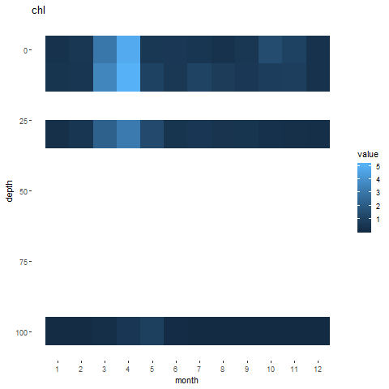
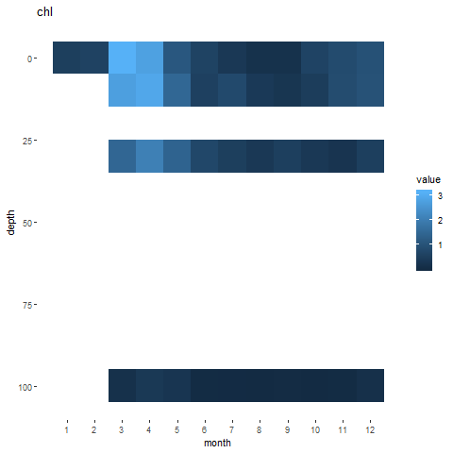
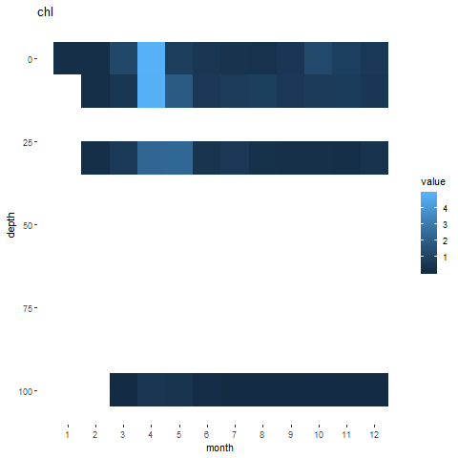
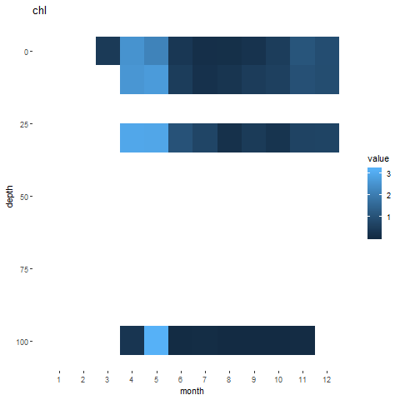
Chlorophyll

Slide 21
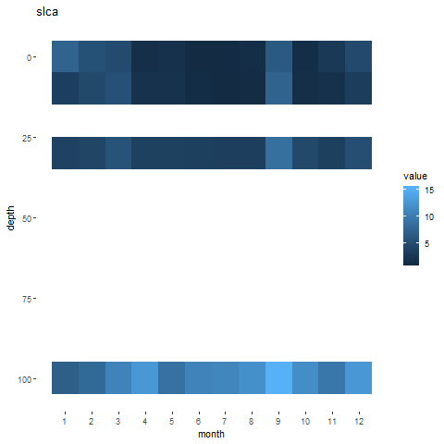
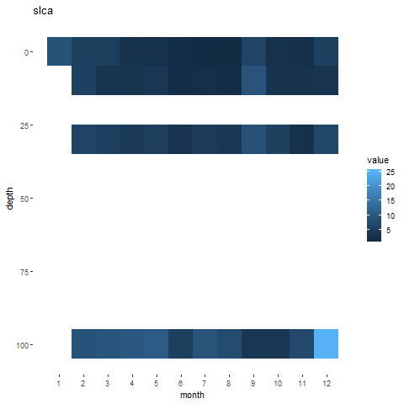
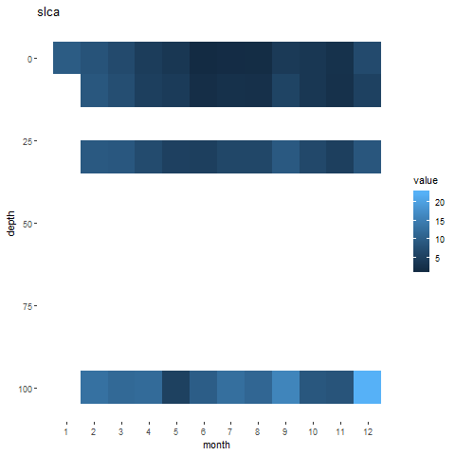
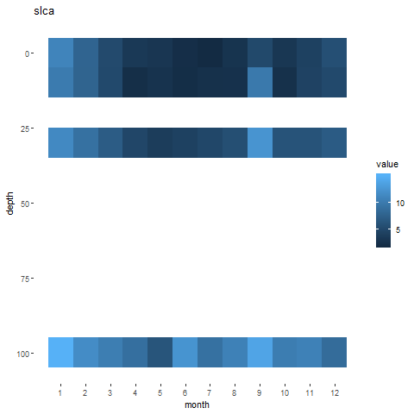
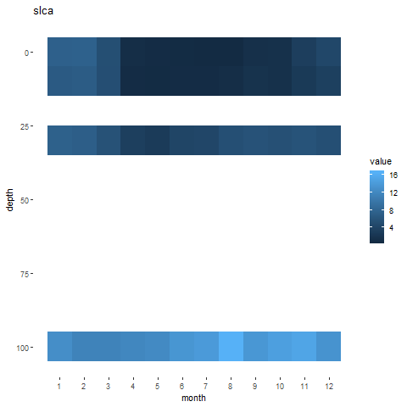
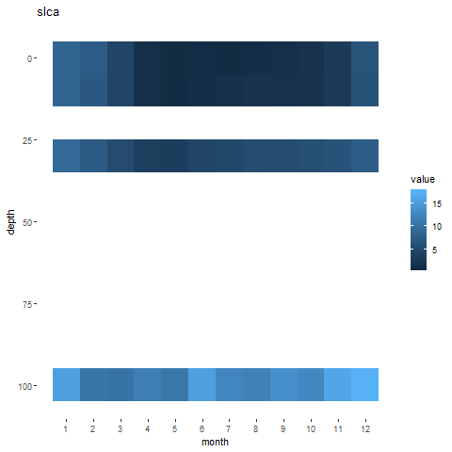
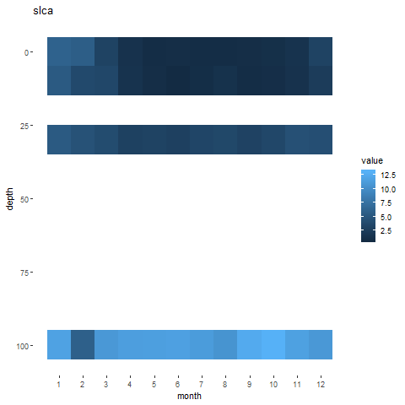
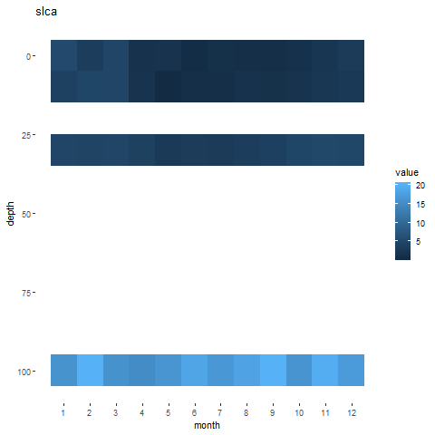
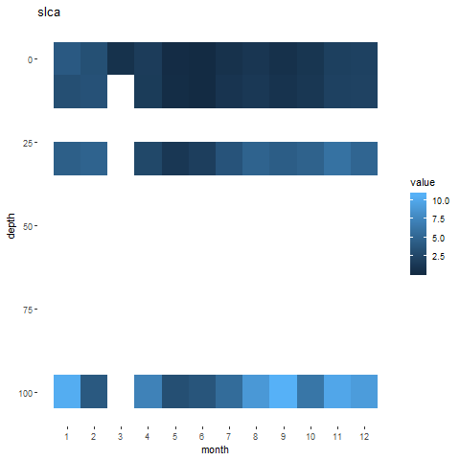
Silicate

Slide 22
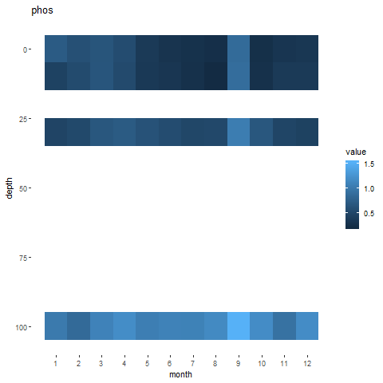
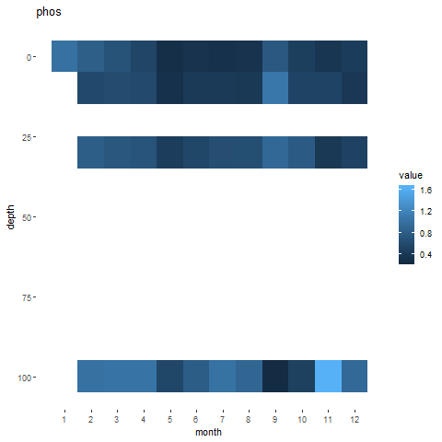







Phosphate

Slide 23









Nitrate

Slide 24



Nitrate

Slide 25



Phosphate

Slide 26



Silicate

Slide 27



Chlorophyll

Slide 28
Conclusions
Temperature and Salinity
Have reasonable ranges
Have good coverage excluding summer and late fall
Have small enough boxes to allow good resolution
Nutrients
Have reasonable ranges
Have good year round coverage
Have relatively large boxes and may not provide the best resolution

