Slide 1
Spatial data models
Vector, raster and the OGC Simple Features model
Examples: Kamp-Lintfort and Frohnenbruch

Slide 2
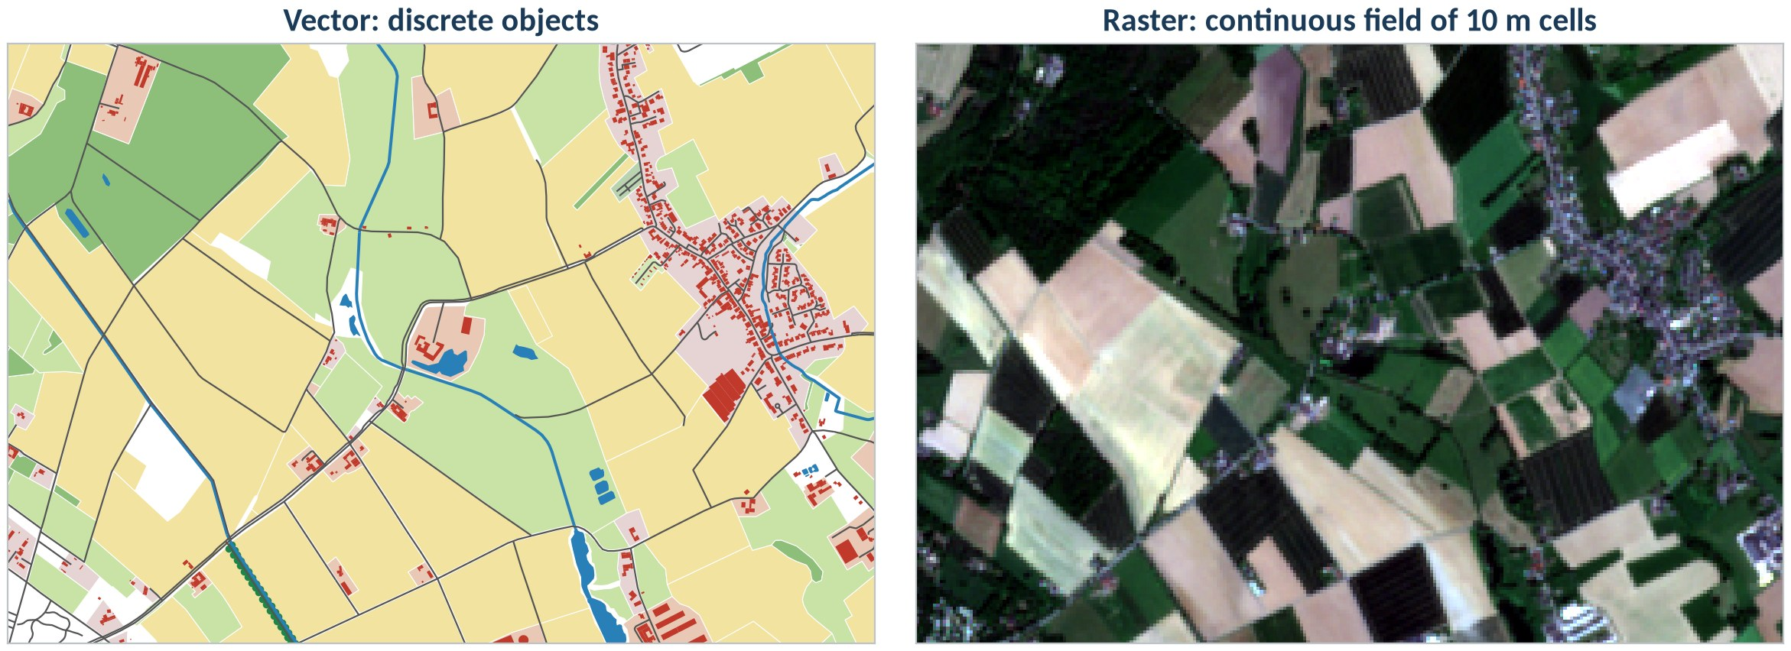
Same place, two models
Vector models things that have a boundary and an identity. Raster models a quantity that varies everywhere in space.
© OpenStreetMap contributors (ODbL) · Contains modified Copernicus Sentinel-2 data 2025 (13 May 2025)
geo0160 · Spatial data models · opengeo
‹#›

Slide 3
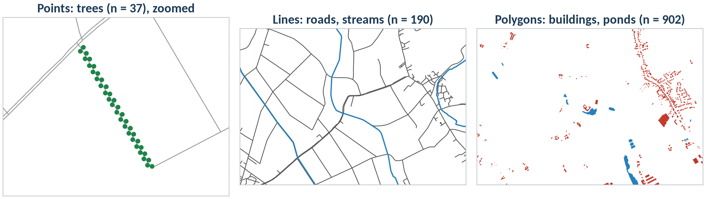
Vector model: geometry + attributes
fid | building | name | geometry
40 | yes | Freie evangelische Gemeinde Hoerstgen | POLYGON ((324623 …))
1 | yes |  | POLYGON ((324889 …))
… | … | … | …
In QGIS
Layer → Add Layer → Add Vector Layer… (GeoPackage, layer buildings)
Right-click the layer → Open Attribute Table: one row per feature
Identify Features (Ctrl+Shift+I): click a building, see its row
© OpenStreetMap contributors (ODbL)
geo0160 · Spatial data models · opengeo
‹#›

Slide 4
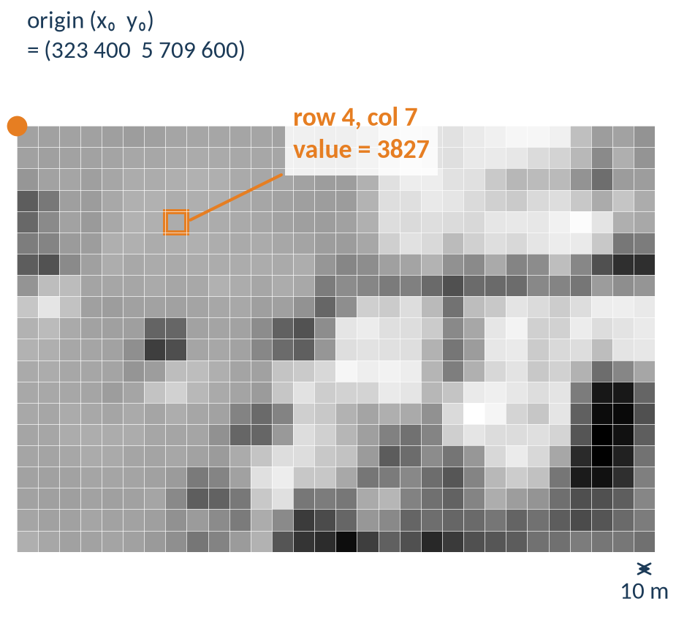
Raster model: a grid of cells
Grid: rows × columns of cells (pixels)
Cell size: resolution, here 10 m × 10 m
Bands: several values per cell (B02 … B08)
NoData: a value that means ‘no measurement’
CRS + origin: place the grid on the Earth
In QGIS
Layer Properties → Information: width × height (cells), pixel size, CRS, bands, NoData
Identify Features on a pixel: the value of every band
Zoom in until you see the cells
Contains modified Copernicus Sentinel-2 data 2025
geo0160 · Spatial data models · opengeo
‹#›

Slide 5
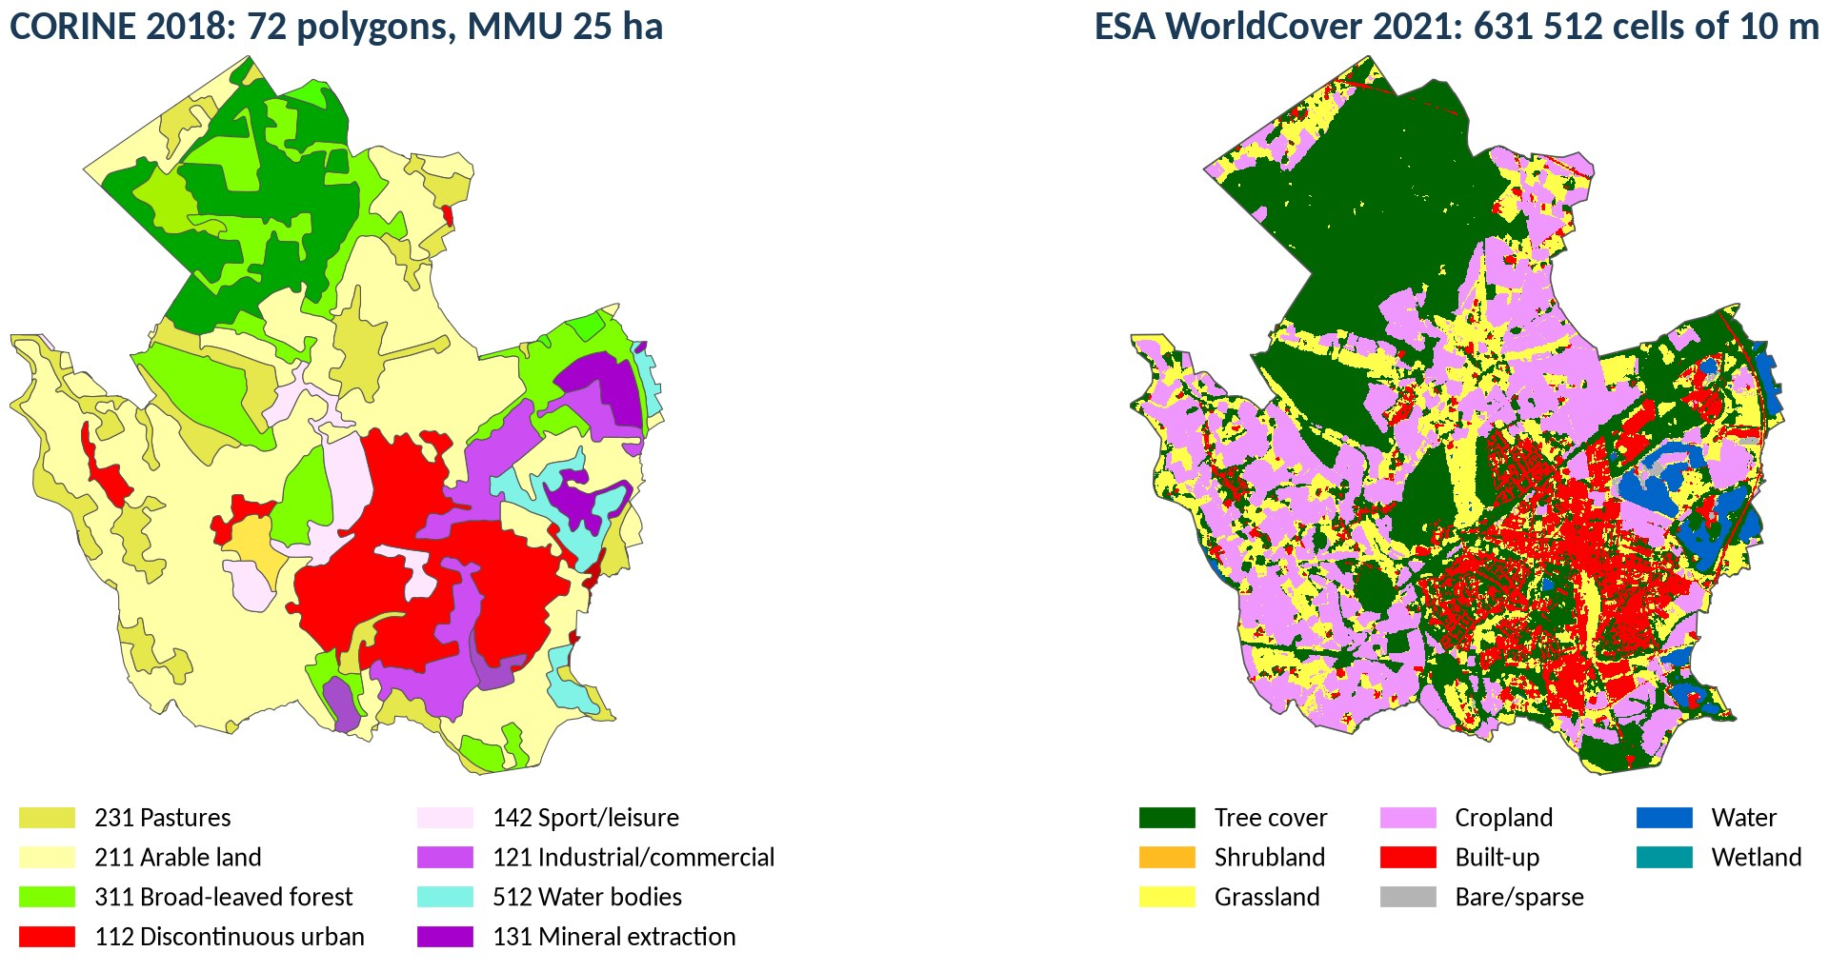
Resolution decides what you can see
CORINE Land Cover 2018, © European Union, Copernicus Land Monitoring Service, EEA · ESA WorldCover 10 m 2021 v200 (CC BY 4.0)
geo0160 · Spatial data models · opengeo
‹#›

Slide 6
Vector or raster?
 | Vector | Raster
Models | discrete objects with identity | continuous fields, images
Geometry | points, lines, polygons (exact coordinates) | regular grid, cell size = resolution
Attributes | many columns per feature | one value per cell and band
Strong at | topology, networks, precise boundaries, cartography | map algebra, surfaces, remote sensing
Weak at | continuous variation | sharp boundaries, storage of sparse data
Formats | GeoPackage, GeoJSON, Shapefile, PostGIS, FlatGeobuf | GeoTIFF / COG, NetCDF, Zarr, JPEG2000
Python | shapely, GeoPandas | rasterio, xarray / rioxarray
geo0160 · Spatial data models · opengeo
‹#›

Slide 7
File formats you will meet
Format | Model | Files | Good to know
GeoPackage (.gpkg) | vector + raster | 1 (SQLite) | many layers, long field names, OGC standard: our default
Shapefile (.shp) | vector | 3–7 (.shp .shx .dbf .prj …) | one layer, field names ≤ 10 characters, 2 GB limit
GeoJSON (.geojson) | vector | 1 (text) | web, always WGS 84 lon/lat (RFC 7946), large files get slow
CSV with x/y | points only | 1 (text) | no CRS stored: you must know it; keys as text (leading zeros)
GeoTIFF / COG (.tif) | raster | 1 | bands + georeference; COG = cloud-optimised, read in pieces
NetCDF / Zarr | raster cubes | 1 / folder | time series of grids (climate, RADOLAN)
Rule of thumb: GeoPackage for vector exchange, GeoTIFF/COG for rasters, PostGIS when many people work on the same data (geo0840).
geo0160 · Spatial data models · opengeo
‹#›

Slide 8
Attribute types matter
Type | Example | Pitfall
text (string) | name = 'Haus Frohnenbruch', KN = '05170020' | keys stay text
integer | building:levels = 2 | no decimals
decimal (real) | area_ha = 6315.2 | unit in the field name
date | survey_date = 2025-05-13 | CSV import may read text
boolean | active = true | Shapefile has none
'05170020' → 5170020
a key read as a number loses its leading zero: the join fails
In QGIS
Layer Properties → Fields: name, type, length
Add Delimited Text Layer: uncheck ‘Detect field types’ for keys
Field Calculator: to_string(), to_int(), to_date()
geo0160 · Spatial data models · opengeo
‹#›

Slide 9
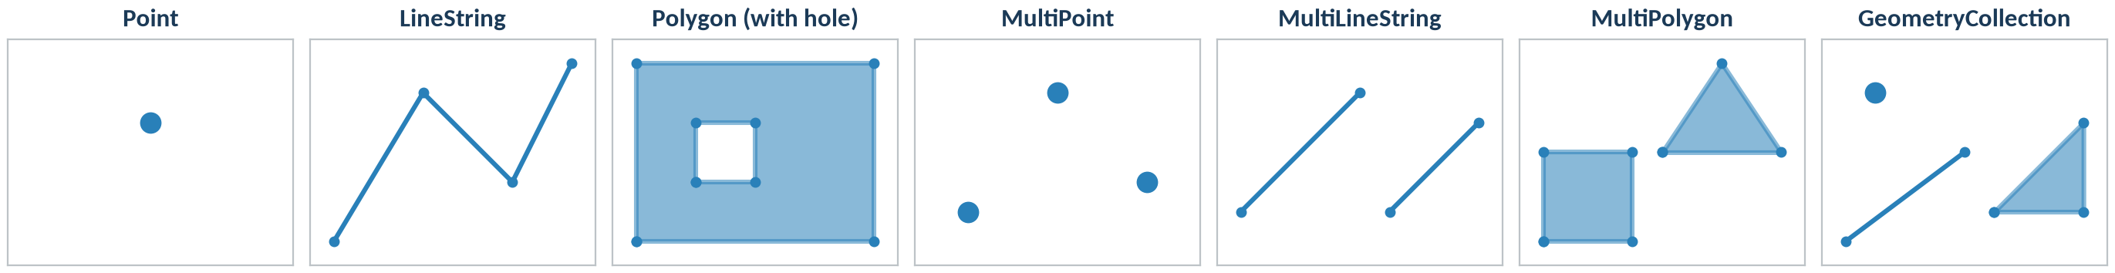
Seven geometry types, written as WKT
POINT (2 2)
LINESTRING (0 0, 1.5 2.5, 3 1, 4 3)
POLYGON ((0 0, 4 0, 4 3, 0 3, 0 0), (1 1, 2 1, 2 2, 1 2, 1 1))
MULTIPOINT ((0.5 0.5), (2 2.5), (3.5 1))
MULTILINESTRING ((0 0.5, 2 2.5), (2.5 0.5, 4 2))
MULTIPOLYGON (((0 0, 1.5 0, 1.5 1.5, 0 1.5, 0 0)), ((2 1.5, 4 1.5, 3 3, 2 1.5)))
GEOMETRYCOLLECTION (POINT (0.5 2.5), LINESTRING (0 0, 2 1.5), POLYGON ((2.5 0.5, 4 0.5, 4 2, 2.5 0.5)))
from shapely import wkt; g = wkt.loads("POINT (2 2)"); g.wkt, g.wkb_hex, g.geom_type
geo0160 · Spatial data models · opengeo
‹#›

Slide 10
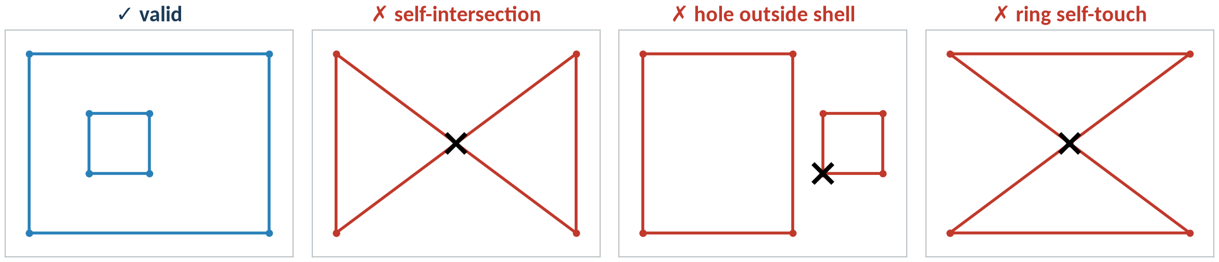
Valid geometries: rules of the model
Rings are closed and do not cross themselves
Holes lie inside the shell and touch it in at most one point
Parts of a MultiPolygon do not overlap
In QGIS
Vector → Geometry Tools → Check Validity: lists the errors with their location
Processing Toolbox → Fix geometries: repaired copy of the layer
geo0160 · Spatial data models · opengeo
‹#›

Slide 11
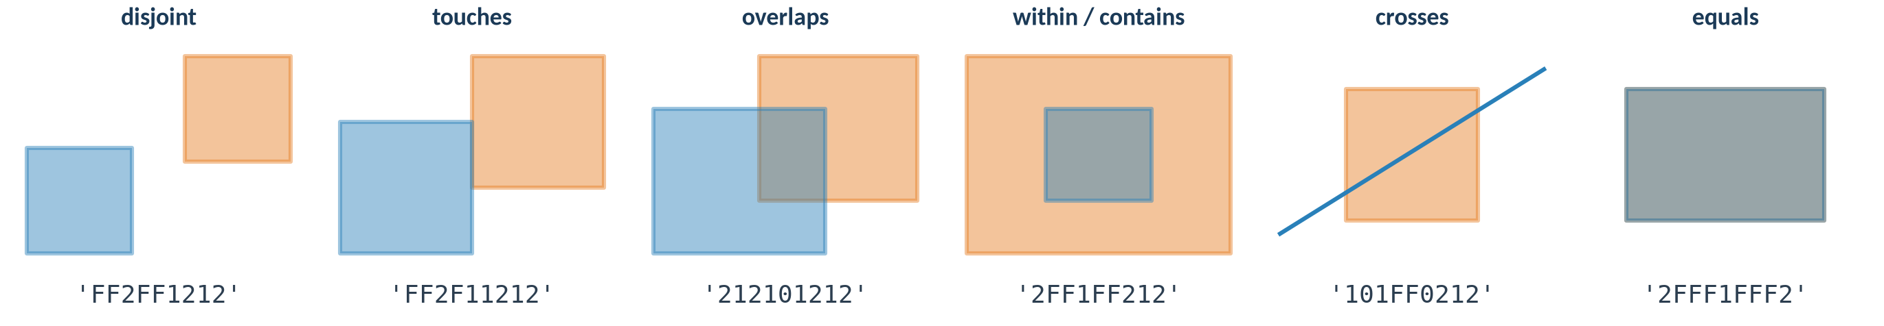
Spatial relationships between objects
Relationship | means
disjoint | no common point
touches | common boundary, no common interior
overlaps / crosses | share part of the interior
within / contains | one lies completely inside the other
intersects | anything but disjoint
In QGIS
Vector → Research Tools → Select by Location
Processing → Join attributes by location (predicate: within, intersects, …)
Example: wells within groundwater bodies
geo0160 · Spatial data models · opengeo
‹#›

Slide 12
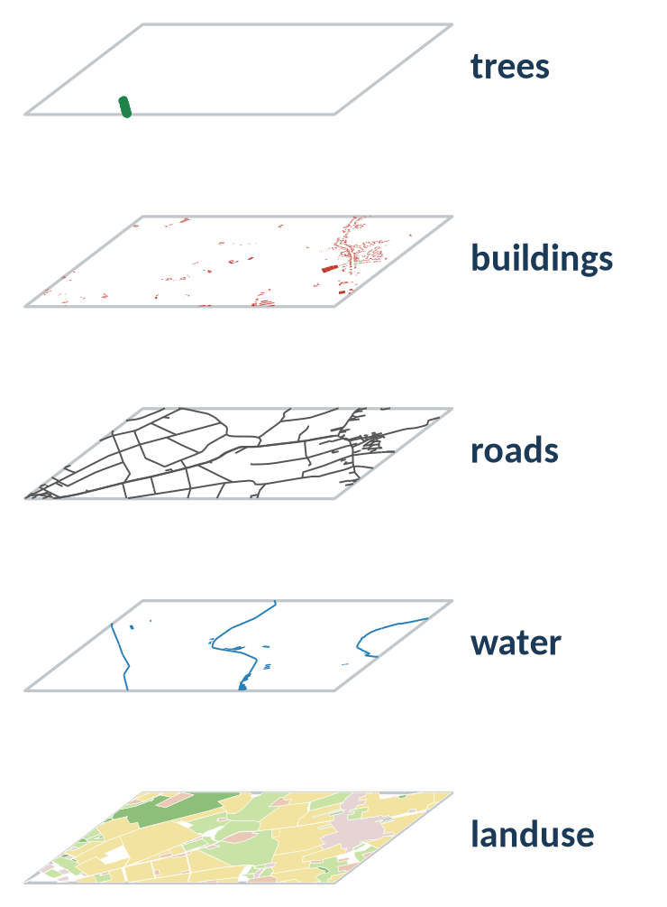
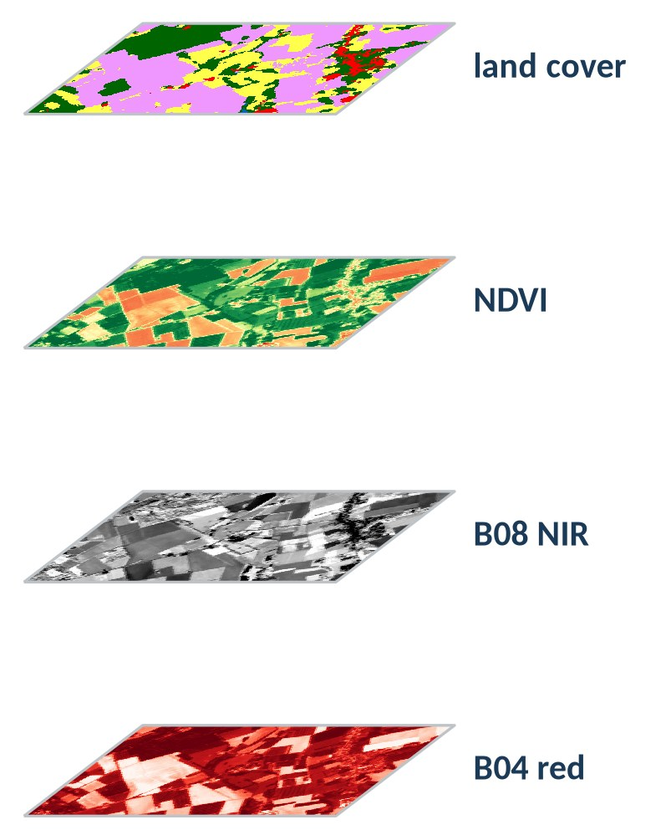
Thinking in layers
Vector stack: overlay geometries (intersection, union, …)
Raster stack: combine aligned cells (260 × 180 each)
© OpenStreetMap contributors (ODbL) · Contains modified Copernicus Sentinel-2 data 2025 · ESA WorldCover 10 m 2021 v200 (CC BY 4.0)
geo0160 · Spatial data models · opengeo
‹#›

Slide 13
Take-aways
1
Two models
Vector for objects, raster for fields; the question and the scale decide.
2
Formats and types
GeoPackage and GeoTIFF; keys as text, know the CRS of a CSV.
3
Valid geometries + relationships
Check validity before analysis; select and join by location.
4
Layers
Same CRS, same extent: the precondition for overlay and map algebra.
geo0160 · Spatial data models · opengeo
‹#›

Slide 14
Sources and further reading
Standards: OGC 06-103r4 Simple Feature Access Part 1 (ISO 19125-1); OGC GeoPackage 1.4; DE-9IM: Clementini, Di Felice & van Oosterom (1993)
Data: © OpenStreetMap contributors (ODbL); Contains modified Copernicus Sentinel-2 data 2025, scene S2A_32ULC_20250513 via Earth Search STAC; CORINE Land Cover 2018, © European Union, Copernicus Land Monitoring Service, EEA; ESA WorldCover 10 m 2021 v200 (CC BY 4.0)
Further reading (links): Geo-Python and Automating GIS Processes (Univ. of Helsinki); pythongis.org (Tenkanen, Heikinheimo, Whipp); Shapely and GeoPandas user guides; QGIS Training Manual – vector and raster chapters
Figures: own work, generated with shapely, GeoPandas, rasterio and matplotlib (make_slides.py)
geo0160 · Spatial data models · opengeo
‹#›

