Slide 1
Georeferencing: Castra Vetera
geo0240 · a photographed map and a reconstruction drawing
in today's coordinates

Slide 2
Historical background
Vetera I · AD 69/70 · Colonia Ulpia Traiana
geo0240 · Georeferencing: Castra Vetera · opengeo · CC BY-SA 4.0
‹#›

Slide 3
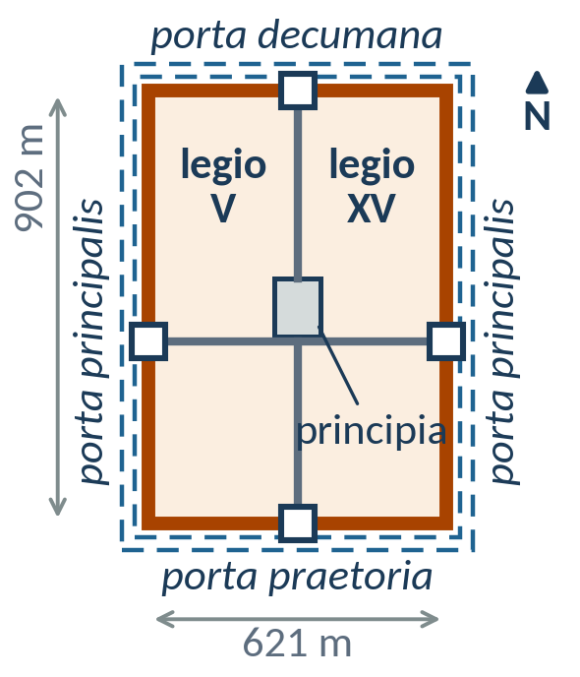
Castra Vetera I on the Fürstenberg
castra (Latin, plural) = military camp; castra legionis = legionary fortress; castellum = auxiliary fort; not a “castle”
13/12 BC: Augustan base opposite the Lippe mouth, probably for Drusus’ campaigns; earth-and-timber camps
AD 14–60: two legions, rebuilt several times
c. AD 60: double-legion fortress (legio V and XV), 902 m × 621 m ≈ 56 ha, the largest known
Lower Germanic Limes: river frontier (ripa), no continuous wall; UNESCO 2021
schematic: wall circuit to scale, ditches exaggerated
Wikipedia: Vetera · Lower Germanic Limes · Castra · Vetera (de)
Text: distilled from Wikipedia (CC BY-SA 4.0), see the last slide. Figures: own work (make_slides.py), CC BY-SA 4.0.
geo0240 · Georeferencing: Castra Vetera · opengeo · CC BY-SA 4.0
‹#›

Slide 4
Vetera I, c. AD 60: defences and layout
Latin | English | Vetera I, c. AD 60
vallum | rampart, palisade | earlier phases: earth-and-timber
murus | wall, wall walk | 3 m, timber frame, clay infill
turres | towers | presumed, not proven
portae | gates | 4, each 2 towers + bridge
fossae | V-shaped ditches | 2, plus abatis
principia | headquarters | stone, 120 m × 94.8 m
valetudinarium | hospital | stone, 83.5 m × 83.5 m
Wikipedia: Vetera · Castra · Vetera (de)
Text: distilled from Wikipedia (CC BY-SA 4.0), see the last slide. Figures: own work (make_slides.py), CC BY-SA 4.0.
geo0240 · Georeferencing: Castra Vetera · opengeo · CC BY-SA 4.0
‹#›

Slide 5
AD 68–70: four emperors, Batavian revolt
Rome: four emperors in one year
Lower Rhine: revolt of the Batavi
 | emperor | end
68 | Nero † | 9 June 68
68–69 | Galba | murdered 15 Jan 69
69 | Otho | suicide, April 69
69 | Vitellius | acclaimed by the Rhine legions; killed 20 Dec 69
69–79 | Vespasian | Flavian dynasty
Batavi: Germanic people in the Rhine delta, allies supplying auxiliary troops
Julius Civilis: Batavian noble, Roman citizen, prefect of a cohort
69: revolt during the civil war; Vetera besieged
70: Vetera surrenders (hunger), legions V and XV destroyed, fortress burnt
summer 70: Cerialis defeats Civilis at Vetera
Wikipedia: Year of the Four Emperors · Revolt of the Batavi · Gaius Julius Civilis
Text: distilled from Wikipedia (CC BY-SA 4.0), see the last slide. Figures: own work (make_slides.py), CC BY-SA 4.0. Main ancient source: Tacitus, Histories.
geo0240 · Georeferencing: Castra Vetera · opengeo · CC BY-SA 4.0
‹#›

Slide 6
Colonia Ulpia Traiana (Xanten)
Before: settlement of the Cugerni next to Vetera I, probably burnt in AD 70
c. AD 100: Emperor Trajan (Marcus Ulpius Traianus) grants the rank of colonia, the highest rank of a Roman town
73 ha inside a 3.4 km town wall with 22 towers; c. 10 000 inhabitants; grid of 40 insulae with forum, capitol, baths, harbour temple, amphitheatre; harbour on a Rhine arm
Built partly with stones from the ruins of Vetera I
3rd–5th century: decline; late Roman fortress on the 9 central insulae; taken by the Franks in 352, abandoned in the 5th century
Today: LVR Archaeological Park Xanten; part of the UNESCO World Heritage site since 2021. Find it on the DTK25 photo!
Wikipedia: Colonia Ulpia Traiana · Xanten · Archaeological Park Xanten
Text: distilled from Wikipedia (CC BY-SA 4.0), see the last slide. Figures: own work (make_slides.py), CC BY-SA 4.0.
geo0240 · Georeferencing: Castra Vetera · opengeo · CC BY-SA 4.0
‹#›

Slide 7
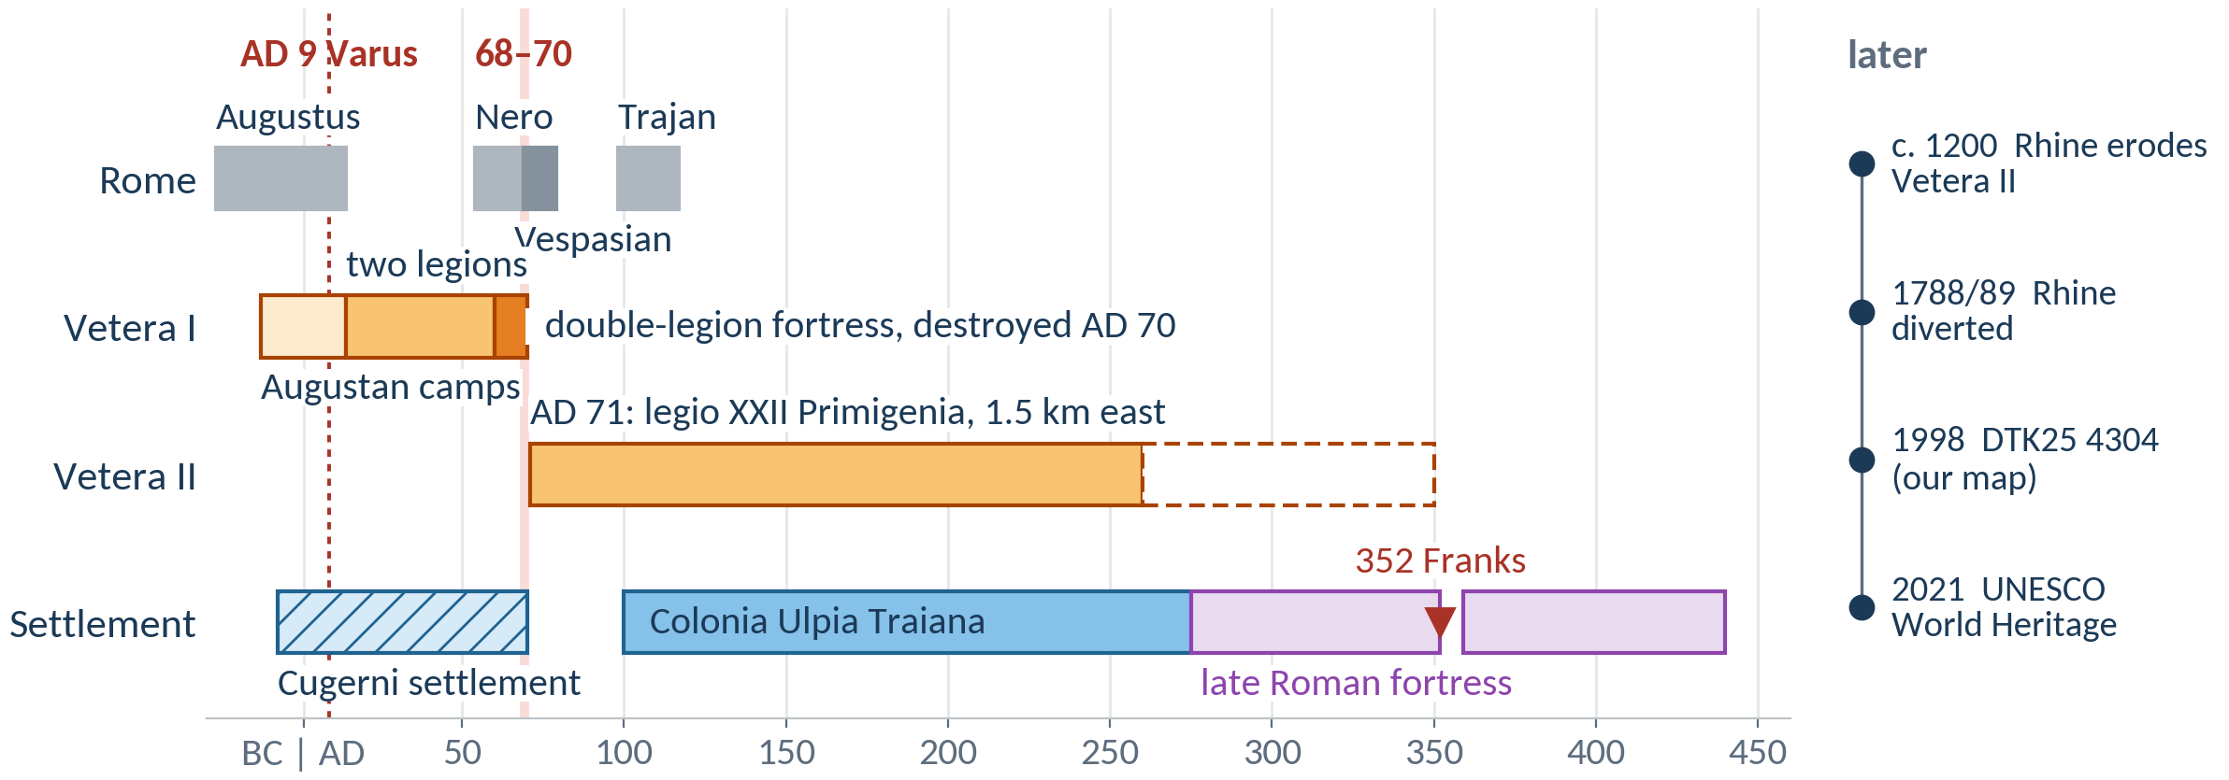
Xanten in Roman times: a time scale
Wikipedia: Vetera · Colonia Ulpia Traiana · Lower Germanic Limes
Text: distilled from Wikipedia (CC BY-SA 4.0), see the last slide. Figures: own work (make_slides.py), CC BY-SA 4.0.
geo0240 · Georeferencing: Castra Vetera · opengeo · CC BY-SA 4.0
‹#›

Slide 8
The method
control points · transformations · RMS · resampling
geo0240 · Georeferencing: Castra Vetera · opengeo · CC BY-SA 4.0
‹#›

Slide 9
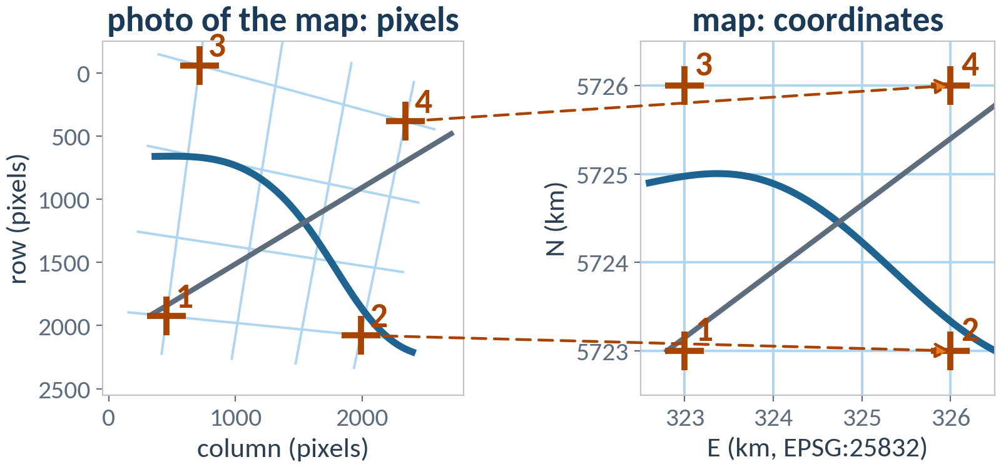
What georeferencing does
Ground control point (GCP): known in the image (column, row) and on the map (E, N)
Transformation: fitted to the GCPs, applied to every pixel → GeoTIFF in the target CRS
QGIS user manual: Georeferencer
Wikipedia: Georeferencing · Ground control point · Image registration · World file · GeoTIFF
Figure: own work (make_slides.py), CC BY-SA 4.0; schematic.
geo0240 · Georeferencing: Castra Vetera · opengeo · CC BY-SA 4.0
‹#›

Slide 10
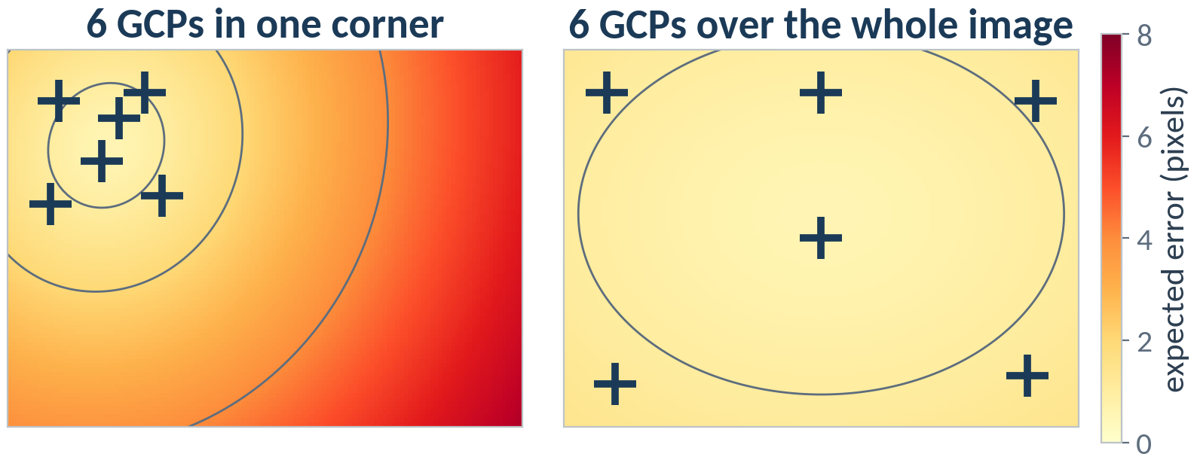
Ground control points: where to click
Spread the GCPs over the whole image, corners included: no extrapolation
Sharp and stable: grid crossings, road crossings, bridges; not rivers or forest edges
Enough: 2–3 × the minimum of the transformation, plus check points
Figures: own work (make_slides.py), CC BY-SA 4.0; simulated example, not the map photo.
geo0240 · Georeferencing: Castra Vetera · opengeo · CC BY-SA 4.0
‹#›

Slide 11
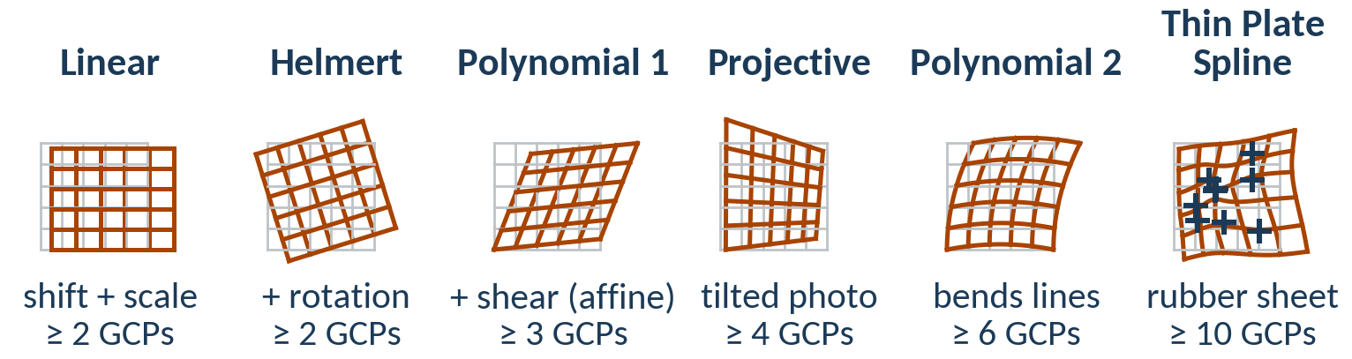
Transformations in the Georeferencer
More parameters fit the GCPs better, but need more GCPs and can bend the image between them
Choose by the source: scan of a good map → Helmert / Polynomial 1; photo taken at an angle → Projective; warped paper → Polynomial 2; poor originals → Thin Plate Spline
Wikipedia: Helmert transformation · Affine transformation · Homography · Thin plate spline
Text: QGIS user manual, Georeferencer (docs.qgis.org, CC BY-SA 3.0). Figures: own work (make_slides.py), CC BY-SA 4.0.
geo0240 · Georeferencing: Castra Vetera · opengeo · CC BY-SA 4.0
‹#›

Slide 12
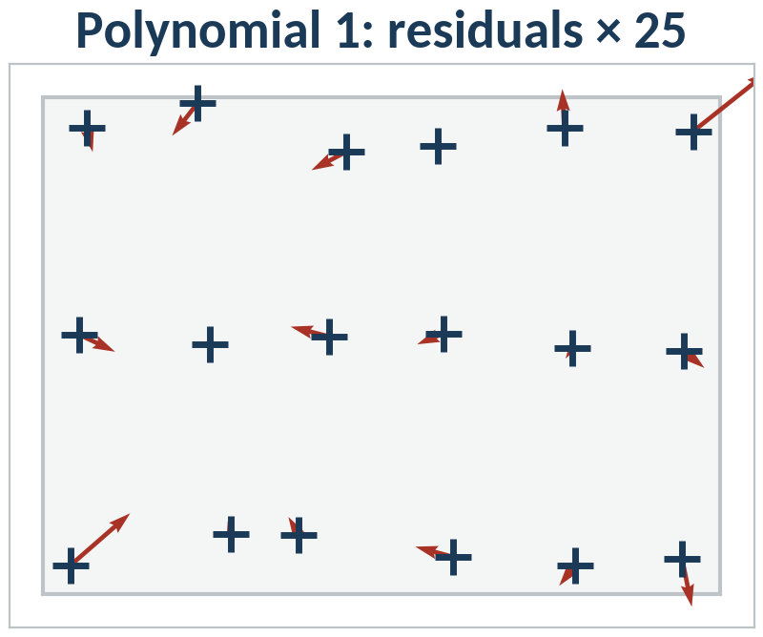
Residuals and RMS error
RMS = √[ Σ (dX² + dY²) / n ]
Residual: how far a GCP lands from its map position
RMS: one number for all GCPs, in pixels or metres
Systematic pattern → transformation too simple
One long arrow → wrong click: fix it or switch the GCP off
Wikipedia: Errors and residuals · Root-mean-square deviation · Least squares
Figures: own work (make_slides.py), CC BY-SA 4.0; simulated example, not the map photo.
geo0240 · Georeferencing: Castra Vetera · opengeo · CC BY-SA 4.0
‹#›

Slide 13
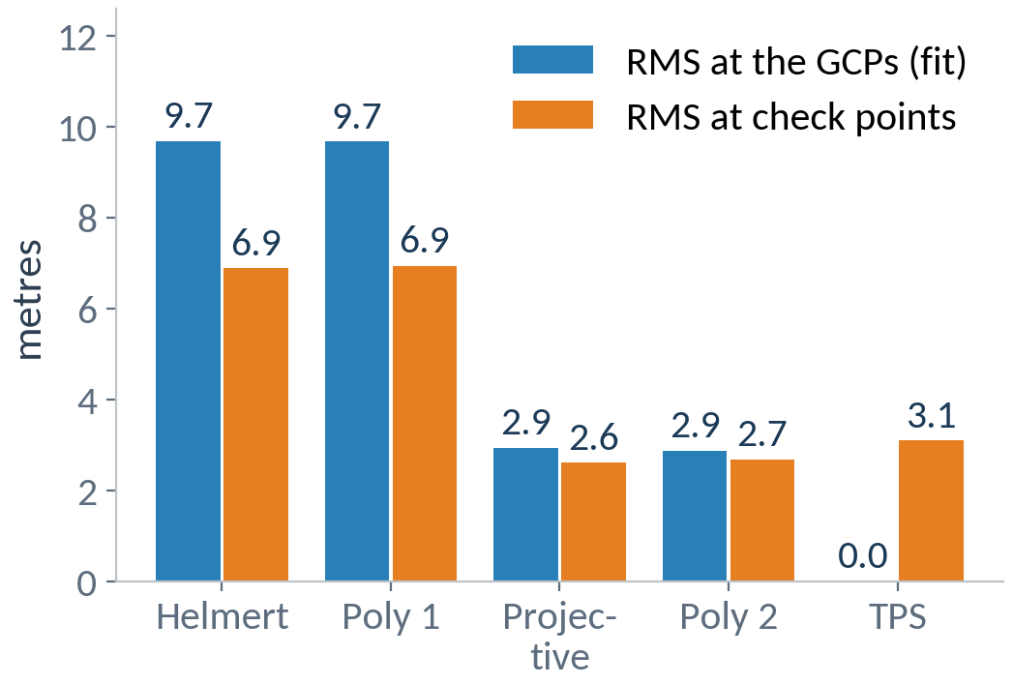
A small RMS is not yet an accurate map
RMS at the GCPs shrinks with every extra parameter
Thin Plate Spline (TPS): RMS = 0 by construction
Check points: switch 3–5 GCPs off and look at their error
Report: transformation, number of GCPs, RMS and check error in metres
Wikipedia: Overfitting · Cross-validation
Figures: own work (make_slides.py), CC BY-SA 4.0; simulated example, not the map photo.
geo0240 · Georeferencing: Castra Vetera · opengeo · CC BY-SA 4.0
‹#›

Slide 14
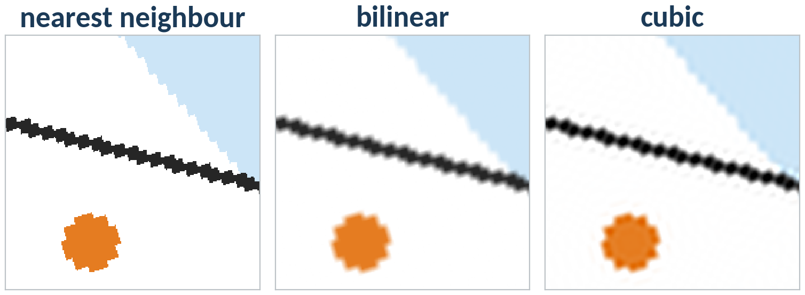
Resampling: new pixels from old ones
Nearest neighbour: keeps the original values; required for classes and codes
Bilinear, cubic: smoother, but mixed values; fine for photos and map scans
Wikipedia: Nearest-neighbor interpolation · Bilinear interpolation · Bicubic interpolation
Figure: own work (make_slides.py), CC BY-SA 4.0; a synthetic map patch rotated by 17°, ×5.
geo0240 · Georeferencing: Castra Vetera · opengeo · CC BY-SA 4.0
‹#›

Slide 15
Georeferencing step by step
import numpy as np, pandas as pd
g = pd.read_csv("dtk_photo.points", comment="#") # QGIS GCP file
A = np.c_[g.sourceX, g.sourceY, np.ones(len(g))] # Polynomial 1
xy = g[["mapX", "mapY"]].to_numpy()
coef, *_ = np.linalg.lstsq(A, xy, rcond=None)
print("RMS", np.sqrt(((A @ coef - xy) ** 2).sum(1).mean()))
gdal_translate -gcp 103.1 402.4 322000 5728000 ... a.jpg a_gcp.tif
gdalwarp -t_srs EPSG:25832 -order 1 -r cubic a_gcp.tif a_utm.tif
# -order 2: Polynomial 2, -tps: Thin Plate Spline
Same mathematics as the Georeferencer: least squares on the GCPs, then warp and resample. Extend: leave-one-out check error.
Code: own example (CC BY-SA 4.0); GDAL utilities gdal_translate, gdalwarp.
geo0240 · Georeferencing: Castra Vetera · opengeo · CC BY-SA 4.0
‹#›

Slide 16
Take-aways: georeferencing
Know the CRS of your GCPs: read the map legend (grid, datum)
Spread sharp, stable GCPs over the whole image
Choose the transformation by the source, not by the smallest RMS
Judge with check points and by overlaying a reference map
Resample with nearest neighbour when the values are classes; cubic for photos
Keep the .points file: it documents and repeats your work
geo0240 · Georeferencing: Castra Vetera · opengeo · CC BY-SA 4.0
‹#›

Slide 17
Case study: Castra Vetera
TK25 4304 Xanten (1998) · Vetera I reconstruction · DTM
geo0240 · Georeferencing: Castra Vetera · opengeo · CC BY-SA 4.0
‹#›

Slide 18
The processing chain
1 Photo
TK25 4304 Xanten, 1998
2 Georeference
UTM grid crossings → EPSG:25832
3 Digitise
location of Castra Vetera → polygon
4 Georeference
Dießenbacher's reconstruction
5 Overlay
DTM hillshade + DTK WMS
6 Interpret
terrain vs. map vs. reconstruction
Tool: QGIS Georeferencer (Layer → Georeferencer…), digitising in a GeoPackage
geo0240 · Georeferencing: Castra Vetera · opengeo · CC BY-SA 4.0
‹#›

Slide 19
Investigate the map
Type of map: which map series, scale, edition name?
Publisher: who made it? Who is responsible today?
Year: edition, last update, sales period – how current is the content?
CRS: geodetic datum, ellipsoid, projection of the map content?
Grids: which coordinate grids are printed, and in which CRS? Which EPSG code do you use in the Georeferencer?
Look at: cover, legend (Geodätische Grundlagen, Koordinaten und Höhen der Karte), map margin
geo0240 · Georeferencing: Castra Vetera · opengeo · CC BY-SA 4.0
‹#›

Slide 20
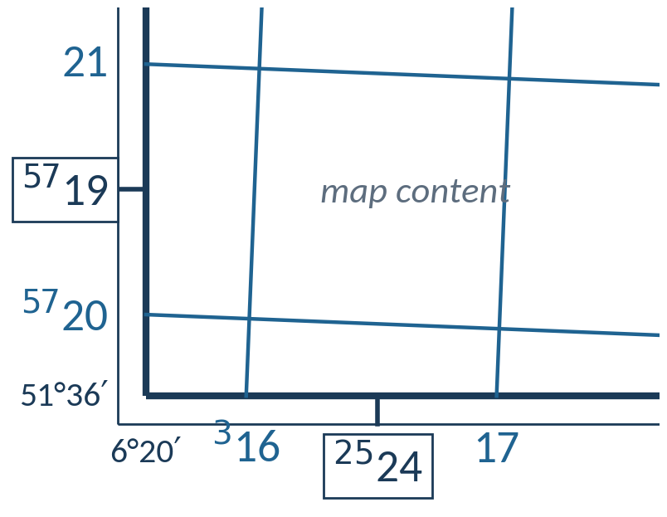
Read the map margin
Which lines belong to the UTM grid?
What do the numbers mean? What are the small raised digits?
What is the interval between two lines – in km and in cm on the map?
And the boxed numbers and the corner values?
Wikipedia: Universal Transverse Mercator · Gauss-Krüger (de)
Figure: own schematic after the map margin (not to scale), CC BY-SA 4.0.
geo0240 · Georeferencing: Castra Vetera · opengeo · CC BY-SA 4.0
‹#›

Slide 21
Our map has three coordinate systems
on the map sheet | datum | EPSG | for the GCPs
UTM zone 32, km grid | ETRS89 (“WGS84/ETRS89”) | 25832 | yes: grid crossings
Gauss-Krüger, zone 2 | DHDN (Potsdam, Bessel) | 31466 | only with 31466
geographic, ° ′ ″ | DHDN (Potsdam, Bessel) | 4314 | never as 4326
Read the legend first: which grid, which datum? The sheet itself says how to convert GNSS positions: +2.5″ longitude, +4.8″ latitude
Same numbers, wrong datum: about 155 m off (geo0220, DHDN → ETRS89)
Our choice: UTM grid crossings at full kilometres, target CRS EPSG:25832
Wikipedia: Universal Transverse Mercator · Gauß-Krüger-Koordinatensystem (de) · Deutsches Hauptdreiecksnetz (de)
Source: legend of DTK25 4304 Xanten, Landesvermessungsamt NRW, 1998 (facts only).
geo0240 · Georeferencing: Castra Vetera · opengeo · CC BY-SA 4.0
‹#›

Slide 22
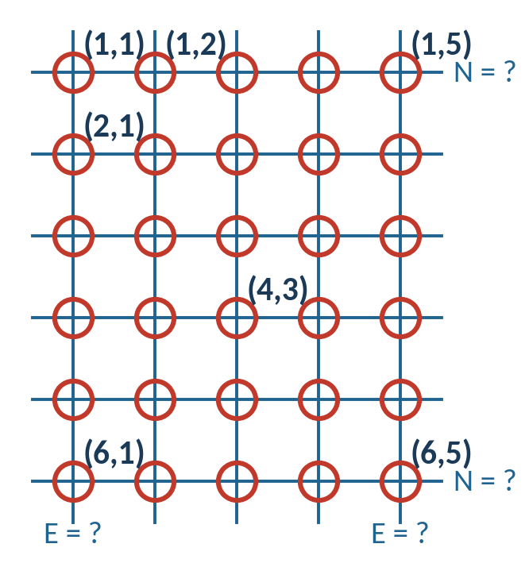
Ground control points: the grid crossings
The red circles on the detail number the crossings (row, column): a common reference for everyone
Determine (E, N) of every crossing from the blue numbers in the margin
Enter them in the Georeferencer, target CRS EPSG:25832
Compare transformations and their RMS error
Figure: own work, CC BY-SA 4.0.
geo0240 · Georeferencing: Castra Vetera · opengeo · CC BY-SA 4.0
‹#›

Slide 23
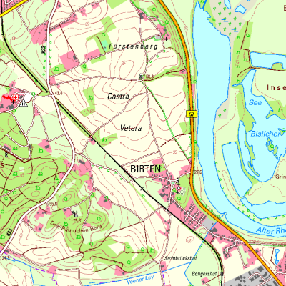
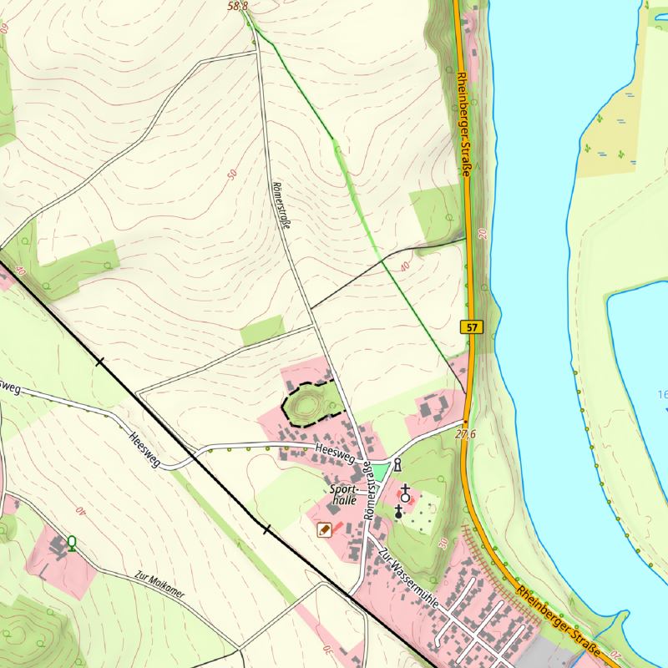
Today's DTK: where is Castra Vetera?
1998: label and KD mark the approximate location
What is left today?
Digitise the location from the 1998 map
1:25 000
about 1:6 000 (zoomed in)
© Geobasis NRW (dl-de/zero-2-0), WMS. Left 2.8 km × 2.8 km, right 1.4 km × 1.4 km, EPSG:25832.
geo0240 · Georeferencing: Castra Vetera · opengeo · CC BY-SA 4.0
‹#›

Slide 24
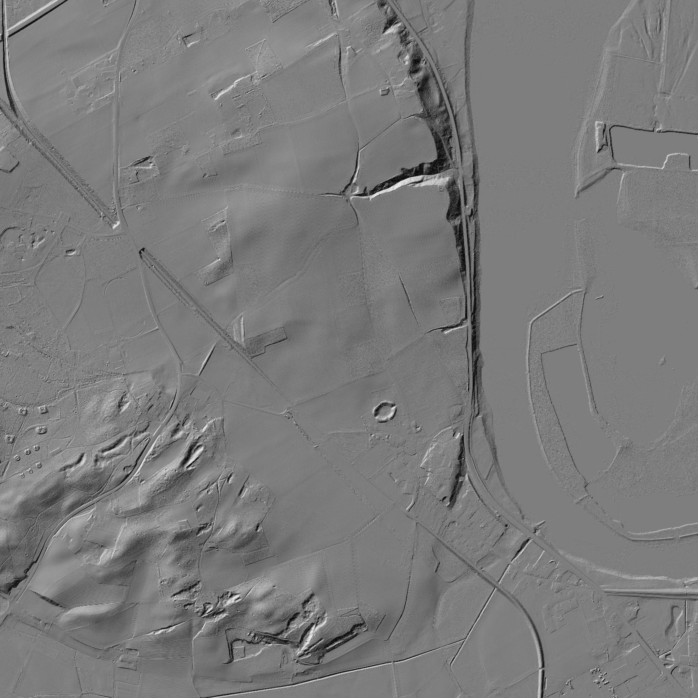
Task: read the DTM hillshade
Overlay your georeferenced map and the polygon of Castra Vetera with the DTM hillshade
Which pronounced features does the hillshade show around the polygon? Describe them
Which of them do you find on the 1998 map, which on today's DTK?
Wikipedia: Hillshading · Digital elevation model
DTM hillshade: © Geobasis NRW (dl-de/zero-2-0), WMS (wms_nw_dgm-schummerung), 2.8 km × 2.8 km.
geo0240 · Georeferencing: Castra Vetera · opengeo · CC BY-SA 4.0
‹#›

Slide 25
Task: interpret the reconstruction
Georeference Dießenbacher's reconstruction (GCPs from your georeferenced map and the DTM)
Overlay it with the DTM hillshade and the DTK
How does the reconstruction imagine the surroundings of Castra Vetera?
Find inconsistencies between the reconstruction and the terrain. What could be the reasons?
geo0240 · Georeferencing: Castra Vetera · opengeo · CC BY-SA 4.0
‹#›

Slide 26
Sources and further reading
Castra Vetera I on the Fürstenberg: Vetera · Lower Germanic Limes · Castra · Vetera (de)
Vetera I, c. AD 60: defences and layout: Vetera · Castra · Vetera (de)
AD 68–70: four emperors, Batavian revolt: Year of the Four Emperors · Revolt of the Batavi · Gaius Julius Civilis
Colonia Ulpia Traiana (Xanten): Colonia Ulpia Traiana · Xanten · Archaeological Park Xanten
Xanten in Roman times: a time scale: Vetera · Colonia Ulpia Traiana · Lower Germanic Limes
What georeferencing does: Georeferencing · Ground control point · Image registration · World file · GeoTIFF
Transformations in the Georeferencer: Helmert transformation · Affine transformation · Homography · Thin plate spline
Residuals and RMS error: Errors and residuals · Root-mean-square deviation · Least squares
A small RMS is not yet an accurate map: Overfitting · Cross-validation
Resampling: new pixels from old ones: Nearest-neighbor interpolation · Bilinear interpolation · Bicubic interpolation
Read the map margin: Universal Transverse Mercator · Gauss-Krüger (de)
Our map has three coordinate systems: Universal Transverse Mercator · Gauß-Krüger-Koordinatensystem (de) · Deutsches Hauptdreiecksnetz (de)
Task: read the DTM hillshade: Hillshading · Digital elevation model
Text distilled from Wikipedia (CC BY-SA 4.0) and the QGIS user manual (CC BY-SA 3.0), October 2026. Figures: own work (make_slides.py), CC BY-SA 4.0.
geo0240 · Georeferencing: Castra Vetera · opengeo · CC BY-SA 4.0
‹#›

