Slide 1
Spatial data models
Vector, raster and the OGC Simple Features model
Examples: Kamp-Lintfort and Frohnenbruch

Slide 2
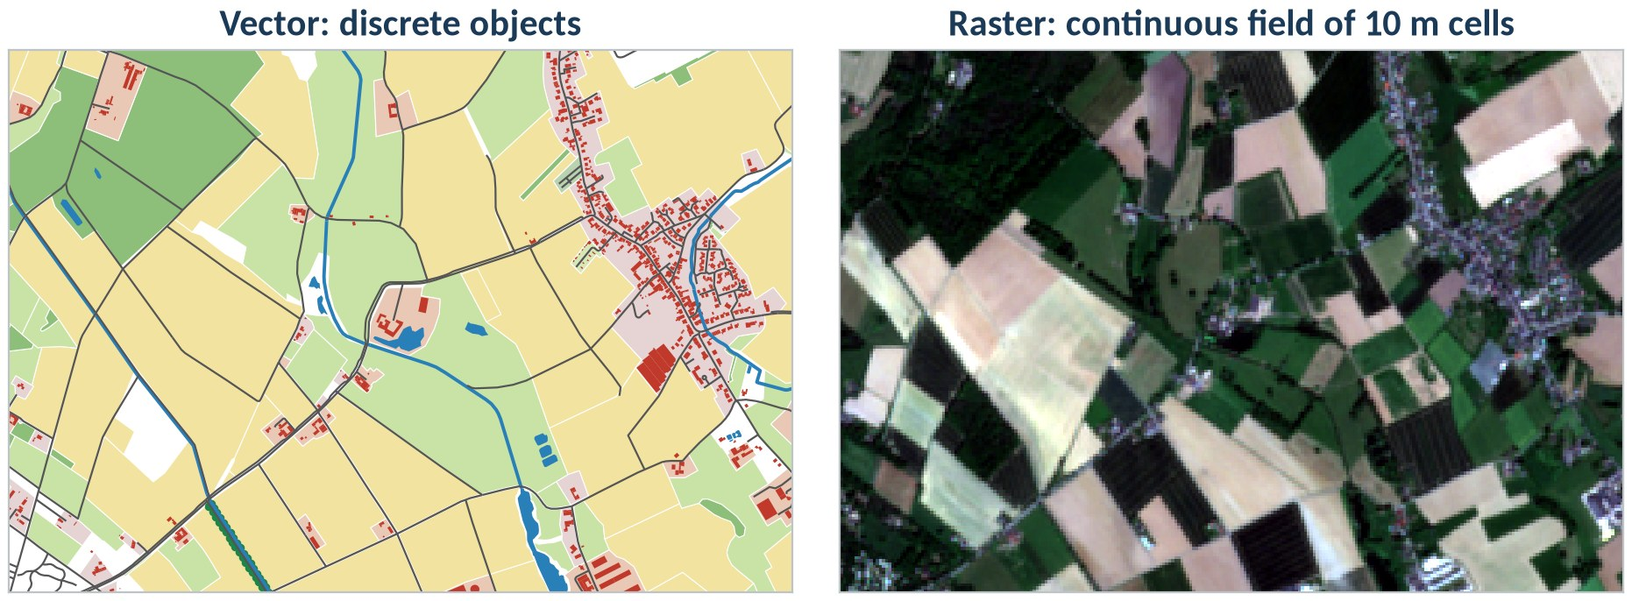
Same place, two models
Vector models things that have a boundary and an identity. Raster models a quantity that varies everywhere in space.
© OpenStreetMap contributors (ODbL) · Contains modified Copernicus Sentinel-2 data 2025 (13 May 2025)
geo0160 · Spatial data models · opengeo
‹#›

Slide 3
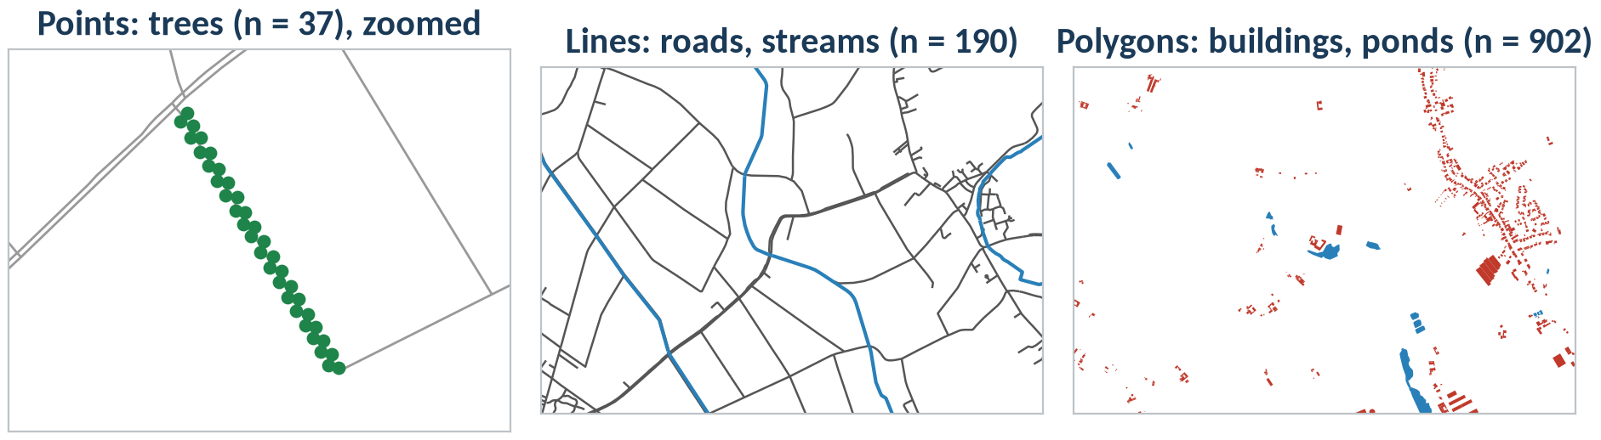
Vector model: geometry + attributes
fid | building | name | geometry
40 | yes | Freie evangelische G… | POLYGON (…)
1 | yes |  | POLYGON (…)
import geopandas as gpd
b = gpd.read_file("kamp_lintfort.gpkg",
layer="buildings")
b.geom_type.value_counts() # Polygon
b.crs # EPSG:25832
© OpenStreetMap contributors (ODbL)
geo0160 · Spatial data models · opengeo
‹#›

Slide 4
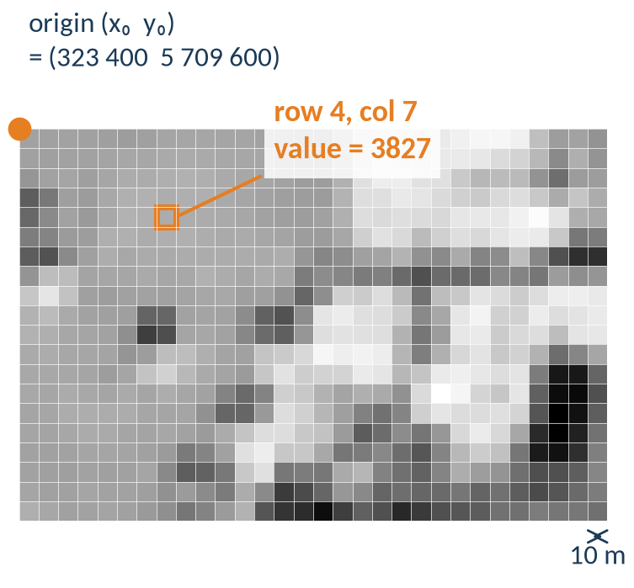
Raster model: a grid of cells
Grid: rows × columns of cells (pixels)
Cell size: resolution, here 10 m × 10 m
Bands: several values per cell (B02 … B08)
NoData: a value that means ‘no measurement’
CRS + origin: place the grid on the Earth
import rasterio
src = rasterio.open("s2_l2a_10m.tif")
src.res # (10.0, 10.0)
src.count # 4 bands
src.transform # origin + cell size
src.xy(4, 7) # row, col -> x, y
src.index(x, y) # x, y -> row, col
Contains modified Copernicus Sentinel-2 data 2025
geo0160 · Spatial data models · opengeo
‹#›

Slide 5
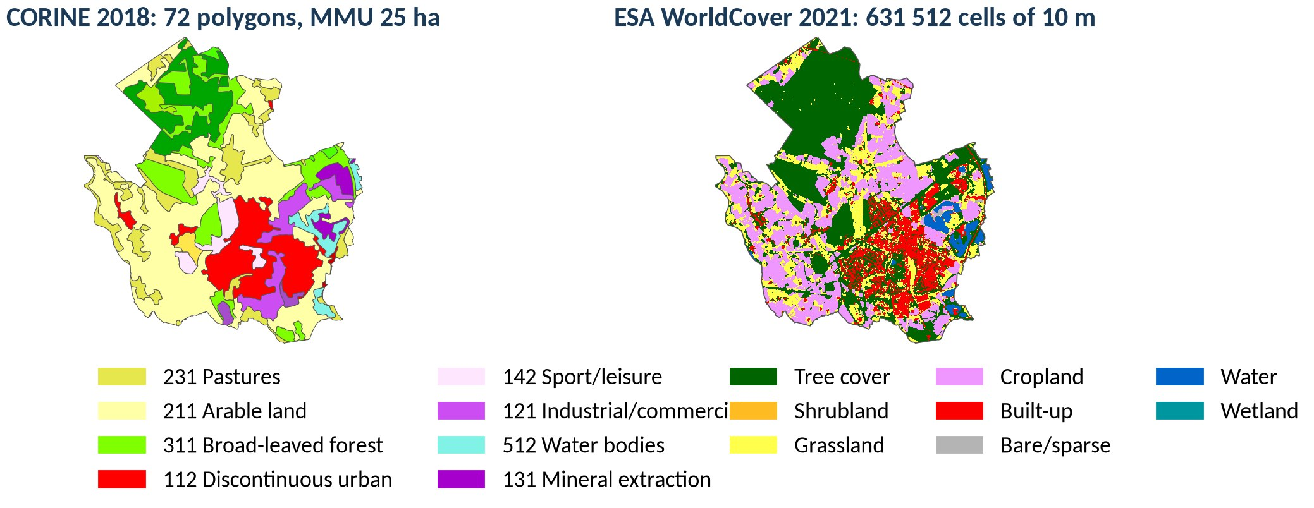
Resolution decides what you can see
CORINE Land Cover 2018, © European Union, Copernicus Land Monitoring Service, EEA · ESA WorldCover 10 m 2021 v200 (CC BY 4.0)
geo0160 · Spatial data models · opengeo
‹#›

Slide 6
Vector or raster?
 | Vector | Raster
Models | discrete objects with identity | continuous fields, images
Geometry | points, lines, polygons (exact coordinates) | regular grid, cell size = resolution
Attributes | many columns per feature | one value per cell and band
Strong at | topology, networks, precise boundaries, cartography | map algebra, surfaces, remote sensing
Weak at | continuous variation | sharp boundaries, storage of sparse data
Formats | GeoPackage, GeoJSON, Shapefile, PostGIS, FlatGeobuf | GeoTIFF / COG, NetCDF, Zarr, JPEG2000
Python | shapely, GeoPandas | rasterio, xarray / rioxarray
geo0160 · Spatial data models · opengeo
‹#›

Slide 7
File formats you will meet
Format | Model | Files | Good to know
GeoPackage (.gpkg) | vector + raster | 1 (SQLite) | many layers, long field names, OGC standard: our default
Shapefile (.shp) | vector | 3–7 (.shp .shx .dbf .prj …) | one layer, field names ≤ 10 characters, 2 GB limit
GeoJSON (.geojson) | vector | 1 (text) | web, always WGS 84 lon/lat (RFC 7946), large files get slow
CSV with x/y | points only | 1 (text) | no CRS stored: you must know it; keys as text (leading zeros)
GeoTIFF / COG (.tif) | raster | 1 | bands + georeference; COG = cloud-optimised, read in pieces
NetCDF / Zarr | raster cubes | 1 / folder | time series of grids (climate, RADOLAN)
Rule of thumb: GeoPackage for vector exchange, GeoTIFF/COG for rasters, PostGIS when many people work on the same data (geo0840).
geo0160 · Spatial data models · opengeo
‹#›

Slide 8
OGC Simple Features: the geometry model
Geometry
+ SRID, dimension, envelope
Point
Curve
Surface
GeometryCollection
LineString
Polygon
MultiPoint
MultiCurve
MultiSurface
LinearRing
PolyhedralSurface
MultiLineString
MultiPolygon
instantiable class
abstract class
Arrows point to the parent class (‘is a’). A Polygon is bounded by LinearRings: one exterior ring, 0…n holes.
Simplified after OGC 06-103r4 Simple Feature Access – Part 1: Common Architecture (ISO 19125-1); redrawn
geo0160 · Spatial data models · opengeo
‹#›

Slide 9
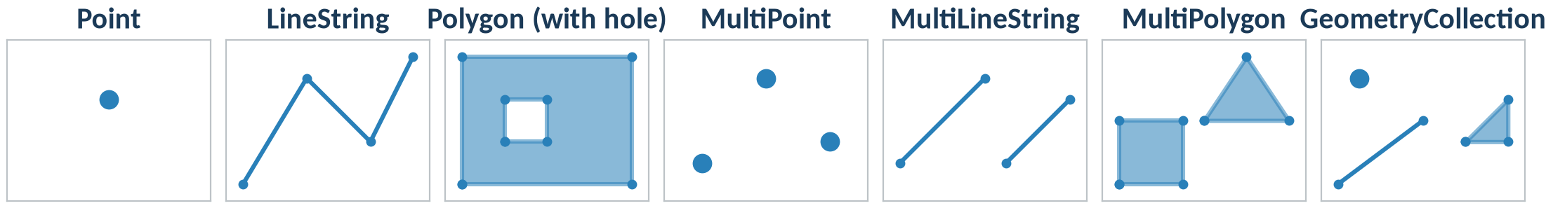
Seven geometry types, written as WKT
POINT (2 2)
LINESTRING (0 0, 1.5 2.5, 3 1, 4 3)
POLYGON ((0 0, 4 0, 4 3, 0 3, 0 0), (1 1, 2 1, 2 2, 1 2, 1 1))
MULTIPOINT ((0.5 0.5), (2 2.5), (3.5 1))
MULTILINESTRING ((0 0.5, 2 2.5), (2.5 0.5, 4 2))
MULTIPOLYGON (((0 0, 1.5 0, 1.5 1.5, 0 1.5, 0 0)), ((2 1.5, 4 1.5, 3 3, 2 1.5)))
GEOMETRYCOLLECTION (POINT (0.5 2.5), LINESTRING (0 0, 2 1.5), POLYGON ((3 1, 4 1, 4 2, 3 1)))
g = shapely.wkt.loads("POINT (2 2)"); g.wkt, g.wkb_hex
geo0160 · Spatial data models · opengeo
‹#›

Slide 10
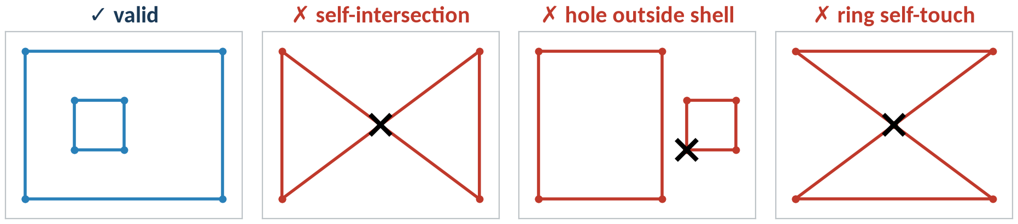
Valid geometries: rules of the model
Rings are closed and do not cross themselves
Holes lie inside the shell, touching it in one point at most
Parts of a MultiPolygon do not overlap
from shapely.validation import (
explain_validity, make_valid)
g.is_valid # False
explain_validity(g) # Self-intersection
make_valid(g) # 2 triangles
geo0160 · Spatial data models · opengeo
‹#›

Slide 11
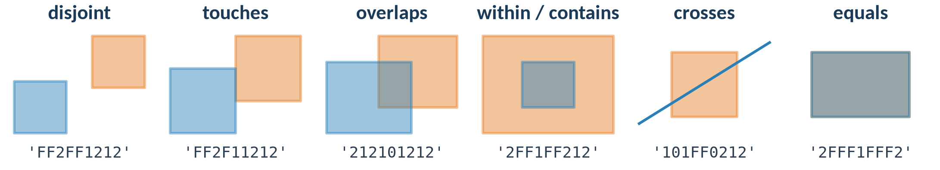
Spatial relationships: DE-9IM
A ∩ B | Interior B | Boundary B | Exterior B
Interior A | 2 | 1 | 2
Boundary A | 1 | 0 | 1
Exterior A | 2 | 1 | 2
A.within(B), A.touches(B)
A.relate(B) # '212101212'
A.relate_pattern(B, "T*T***T**")
# whole layers:
gpd.sjoin(wells, gw_bodies,
predicate="within")
under each pair: A.relate(B); ‘overlaps’ = pattern T*T***T**
geo0160 · Spatial data models · opengeo
‹#›

Slide 12
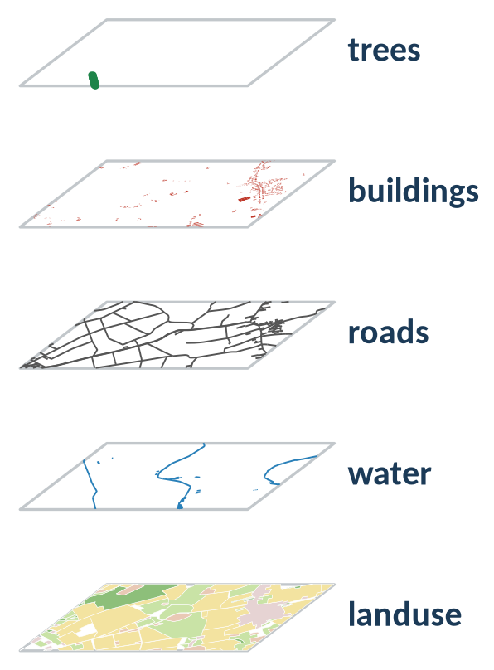
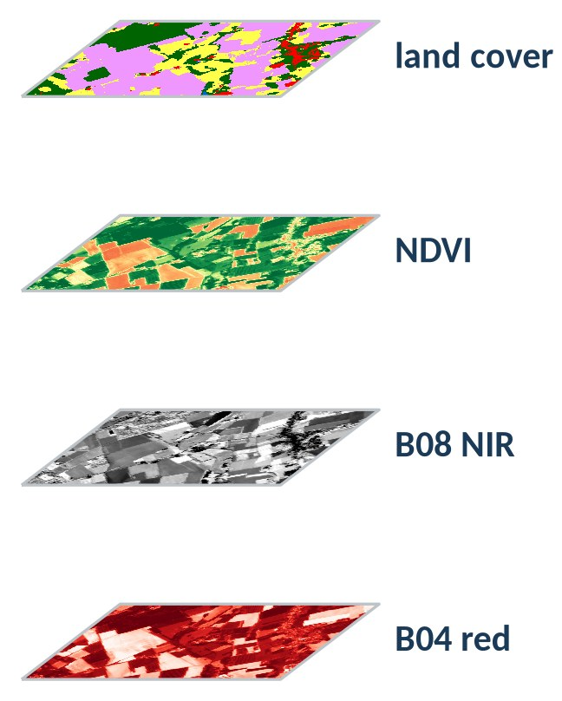
Thinking in layers
Vector stack: overlay geometries
Raster stack: combine aligned cells
© OpenStreetMap contributors (ODbL) · Contains modified Copernicus Sentinel-2 data 2025 · ESA WorldCover 10 m 2021 v200 (CC BY 4.0)
geo0160 · Spatial data models · opengeo
‹#›

Slide 13
Take-aways
1
Two models
Vector for objects, raster for fields; the question and the scale decide.
2
Simple Features
One geometry model behind shapely, GeoPandas, PostGIS, GDAL and GeoPackage.
3
Validity + DE-9IM
Check geometries before analysis; spatial predicates are matrix patterns.
4
Layers
Same CRS, same extent: the precondition for overlay and map algebra.
geo0160 · Spatial data models · opengeo
‹#›

Slide 14
Sources and further reading
Standards: OGC 06-103r4 Simple Feature Access Part 1 (ISO 19125-1); OGC GeoPackage 1.4; DE-9IM: Clementini, Di Felice & van Oosterom (1993)
Data: © OpenStreetMap contributors (ODbL); Contains modified Copernicus Sentinel-2 data 2025, scene S2A_32ULC_20250513 via Earth Search STAC; CORINE Land Cover 2018, © European Union, Copernicus Land Monitoring Service, EEA; ESA WorldCover 10 m 2021 v200 (CC BY 4.0)
Further reading (links): Geo-Python and Automating GIS Processes (Univ. of Helsinki); pythongis.org (Tenkanen, Heikinheimo, Whipp); Shapely and GeoPandas user guides; QGIS Training Manual – vector and raster chapters
Figures: own work, generated with shapely, GeoPandas, rasterio and matplotlib (make_slides.py)
geo0160 · Spatial data models · opengeo
‹#›

