Slide 1
Coordinate reference systems
Shape of the Earth, coordinates, map projections and CRS in practice
Examples: NRW, Kamp-Lintfort

Slide 2
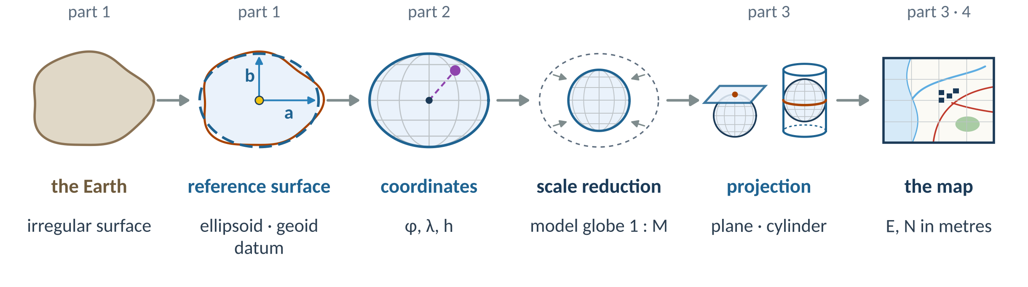
From the Earth to a map
A coordinate is only meaningful together with its CRS.
CRS = datum (ellipsoid + position) + coordinate system (+ projection, units, axes)
Shape of the Earth
Coordinates
Map projections
Germany / NRW
CRS in practice
Wikipedia: Spatial reference system · Map projection
geo0220 · Coordinate reference systems · opengeo · CC BY-SA 4.0
‹#›

Slide 3
1 Shape of the Earth
ellipsoid · geoid · datum
Shape of the Earth
Coordinates
Map projections
Germany / NRW
CRS in practice
geo0220 · Coordinate reference systems · opengeo · CC BY-SA 4.0
‹#›

Slide 4
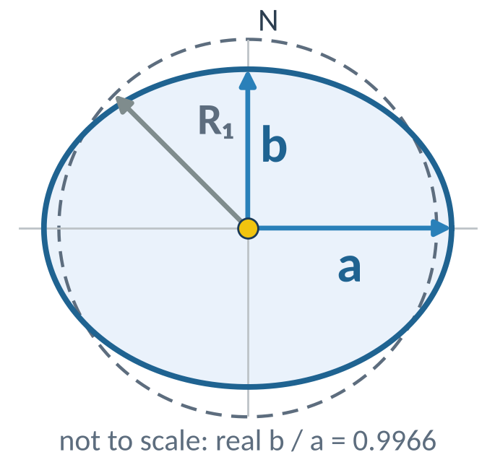
WGS 84: the ellipsoid with a, b and f
Used by GPS, EPSG:4326
Origin: Earth's centre of mass
a = 6 378 137 m (equator)
b = 6 356 752 m (pole)
f = (a − b) / a = 1 / 298.257
R₁ = (2a + b) / 3 = 6 371 km
(mean radius)
Wikipedia: World Geodetic System · Flattening
geo0220 · Coordinate reference systems · opengeo · CC BY-SA 4.0
‹#›

Slide 5
Reference ellipsoids
Ellipsoid | a [m] | b [m] | 1 / f | used by (datum · EPSG)
GRS80 | 6 378 137.000 | 6 356 752.314 | 298.257222101 | ETRS89 · EPSG:4258
WGS84 | 6 378 137.000 | 6 356 752.314 | 298.257223563 | WGS 84 · EPSG:4326 (GPS)
Bessel 1841 | 6 377 397.155 | 6 356 078.963 | 299.1528128 | DHDN · EPSG:4314 (DE, old)
Clarke 1866 | 6 378 206.400 | 6 356 583.800 | 294.978698214 | NAD27 · EPSG:4267 (US, old)
from pyproj import CRS, Geod
CRS("EPSG:25832").ellipsoid # GRS 1980
g = Geod(ellps="GRS80"); g.a, g.b, 1/g.f
a − b ≈ 21.4 km
flattening f = (a − b) / a
f ≈ 1 : 298, round to 0.3 %
Wikipedia: Earth ellipsoid · GRS 80 · World Geodetic System · Flattening
geo0220 · Coordinate reference systems · opengeo · CC BY-SA 4.0
‹#›

Slide 6
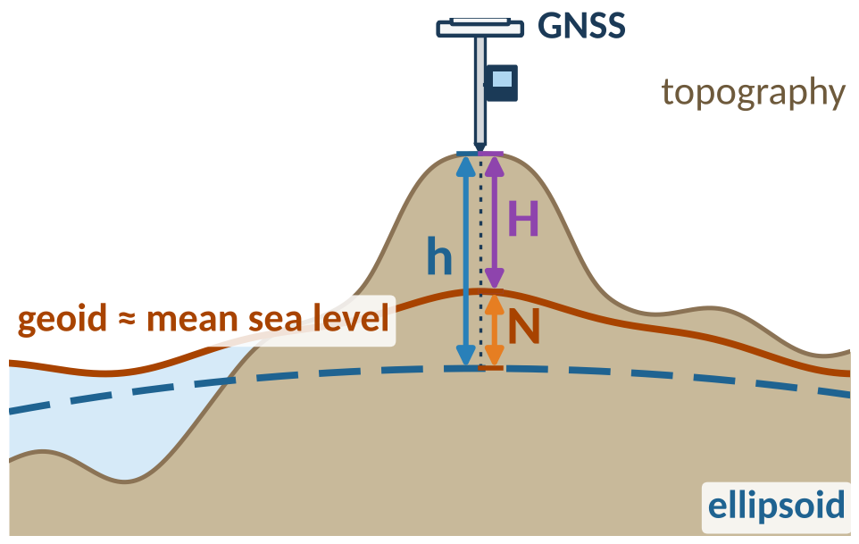
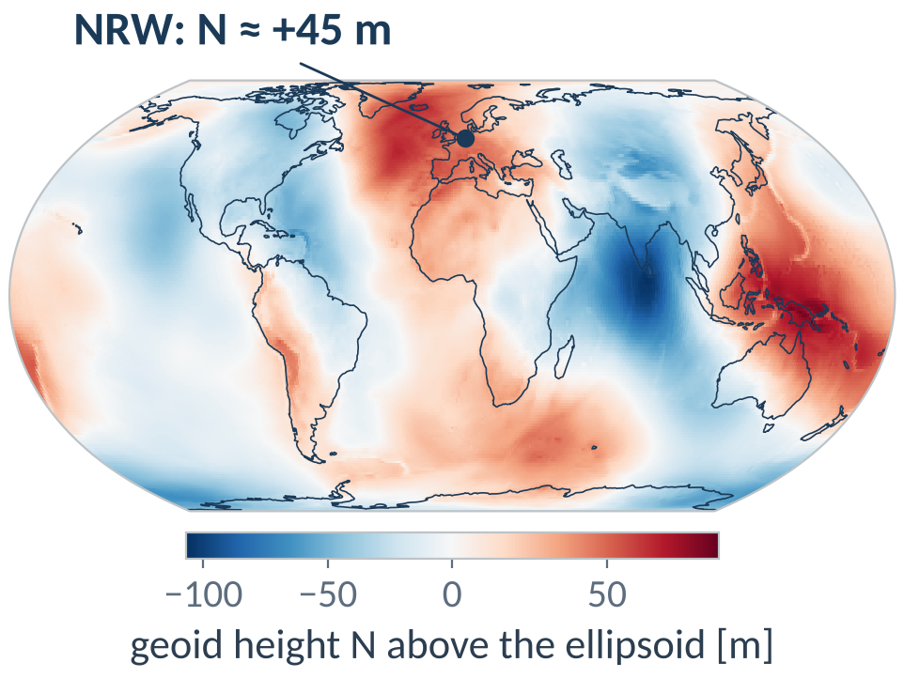
The geoid: where is 'zero height'?
h = H + N
h GNSS H maps, DEM N geoid height
NRW: GNSS height ≈ map height + 45 m
Wikipedia: Geoid · Earth Gravitational Model · Orthometric height
Geoid: EGM96 (NGA/NASA, public domain) via PROJ-data. Coastlines and borders: Natural Earth (public domain). Cross-section schematic, vertical scale exaggerated.
geo0220 · Coordinate reference systems · opengeo · CC BY-SA 4.0
‹#›

Slide 7
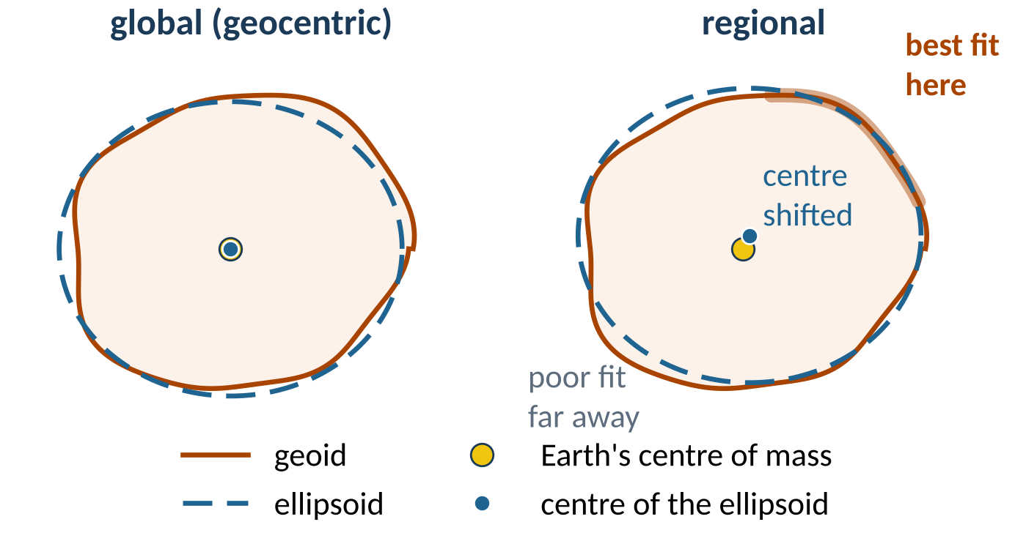
Datum: where does the ellipsoid sit?
Global: centre = centre of mass,
used by GNSS
Regional: fits one country closely
(Bessel / DHDN),
centre ≈ 0.7 km off
Wikipedia: Geodetic datum · Figure of the Earth
geo0220 · Coordinate reference systems · opengeo · CC BY-SA 4.0
‹#›

Slide 8
2 Coordinates
φ, λ, h · X, Y, Z
Shape of the Earth
Coordinates
Map projections
Germany / NRW
CRS in practice
geo0220 · Coordinate reference systems · opengeo · CC BY-SA 4.0
‹#›

Slide 9
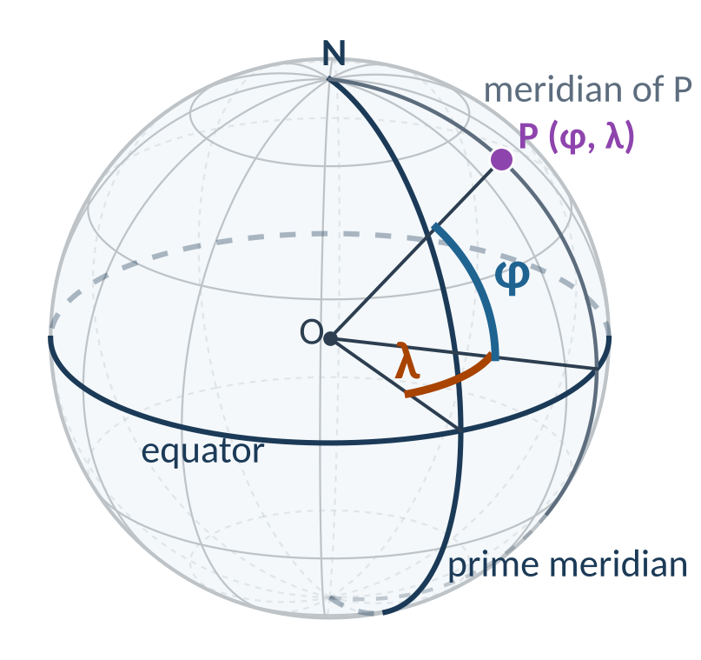
Geographic coordinates: latitude φ and longitude λ
λ longitude: east + / west −, from the prime meridian, −180° … +180°
φ latitude: north + / south −, from the equator, −90° … +90°
h ellipsoidal height in m (part 1)
Kamp-Lintfort: (φ, λ) = (51.5°, +6.53°)
= (51.5° N, 6.53° E)
On the ellipsoid φ is the angle of the surface normal, not of the line to the centre (difference up to 0.19°).
Wikipedia: Geographic coordinate system · Latitude · Longitude · Prime meridian
geo0220 · Coordinate reference systems · opengeo · CC BY-SA 4.0
‹#›

Slide 10
Writing degrees
notation | latitude | longitude
degrees, minutes, seconds (DMS) | 51° 30′ 00″ N | 6° 32′ 00″ E
degrees, decimal minutes | 51° 30.000′ N | 6° 32.000′ E
decimal degrees | 51.500000° | +6.533333°
Boston, signed (west < 0) | 42.3601° | −71.0589°
lat = 51 + 30/60 + 0/3600 # DMS -> decimal degrees: 51.5
deg = int(lat) # whole degrees: 51
mins = (lat - deg) * 60 # decimal minutes: 30.000
f"{lat:.6f}" # 6 decimals (≈ 0.1 m): '51.500000'
Wikipedia: Decimal degrees · NMEA 0183
geo0220 · Coordinate reference systems · opengeo · CC BY-SA 4.0
‹#›

Slide 11
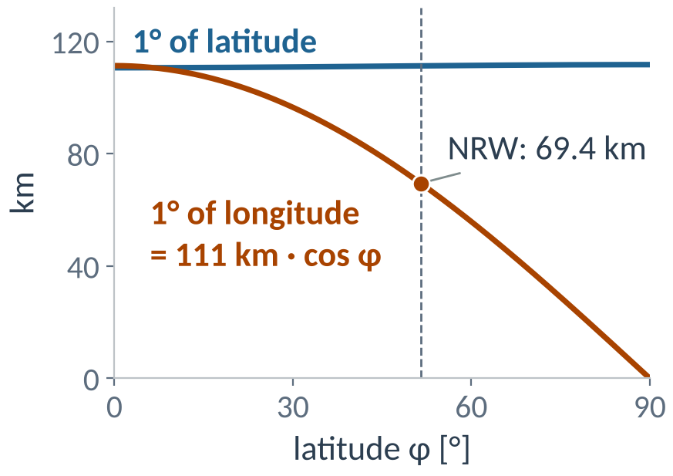
How long is a degree?
NRW (φ ≈ 51.5°) | north–south | east–west
1° | ≈ 111 km | ≈ 69 km
1′ | ≈ 1.85 km | ≈ 1.16 km
1″ | ≈ 31 m | ≈ 19 m
0.00001° | ≈ 1.1 m | ≈ 0.7 m
1′ N–S ≈ 1 nautical mile · NRW: 2.2° ≈ 245 km N–S
g = Geod(ellps="GRS80")
g.inv(6, 51.5, 7, 51.5)[2] # 69 440 m
g.inv(7, 51, 7, 52)[2] # 111 258 m
Wikipedia: Nautical mile · Geographic coordinate system
geo0220 · Coordinate reference systems · opengeo · CC BY-SA 4.0
‹#›

Slide 12
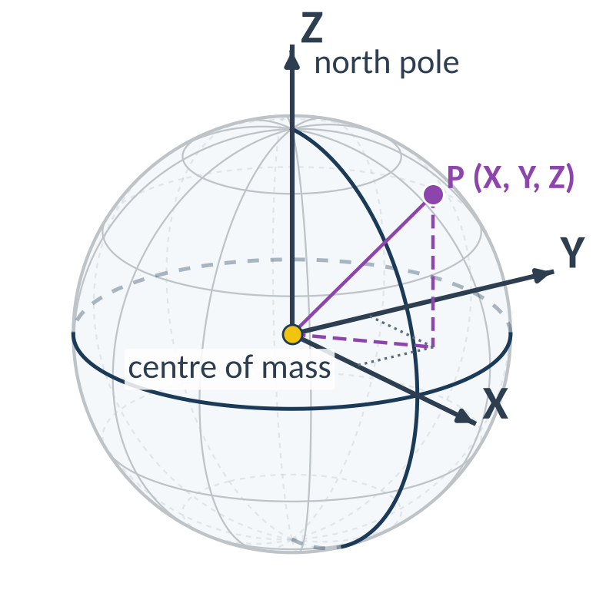
Geocentric coordinates X, Y, Z
Origin: centre of mass, Z: rotation axis
X: (φ, λ) = (0°, 0°) = (0° N, 0° E)
Y: (φ, λ) = (0°, +90°) = (0° N, 90° E)
Cartesian, metres, no projection
Kamp-Lintfort (ETRS89) | value
X | 3 952 854 m
Y | 452 700 m
Z | 4 968 417 m
t = Transformer.from_crs(
4937, 4936, always_xy=True)
t.transform(6.5333, 51.5, 70)
Wikipedia: Earth-centered, Earth-fixed coordinate system · Helmert transformation
geo0220 · Coordinate reference systems · opengeo · CC BY-SA 4.0
‹#›

Slide 13
Kamp-Lintfort in four notations
notation | value
DMS | 51° 30′ 00″ N 6° 32′ 00″ E
decimal (φ, λ) | (51.500000°, +6.533333°)
(X, Y, Z) [m] | (3 952 854, 452 700, 4 968 417)
UTM 32N (E, N) [m] | (328 794, 5 708 314)
Pause: which city?
40° 42′ 46″ N
74° 00′ 22″ W
(40.7128°, −74.0060°)
UTM 18N (E, N):
(583 959, 4 507 351)
Same place, different numbers: always state the CRS.
Compare the UTM values of the two cities.
1 minute with your neighbour
geo0220 · Coordinate reference systems · opengeo · CC BY-SA 4.0
‹#›

Slide 14
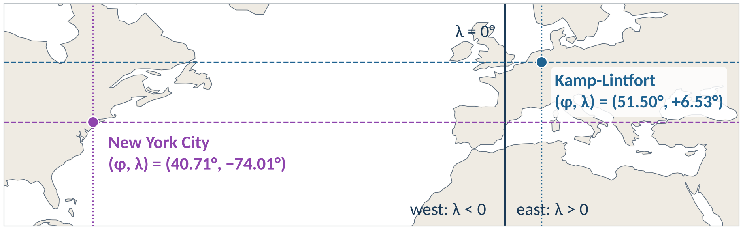
Answer: New York City
11° further south than Kamp-Lintfort. West of Greenwich λ < 0: without the minus sign you land in Kyrgyzstan.
Coastlines and borders: Natural Earth (public domain)
geo0220 · Coordinate reference systems · opengeo · CC BY-SA 4.0
‹#›

Slide 15
3 Map projections
surfaces · distortion · UTM
Shape of the Earth
Coordinates
Map projections
Germany / NRW
CRS in practice
geo0220 · Coordinate reference systems · opengeo · CC BY-SA 4.0
‹#›

Slide 16
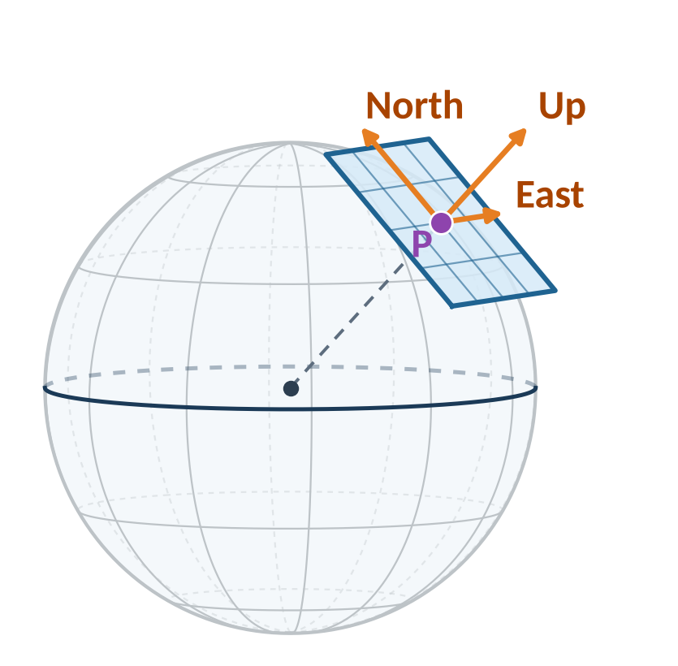
Locally flat: the tangent plane
Near P the Earth is almost flat: the tangent plane is a local map
Local coordinates East, North, Up in metres
Lengths fine to ≈ 10 km,
heights not: curvature
distance from P | plane above sphere | length error
1 km | 8 cm | < 1 mm
10 km | 7.8 m | 8 mm
100 km | 785 m | 8.2 m
Wikipedia: Local tangent plane coordinates
geo0220 · Coordinate reference systems · opengeo · CC BY-SA 4.0
‹#›

Slide 17
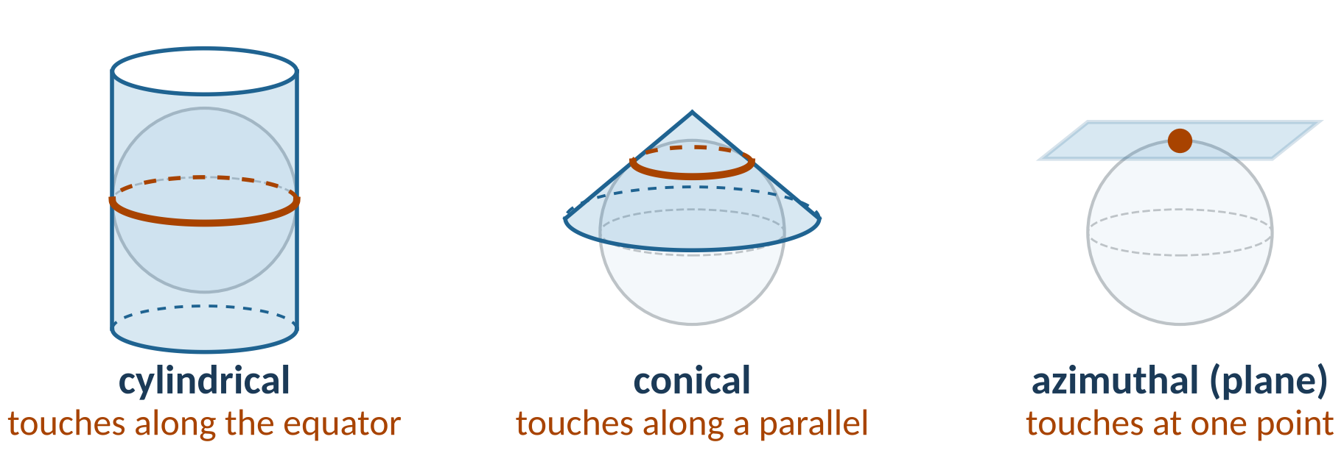
From the ellipsoid to the plane
A projection is a formula (φ, λ) → (x, y); a sphere cannot be flattened without distortion.
No distortion along the line of contact; the surface can be normal, transverse or oblique.
Wikipedia: Map projection · List of map projections
geo0220 · Coordinate reference systems · opengeo · CC BY-SA 4.0
‹#›

Slide 18
What can a projection preserve?
projection class | invariant: what is preserved | where it holds | examples (EPSG)
conformal (orthomorphic) | angles, shapes of small areas | everywhere | Mercator (3395), UTM (25832), stereographic
equal-area (equivalent, authalic) | areas | everywhere | LAEA (3035), Equal Earth (8857), Gall–Peters
equidistant | distances | from one or two points, or along certain lines | azimuthal equidistant, Plate Carrée
azimuthal (zenithal) | directions (azimuths) | only from the centre | stereographic, LAEA, gnomonic
gnomonic | great circles as straight lines | whole map (< hemisphere) | gnomonic
No projection is both conformal and equal-area. Azimuthal combines with the others.
Wikipedia: Map projection · Theorema Egregium
geo0220 · Coordinate reference systems · opengeo · CC BY-SA 4.0
‹#›

Slide 19
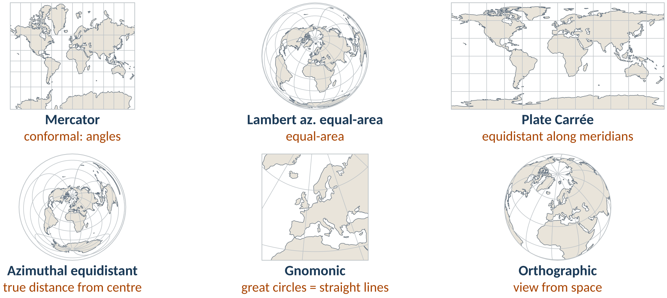
Six projections, six properties
Each projection keeps one property: choose the projection by purpose.
Wikipedia: List of map projections · Gnomonic projection · Lambert azimuthal equal-area projection
Coastlines and borders: Natural Earth (public domain)
geo0220 · Coordinate reference systems · opengeo · CC BY-SA 4.0
‹#›

Slide 20
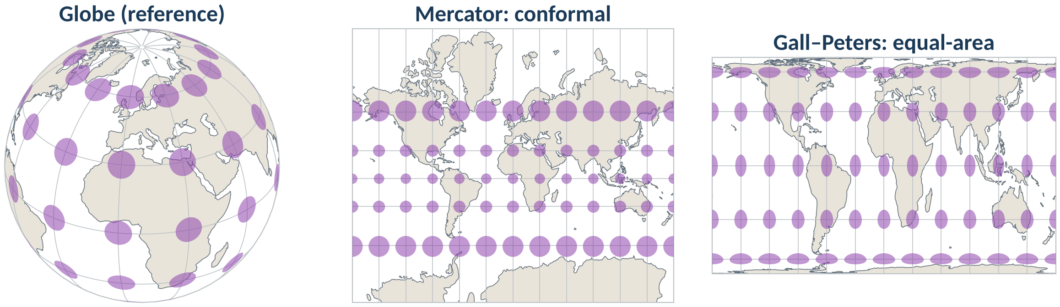
Tissot's indicatrix: one circle, many places
On the globe all circles are equal (rim flattening is perspective).
Same cylinder, opposite property: Mercator keeps shapes, Gall–Peters keeps areas.
Wikipedia: Tissot's indicatrix · Mercator projection · Gall–Peters projection
Coastlines and borders: Natural Earth (public domain)
geo0220 · Coordinate reference systems · opengeo · CC BY-SA 4.0
‹#›

Slide 21
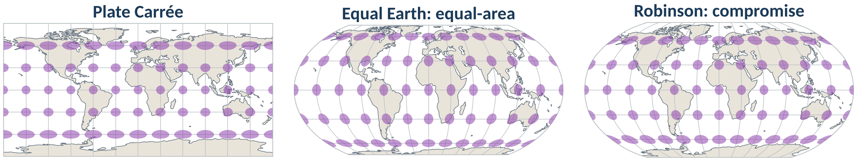
Tissot's indicatrix: more projections
Plate Carrée = (φ, λ) plotted directly: stretched east–west.
Equal Earth: equal-area, natural shapes. Robinson: compromise.
Wikipedia: Tissot's indicatrix · Equal Earth projection · Robinson projection
Coastlines and borders: Natural Earth (public domain)
geo0220 · Coordinate reference systems · opengeo · CC BY-SA 4.0
‹#›

Slide 22
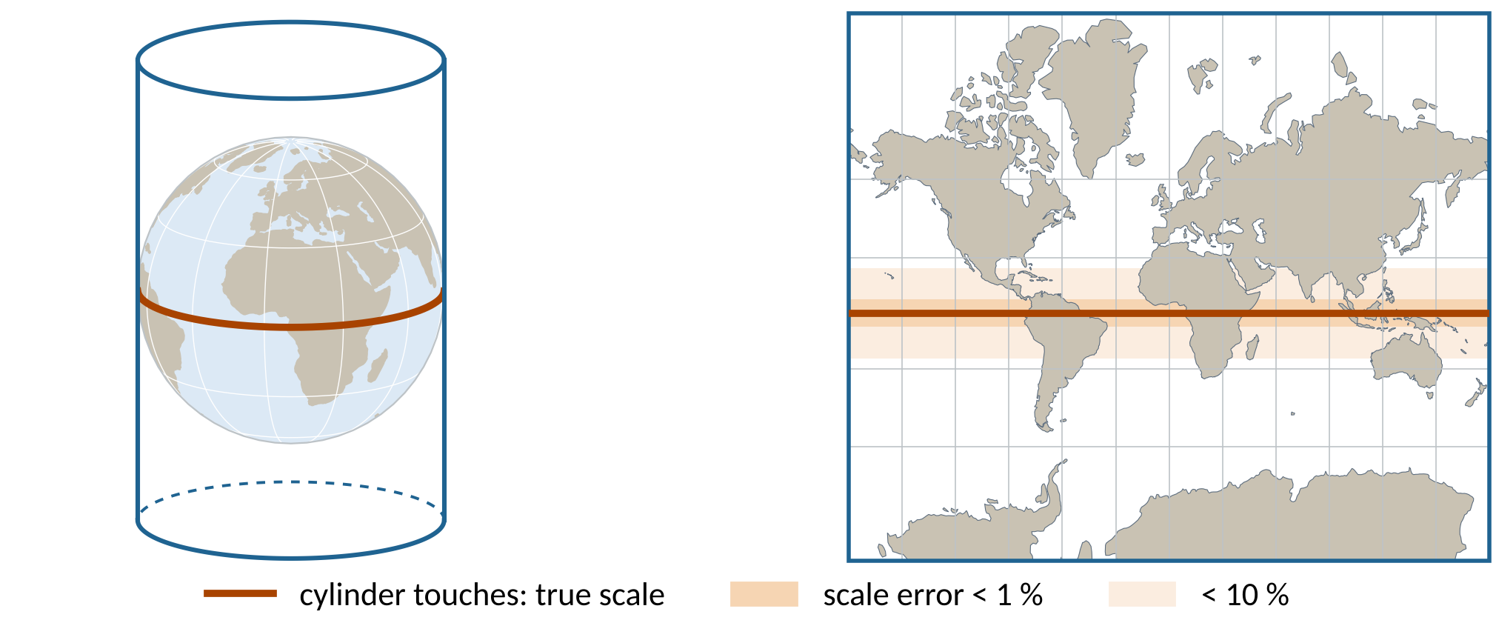
Mercator: the cylinder touches the equator
Exact along the equator, increasingly stretched towards the poles.
Wikipedia: Mercator projection
Coastlines and borders: Natural Earth (public domain)
geo0220 · Coordinate reference systems · opengeo · CC BY-SA 4.0
‹#›

Slide 23
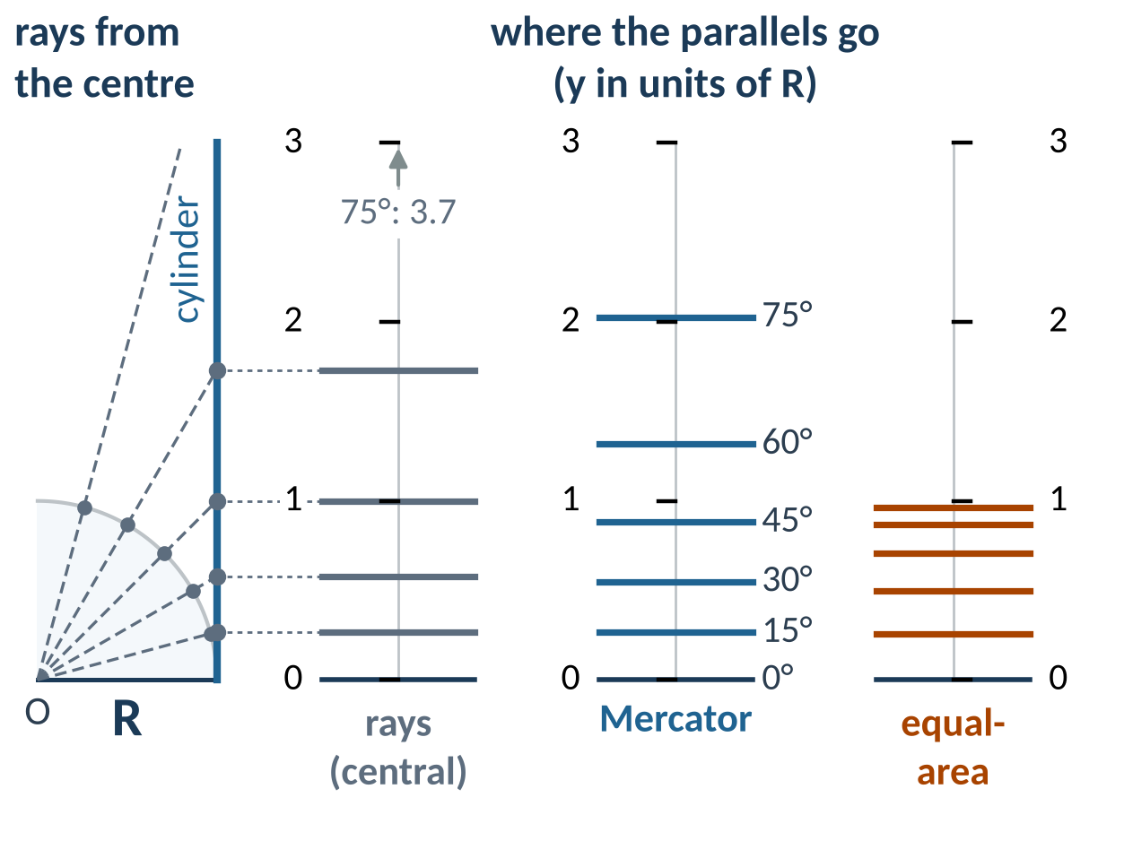
How the Mercator map is built
Rays from the centre give a different map
Mercator: east–west stretch 1/cos φ
Keep shapes ⇒ same stretch north–south: Δy = R Δφ / cos φ
d = np.radians(1/60) # 1′ step
# midpoints of all 1′ strips to 75°
phi = np.arange(d/2,
np.radians(75), d)
# Wright: add up Δy = Δφ / cos φ
y = np.sum(d/np.cos(phi)) # 2.0276
# formula: y = ln tan(45° + φ/2)
np.log(np.tan(np.pi/4 +
np.radians(75)/2)) # 2.0276
Wikipedia: Mercator projection · Central cylindrical projection
geo0220 · Coordinate reference systems · opengeo · CC BY-SA 4.0
‹#›

Slide 24
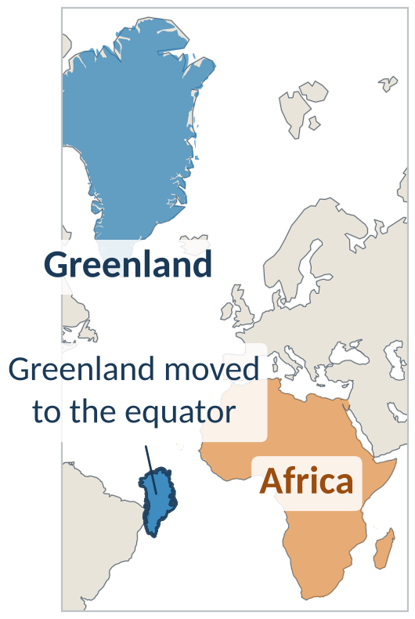
Mercator: true angles, wrong areas
million km² | Greenland | Africa
true area | 2.2 | 29.9
Africa is 14 × larger than Greenland
On Mercator, Greenland looks even larger than Africa
Scale grows with 1 / cos φ:
×2 at 60°
Try it: thetruesize.com
Wikipedia: Mercator projection · Web Mercator projection
Coastlines and borders: Natural Earth (public domain)
geo0220 · Coordinate reference systems · opengeo · CC BY-SA 4.0
‹#›

Slide 25
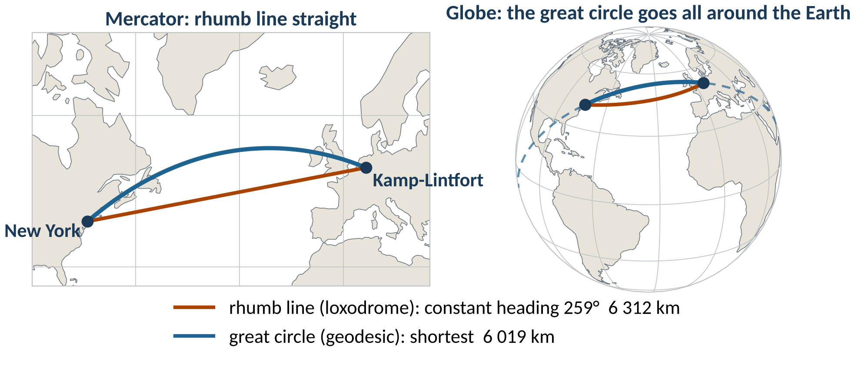
Rhumb line or great circle?
Shortest is not straight on the map: the great circle saves 294 km.
Wikipedia: Rhumb line · Great circle · Great-circle navigation
Coastlines and borders: Natural Earth (public domain)
geo0220 · Coordinate reference systems · opengeo · CC BY-SA 4.0
‹#›

Slide 26
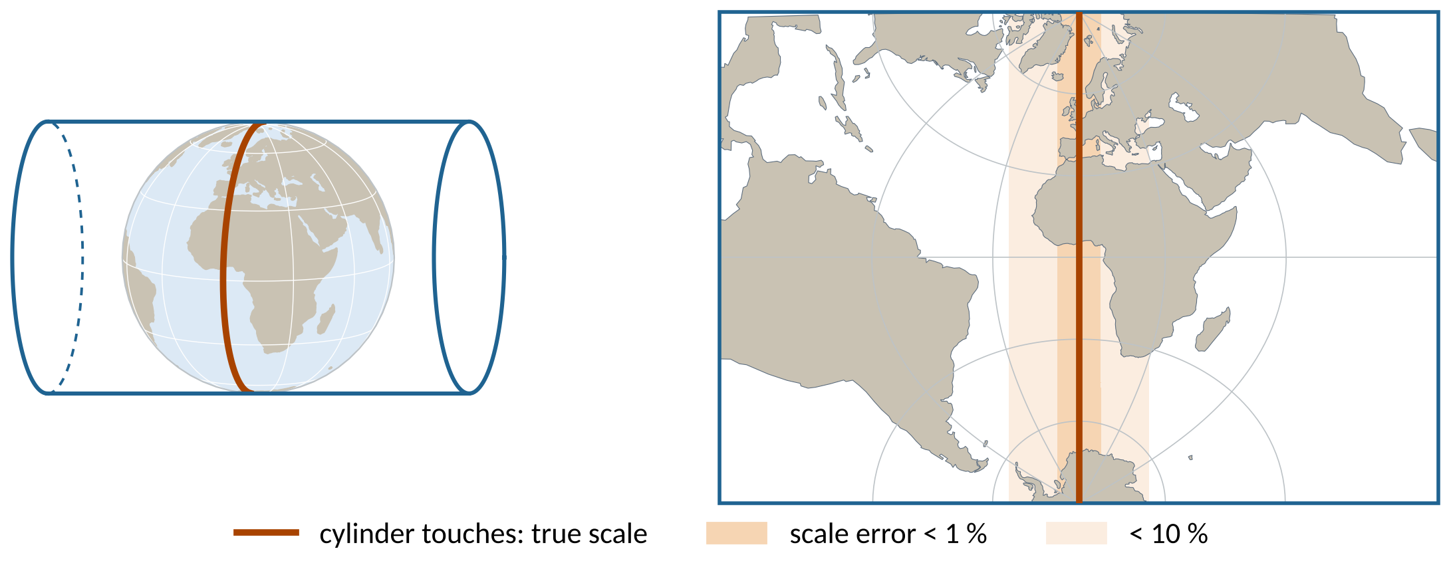
Transverse Mercator: the cylinder turned sideways
Exact along the central meridian: used in narrow strips (Gauss-Krüger 3°, UTM 6°).
Wikipedia: Transverse Mercator projection
Coastlines and borders: Natural Earth (public domain)
geo0220 · Coordinate reference systems · opengeo · CC BY-SA 4.0
‹#›

Slide 27
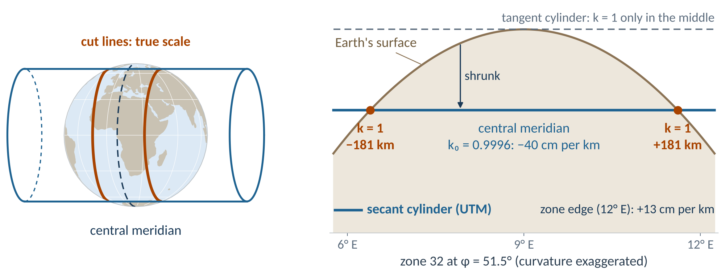
UTM: the secant cylinder
× 0.9996: tangent → secant cylinder, true scale ≈ 181 km east and west
Wikipedia: Universal Transverse Mercator coordinate system
Coastlines and borders: Natural Earth (public domain)
geo0220 · Coordinate reference systems · opengeo · CC BY-SA 4.0
‹#›

Slide 28
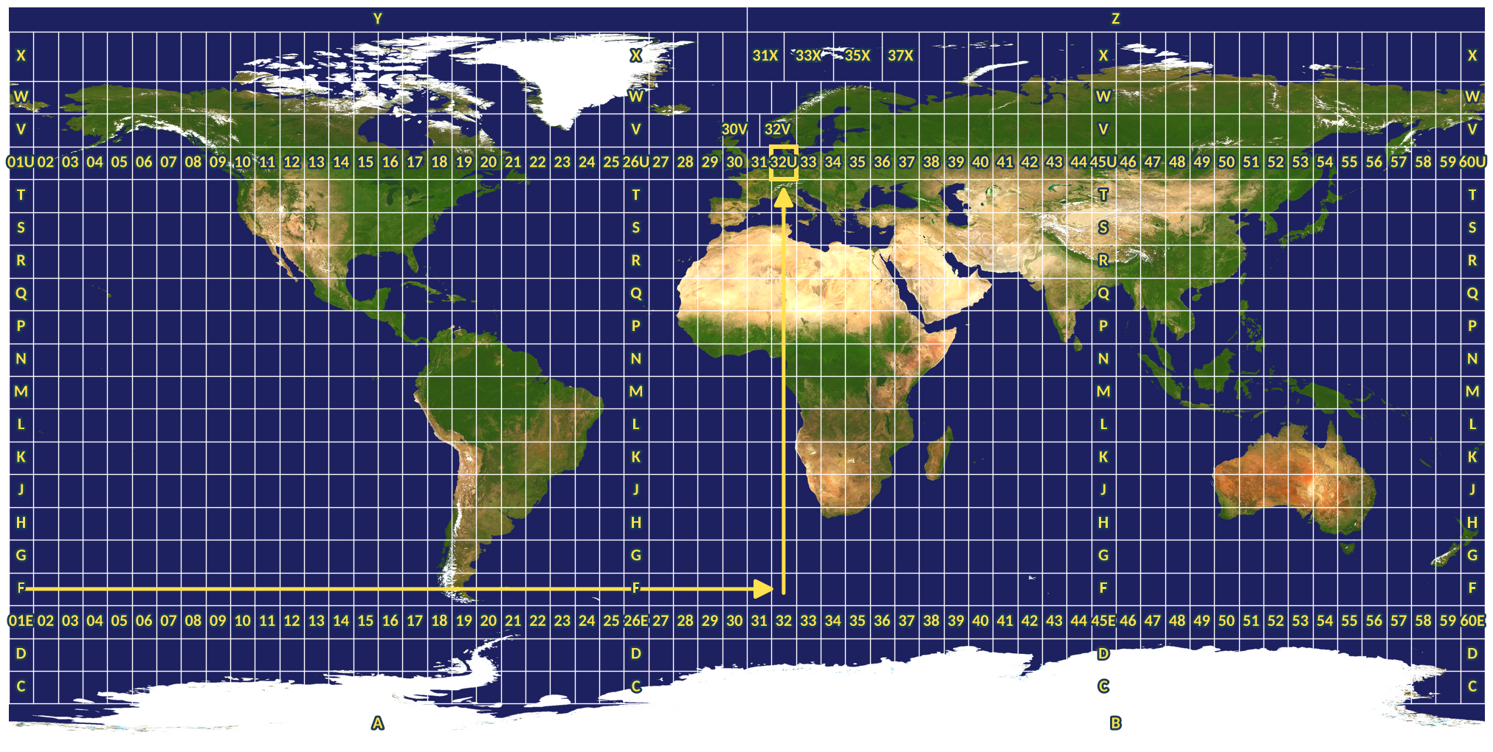
UTM: 60 zones around the world
Wikipedia: Universal Polar Stereographic · Military Grid Reference System
Background: NASA Blue Marble (public domain). Grid: own work.
geo0220 · Coordinate reference systems · opengeo · CC BY-SA 4.0
‹#›

Slide 29
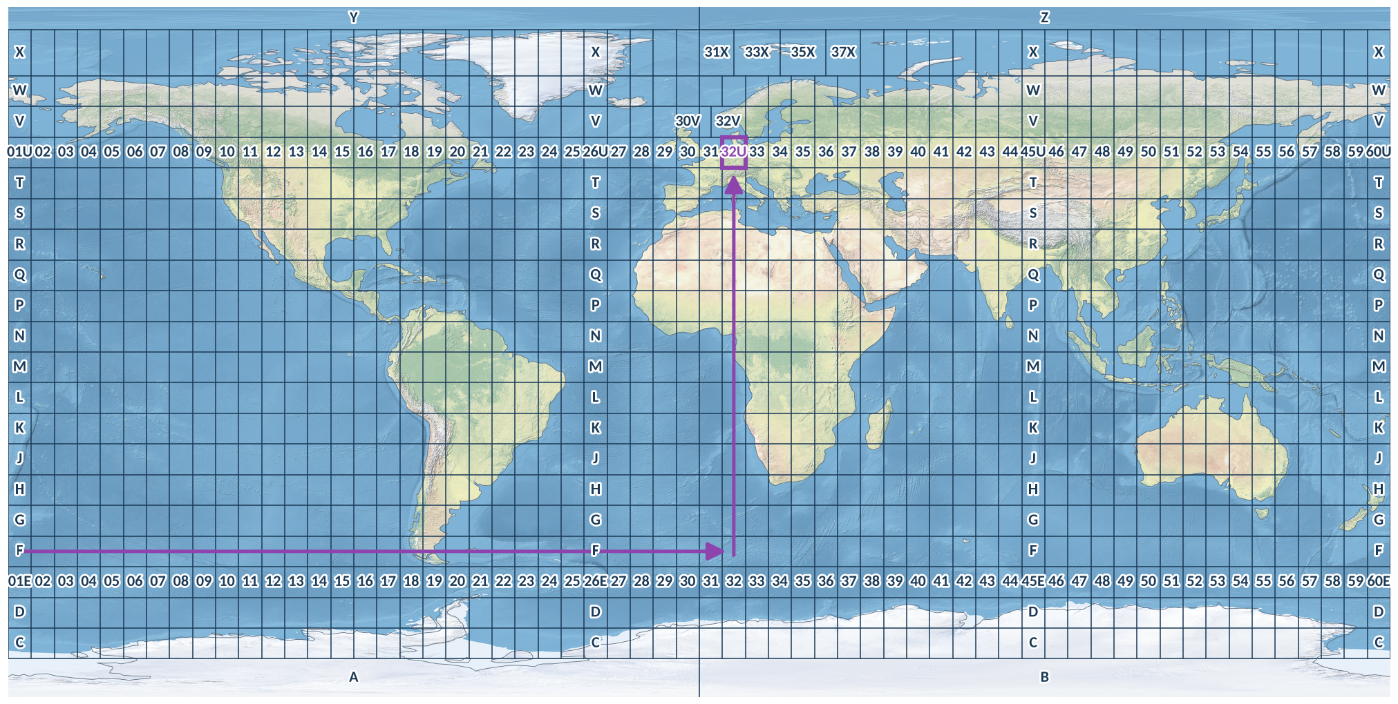
UTM: 60 zones around the world
Wikipedia: Universal Polar Stereographic · Military Grid Reference System
Background: Natural Earth shaded relief (public domain). Grid: own work.
geo0220 · Coordinate reference systems · opengeo · CC BY-SA 4.0
‹#›

Slide 30
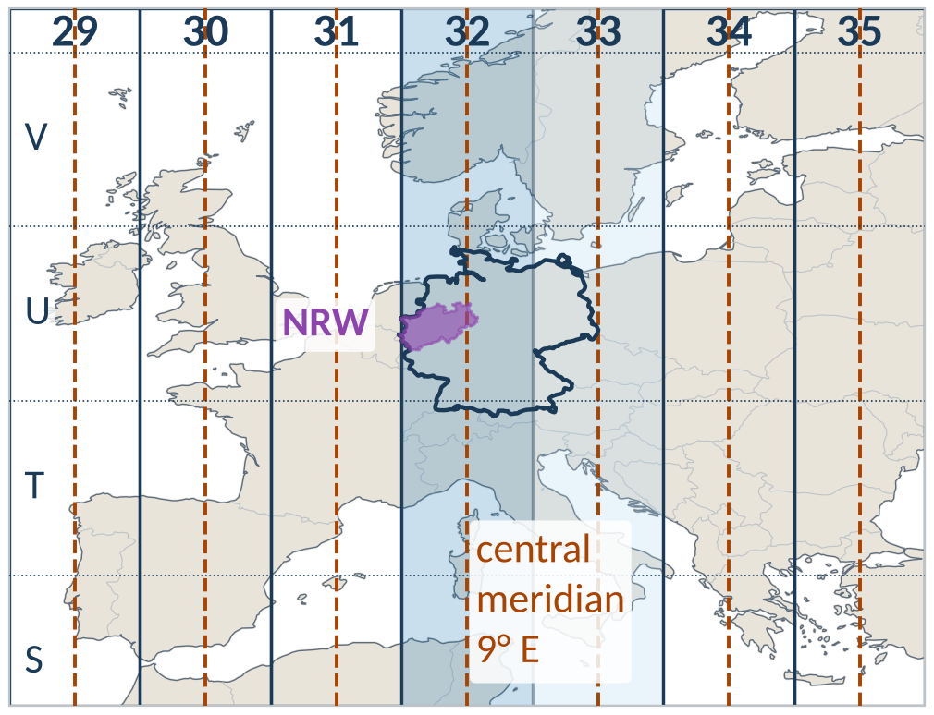
UTM in Europe: zone 32
zone 32N | value
longitudes | 6° … 12° E
central meridian | 9° E
scale factor k₀ | 0.9996
false easting | 500 000 m
datum (Germany) | ETRS89
EPSG | 25832
Kamp-Lintfort: zone 32, band U
(E, N) = (328 794 m, 5 708 314 m)
Wikipedia: Universal Transverse Mercator coordinate system
Coastlines and borders: Natural Earth (public domain)
geo0220 · Coordinate reference systems · opengeo · CC BY-SA 4.0
‹#›

Slide 31
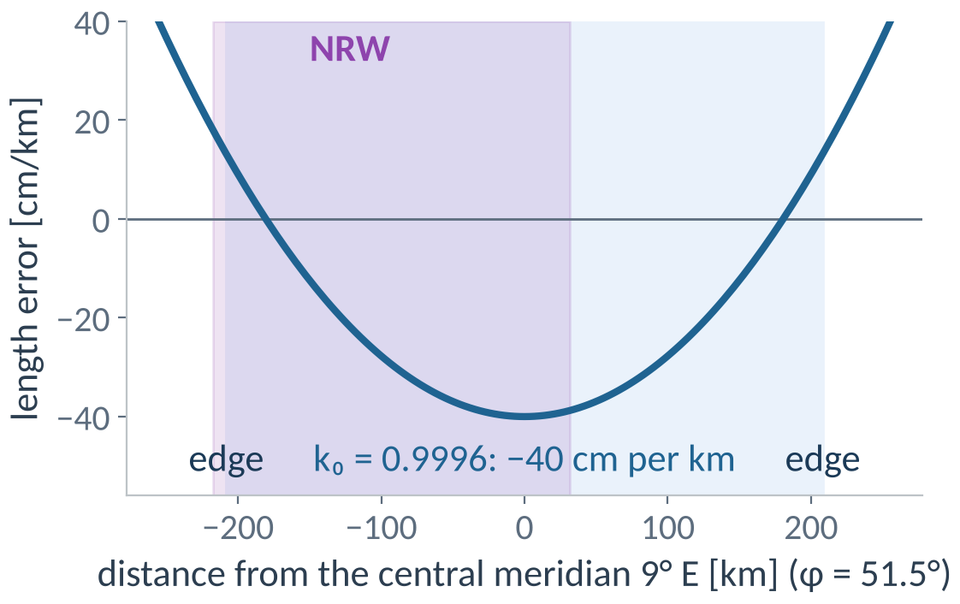
How exact is UTM in NRW?
Central meridian: −40 cm per km
True scale ≈ 181 km east and west
Zone edge (φ = 51.5°): +13 cm per km
p = Proj("EPSG:25832") # UTM 32N
# scale factor k at Kamp-Lintfort
f = p.get_factors(6.5333, 51.5)
f.meridional_scale # 0.99996
Wikipedia: Universal Transverse Mercator coordinate system
geo0220 · Coordinate reference systems · opengeo · CC BY-SA 4.0
‹#›

Slide 32
Which projection for what?
purpose | projection | property | EPSG
maps and analysis in NRW / Germany | UTM zone 32N | conformal | 25832
statistics and areas in Europe | Lambert azimuthal equal-area | equal-area | 3035
world thematic maps | Equal Earth | equal-area | 8857
web maps (display only) | Web Mercator | conformal (sphere) | 3857
navigation charts | Mercator | conformal | 3395
storing and exchanging data | none: (φ, λ) | – | 4326 / 4258
Wikipedia: EPSG Geodetic Parameter Dataset · European Terrestrial Reference System 1989
geo0220 · Coordinate reference systems · opengeo · CC BY-SA 4.0
‹#›

Slide 33
4 Germany / NRW
DHDN · Gauss-Krüger · ETRS89 · DHHN2016
Shape of the Earth
Coordinates
Map projections
Germany / NRW
CRS in practice
geo0220 · Coordinate reference systems · opengeo · CC BY-SA 4.0
‹#›

Slide 34
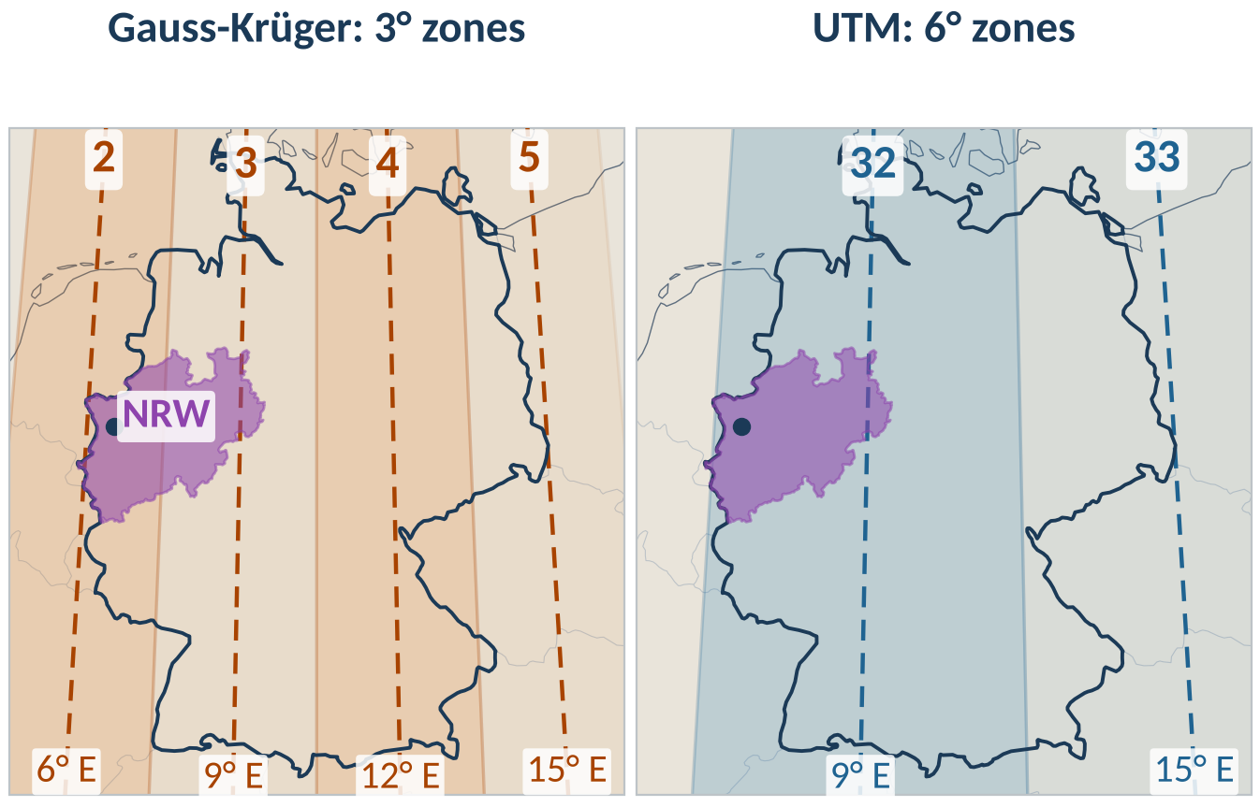
Old and new: DHDN / Gauss-Krüger → ETRS89 / UTM
 | DHDN / GK | ETRS89 / UTM
ellipsoid | Bessel 1841 | GRS80
datum | regional | geocentric
zone width | 3° | 6°
CM in NRW | 6° E, 9° E | 9° E
k₀ | 1 | 0.9996
E (Kamp-L.) | 2 537 078 | 328 794
EPSG | 31466/31467 | 25832/4647
2 537 078: zone 2,
37 km east of 6° E
Wikipedia: Gauss–Krüger coordinate system · ETRS89
Coastlines and borders: Natural Earth (public domain)
geo0220 · Coordinate reference systems · opengeo · CC BY-SA 4.0
‹#›

Slide 35
EPSG: a unique ID for every CRS
EPSG: European Petroleum Survey Group, registry today run by IOGP
A unique numeric key for every registered CRS
EPSG:4326 WGS 84, geographic (GPS)
EPSG:25832 ETRS89 / UTM zone 32N
Kamp-Lintfort: 328 794, 5 708 314
EPSG:4647 ETRS89 / UTM zone 32N (zE-N)
Kamp-Lintfort: 32 328 794, 5 708 314 (zone prefix 32)
EPSG:3857 WGS 84 / Pseudo-Mercator: OpenStreetMap, Google, Bing
Wikipedia: EPSG Geodetic Parameter Dataset
geo0220 · Coordinate reference systems · opengeo · CC BY-SA 4.0
‹#›

Slide 36
Kamp-Lintfort in eight CRSs
CRS | EPSG | east value | north value | unit
WGS 84, geographic | 4326 | +6.533333° | 51.500000° | degree
ETRS89, geographic | 4258 | +6.533333° | 51.500000° | degree
DHDN, geographic | 4314 | +6.534036° | 51.501317° | degree
DHDN / Gauss-Krüger zone 2 | 31466 | 2 537 078 | 5 707 408 | m
DHDN / Gauss-Krüger zone 3 | 31467 | 3 328 800 | 5 710 156 | m
ETRS89 / UTM zone 32N | 25832 | 328 794 | 5 708 314 | m
ETRS89 / UTM 32N (zE-N) | 4647 | 32 328 794 | 5 708 314 | m
WGS 84 / Pseudo-Mercator | 3857 | 727 287 | 6 710 219 | m (web)
for epsg in (4314, 31466, 31467, 25832, 4647): # target CRSs
t = Transformer.from_crs(4258, epsg, always_xy=True) # from ETRS89
print(epsg, t.transform(6.5333, 51.5)) # (east, north)
Wikipedia: Spatial reference system
geo0220 · Coordinate reference systems · opengeo · CC BY-SA 4.0
‹#›

Slide 37
Recognise a CRS from its numbers
pattern of the east value | east range | north range | probably
≈ 6 … 9.5, with decimals | 5.9 … 9.5 | 50.3 … 52.5 | degrees: 4258/4326
7 digits, starts with 2 | 2 490 000 … 2 739 000 | 5 576 000 … 5 825 000 | GK zone 2: 31466
7 digits, starts with 3 | 3 279 000 … 3 532 000 | 5 580 000 … 5 821 000 | GK zone 3: 31467
6 digits | 279 000 … 532 000 | 5 578 000 … 5 819 000 | UTM 32N: 25832
8 digits, starts with 32 | 32 279 000 … 32 532 000 | 5 578 000 … 5 819 000 | UTM 32N: 4647
6–7 digits, north ≈ 6.6 M | 651 000 … 1 053 000 | 6 502 000 … 6 895 000 | Web Mercator: 3857
Count the digits, read the first ones. In degrees, check which value is the latitude.
Wikipedia: EPSG Geodetic Parameter Dataset
geo0220 · Coordinate reference systems · opengeo · CC BY-SA 4.0
‹#›

Slide 38
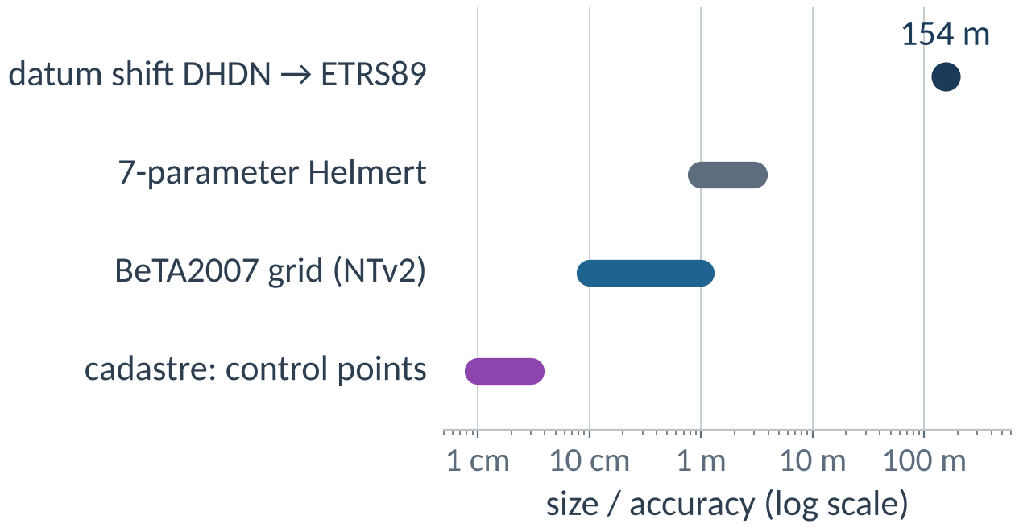
DHDN → ETRS89 is a transformation
New datum: new ellipsoid and new position
Same numbers ≈ 154 m apart
The method decides the accuracy
tg = TransformerGroup(4314, 4258, always_xy=True) # DHDN -> ETRS89
[(t.description, t.accuracy) for t in tg.transformers] # best first
# Kamp-Lintfort: BeTA2007 grid vs Helmert = 1.8 m
Wikipedia: Helmert transformation · Geodetic datum
geo0220 · Coordinate reference systems · opengeo · CC BY-SA 4.0
‹#›

Slide 39
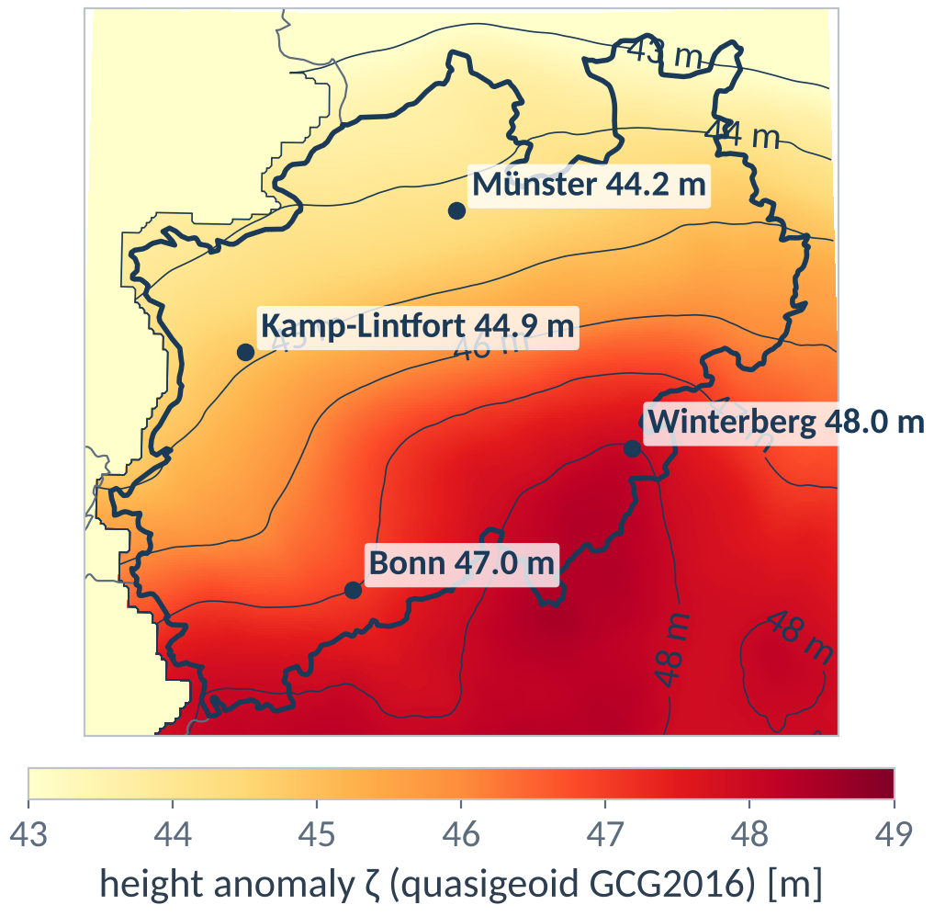
Heights in Germany: DHHN2016
h GNSS, ellipsoidal (ETRS89)
H maps, DEM NRW: DHHN2016 (NHN)
H = h − ζ, ζ from GCG2016 (< 1 cm)
NRW: ζ ≈ 44 … 48 m
t = Transformer.from_crs(4937, 9924,
always_xy=True) # uses GCG2016
t.transform(6.5333, 51.5, 100.0)
# h = 100 m -> H = 55.13 m
Wikipedia: Normal height · Geoid
geo0220 · Coordinate reference systems · opengeo · CC BY-SA 4.0
‹#›

Slide 40
ITRF: the global reference frame
ITRS: the system
definition: centre of mass, axes, metre
The plates move: in ITRF, Germany
moves ≈ 2.5 cm per year north-east
ITRF / WGS 84: grid fixed to the
whole Earth, coordinates change
ETRS89: grid glued onto Europe,
coordinates stay
Kamp-Lintfort 2026: 0.92 m apart
ITRF2014, ITRF2020: the frame
≈ 1 500 stations: coordinates + velocities
WGS 84
GPS, ≈ ITRF (1 cm)
EPSG:4326
ETRS89
= ITRF in 1989,
then fixed to Eurasia
EPSG:4258
Wikipedia: International Terrestrial Reference System and Frame
geo0220 · Coordinate reference systems · opengeo · CC BY-SA 4.0
‹#›

Slide 41
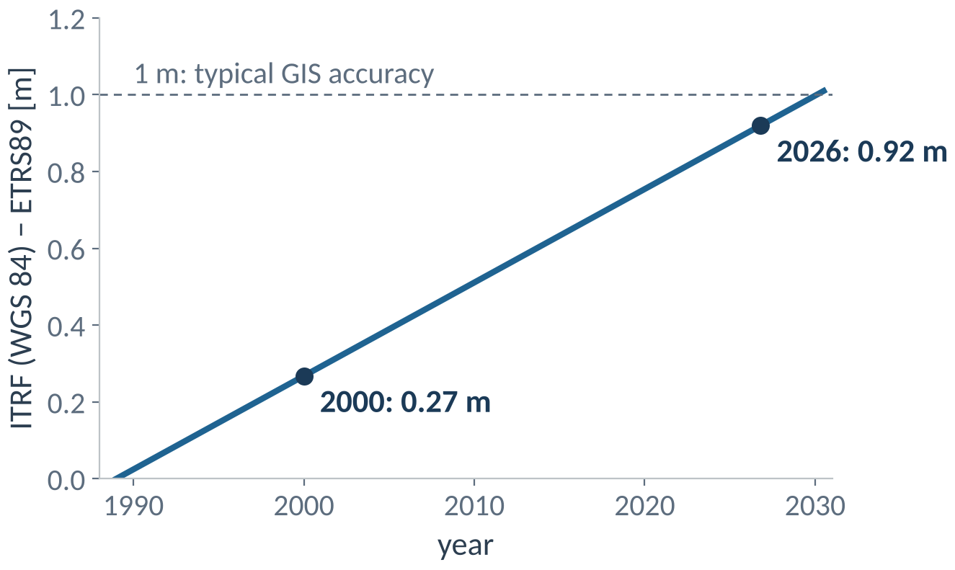
ETRS89 is not WGS 84
ETRS89 is fixed to the Eurasian plate (1989)
WGS 84 is global: Europe moves ≈ 2.4 cm per year north-east
Kamp-Lintfort 2026: 0.92 m apart
GIS at 1 m: treat as equal
GNSS / RTK: use ETRS89 (SAPOS)
Wikipedia: ETRS89 · Plate tectonics
geo0220 · Coordinate reference systems · opengeo · CC BY-SA 4.0
‹#›

Slide 42
Sources and further reading (1/2)
From the Earth to a map: Spatial reference system · Map projection
WGS 84: the ellipsoid with a, b and f: World Geodetic System · Flattening
Reference ellipsoids: Earth ellipsoid · GRS 80 · World Geodetic System · Flattening
The geoid: where is 'zero height'? Geoid · Earth Gravitational Model · Orthometric height
Datum: where does the ellipsoid sit? Geodetic datum · Figure of the Earth
Geographic coordinates: latitude φ and longitude λ: Geographic coordinate system · Latitude · Longitude · Prime meridian
Writing degrees: Decimal degrees · NMEA 0183
How long is a degree? Nautical mile · Geographic coordinate system
Geocentric coordinates X, Y, Z: Earth-centered, Earth-fixed coordinate system · Helmert transformation
Locally flat: the tangent plane: Local tangent plane coordinates
From the ellipsoid to the plane: Map projection · List of map projections
What can a projection preserve? Map projection · Theorema Egregium
Six projections, six properties: List of map projections · Gnomonic projection · Lambert azimuthal equal-area projection
Tissot's indicatrix: one circle, many places: Tissot's indicatrix · Mercator projection · Gall–Peters projection
Tissot's indicatrix: more projections: Tissot's indicatrix · Equal Earth projection · Robinson projection
Mercator: the cylinder touches the equator: Mercator projection
How the Mercator map is built: Mercator projection · Central cylindrical projection
Mercator: true angles, wrong areas: Mercator projection · Web Mercator projection
Data: Natural Earth, EGM96 (public domain); BeTA2007, GCG2016 (open licence) via PROJ-data. Figures: own work (make_slides.py), CC BY-SA 4.0.
geo0220 · Coordinate reference systems · opengeo · CC BY-SA 4.0
‹#›

Slide 43
Sources and further reading (2/2)
Rhumb line or great circle? Rhumb line · Great circle · Great-circle navigation
Transverse Mercator: the cylinder turned sideways: Transverse Mercator projection
UTM: the secant cylinder: Universal Transverse Mercator coordinate system
UTM: 60 zones around the world: Universal Polar Stereographic · Military Grid Reference System
UTM in Europe: zone 32: Universal Transverse Mercator coordinate system
How exact is UTM in NRW? Universal Transverse Mercator coordinate system
Which projection for what? EPSG Geodetic Parameter Dataset · European Terrestrial Reference System 1989
Old and new: DHDN / Gauss-Krüger → ETRS89 / UTM: Gauss–Krüger coordinate system · ETRS89
EPSG: a unique ID for every CRS: EPSG Geodetic Parameter Dataset
Kamp-Lintfort in eight CRSs: Spatial reference system
Recognise a CRS from its numbers: EPSG Geodetic Parameter Dataset
DHDN → ETRS89 is a transformation: Helmert transformation · Geodetic datum
Heights in Germany: DHHN2016: Normal height · Geoid
ITRF: the global reference frame: International Terrestrial Reference System and Frame
ETRS89 is not WGS 84: ETRS89 · Plate tectonics
Data: Natural Earth, EGM96 (public domain); BeTA2007, GCG2016 (open licence) via PROJ-data. Figures: own work (make_slides.py), CC BY-SA 4.0.
geo0220 · Coordinate reference systems · opengeo · CC BY-SA 4.0
‹#›

