Slide 1
CS131 Lecture 1
introduction
2018. 05. 11 Eojindl Yi(이어진들)

Slide 2
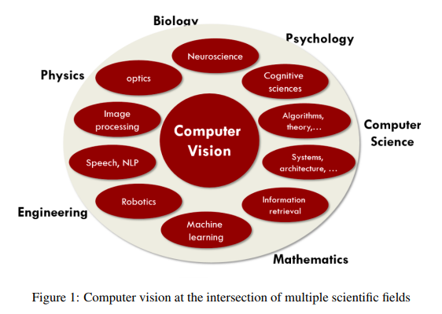
Computer Vision is…
a scientific field that extracts information out of digital images
a building algorithm that understands and utilizes content of images
an interdisciplinary field interacting with multiple scientific fields

Slide 3
Vision
Two components of vision
Sensing device : that tries to capture as much detail from the image as possible
Interpreting device : that processes information and extracts meaning from it
Information dealt in computer vision can either be used as semantic information or measurement for various applications
Semantic information : Contents in the image contain e.g. medical information
Measurement : Image is used to measure depth, distance, 3D surface
Neuroscience aims to solve the concepts behind vision, and eventually, intelligence

Slide 4
Applications
Special effects
3D urban modeling
Scene recognition
Face detection/recognition
Optical Character Recognition
Mobile visual search
Self-driving cars
Automatic checkout
Vision-based interaction
AR, VR

