Slide 1
OpenCV & Extracting LBP
2018. 05. 10 Eojindl Yi(이어진들)
Project original date : 2018. 02. 13

Slide 2
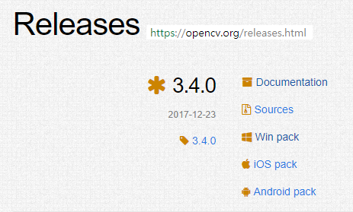
Basic Settings for OpenCV(C++)

Slide 3
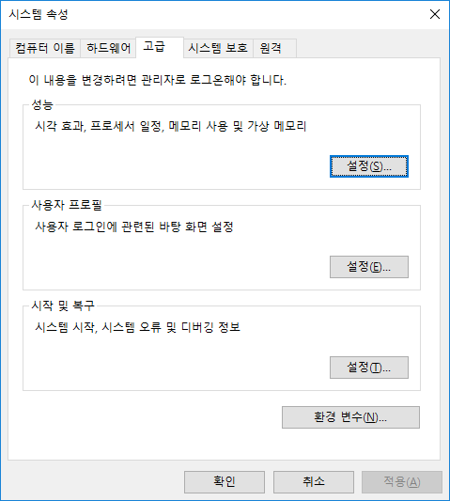
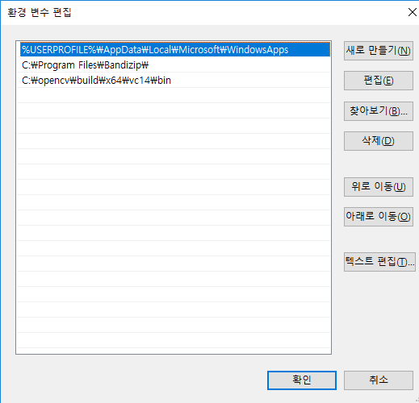
시스템 속성 > 환경 변수

Slide 4
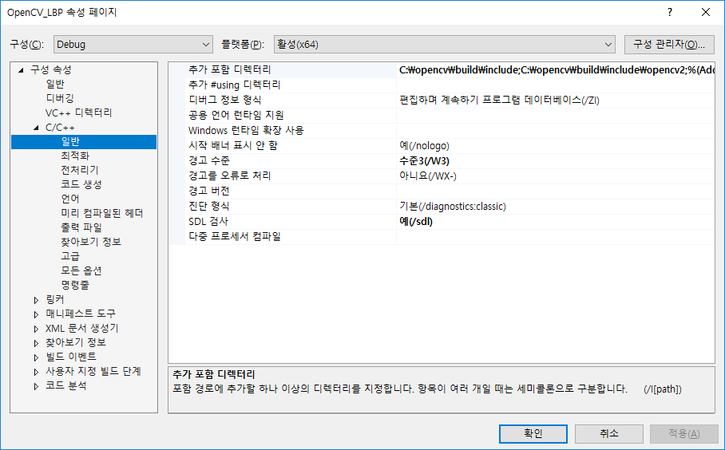
Visual Studio > 메뉴 > 프로젝트 > 속성

Slide 5
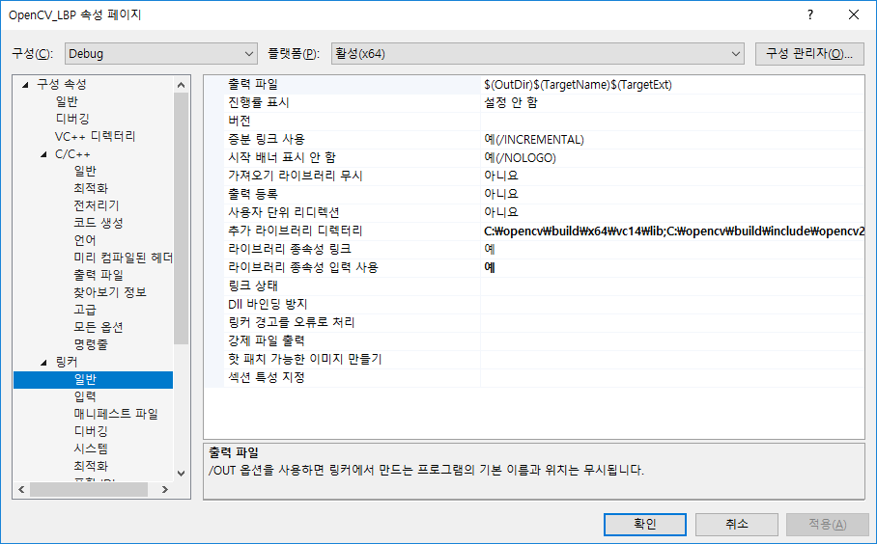

Slide 6
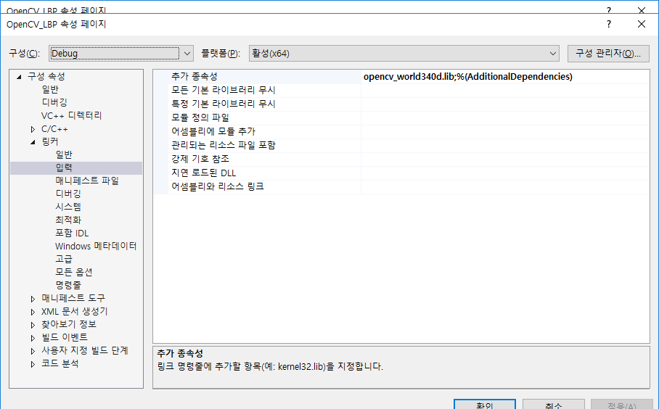

Slide 7
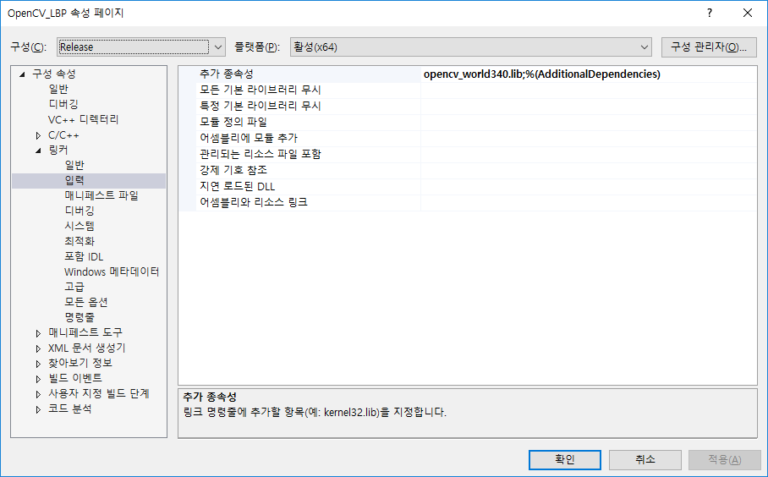

Slide 8

When you write a code, include…

Slide 9
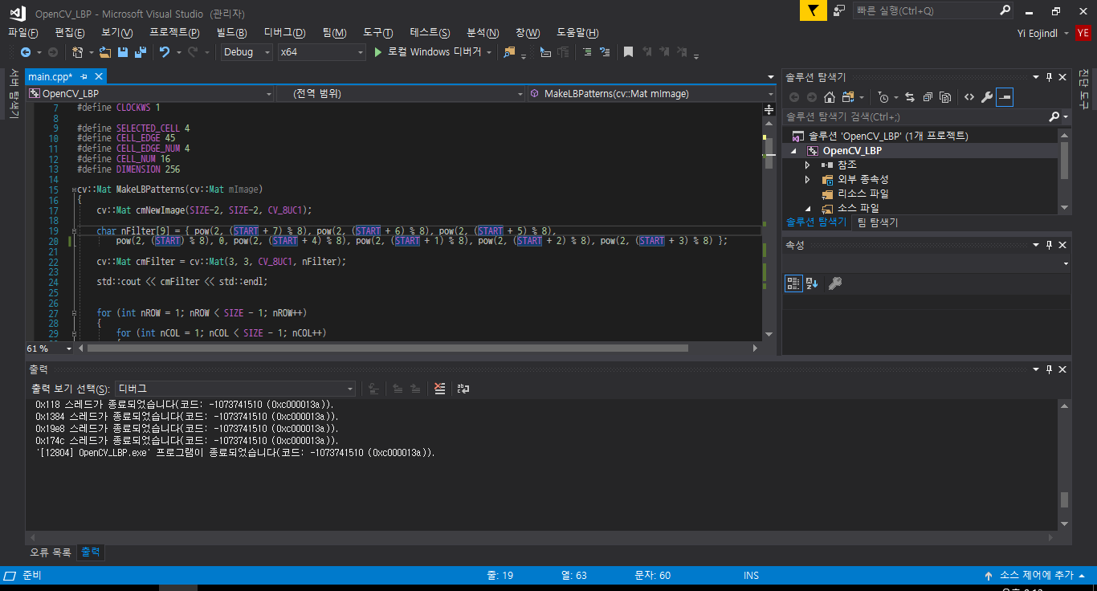



LBP
Detailed information about the topic can be found at https://en.wikipedia.org/wiki/Local_binary_patterns
This is the function I created for making the LBPs
Basic Idea : I made a filter that makes the LBP for each 3 x 3 pixel, and did convolution(well, in strict terms its correlation) with it
#define START specifies which position among the 8 positions of the 3 x 3 matrix is weighted highest
0 | 1 | 2
7 |  | 3
6 | 5 | 4

Slide 10
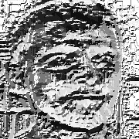
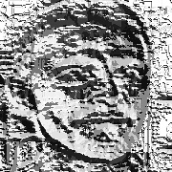
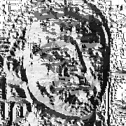

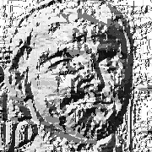
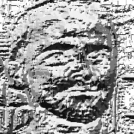
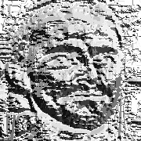
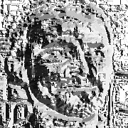
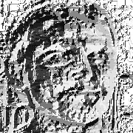
LBP
I ignored boundary conditions; original image size becomes shorter by pixel size 2 in both width and height
The images below are the LBPs created from a single image with different #define START

Slide 11
LBP
Image size 180 x 180 is divided into 16 regions, each with 45 x 45
Among the 16 regions, we select 4, which means we have 16C4(=1820) cases
Each of these cases are stored in a 4 * 1820 sized 2-dimensional vector vComb
nCounter stores the number 1820
This function takes in the 2-dimensional vector and makes a histogram for each case
For each case in vComb, we make a histogram which in total will be a 1820 * 256 sized vector
We store this vector in vFeat

