Slide 1
ID3 Decision Tree
2018. 05. 09 Eojindl Yi(이어진들)

Slide 2
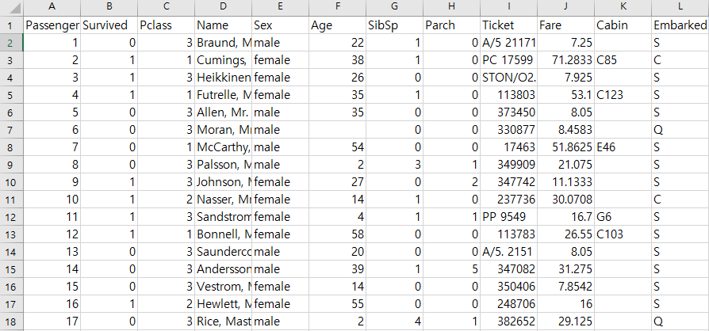
Algorithm & Data Set
Explanation for the algorithm is best explained at : http://jihoonlee.tistory.com/16
Note : the ID3 Algorithm can only deal with nominal valued datasets
We use the popular Titanic Data Set : https://www.kaggle.com/c/titanic

Slide 3
Data Set
From these attributes I used Pclass, Sex, SibSp, Parch, Embarked to train the tree
And Survived was used as the label of data
The strange thing about this data set is that the test data set is not labelled; therefore, it is impossible to evaluate the test set error

Slide 4
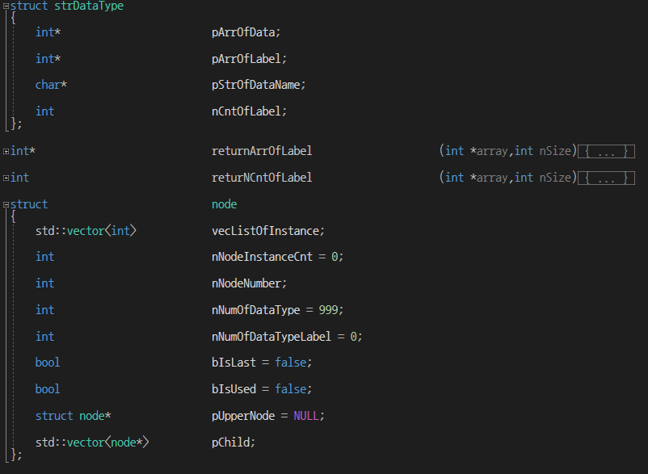
Structures

Slide 5
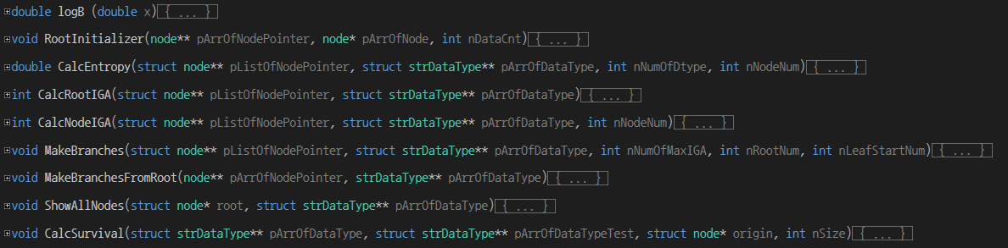
Functions

