Slide 1
C4.5 Decision Tree
2018. 05. 11 Eojindl Yi(이어진들)
original project date(2018. 01. 25)

Slide 2
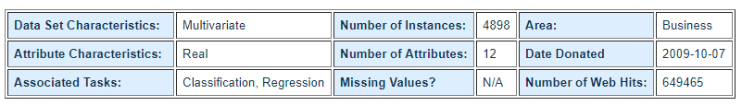
Algorithm & Data Set
Explanation for the algorithm is best explained at : http://jihoonlee.tistory.com/17
Note : Unlike the ID3 Algorithm which can only deal with nominal valued datasets, C4.5 is able to deal with any real valued datasets
We use the UCI Wine Quality Data set : https://archive.ics.uci.edu/ml/datasets/wine+quality

Slide 3
Data Set
2000 are use for the training set, 400 are used for the test set
During the algorithm, each feature(attribute) is sorted in ascending order. Then the average of the two neighboring values in each feature are used as threshold values.

Slide 4
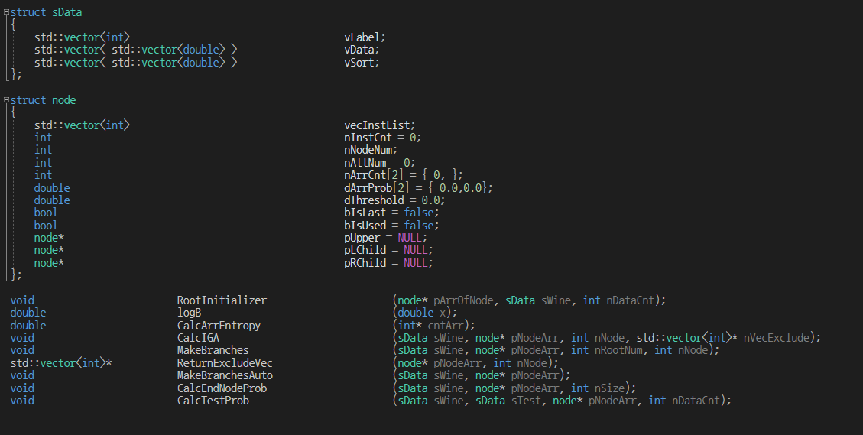
Structures

Slide 5
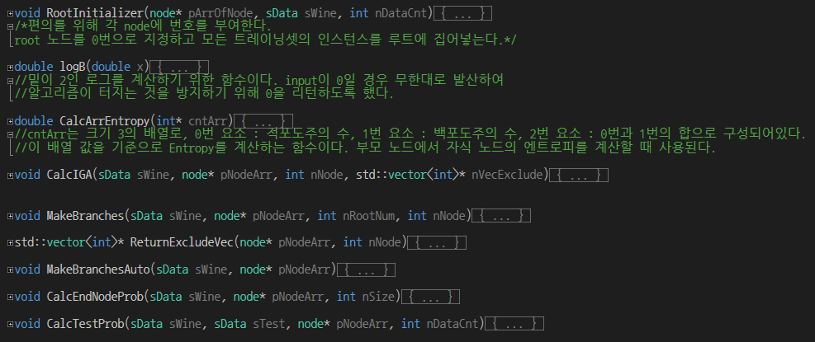
Functions

Slide 6
Analysis with varying conditions
Other constraints : terminate if Information Gain is below 0.10
Tree Depth | Train Error | Accuracy | Test Error | Accuracy
2 | 131/2000 | 93.45% | 24/400 | 94.00%
3 | 53/2000 | 97.35% | 20/400 | 95.00%
4 | 27/2000 | 98.65% | 17/400 | 95.75%
5 | 11/2000 | 99.45% | 18/400 | 95.5%
6 | 7/2000 | 99.65% | 15/400 | 96.25%
7 | 4/2000 | 99.80% | 17/400 | 95.75%
Tree Depth | Train Error | Accuracy | Test Error | Accuracy
2 | 131/2000 | 93.45% | 24/400 | 94.00%
3 | 56/2000 | 97.20% | 18/400 | 95.50%
4 | 43/2000 | 97.85% | 18/400 | 95.50%
5 | 28/2000 | 98.60% | 19/400 | 95.25%
6 | 25/2000 | 98.75% | 16/400 | 96.00%
7 | 23/2000 | 98.85% | 16/400 | 96.00%

