Slide 1
Next Gen AI Solutions
Transforming Business with Intelligent Data

Slide 2
Agenda
1. Vision & Strategy
2. AI Data Flow
3. Market Growth Analysis
4. System Overview

Slide 3
Architecture & Data
Technical Deep Dive

Slide 4
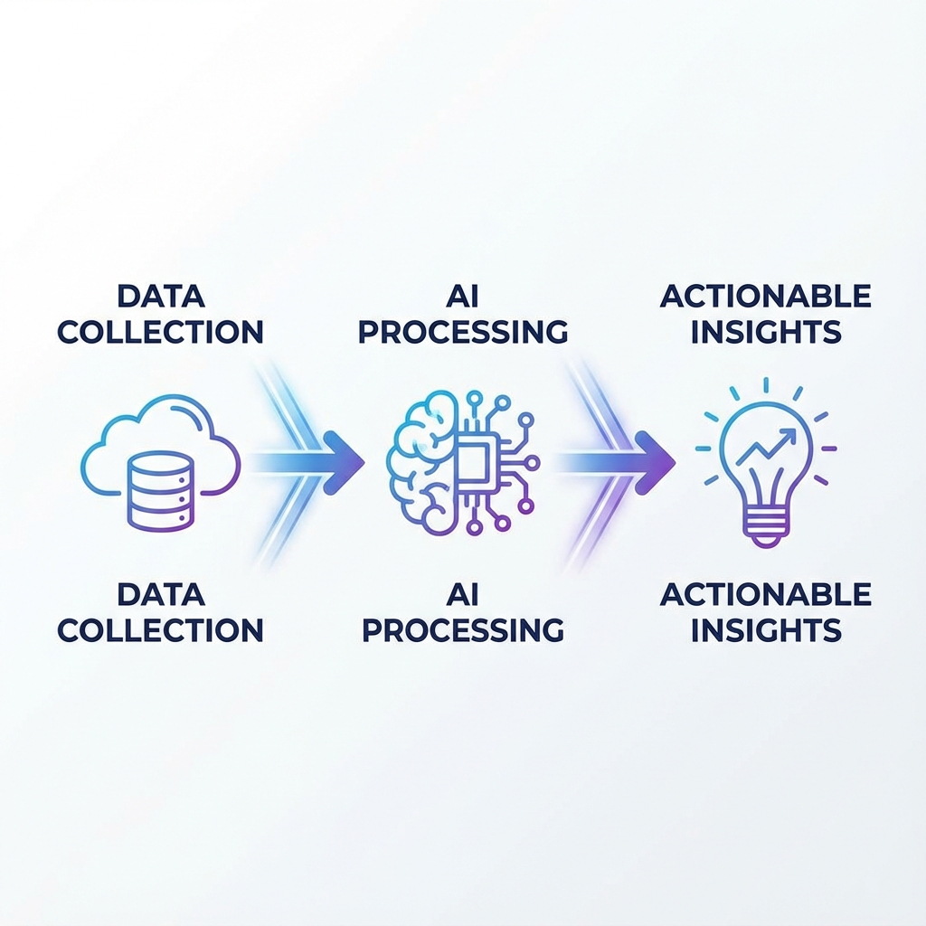
AI Data Flow
Seamless Data Integration: Unifying data silos across the enterprise.
Intelligent Processing: Advanced neural networks analyze patterns with <10ms latency.
Actionable Insights: delivering predictive analytics directly to decision makers.

Slide 5
Market Growth
Rapid Adoption: We are seeing unprecedented growth in the sector.
Revenue Increase: Projected 30% Year-over-Year revenue increase driven by AI adoption.
Strategic Focus: Healthcare and Finance sectors are leading the charge.

Slide 6
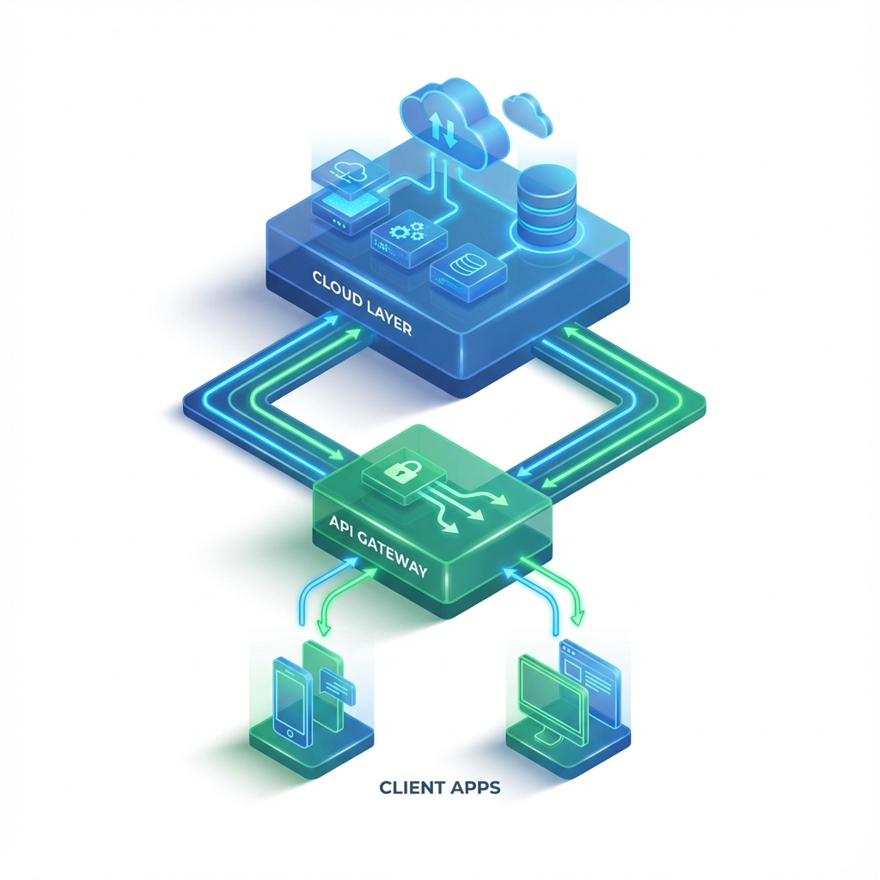
System Architecture
Scalable Infrastructure: Auto-scaling cloud resources to process terabytes of data.
Secure Gateway: Enterprise-grade security with encrypted API endpoints.
Multi-Platform: Native support for Web, iOS, and Android clients.

