Slide 1

A short history of EOS bugs, fixes, testing in the Jungle Testnet, and discussion regarding the stability of the EOS chain.
by Bohdan Kossak CryptoLions.io

Slide 2

Introduction
Who we are?
CryptoLoins is EOS block producer based in Ukraine
What we do?
Supporting EOS chain, testing, sharing knowledge, building software

Slide 3

Jungle Testnet and experiments before launch
Jungles testing EOS since DAWN 2 (March 2018)
First testings and findings.
First EOS contract – BIOS
Sharing knowledge(steemit, github)
https://github.com/CryptoLions
Role in mainnet start

Slide 4
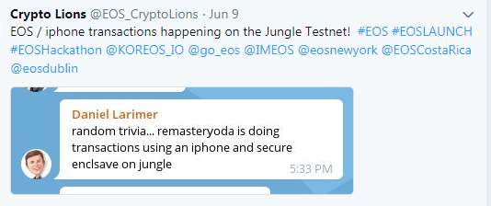
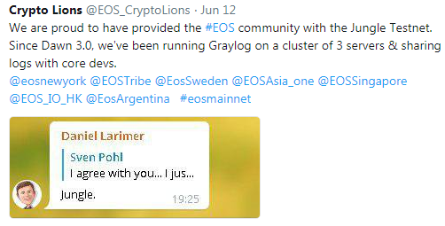
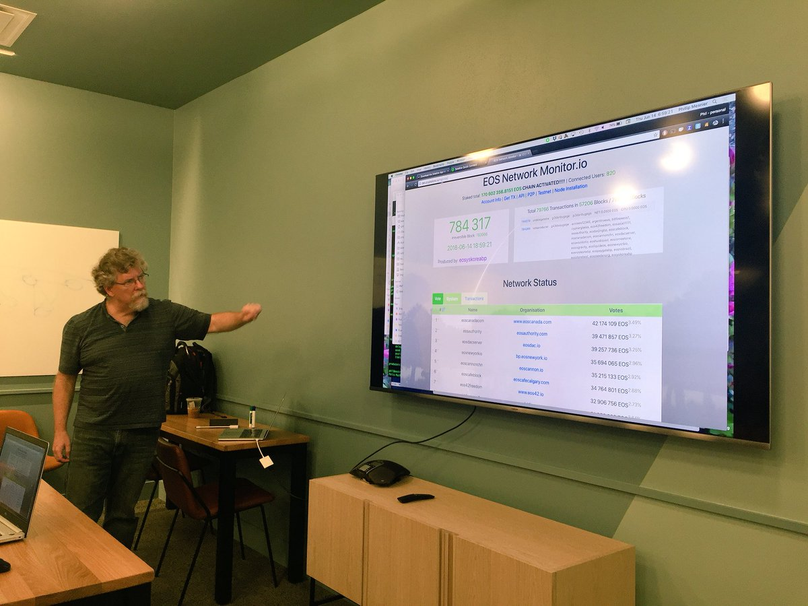
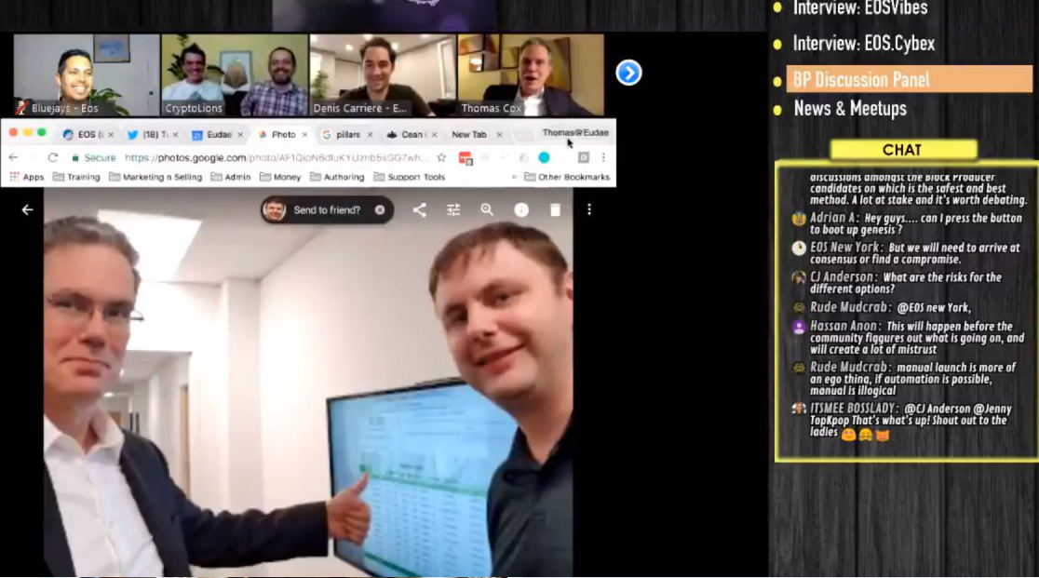
Amazing support from B1

Slide 5
Jungles Crashes and forks

Slide 6
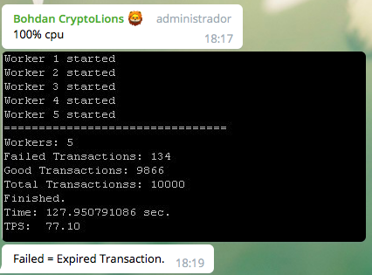
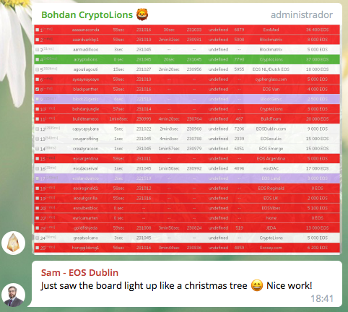
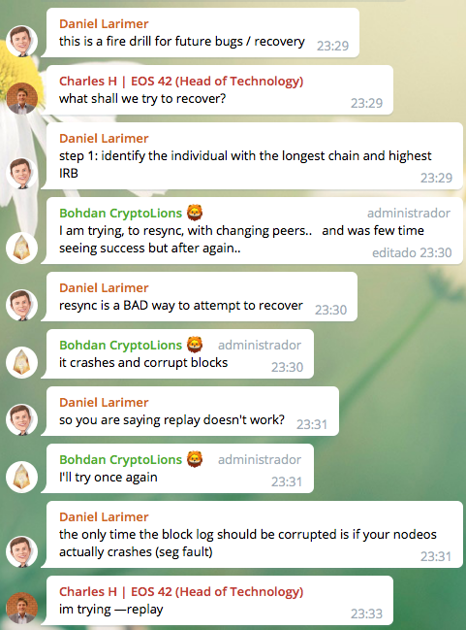
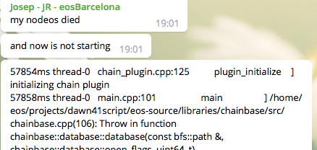
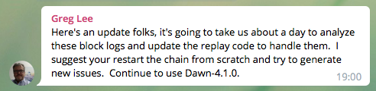
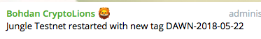


Slide 7
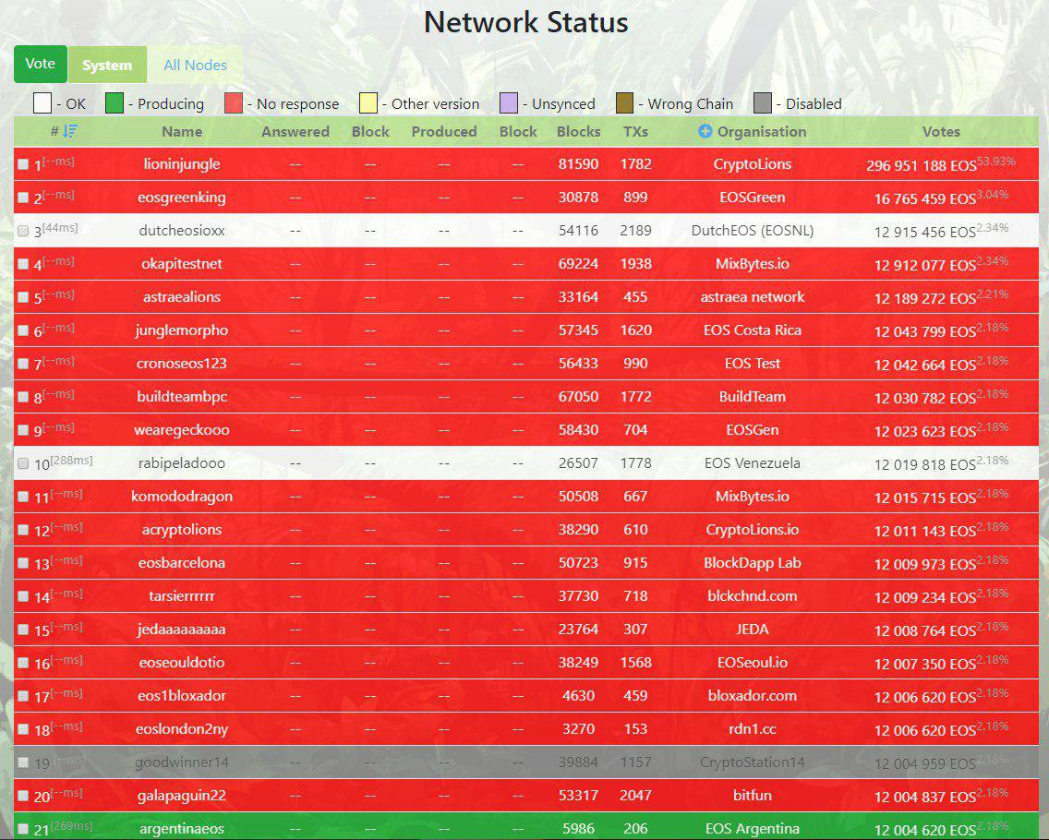
20 Jun - crash
Jungle Testnet died as wasn’t allocated enough RAM for state folder

Slide 8
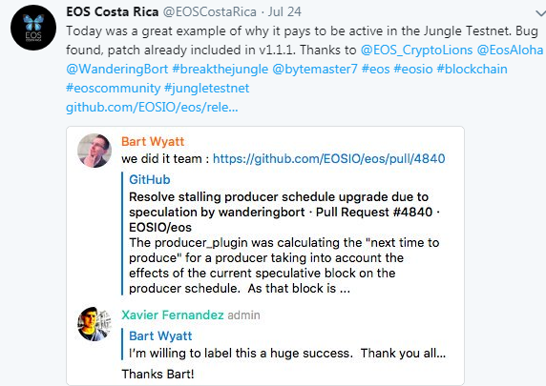
24 July – critical bug found
in v.1.1.0, fixed in 1.1.1
Special thanks to prospectors.io with bug discovering

Slide 9
Other crashes or bugs detected in Jungles:
blocking producer schedule update (30 Jul) https://github.com/EOSIO/eos/pull/4840
Voting for more than 7 bad producer by mistake – caused chain freezing (15 Aug)

Slide 10
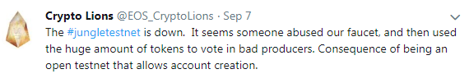

Killer Whale Attack: Recovering a hi-jacked EOS chain
Using backup or syncing till poisoned block
use only trusted peers
Use peer-private-key option to band bad actors
Use checkpoints
Check lost transactions
Open question: What to do if to far return back?

Slide 11



Slide 12
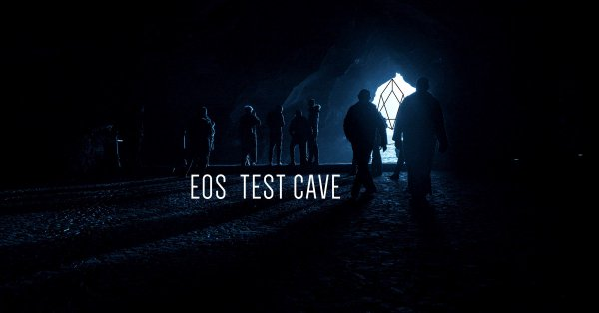
Automated testing framework
Contributors:
CryptoLions
HKEOS
Block Matrix
EOSSW/eden
EOSeoul
eosDAC
shEOS

Slide 13
Other our projects
Deru.io
EOSnetworkMonitor.io
Jungle.cryptolions.io
Roshambo.cryptolions.io
Zeos.co
History API for mongo plugin
Different Telegram Bots for monitoring
Testing scripts and tools

Slide 14





Thank You
Your Photo
Name: Bohdan Kossak
Company: CryptoLions
www
CryptoLions.io
twitter.com/EOS_CryptoLions
roar@cryptolions.io
Github.com/CryptoLions
Notes:
Here you can enter your personal information and move this slide to the end of the presentation.

