Slide 1

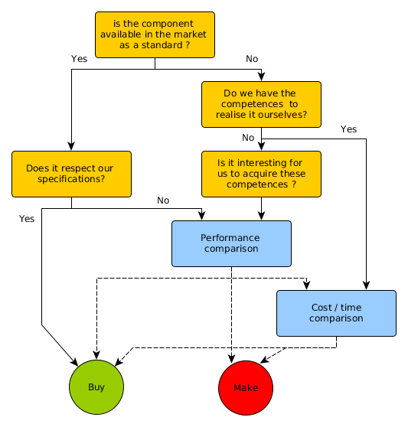
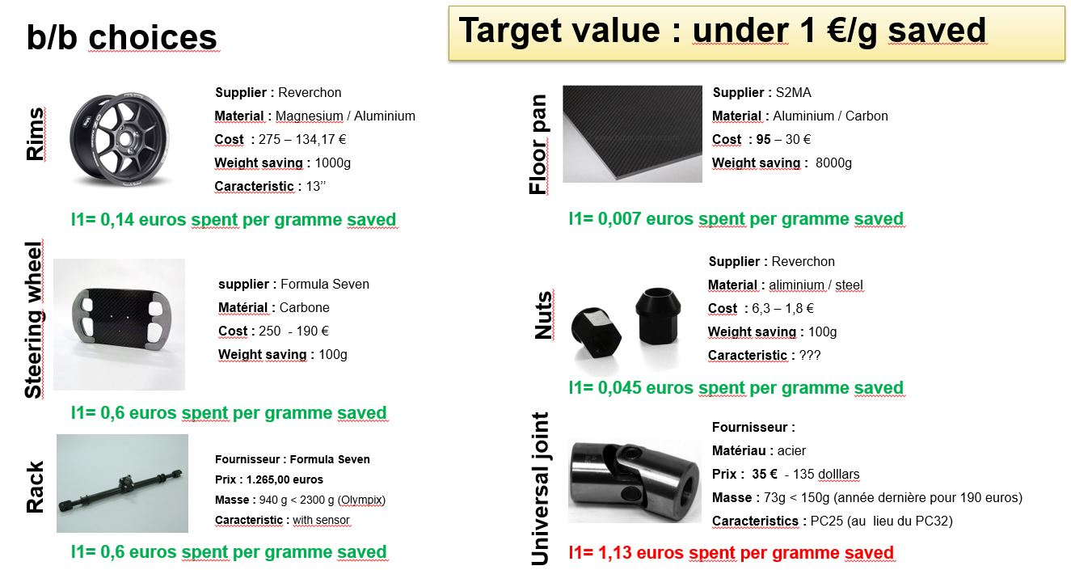
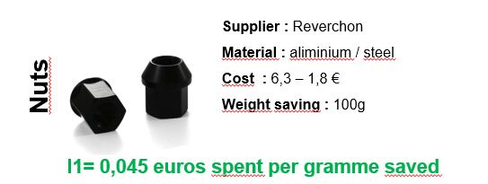
Make or buy decisions
Arbitrage between make or buy
Bought items
Diagram to represent the procedure to arbitrate decisions between make or buy.
Indicator used to compare products available in the market.

