Slide 1

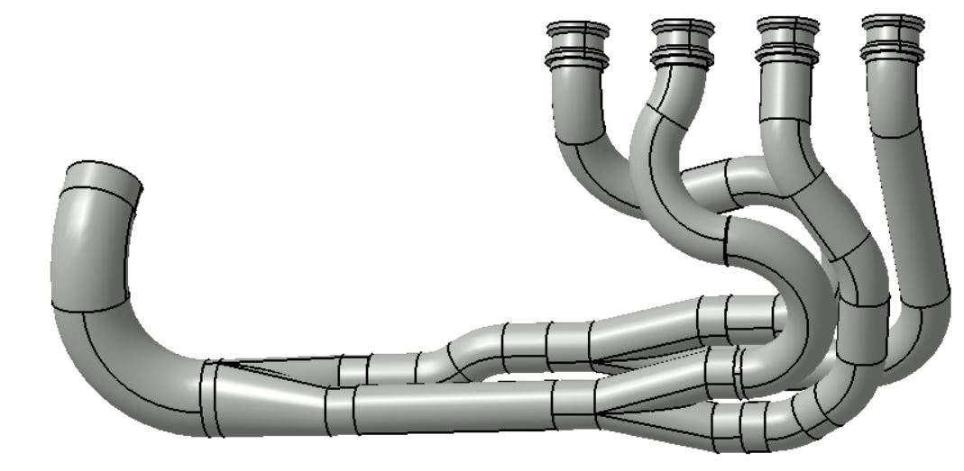
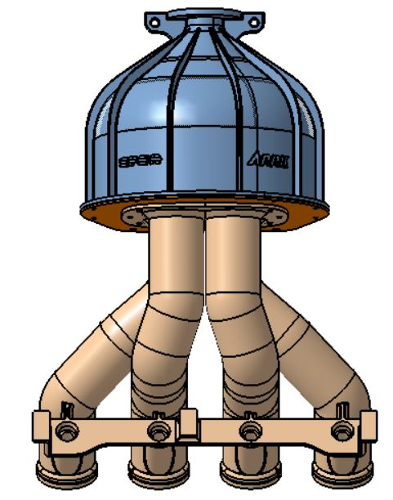
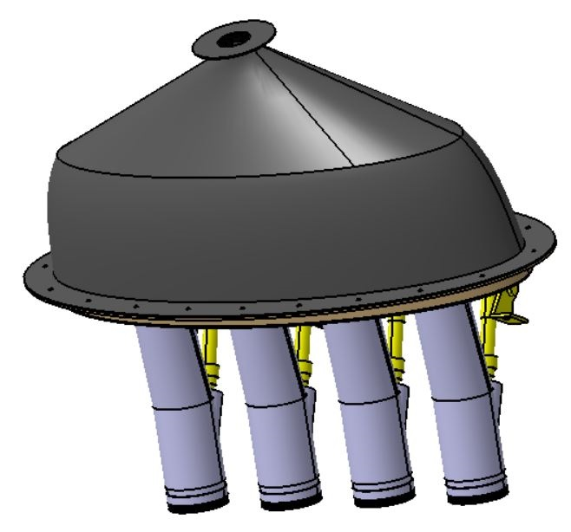
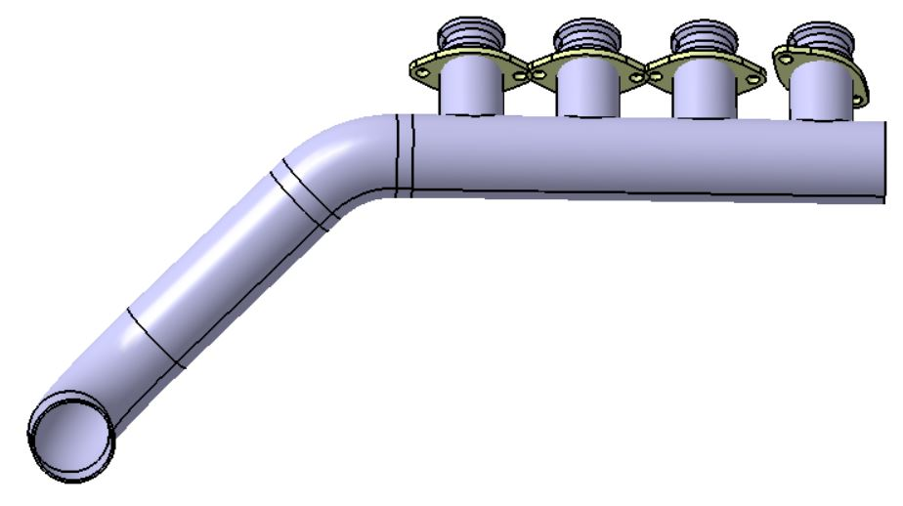
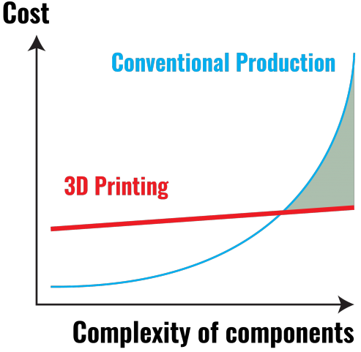
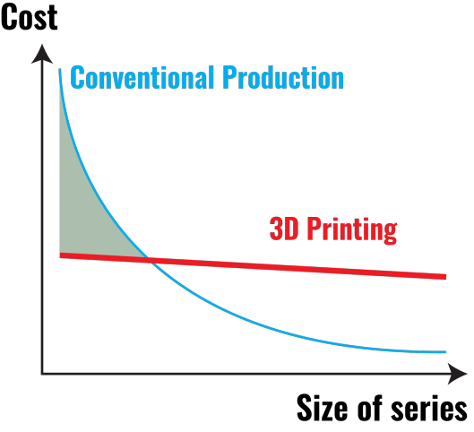
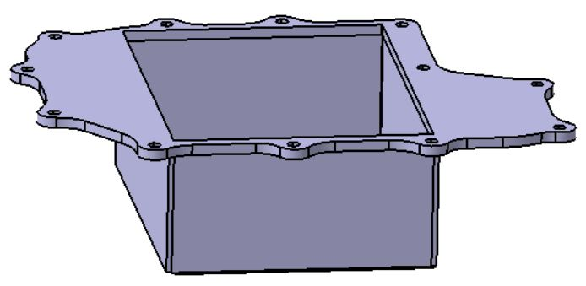
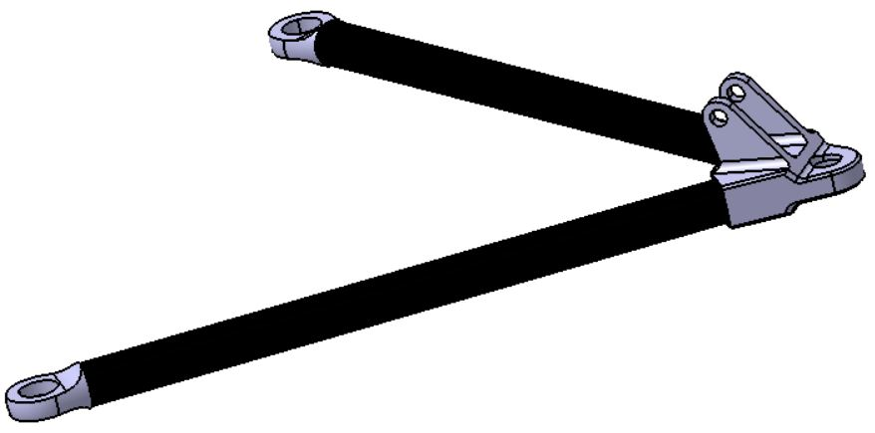
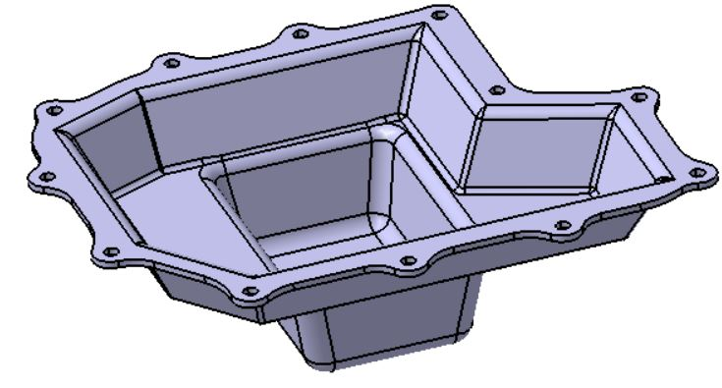
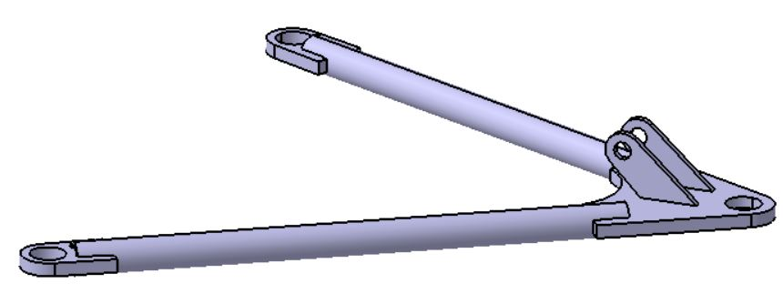
Prototype and mass production
Different manufacturing processes
Examples of manufacturing processes for mass production
Manufacturing processes (for prototyping and mass production):
Milling
Turning
Laser and waterjet cut
3D printing
Weldments
Manufacturing processes (for mass production):
Stamping
Foundry
Broaching
Injection molding
Exhaust system
Intake system
Prototype: Complex geometry to realise acoustic waves.
Prototype: 3D printed part + aluminium laser cutted part.
Mass production: Left: Changement of manufacturing process. Thermoforming from extruded pipes + injection molding.
Right: Injection molding.
Mass production: Reduce complexity to reduce cost.
Example of cost evolution
See below an example of cost evolution versus complexity and size of the series for 3D printing and conventionnal production.
Oil pan
A-arms
Prototype: Aluminiun laser and waterjet cutted part + welding.
Prototype: CFRP tubes with aluminium machined parts.
Mass production: Changement of manufacturing process. Stamping process.
Prototype: Changement of materials, manufacturing and assembly processes. Weldments, steel with tubes and laser cutted part.

