Slide 1

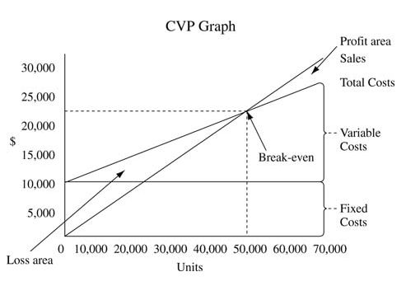
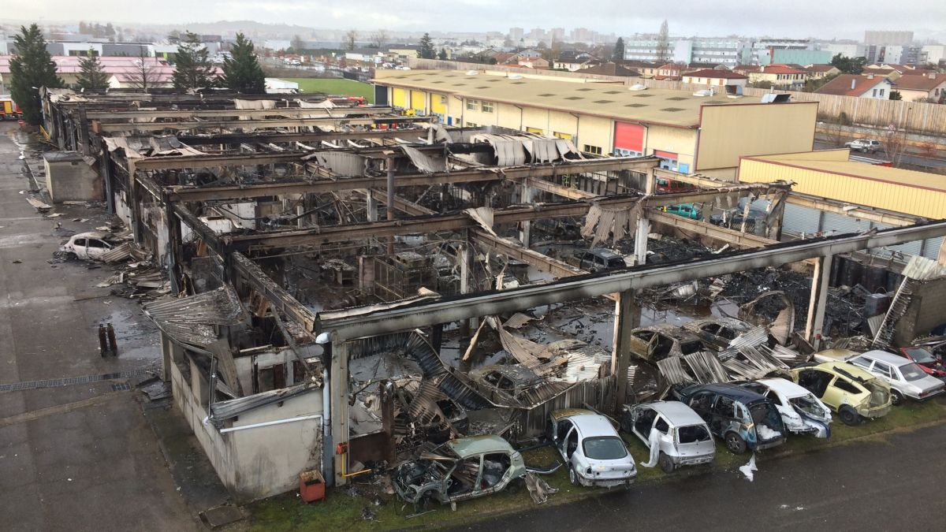
Financial and production risk management
Mass production
Risk management in the project
Diagrams to represent volume analysis for mass production in industry.
See below examples of financial and production risk the team have been dealing with this year.
Financial risk
It is mportant to have financial provision in case of a major issue.
Example: Supply of wheels’ bearings.
Delay of delivery due to absence of stock
Initially planned on March
Delivery delayed to the beginning of June
To respect the roll-out deadline, wheels bearings supplied with the budget
Diminution of the financial provision
Production risk
Example: Fire in one of the workshops of our partner Boisard.
A fire destroyed the workshops of our partner during the manufacturing of the uprights and hubs. The team reacted quickly to move the production to another partner and to the university workshop.

