Slide 1

Quizz #1
Mardi 27 Novembre 2018

Slide 2
Question #1
A team want to use Aluminum for all parts of the primary structure, excepted for the main hoop. The main hoop shall be made in 30CrNiMo8+ QT.
It’s forbidden by the rules
Aluminum can’t meet T3.2 requirements
The use of 30CrNiMo8+ QT need additional testing
The front hoop must be steel

Slide 3
Question #2
The design below is a bottom view of the floor pan.
Front hoop
Front Bulkhead
2mm
4mm
This design is compliant with the rules
This design implies that the floor pan is made for Aluminum
This design is not compliant
This design can be compliant if there is a steel tube between the first two front plates.

Slide 4
Question #3
Titanium wheel nuts may be used …
Only with titanium studs
With both steel or titanium studs
If anodized and in pristine condition
Titanium wheel nuts can’t be used

Slide 5
Question #4
A team as made the followind design choices :
Front track : 1100mm
Rear track 830mm
Wheelbase : 1530mm
CG’s height : 525mm from the ground
This design is compliant with the rules
Rear track is too short
The vehicle will pass the technical inspection
The wheelbase is too short
The CG is too high

Slide 6
Question #5
A team as chose this design and position for the brake light :
Brake light facing rearwards
200mm
15mm
This design is compliant with the rules
The LED bar need a diffuser to be a valid design
The LED needs to be blue or green
The brake light is mispositionned

Slide 7
Question #6
A team is using pneumatic shifter and Indirect injection.
Pneumatic pressure is 350psi | Fuel pressure is 55psi
Both lines are high pressure
No shielding are required for both lines
The pneumatic system must be shielded
The firewall may only be composed of carbon-fiber (Compliant with T1.2) with a minimum width of 2mm

Slide 8
Question #7
Steel springs calculations
Wire radius : 1,5mm
Mean spring radius : 15mm
50 loops
What is the stifness of such spring ?
38N/m
60N/m
600N/m
4860N/m

Slide 9
Question #8
Minimum diameter of Cockpit mounted Shutdown button
20mm
22mm
24mm
26mm

Slide 10
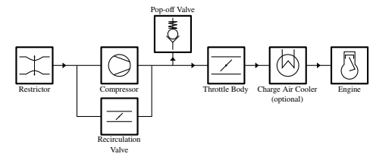
Question #9
On the red dot, the section is a oval shape with :
a= 40mm
b= 23mm
This design is compliant with the rules
This design is not compliant
An oval shape is not permitted downwards of the restrictor
Such design would be valid without turbocharger

Slide 11
Question #10
A team oil system contains 6L. The fluid recuperator minimum volume is :
50mm*80mm*200mm
50mm*80mm*300mm
10mm*400mm*20mm
10mm*400mm*30mm

