Slide 1

Quizz #3
Mercredi 12 Décembre 2018

Slide 2
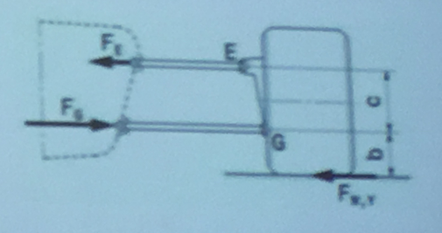
Question #1
Calculate the suspension reaction forces Fe and Fg according to the scheme if Fw,y=1kN ; c=200mm; b=100mm
Fe=2.0kN, Fg=3.0kN
Fe=1.0kN, Fg=2.0kN
Fe=0.5kN, Fg=1.5kN
Fe=3.0kN, Fg=1.5kN
Notes:
68.6

Slide 3
Question #2
Which frame component does not necessarily belong to the primary structure?
Suspension Mounting Points
Front Bulkhead
Side Impact Structure
Front Hoop
Notes:
Suspension

Slide 4
Question #3
Which of these measures is not used to dimension the external part of cockpit opening template ?
50mm
100mm
75mm
350mm
Notes:
50mm

Slide 5
Question #4
If any type tube diameter and wall thickness would be available how much would 1m of shoulder harness steel tube weight if we choose the lightest ? (Density is 7.85 g/cm^3, pick the closest value)
1,225 kg
1,198 kg
1,378 kg
1,511 kg
1,000 kg
Notes:
150mm

Slide 6
Question #5
In order to test, if the vehicle provides sufficient overall stability for cornering with 1.7G, it is tilted to 60° on the tilt table. To which angle must the vehicle be tilted to simulate cornering with 2.5G? (Pick the closest value)
68.5°
65.0°
67.8°
69.1°

Slide 7
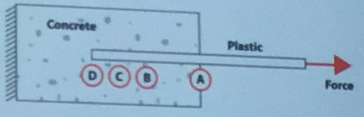
Question #6
Where is the maximum stress in the concrete located ?
Point A – Outer end of the hole
Point B – Half lenght of the hole
Point C – Three quarter lenght of the hole
Point D – End of the hole
Notes:
A

Slide 8
Question #7
How far must throttle cables at least be apart from any exhaust system component?
50 mm
25 mm
75 mm
100 mm
Notes:
50mm

Slide 9
Question #8
What is the first natural frequency of the steel coil spring with spring rate (stiffness) 19500N/m, wire diameter 5mm, nominal spring diameter 30mm and 12 coils ?
158 Hz
168 Hz
178 Hz
198 Hz
Notes:
168Hz

Slide 10
Question #9
The quick jack must be able to lift up the car, so that the driven wheels are at least :
10.0 cm
12.5 cm
15 cm
18 cm
Notes:
10.5

Slide 11
Question #10
What is brake efficiency of 4stroke 2 cylinder engine with bore 80mm and stroke 55mm. Engine power is defined by the 12bar of mean effective pressure at 9500RPM. Engine is running on the unleaded gasoline with density 740kg/m3, octane number 98 and lower heating value of 42.53 Mj/kg. Actual lambda value at defined load point is 1.05 and stoichiometric ratio of the used fuel is 14.17. Engine is running at following barometric pressure 985mbar, temperature 24degC. Volumetric efficiency defined to the atmospheric conditions was 1.07.
31,0%
32,5%
34,0%
35,5%
Notes:
31%

