Slide 1
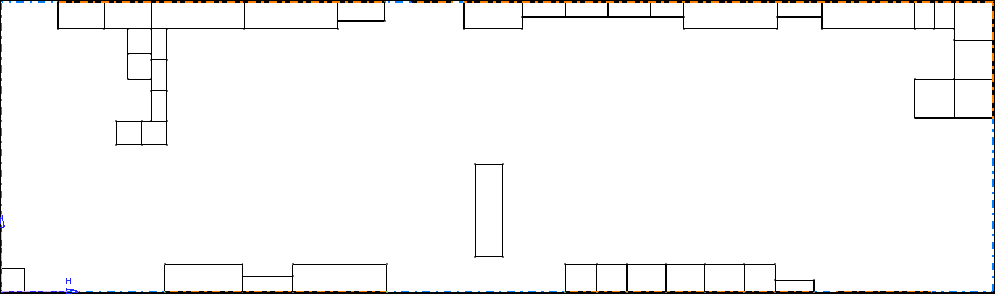
Plateforme de ISYPRO (Lycée Emile Bejuit - Bron)
1,1 m
2,4 m
2,4 m
2 m
Sector 3
Sector 2
3 m
Sector 5
7,5 m
Sector 7
Sector 1
Sector 5
Sector 4
Sector 5
1,6 m
3 m
0,8 m
1 m
0,6 m
2,4 m
1,6 m
Machines
25,5 m
Sector 1
Sector 2
Sector 3
Sector 4
Sector 5
Sector 6
Sector 7
Raw materials & trailer & machining
Electrical Departement
Etagère Kit Montage & Inventaire Pièces
Etagère Kit Montage & Inventaire Pièces
Version : v3.0

Slide 2
Plateforme de ISYPRO (Lycée Emile Bejuit - Bron)
I - Working rules :
Rule I-1 : Always clean up after working time
Rule I-2 : Put the tools back where you found them
Rule I-3 : Leave written messages on parts you worked on if necessary
II - Safety rules :
Rule II-1 : Do not work when you are alone
Rule II-2 : Always wear the appropriate protection clothes & shoes
Rule II-3 : When machining, wear safety glasses and gloves
Version : v3.0

Slide 3
Sector 1 : Machining & Storage
Officer : MPL
Grinder
Drilling machine
2 metal shears
One hydraulic press
2 Vices
4 raw material storage slots (plates, woods, plain material & misc.)
Version : v3.0

Slide 4
Sector 2 : Electrical Departement
Officer : BAT
…
Version : v3.0

Slide 5
Sector 3 : Assembly Boxes
Officer : MPL
…
Version : v3.0

Slide 6
Sector 4 : …
Officer : …
…
Version : v3.0

Slide 7
Sector 5 : …
Officer : …
…
Version : v3.0

Slide 8
Sector 6 : …
Officer : …
…
Version : v3.0

Slide 9
Sector 7 : …
Officer : …
…
Version : v3.0

Slide 10
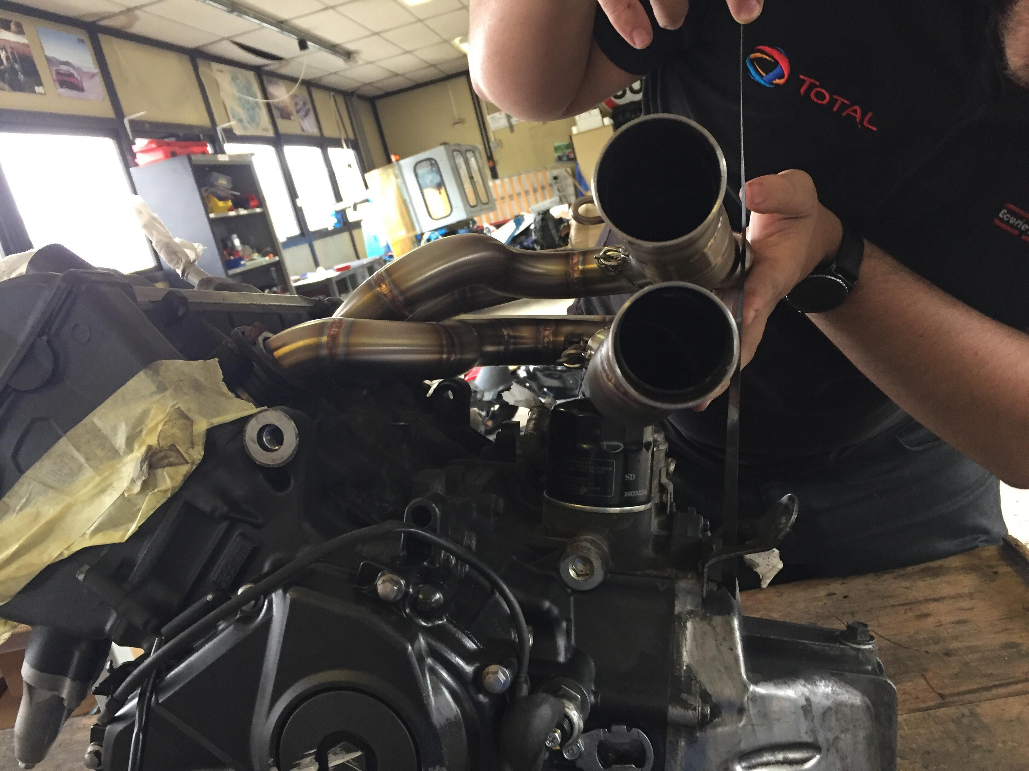
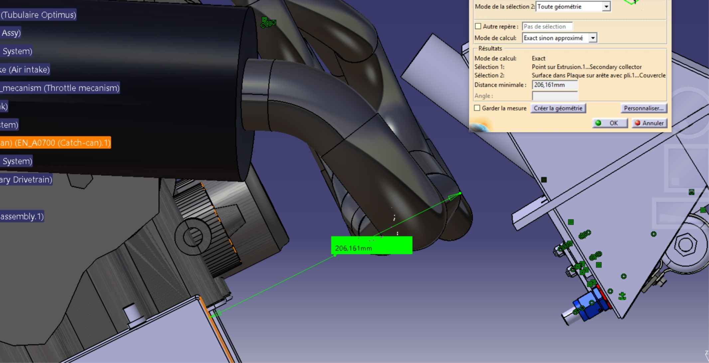
Pb echappement : distance entre echappement et réservoir
? < 50 mm
215 mm
53 mm
200 mm

